Slide 1





SANTIAGO
“The water flows where the money goes!”
A game of plantations, irrigation and bribery — Claudia Hely & Roman Pelek (AMIGO, 2003)
3–5 players · ages 10+ · about 60 minutes
Bananas
Sugar cane
Potatoes
Beans
Red peppers

Slide 2
The island of Santiago
What the game is about
• On the hot Cape Verde island of Santiago, every drop of water is precious.
• Your goal: Buy plantations at auction, join them into big same-crop areas, and get canals built to them — dry plantations crumble to desert.
• The twist: Canals go where the Canal Overseer wants. The Overseer listens to bribes.
• Winning: Most money at the end wins. Every Escudo spent must earn itself back.
Five crops to grow:
Bananas
Sugar cane
Potatoes
Beans
Red peppers
Santiago · 2

Slide 3




What’s in the box
45 plantation tiles
22 yield markers each
Bananas
Sugar cane
Potatoes
Beans
Red peppers
your stake in a plantation — one colour per player
9 per crop — with 1 or 2 planters in the corner
15 canals · 1 spring
Escudos & the Canal Overseer
start with 10 — keep yours hidden!
decides where water flows
Santiago · 3

Slide 4
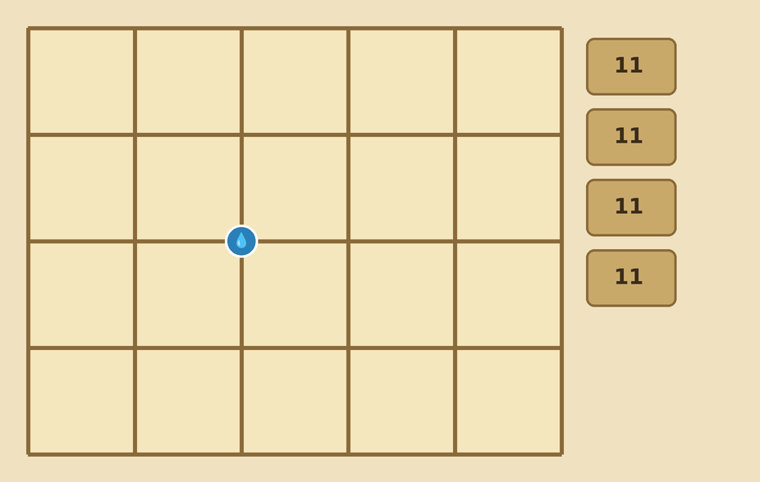
Setting up
• Spring: Spring on any ditch intersection — the middle is friendlier.
• Tiles: 3–4 players: four face-down piles of 11 tiles (one tile removed). 5 players: five piles of 9.
• Canals: 11 canals by the board (9 with five players) + one personal “extra canal” each.
• Players: 10 Escudos, 22 markers and a proposal canal per player; someone random takes the Overseer figure.
• Length: 11 rounds (3–4 players) or 9 rounds (5) — exactly until all tiles are placed.
Board with the spring on a central intersection; face-down tile piles beside it
Santiago · 4

Slide 5
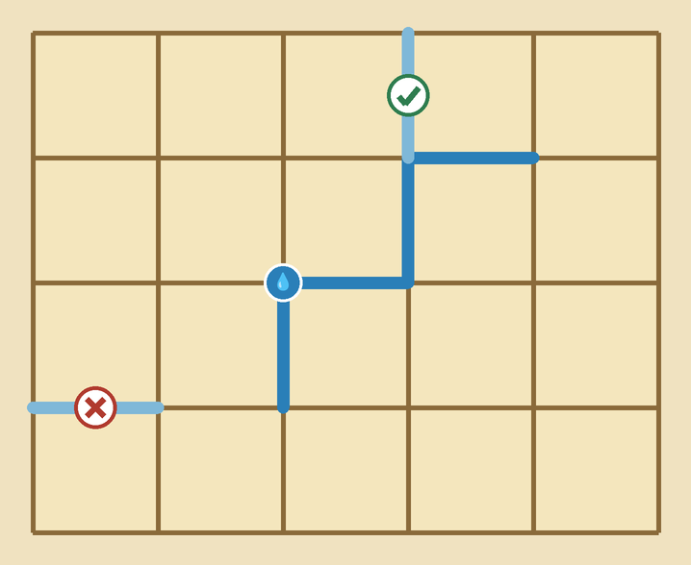

Key concept — building canals
• Canals lie on the brown ditch lines, always intersection to intersection.
• The network grows out from the spring — every new canal must touch the spring or an existing canal.
• Branching and loops are fine.
Only 15 canals all game —
water is the scarcest resource
✔ touches the network — allowed. ✘ floats free of the network — not allowed.
Santiago · 5

Slide 6
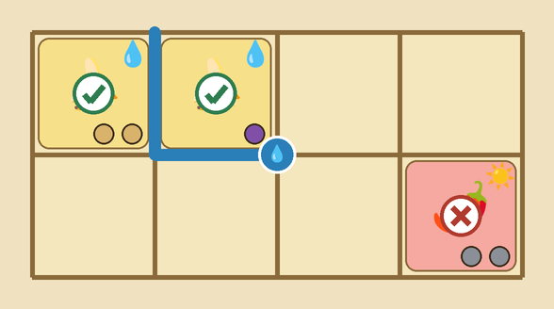

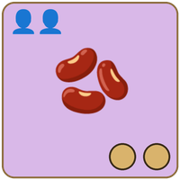
Key concept — irrigation & yield markers
• Place a plantation, add your markers: one per planter shown on the tile.
• Irrigated: A plantation touching a canal on any side is irrigated — forever.
1 planter → 1 marker
2 planters → 2 markers
markers = your share of the harvest
Next to a canal: irrigated ✔ — cut off from the water: drying ✘
Santiago · 6

Slide 7
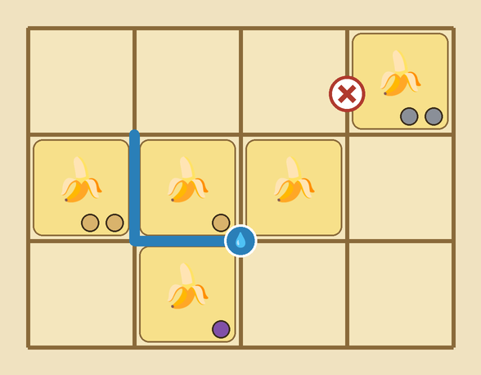
Key concept — connected areas
Where the money comes from
• Same-crop tiles touching side by side form one area — markers of several players can share it.
• Diagonal never counts; a canal running through does NOT split an area.
• Value: Area value for you = its tiles × your markers on it.
The 4-tile banana area is worth:
Beige: 4 tiles × 3 markers = 12 Esc
Purple: 4 tiles × 1 marker = 4 Esc
The diagonal banana belongs to a different area.
One 4-tile banana area (canal through it and a neutral tile included) — the ✘ tile touches only diagonally
Santiago · 7

Slide 8





A round at a glance
Seven phases, always in this order
1
Reveal & bid — one open bid each — or pass
2
New Overseer — lowest bid (or first pass) takes the figure
3
Take & place tiles — highest bidder picks first
4
Bribe the Overseer — one canal gets built
5
Extra irrigation — one player may use their extra canal
6
Drying — dry plantations suffer (skip in last round)
7
Income — everyone collects 3 Escudos (skip in last round)
Santiago · 8

Slide 9
Phases 1–2 — the auction
One bid each, no second chances
• Flip one tile per pile, then everyone bids once, openly — or passes.
• Unique bids: Every bid must be a NEW amount — bidding lower is allowed. All bids go to the bank, win or lose.
• Consolation: Lowest bid — or the first passer — becomes the new Canal Overseer.
Bernd
Dagmar
Anika
Chris
5 Esc
4 Esc
1 Esc
PASS
picks first
picks 2nd
picks 3rd
picks last
new Overseer!
High bid = first pick of land. Low bid = power over the water.
Santiago · 9

Slide 10
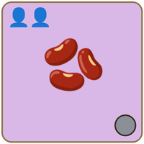
Phase 3 — take & place plantations
• In descending bid order: take one revealed tile, place it on any free square, add your markers.
• Penalty: Passed players place one marker fewer than the planters shown.
• 3 players: With 3 players the leftover tile is placed neutral — no markers — next to another plantation.
You bid
You passed
2 planters → your 2 markers
2 planters → only 1 marker
Santiago · 10

Slide 11
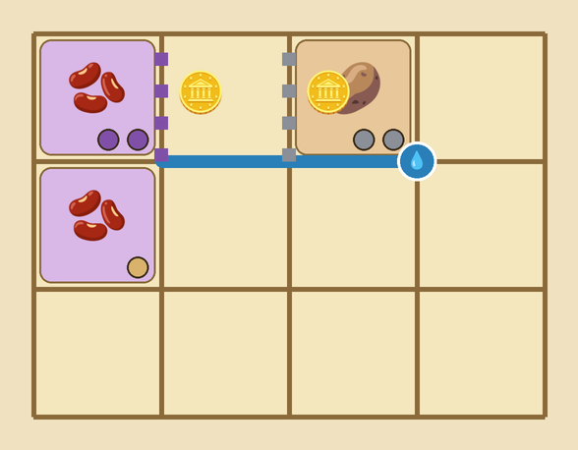

Phase 4 — bribe the Canal Overseer
The heart of the game
Propose a canal + a bribe of 1+ Esc, placed openly
Support someone’s proposal with 1+ Esc more
Pass and keep your money
The Overseer then either accepts ONE proposal — any one! — and pockets its bribe…
…or builds anywhere else, paying the bank 1 Esc more than the highest bribe. Losing bribes are returned.
Two proposals (dashed, with bribes): Purple wants the beans watered, Gray the potatoes
Santiago · 11

Slide 12

Phases 5–7 — extra canal, drying, income
Extra irrigation — your ONE free canal for the whole game — only one player may build it per round
Drying — every plantation without a canal loses a marker; none left → desert
Income — everyone collects 3 Escudos
A plantation left dry, round after round:
…and desert can never be cultivated again. (Drying and income are skipped in the last round.)
Santiago · 12

Slide 13
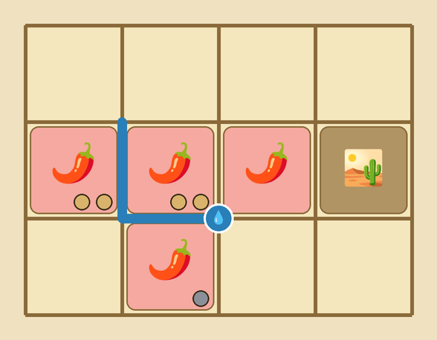

Game end & scoring
After the last tile is placed
• Final drought: Everything still dry turns to desert — even with markers on it.
• Score: Keep your cash, then every area pays every player:
tiles in area
×
your markers
=
Escudos
Beige: 4 tiles × 4 markers = 16 Esc
Gray: 4 tiles × 1 marker = 4 Esc
The desert tile pays nobody.
Most money wins!
Only irrigated, connected tiles pay — the flipped desert tile is gone for good
Santiago · 13

Slide 14

Tips for your first game
Water is scarce
only 15 canals all game — many fields WILL become desert
Cheap bids buy power
the Overseer earns bribes and steers the water
Check who profits
growing an area helps everyone with markers on it
Save the extra canal
one per game — spend it where no bribe will help
Santiago · 14

Slide 15

Play it online — asynchronously
budoludo.com/santiago
Personal secret links — no accounts, no passwords.
An email lands whenever it is your turn.

