Slide 1
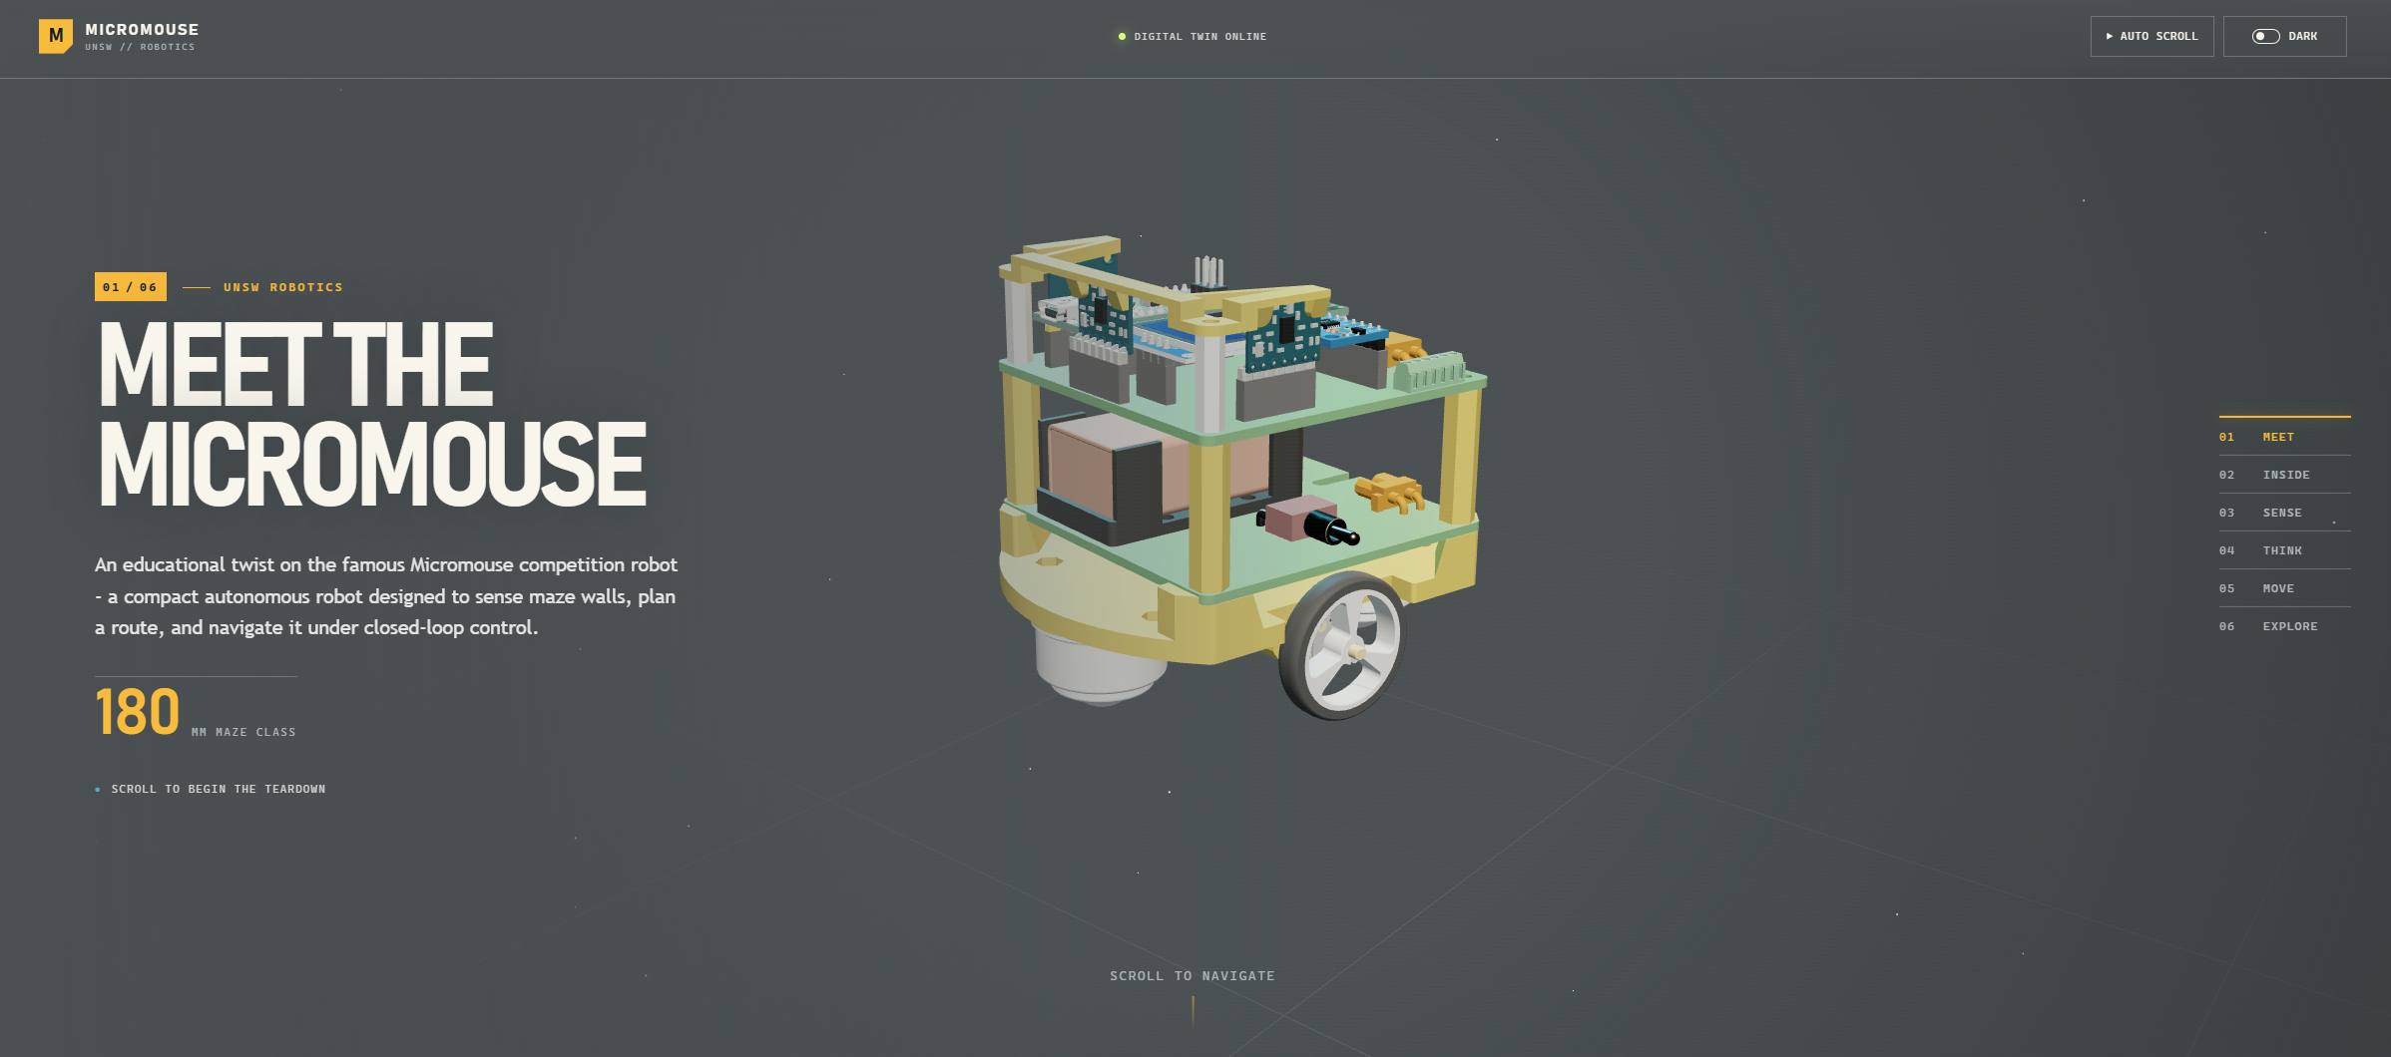
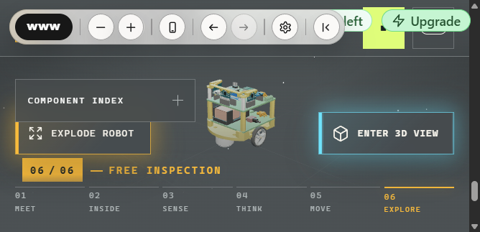
Checkout the Interactive Digital Twin via this QR Code!
Micromouse Showcase
https://randomrunt.github.io/UNSWMicromouseDemo/

