Slide 1
Vibration Logger
An ESP32-Based Datalogger for GPS and Accelerometer Data

Slide 2
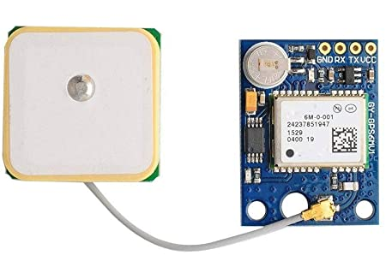
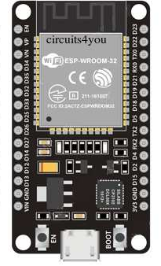
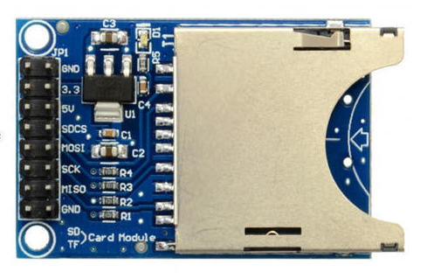
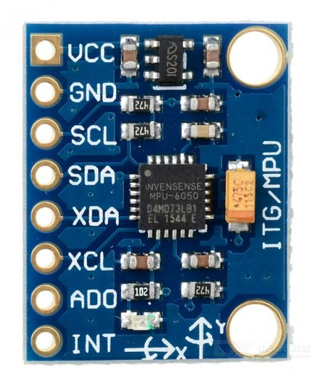
Components
uart
NEO-6M GPS Module
spi
i²c
SD Card Module
ESP32 Board
MPU6050 Accelerometer

Slide 3
Data Structure
struct timeseries
{
int16_t readings[TIMESERIES_LENGTH][TIMESERIES_WIDTH];
};
Accelerometer Readings
struct datablock
{
timeseries acceldata;
uint8_t date_day;
uint8_t date_month;
……..
uint8_t latitude_degrees;
……..
double longitude_minutes;
……..
};
Acceleration Data
GPS Data

Slide 4
Algorithm
Core 1
Core 2
Start
Record Acceleration for 3s
GPS Data Received?
No
Wait
Data Block Free?
Trigger GPS Update on Core 2
No
Yes
Wait
Flag Data Block Busy
Parse Message
Yes
Data Block to File
Flag Data Block Free
Copy GPS Data to Data Block
Delimiter
End

Slide 5
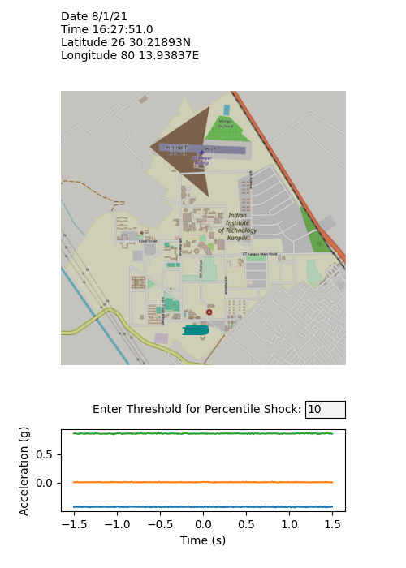
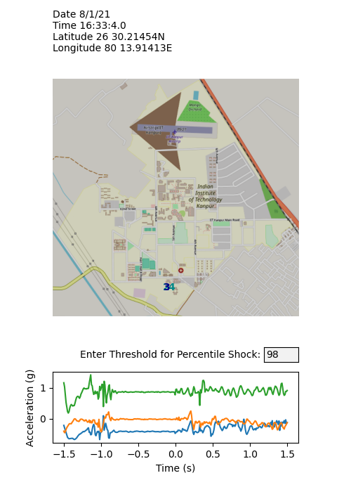
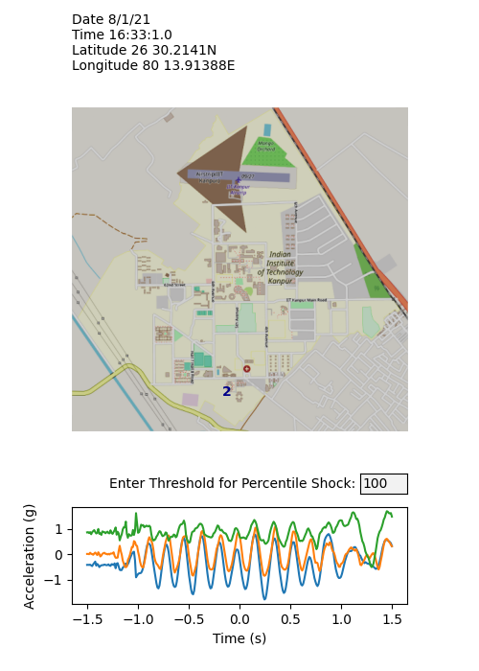
Sample Data

Slide 6
Thank You.

