Slide 1
BellCurveHero
Remove guesswork from exam prep
Notes:
https://www.color-hex.com/color-palette/5354
Brand tone - reliable, friendly, concerned and wants you to do your best

Slide 2
Problem statement
University students in STEM education:
Have no or limited access to past year papers for preparation
Have access to past year papers, but there is no way to obtain the answers
Have access to exam answers, but have to decipher the solutions

Slide 3
Solution
Help university students in STEM:
To score higher for exams by anticipating exam questions, based on past year papers, using predictive machine learning
By providing video explanations and solutions by qualified solvers

Slide 4
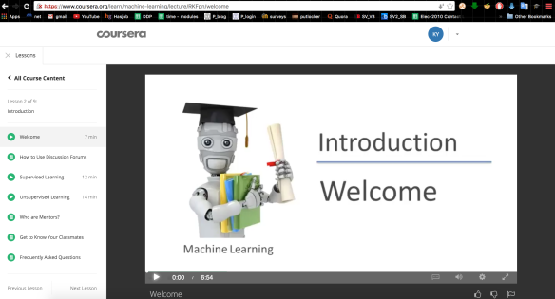
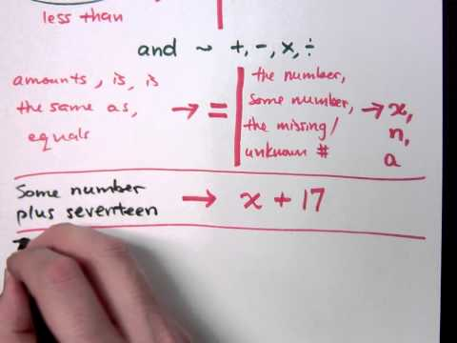
Product
Student wants to prepare for exams
Identifies questions in past year papers
Looks up past year papers in catalog
Gets question prediction for exam
Watches step-by-step explanation on the questions

Slide 5
MVP
Video walkthroughs for exam questions

Slide 6
Tech schematics
Student explainers
* Explains past year paper questions
Past year papers
* as text data
Records
Feeds into
User input
Module code
* Looks up the module past year papers
Watches
Step-by-step explainer videos
* Analyzes and explains the questions in the past year papers
Natural Language Processing
* Parses the question data into units
Text pattern recognition
* identifies language patterns in the question
Text generation
* generates new possible questions based on prior questions
Receives
Generates
New exam questions
* generated by the AI engine

Slide 7

Competitors
 | BellCurveHero | YouTube | Uni Seniors | Chegg | CourseHero
Step-by-step explanation
Verified answers
Exam predictions
Answers to past exams

Slide 8
Business Model
Subscription model for credits for microtransactions
1 credit = 1 exam question
$9.90/month
3 credits
Access to answers
BASIC
$19.90/month
10 credits
Basic plan features
Explainer videos
Exam prediction
PREMIUM
$39.90/month
25 credits
Premium plan features
Q&A with experts
ULTIMATE

Slide 9
Market opportunity
Global Online Education Market Worth $319+ Billion by 2025 - North America Anticipated to Provide the Highest Revenue Generating Opportunities
The global online education market is projected to witness a CAGR of 9.23% during the forecast period to reach a total market size of US$319.167 billion in 2025, increasing from US$187.877 billion in 2019.

Slide 10
Market size 2020
TAM: 25,000 universities. Global online education market (number growing YoY)
US$200B
US$40B
SAM: 5,900 universities in Asia region
US$200M
SOM: University students in STEM core modules in Asia

Slide 11
Go-to Market Strategy
Traction
Build
Scale
Target customers and offerings | Public university students enrolled in core modules | All university students enrolled in all modules | New institutes of higher learning
Target region | Singapore | Singapore | Singapore + 1 APAC country
Sales and channel | Word-of-mouth | Student clubs and societies | Social media advertising

Slide 12
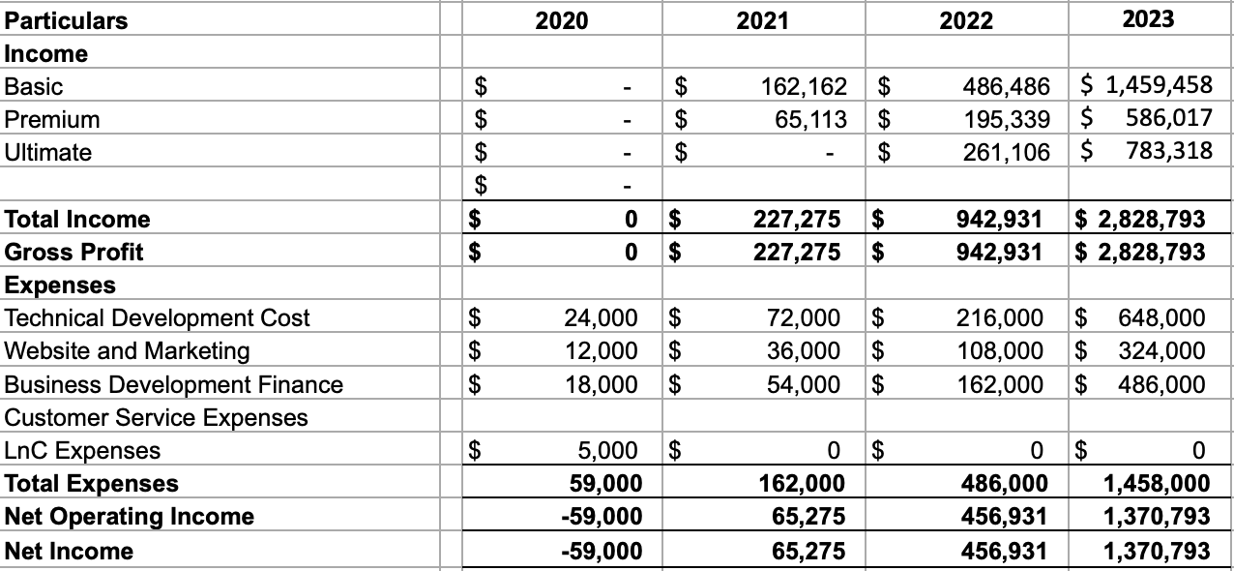
Forecasted PNL
2021
2022
2023
2024

Slide 13
SG Founder’s grant
Item | Percentage usage (%) | Startup Founder Grant | Own Funding
Tech Development | 40 | 20000 | 4000
Website and marketing | 20 | 10000 | 2000
Business development and finance | 30 | 15000 | 3000
Buffer costs | 10 | 5000 | 1000

Slide 14
Timeline
Q1 2021
Q2 2021
Q3 2021
Q4 2021
Get video explainers for 3 modules finals in SG
2 SG universities
Get video explainers for 10 modules in SG
4 SG universities
Prototype exam paper predictor
Get video explainers for 20 modules
6 SG universities
Get video explainers for 40 modules
6 SG universities + 1 APAC university

Slide 15


Team
Rachel Ng
First time founder
2 years’ experience in tutoring
Specialises in education content creation.
NLP coach
Benjamin Koh
Founder x1
3 years’ experience in founding AI companies in S2T and HR space
Specialised in Business Development and Partnerships
Runner-up in Alibaba Cloud SUSS Demo Day
Partnered with universities and SMEs

Slide 16


Team
Wong Li Xuan
First time Founder
C++ and Java programming
Experience in web development programming with NodeJS and mySQL
Experience in mql4 programming for mt4 platform
To specialize in NN/ML
Emily Ng
First time founder
1.5 years’ experience in tutoring
Provided tutoring to over 60++ students in various subjects

