Slide 1
Teleportation
Yong Jie (31) and Asnawi (35)

Slide 2
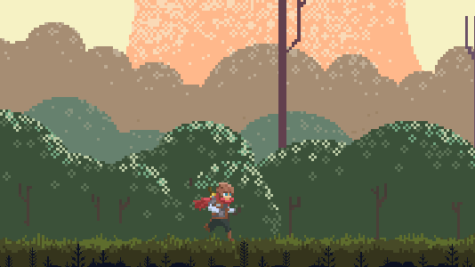
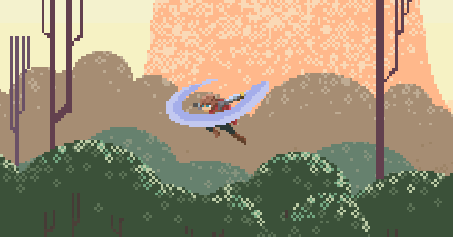
Game Ideas
A 2D Hack-n-Slash Action Platformer
Normal movement combined with a teleport mechanic
Progress through the game by eliminating enemies in the different levels

Slide 3
Project Plan
Basic Mechanics of the game (movement and teleporting) have been completed
Currently working on the combat and UI elements of the game

