Slide 1
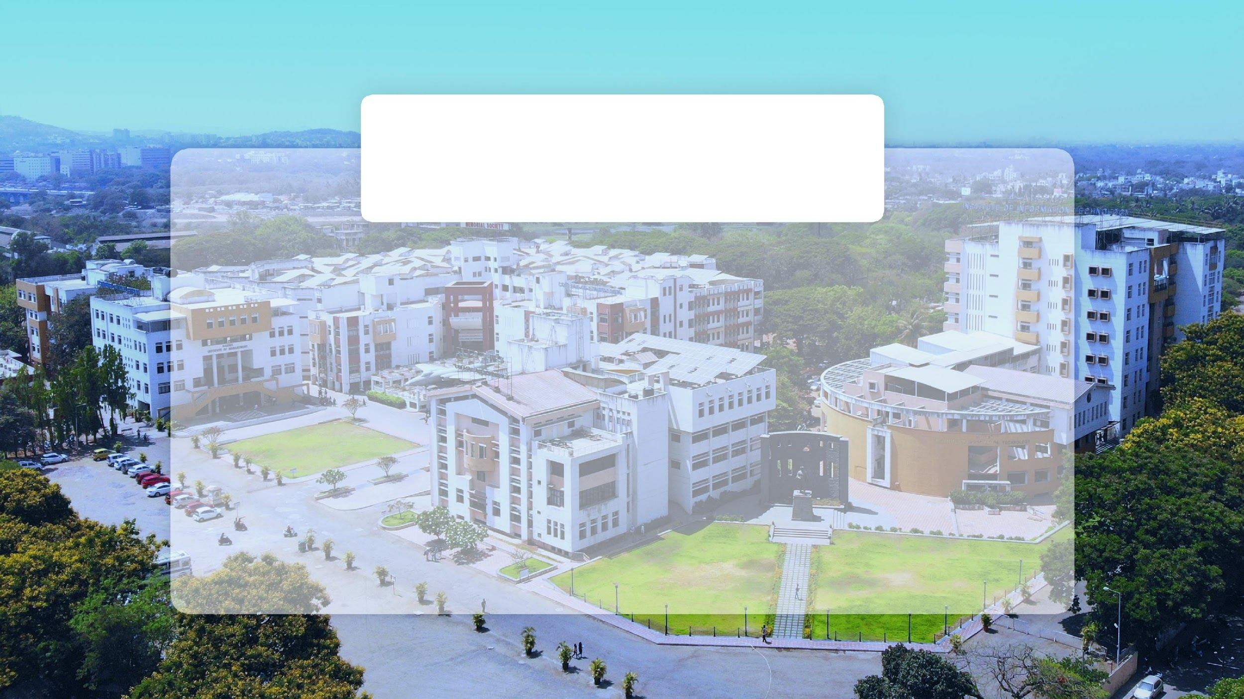

Student GPA Calculator System in C++
Prepared by Rutuja Bidarkar, Kimaya Chavan, Pooja Balpande
SY-A
Roll no: 15, 20, 7

Slide 2
TABLE OF CONTENTS
Introduction
Class Structure
Subject Class Overview
Student Class Overview
GPA Calculation
User Interaction
Exception Handling
Sample Output
Code Highlights
Conclusion

Slide 3
INTRODUCTION
Problem Statement:
A C++ program to manage student subjects and calculate GPA based on marks and credits.
Overview:
This C++ project calculates a student's GPA based on marks and credits for multiple subjects. It uses two classes, subject and student, where Subject stores individual subject details, and Student manages a collection of subjects. The program allows users to input subject data, calculates the GPA using grade points, and handles exceptions for invalid input.

Slide 4
Program Code Explaination
Class Structure
Two Main Classes:
Subject Class: Stores individual subject details.
Student Class: Manages multiple subjects and calculates GPA.
Subject Class Overview
Attributes:
name (string)
marks (double)
credits (double)
Methods:
Constructor, getCredits(), getGradePoints(), getName(), getMarks(), setValues()

Slide 5
Student Class Overview
Attributes:
subjects (array of Subject objects)
totalSubjects (int)
Methods:
Constructor, Destructor
addSubject(), calculateGPA(), getTotalCredits(), displaySubjects()
GPA Calculation
Formula:
Total Grade Points = Sum of (Credits × Grade Points)
GPA = Total Grade Points / Total Credits
Grades based on marks:
90+ -> 10, 80+ -> 9, and so on.

Slide 6
User Interaction
Input:
Number of subjects.
Subject details: Name, Marks (0-100), Credits (1-10).
Output:
Subject table with name, marks, credits, and grade points.
Final GPA and total credits.
Exception Handling
Handles invalid inputs:
Invalid number of subjects.
Out-of-range subject index during addition.
Invalid marks/credits input.

Slide 7
Sample Output
Show a screenshot or an example of input/output.
Subject details.
Summary showing GPA and total credits.
Code Highlights
Highlight core functionality:
Constructor and Destructor in Student.
calculateGPA() function.
Input validation and exception handling.

Slide 8
Conclusion
The project efficiently calculates GPA based on user input for subjects, ensuring accurate results and proper error handling. It offers a modular, scalable design that can be extended with additional features in the future.

Slide 9

Thank You

