Slide 1
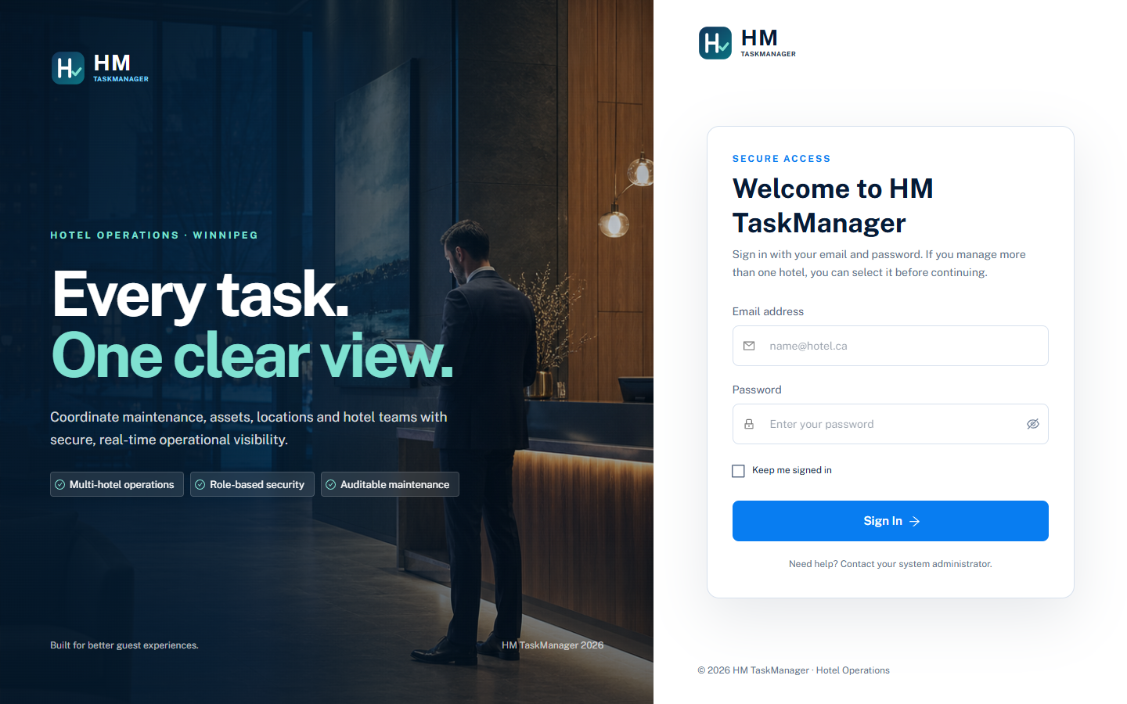
HM TASKMANAGER
One operating view
for every hotel
Maintenance operations, company security, and management intelligence in one controlled workflow.
Executive briefing
Prepared for Canadian hotel leadership

Slide 2
THE OPERATING CASE
A single control plane across a multi-hotel portfolio
HM TaskManager connects property context, work execution, and management visibility.
01
02
03
Hotel context
Operational flow
Management intelligence
Company, hotel, location, asset
Request → assign → execute → close
Status, backlog, completion, asset coverage
HM TaskManager | Executive overview
02

Slide 3
LOGIN & COMPANY CONTEXT
Security starts before the first work order
Users authenticate with their identity and select an authorized hotel context.
What the control means
• The session supplies the active company context
• The screen cannot override the authenticated company
• Permissions are evaluated from company + user + program assignments
• The same identity can support more than one hotel, where authorized
Company-scoped session
Role-aware access
HM TaskManager | Executive overview
03

Slide 4
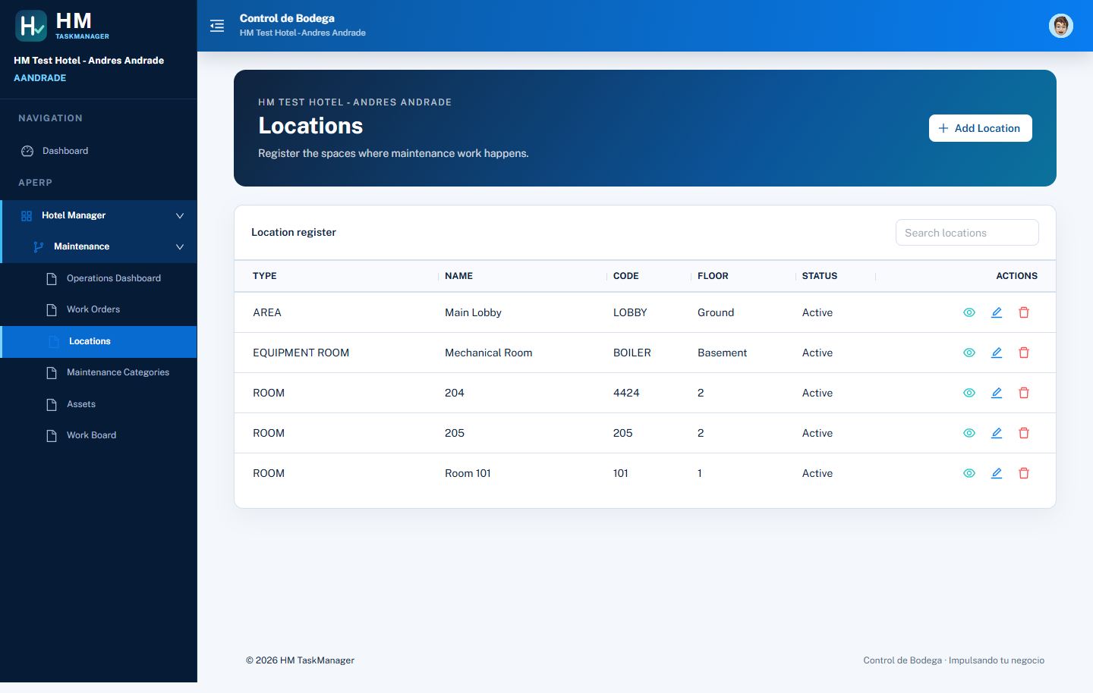
MULTI-HOTEL GOVERNANCE
The portfolio stays connected without mixing hotel data
A tenant-aware backend keeps company boundaries explicit in every request.
Executive implication
A regional or corporate team can standardize the operating model while each hotel sees only its authorized context.
Authenticated EmpCod is the source of truth.
HM TaskManager | Executive overview
04

Slide 5
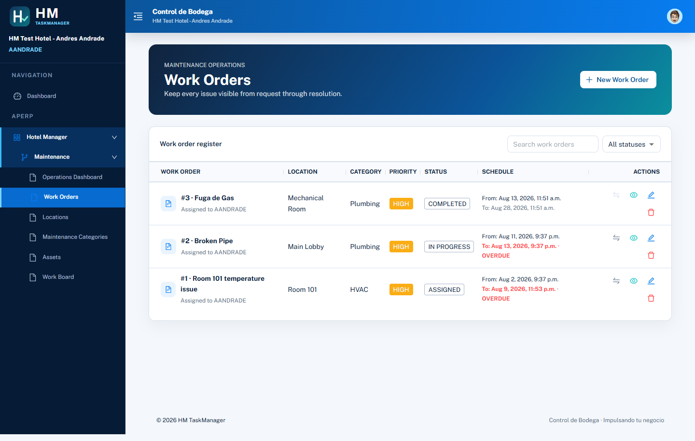
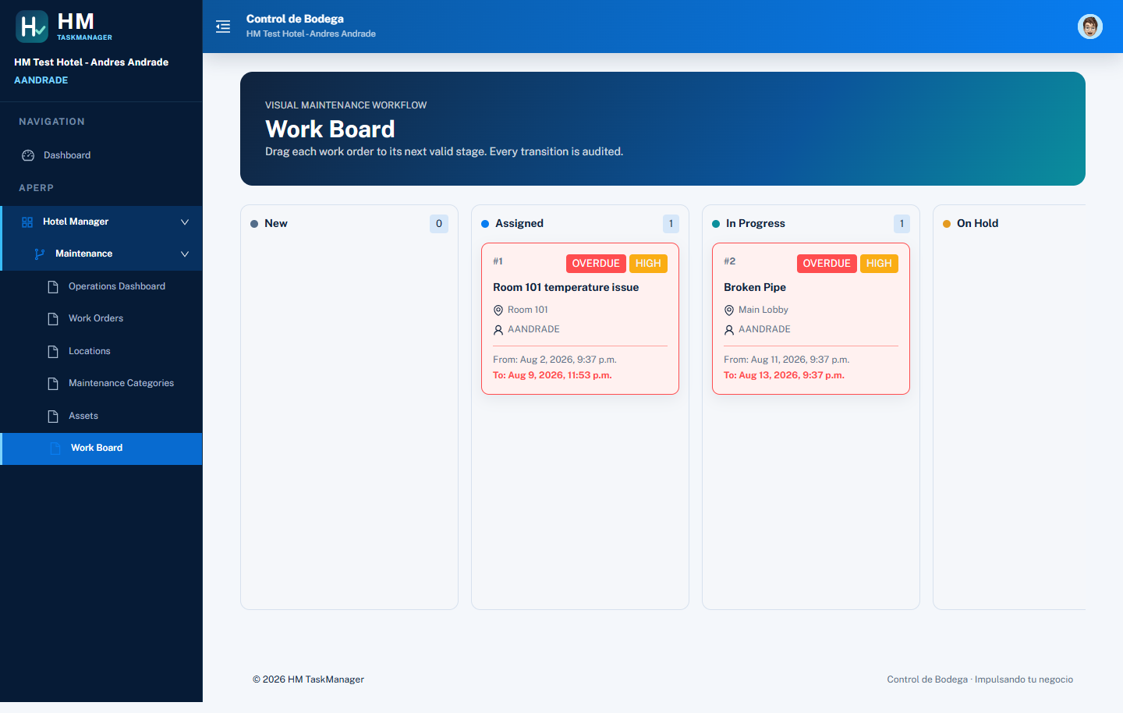
OPERATIONAL WORKFLOW
Work becomes visible, assignable, and auditable
The operating model follows the lifecycle of a real maintenance request.
Work Orders → Work Board → completion history
HM TaskManager | Executive overview
05

Slide 6
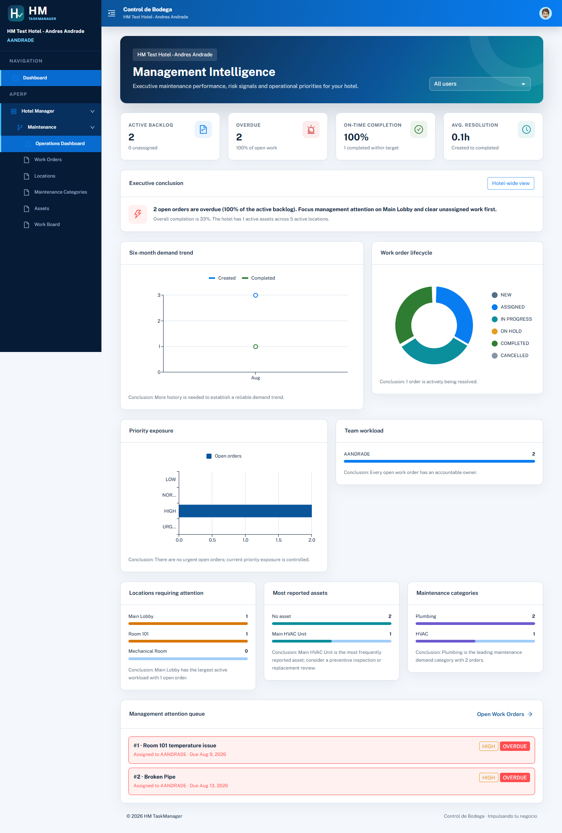
MANAGEMENT INTELLIGENCE
The dashboard turns activity into a management conversation
Leaders see the health of the operation without opening every work order.
Questions leadership can answer
• What is open now?
• Where is work accumulating?
• Which assets drive repeat attention?
• Are teams completing work on time?
• Which hotel needs support?
HM TaskManager | Executive overview
06

Slide 7
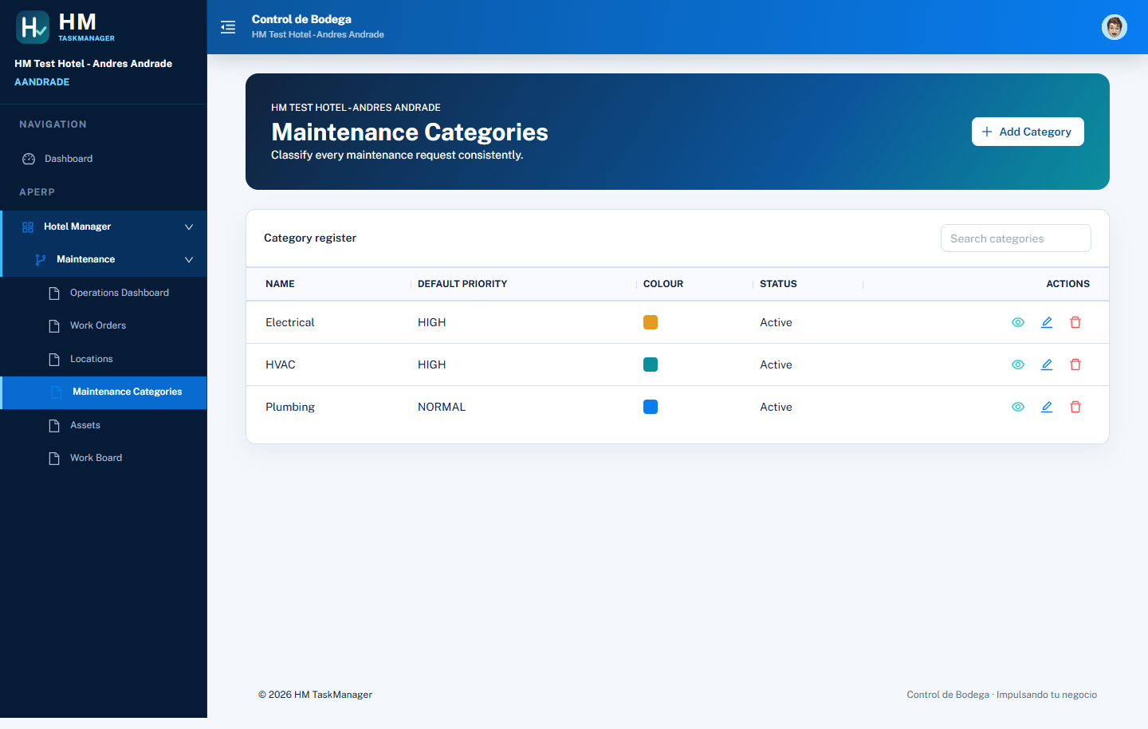

MASTER DATA THAT MAKES WORK ACTIONABLE
Locations, categories, and assets give every work order context
The maintenance model is deliberately simple: define the place, the type of work, and the thing being maintained.
Real screens from the HM test hotel: categories, assets, and locations are linked to the same operating context.
HM TaskManager | Executive overview
07

Slide 8
EXECUTIVE CONCLUSION
HM TaskManager is a practical operating layer for hotel maintenance
It preserves company security while giving teams a modern, measurable workflow.
For leadership
For operations
Standardize the operating model across hotels without losing local accountability.
Make every request visible, owned, and traceable from intake to completion.
For IT & governance
Next step
Keep authorization anchored to the authenticated company and existing security assignments.
Validate with one hotel, confirm operating KPIs, then scale by repeatable configuration.
HM TaskManager | Executive briefing

