Slide 1
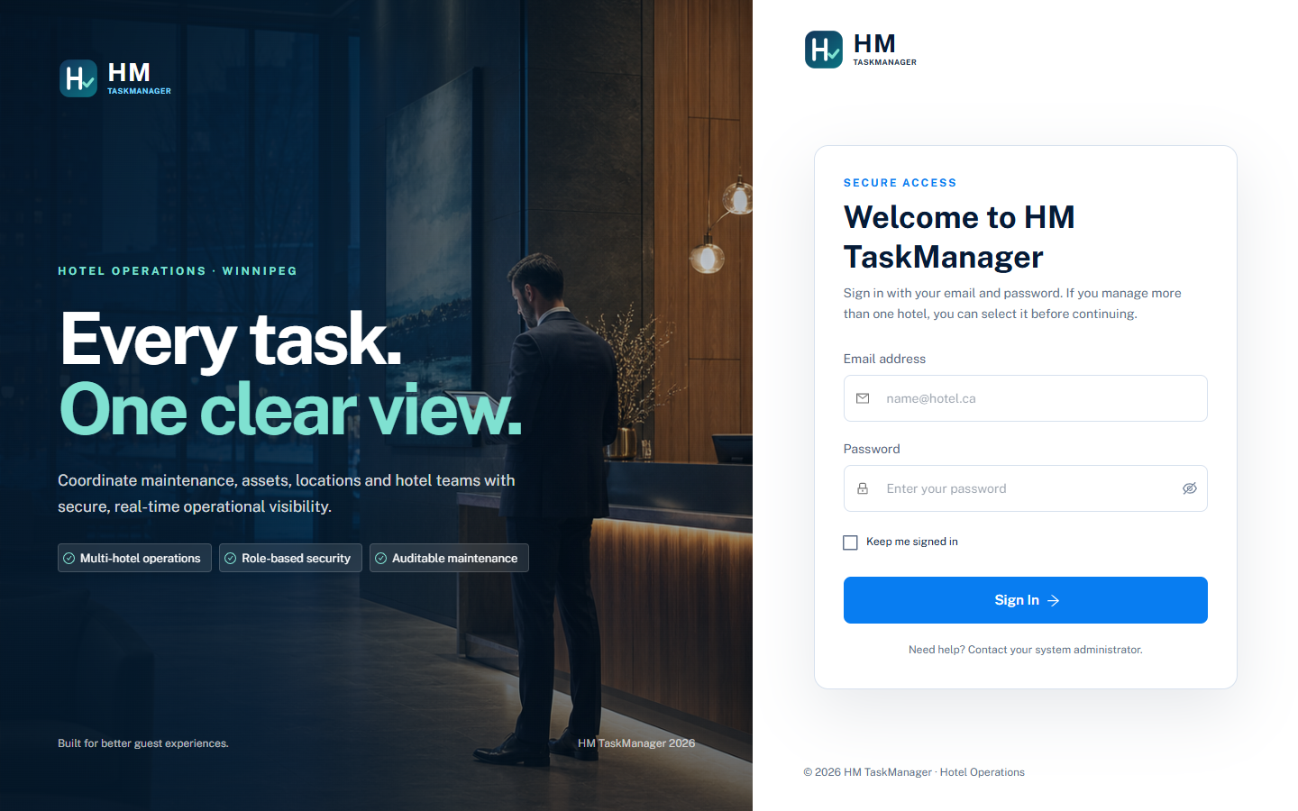
HM TASKMANAGER
Simple User Guide
Hotel maintenance operations
Login, review work, manage tasks and track progress across authorized hotels.
Prepared for hotel managers and maintenance teams

Slide 2
Secure access
02
Sign in with email and select the hotel context when prompted.
1
Enter your email
Use the email assigned by the system administrator.
2
Enter your password
Temporary passwords should be changed after first access.
3
Confirm the hotel
Users see only their authorized hotels. Administrators can view the full portfolio.
HM TaskManager · Simple User Guide

Slide 3
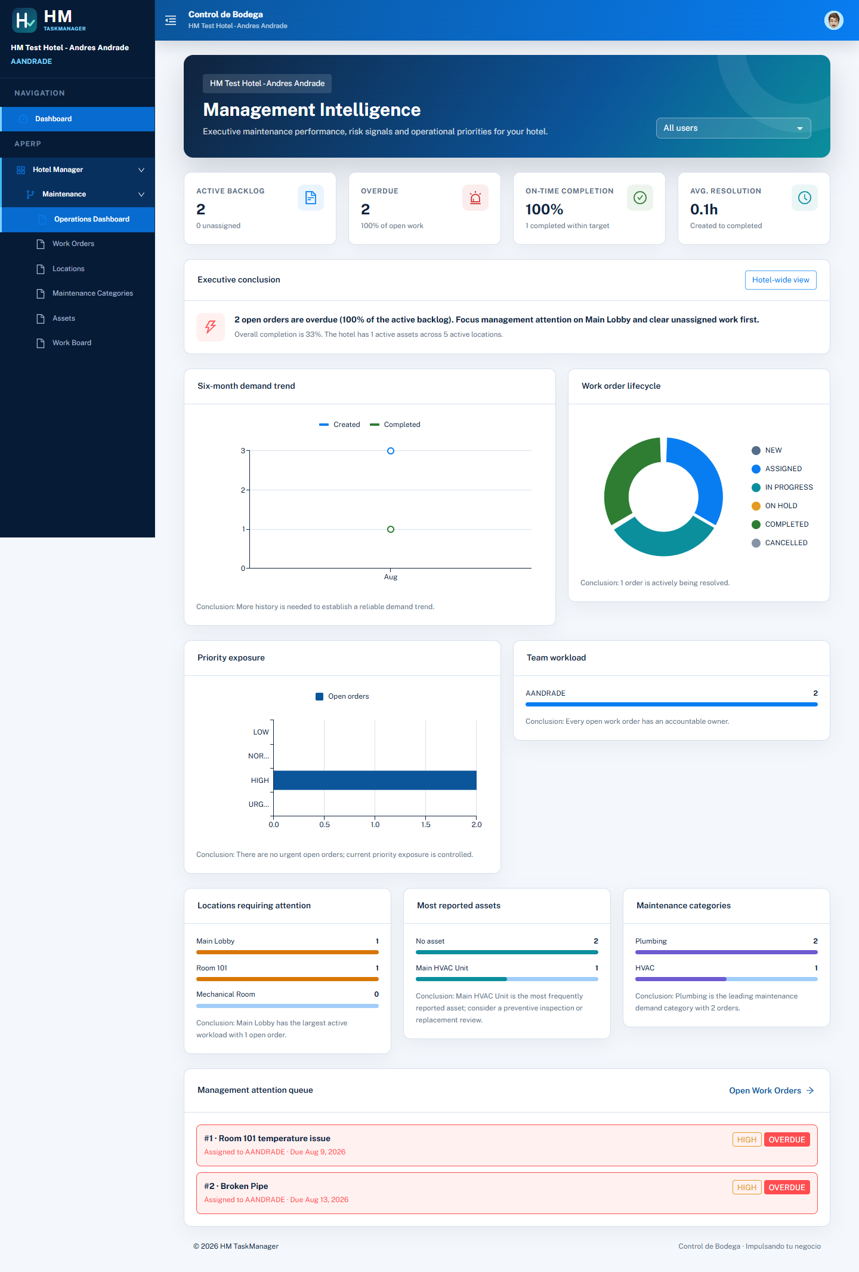
Management dashboard
03
The opening screen summarizes workload, risk and service performance.
Read this screen first
Active backlog shows unfinished work.
Overdue identifies orders past their expected completion date.
On-time completion and resolution time show service performance.
Use the user filter to review an individual workload.
The conclusion highlights the action that needs management attention.
HM TaskManager · Simple User Guide

Slide 4
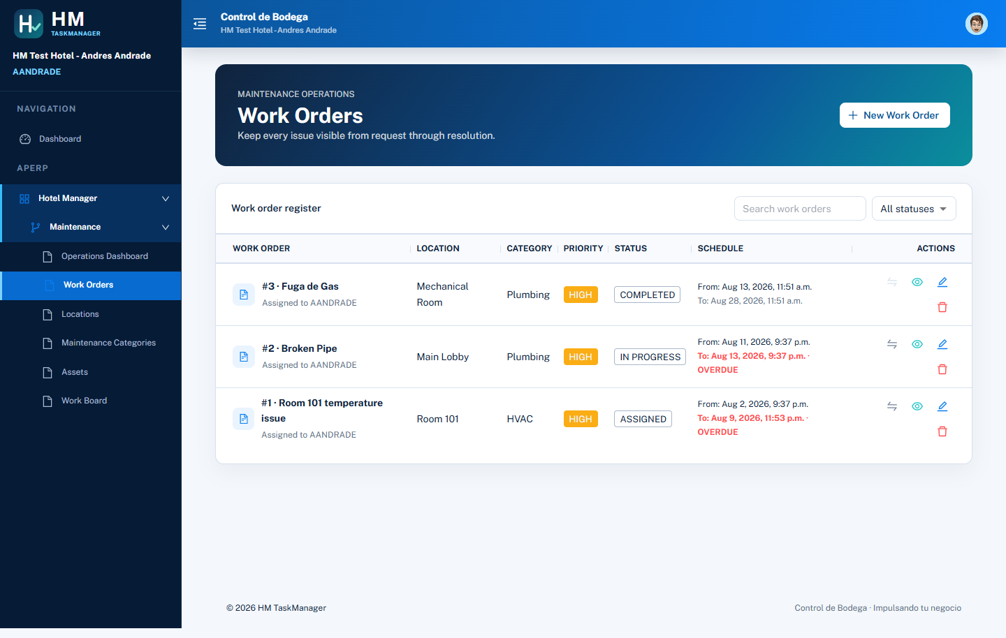
Work order register
04
Search, filter and manage every maintenance request from one list.
1
Create
Select New Work Order and enter title, location, priority, dates and tasks.
2
Review
Use the eye icon for details. Administrators can filter by hotel.
3
Update
Edit the order, manage tasks or open Change Status from the action icons.
4
Track dates
Red dates identify overdue work that still needs attention.
HM TaskManager · Simple User Guide

Slide 5
Tasks and status rules
05
Each work order contains the specific tasks required to finish the job.
Task controls
Header workflow
Each task has a status and an optional responsible worker.
TO DO means work has not started.
IN PROGRESS identifies active work.
COMPLETED closes the task.
CANCELLED records work removed from scope.
NEW
ASSIGNED
IN PROGRESS
ON HOLD
COMPLETED or CANCELLED
Assignment selects the worker.
Starting work requires at least one open task.
On Hold requires a reason.
Completion requires a comment and all tasks completed.
A work order can finish only when every task is COMPLETED.
HM TaskManager · Simple User Guide

Slide 6
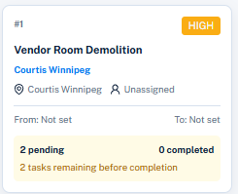
Work Board
06
The board provides a visual view of work by status and hotel.
Daily use
Filter by hotel when working as an administrator.
Drag a card to the next valid status.
Click a card to update its tasks and responsible workers.
The card displays pending tasks, total tasks and completion percentage.
Card colour matches the status lane.
HM TaskManager · Simple User Guide

Slide 7
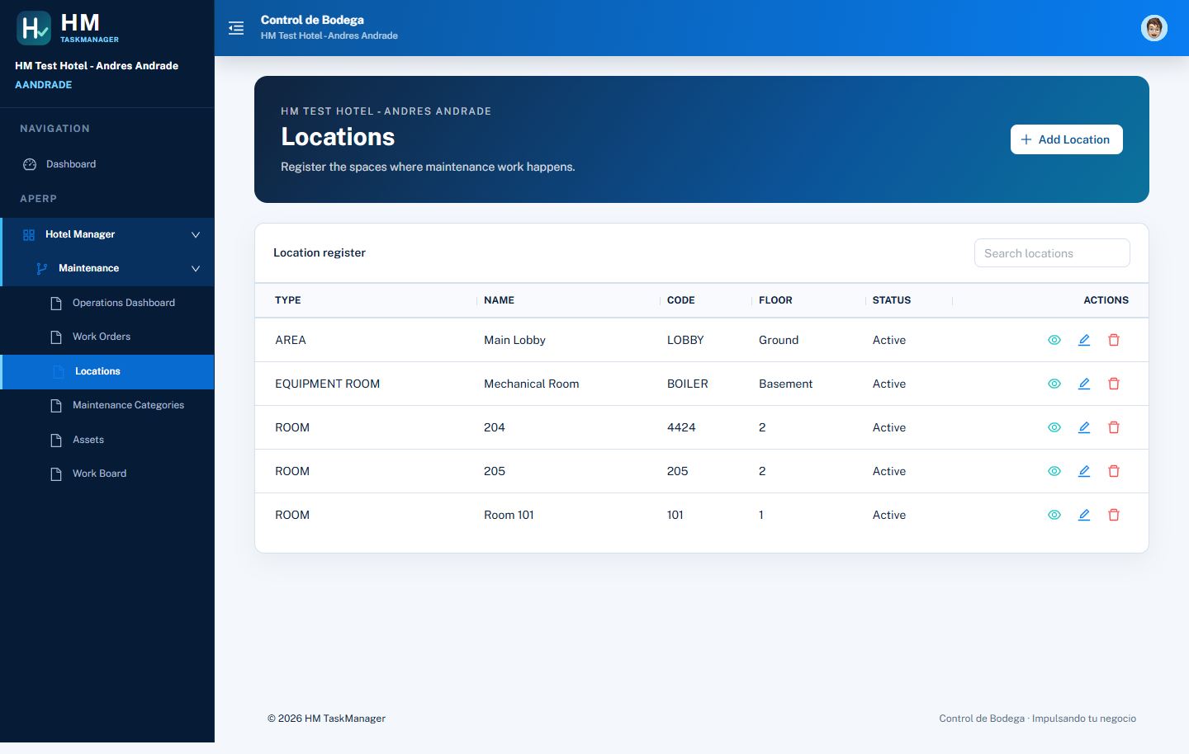
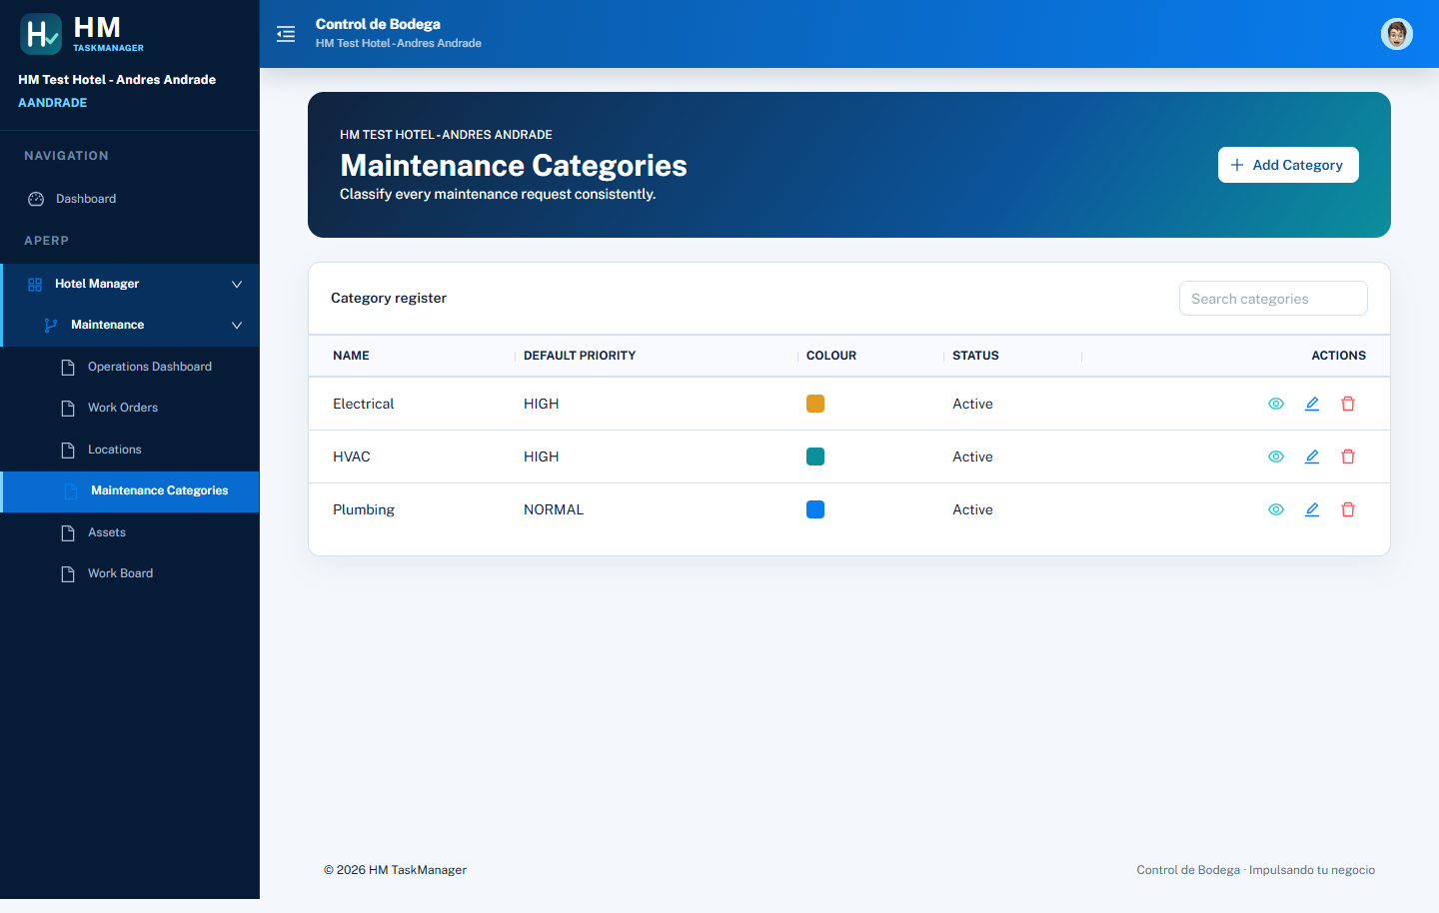
Locations and categories
07
Master records keep work orders consistent and easy to report.
Locations
Maintenance categories
Buildings, floors, rooms and operational areas.
Standard work types with default priority and colour.
HM TaskManager · Simple User Guide

Slide 8

Assets
08
Assets connect maintenance history to hotel equipment.
Asset records include
Asset tag and name
Hotel location
Maintenance category
Manufacturer and model
Operational status
Linking work orders to assets helps identify repeat failures.
HM TaskManager · Simple User Guide

Slide 9
Daily operating routine
A simple sequence for managers and technicians
1
Review the dashboard
2
Open Work Orders
Check backlog, overdue work and the management conclusion.
Create new requests and confirm location, dates and task scope.
3
Assign and start
4
Update tasks
Select the worker, keep at least one task open and move work to IN PROGRESS.
Record progress from the list or by clicking the card in Work Board.
5
Complete the order
Complete every task, add the completion comment and close the work order.
HM TaskManager

