Slide 1

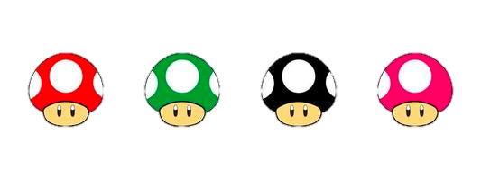
Card Sorting
Workshop by
Cerys
Oz
Luke
Laura

Slide 2
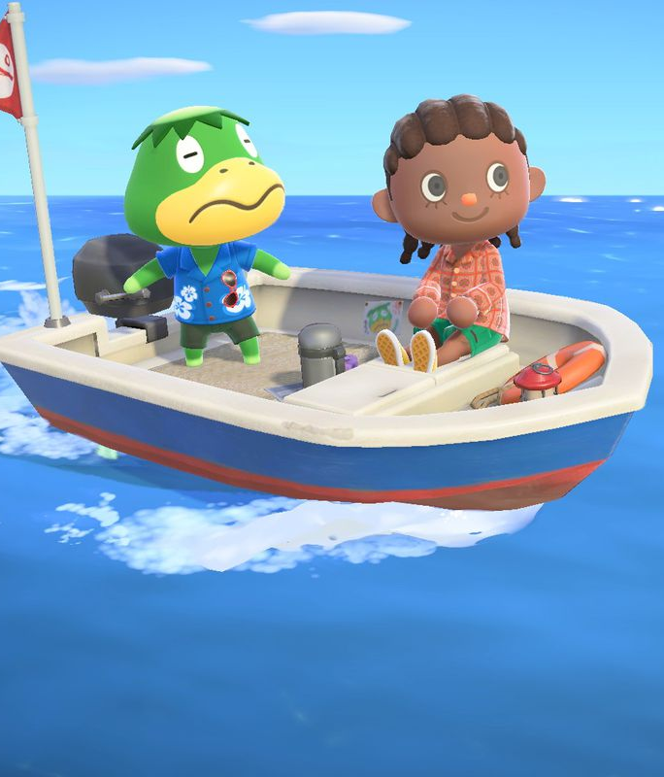
Warm-up Task
You are on the S.S. Seas the Opportunity and you’re heading back to the UK from Canada across the North Atlantic Ocean. Your boat has gotten a hole and it’s starting to sink! Ah! You have less than 5 minutes to grab things to bring on the lifeboat with you.
On the tables you are sat on, put the following items in order of importance.

Slide 3
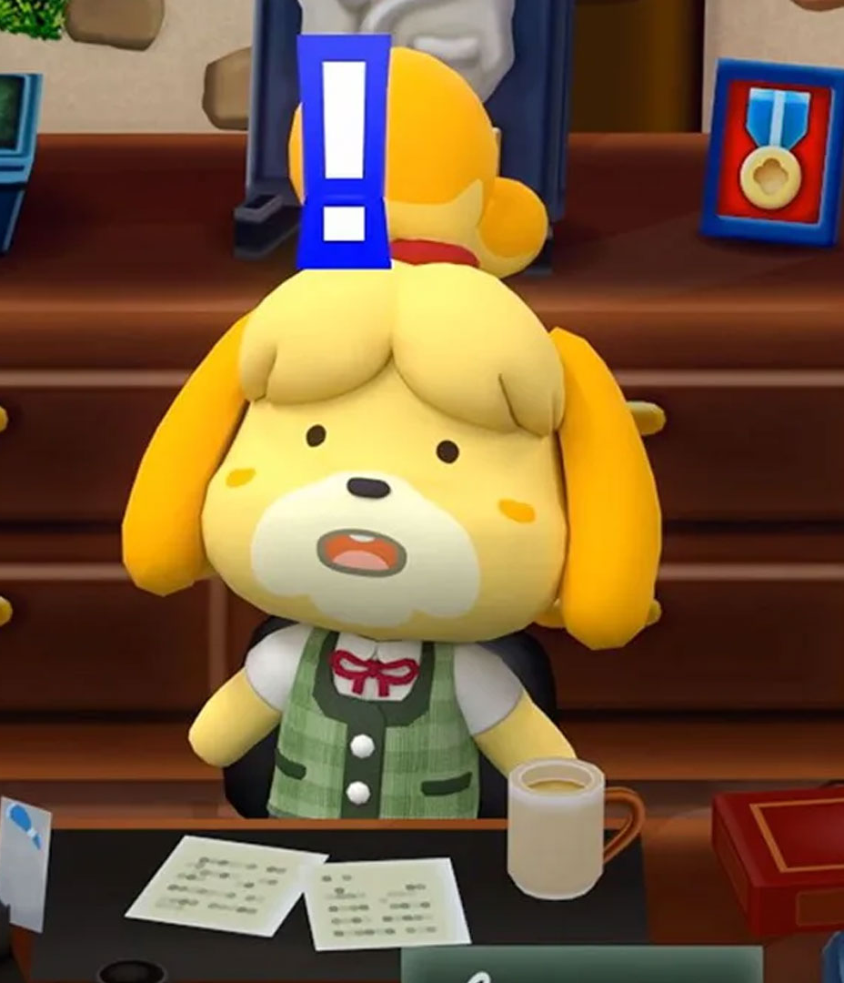
What did you just do?
You just sorted some cards, who would have thought! This is the first step towards the main goal of card sorting.
Card sorting is a research method in which users are asked to order elements into a hierarchical order in which the user deems most efficient. This will then later be used to enhance a product.

Slide 4
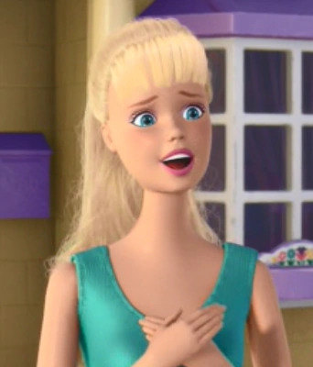
Barbie: An example
The goal of their card sorting was to understand their collectors' opinions towards the Barbie: Showcase website, a website that advertises different toy models and collectors can show off their current collection. They used card sorting to gain ideas on how to redesign the website.
The method involved, working with nine participants who were given two card sorts one focused on an existing line and the other on a fashion-focused line which participants were tasked to organize into themes.
They concluded a single method of search wasn’t an option, the result was a multilayered website that allowed users to browse by doll name, release year, serial numbers or themes.
Maze (2020) 7 Card sorting examples to inform your UX research.
Toy Story 2 (2010) Barbie Screenshot

Slide 5

Main Task
Explore the Nintendo website - https://www.nintendo.co.uk/
Now, on eight separate post-it notes write down notable elements/features found on the Nintendo website, e.g, Login, search bar, etc.
Now organize the post-it notes in the hierarchy of the website.

Slide 6

You Decide
Now organize the post-it notes in the hierarchy of how you would do it.

Slide 7
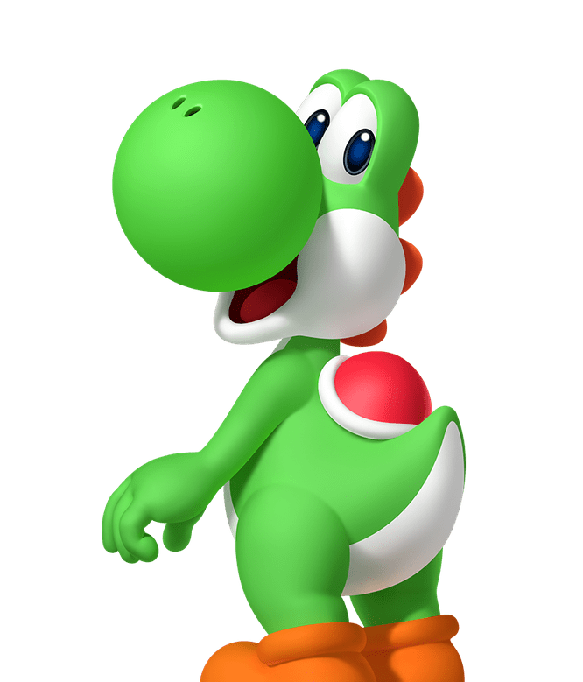
Questions?

Slide 8
References
Maze (2020) 7 Card sorting examples to inform your UX research. Available from: https://maze.co/guides/card-sorting/card-sorting-examples/ [Accessed 5 December 2022].
Toy Story 2 (2010) Barbie Screenshot [Digital]. At: Wiki Disney Fandom [online].Available from: https://disney.fandom.com/wiki/Barbie [Accessed 04 December 2012].

