Slide 1
On-Time Performance Analysis for US Passenger Flight Carriers

Slide 2
Data Insight
Data Source - Bureau of Transportation Statistics (https://www.bts.gov/)
Data Format – CSV (Comma Separated Value) Files
Data Sampling and Details –
Ontime performance details for 18 US Passenger Flight Carriers
Data spanning 12 months (Months of Jan, Apr, July and Oct from 2015 to 2018)
4. Data Volume – 5962813 (~ 6M) rows

Slide 3
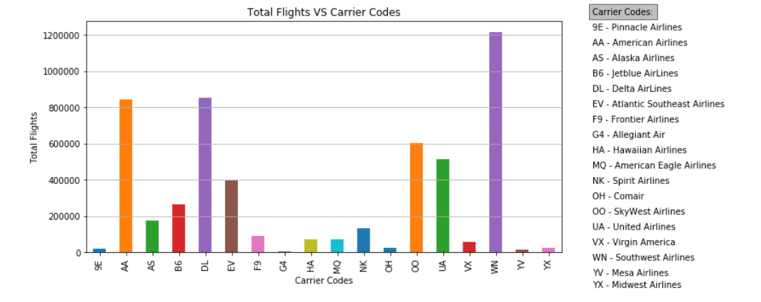
Total Flights for each Carrier
Southwest has the most number of Flights (approx. 1.2M) followed by Delta and American Airlines (approx. 0.8M)

Slide 4
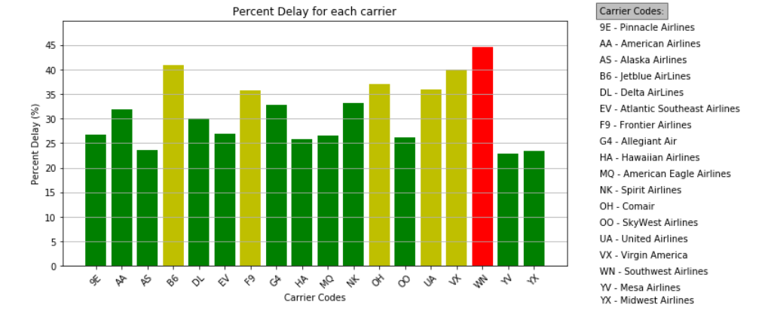
Delay for each carrier
Southwest has the most number of delayed Flights – 45% (approx.)

Slide 5
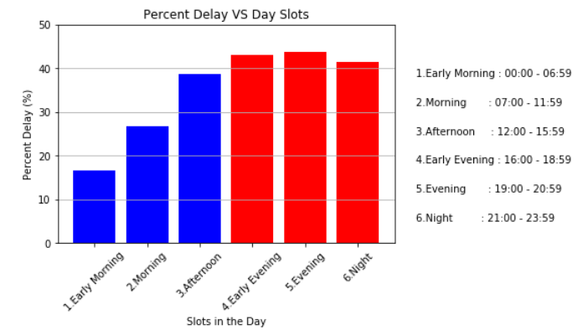
Delay trend for 24 hr period
Words of Wisdom – Catch up a flight in the first half of the day !!!

Slide 6
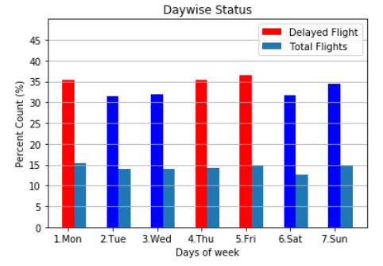
Delay Trend over days of the week
Data Experts say that your chances of catching a delayed flight are marginally higher on Mondays, Thursdays and Fridays

Slide 7
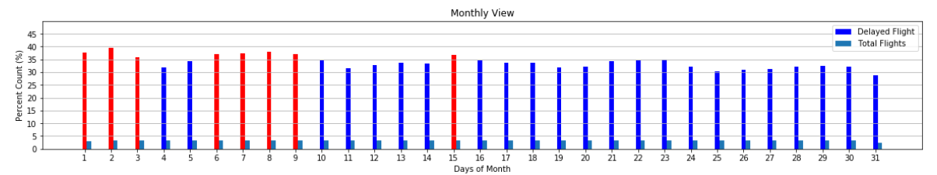
Delay trends for days of a Month
BEWARE - Chances of you hitting a delayed flight are higher in the first 10 days of the month.

Slide 8
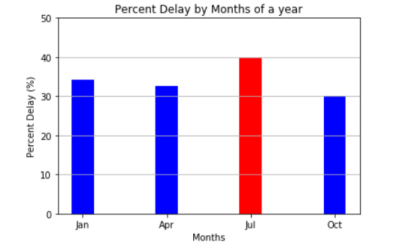
Delay Trend for the 4 seasonal months
Alert - Be prepared to spend some extra time travelling when you pack your bags for Summer break
Null Hypothesis – Delay trend in winter is not as bad then in Summer. In fact, weather plays a very small part in the total occurrences of flight delay. Don’t believe us?? Watch the next slide….

Slide 9
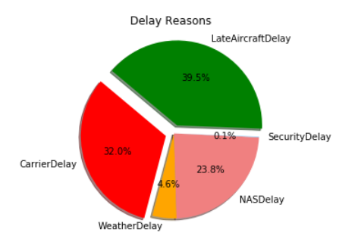
Delay Reasons
More than 70% of the delays are caused by the operating carrier
More Information on Flight Delay reasons –
http://aspmhelp.faa.gov/index.php/Types_of_Delay

Slide 10
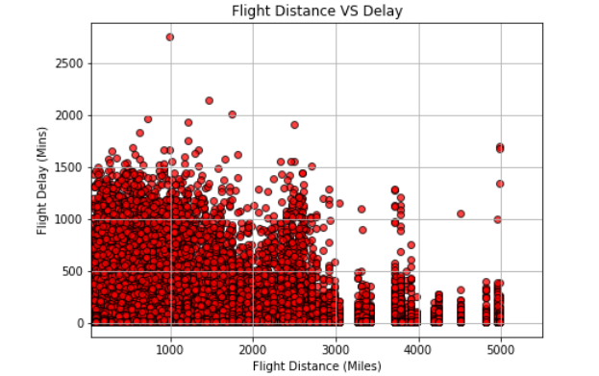
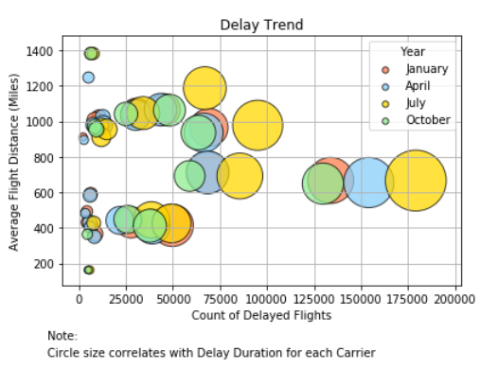
Delay Trends VS Flight Distance
Notable Trends:
1. Total number of delayed flights are more for flights travelling between 600 and 800 miles and another peak at around 2500 miles.
2. Over the same segment of flights (distance wise), the occurrences and total duration of delay is highest in July

Slide 11
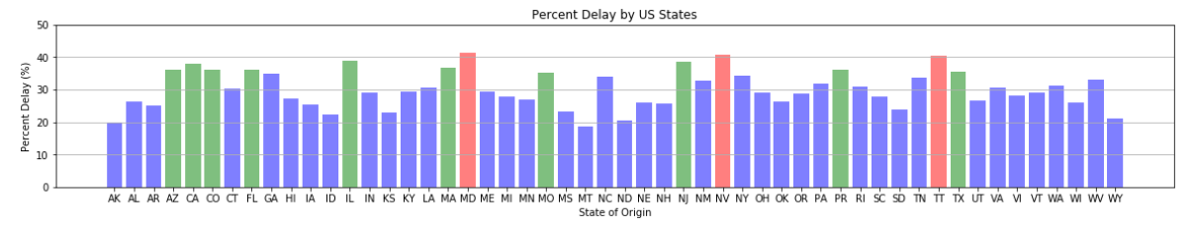
Delay Trend across US States
MD, NV and TT are the 3 origin States/Territories that have the most number of delayed flights

Slide 12
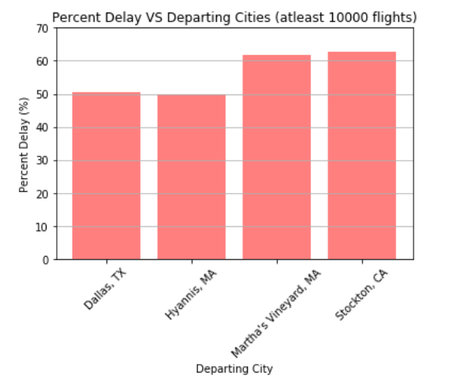
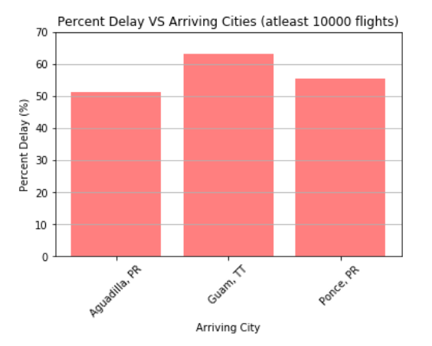
Delay VS Cities

Slide 13
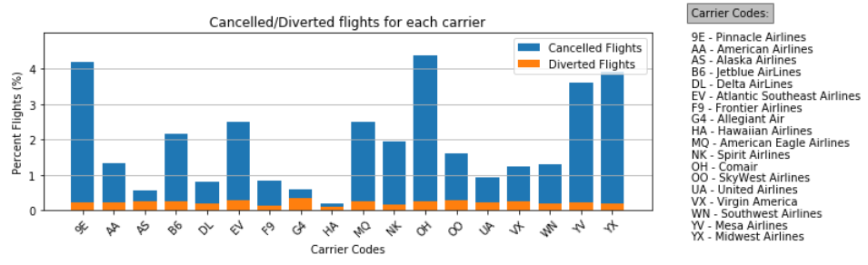
Cancelled/Diverted Flights for each carrier
9E, OH, YV and YX tops the list with nearly 4% of cancelled flights
Make a note of G4 which has more diverted flights than cancelled flights

Slide 14
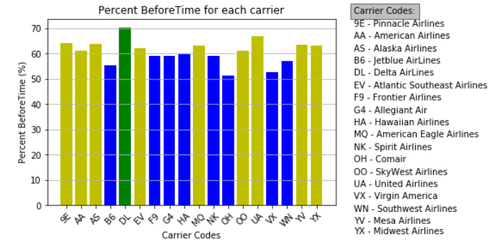
There is something to cheer about as well…. ☺
DL leads the pack with 70% flights that reach the destination before time

Slide 15
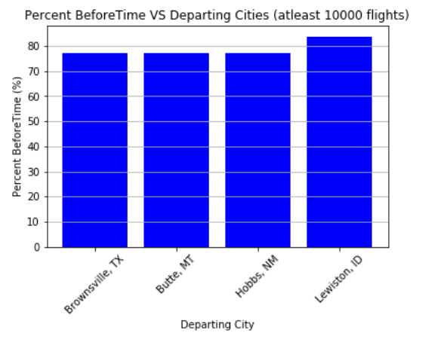
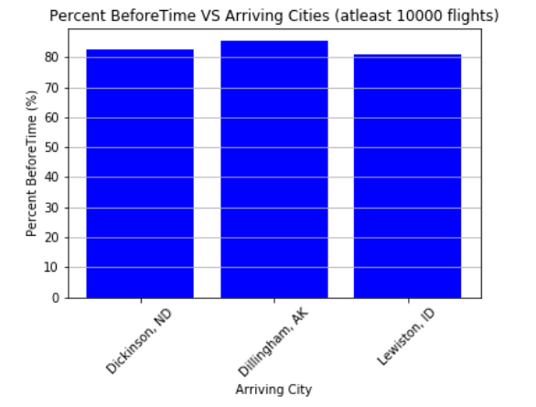
Before Time VS Cities

