Slide 1
Carriers and Airports Like Horses and Carriages
If we have data, let’s look at data. If all we have are opinions, let’s go with mine. —Jim Barksdale

Slide 2

Contributors:
Saifee Dalal
Ghassan Aleqabi
Sandeep Komuravelli

Slide 3
Data Insight
Data Source - Bureau of Transportation Statistics (https://www.bts.gov/), https://openflights.org/data.html
Data Format – CSV (Comma Separated Value) Files
Data Sampling and Details –
Ontime performance details for 18 US Passenger Flight Carriers
Data spanning 12 months (Months of Jan, Apr, July and Oct from 2015 to 2018)
4. Data Volume – 5962813 (~ 6M) rows
5. Data Cleanup – Cleaned up NaN values with “0” .

Slide 4

Sampling Scheme:
large dataset ~ We use stratification to reduce heterogeneity. Flight data is too large. We stratified the data by origin and/or destination airport, and using monthly information. It is recommended to avoid over Stratification, which may lead to an excessive volume of results that might need to be aggregated to summaries.
Passengers per flight info does not exist in our dataset files. Our data is appropriate for “flight focused” analysis but not “passenger focused” analysis.
We examined subset of large amount of data, monthly samples (four months of flight data per year for four years) and to reflect quarterly changes, we chose January, April, July and October data to understand changes in quarterly manner over the years.

Slide 5
Objectives
Analyze on time performance, visualization by cities, airlines, seasons, day of the week, time of the day
Cancelation and diversion trend by airlines
Correlation of weather to flight delays
Techniques & Tools:
Pandas
Matplotlib
Numpy
Scipy and sklearn

Slide 6
Null Hypothesis:
Null hypothesis, H₀: Airline time delays are weather induced.

Slide 7
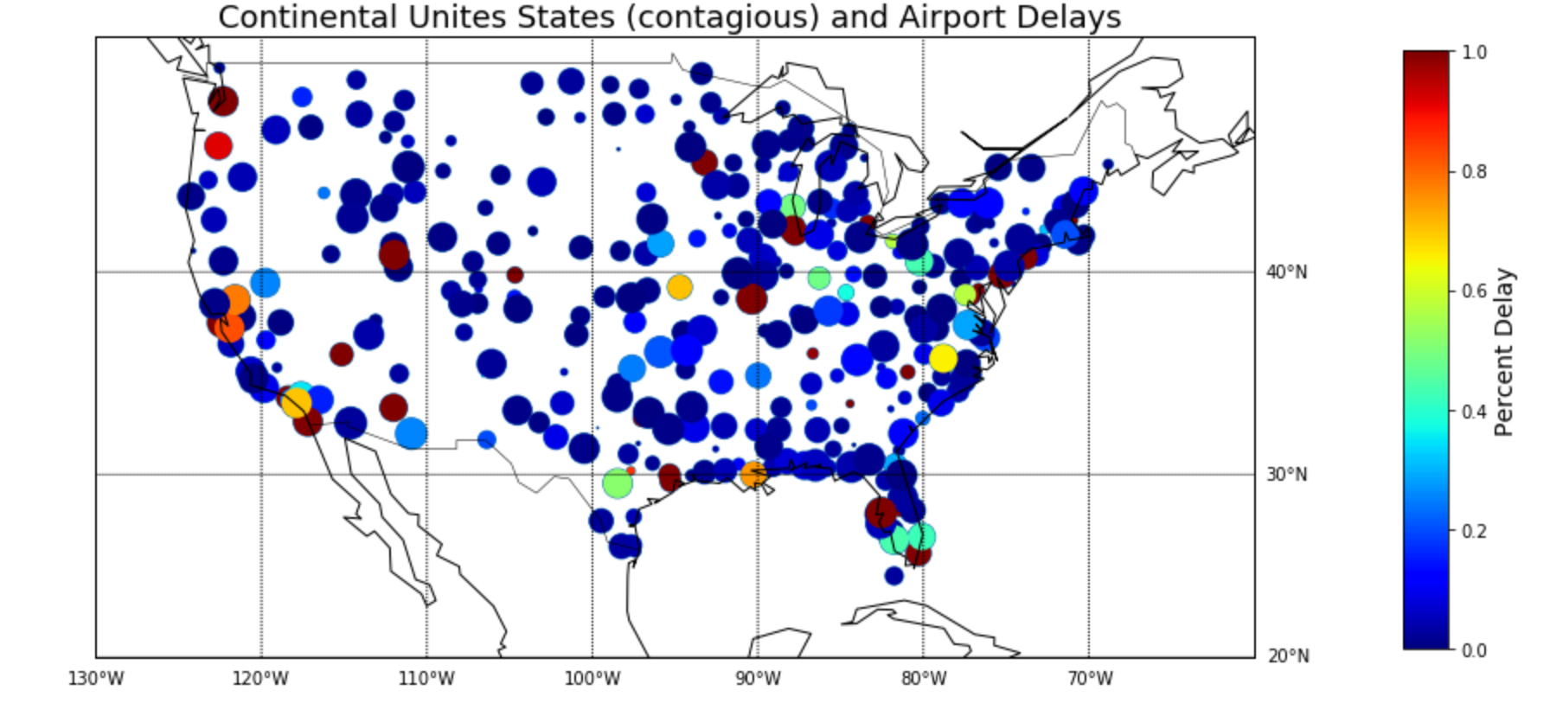
Airport Delays

Slide 8
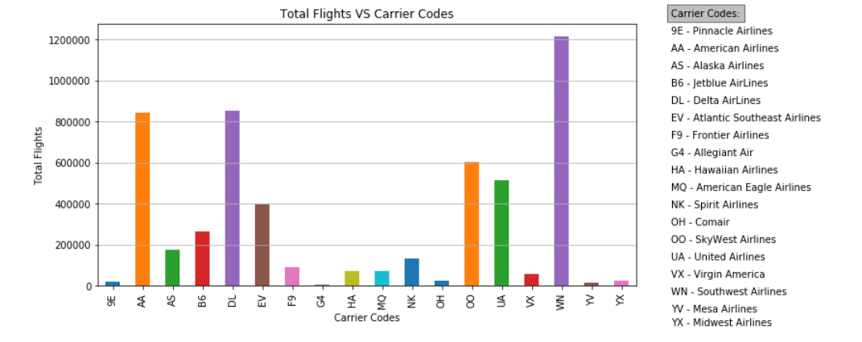
Total Flights for each Carrier
Southwest has the most number of Flights (approx. 1.2M) followed by Delta and American Airlines (approx. 0.8M)

Slide 9
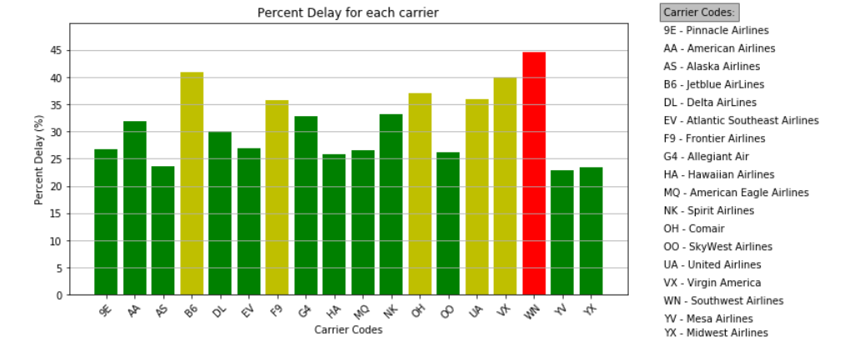
Delay for each carrier
Southwest has the most number of delayed Flights – 45% (approx.)

Slide 10
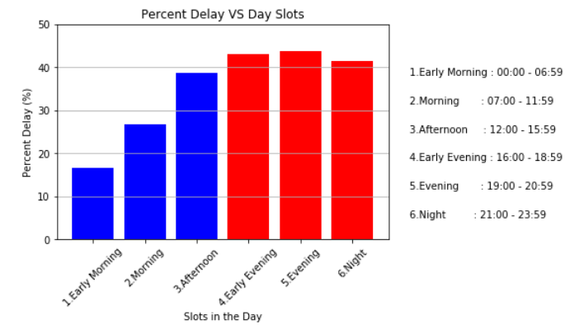
Delay trend for 24 hr period
Words of Wisdom – Catch up a flight in the first half of the day !!!

Slide 11
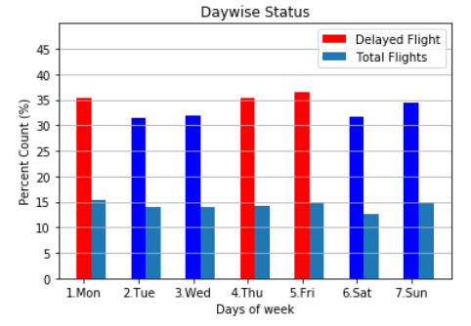
Delay Trend over days of the week
Data Experts say that your chances of catching a delayed flight are marginally higher on Mondays, Thursdays and Fridays

Slide 12
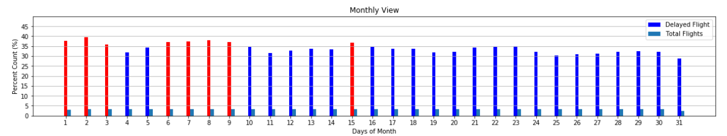
Delay trends for days of a Month
BEWARE - Chances of a delayed flight are higher in the first 10 days of the month.

Slide 13
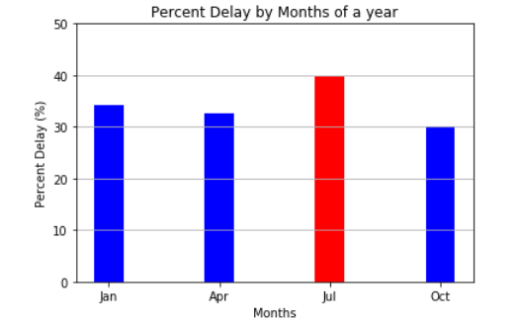
Delay Trend for the 4 seasonal months
Alert - Be prepared to spend some extra time travelling when you pack your bags for Summer vacation

Slide 14
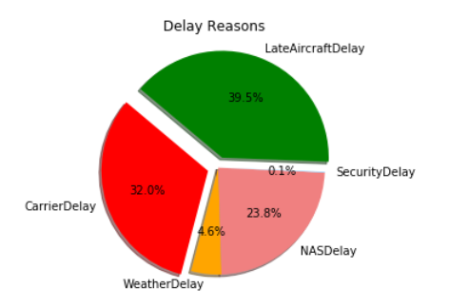
Delay Reasons
More than 70% of the delays are caused by the operating carrier
More Information on Flight Delay reasons –
http://aspmhelp.faa.gov/index.php/Types_of_Delay

Slide 15
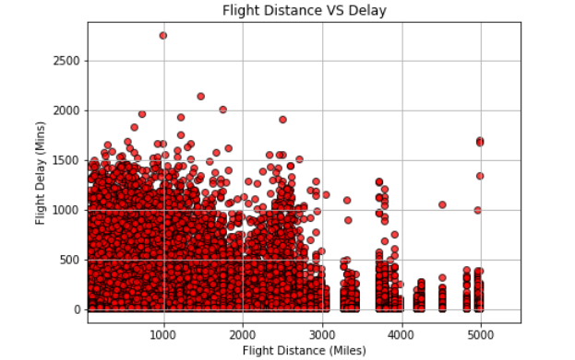
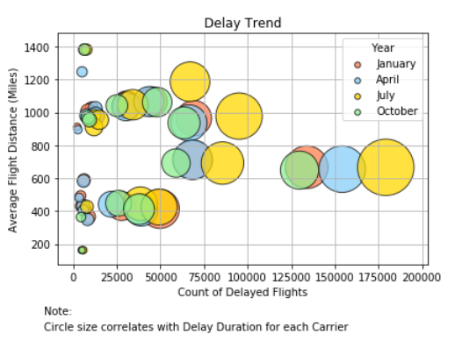
Delay Trends VS Flight Distance
Notable Trends:
1. Total number of delayed flights are more for flights travelling between 600 and 800 miles. The delay is significant at around 2500 miles as well.
2. Over the same segment of flights (distance wise), the occurrences and total duration of delay is highest in July
3- Shorter departure delays for long distance flights. Probably the tower gives preference to longer distance flights.

Slide 16
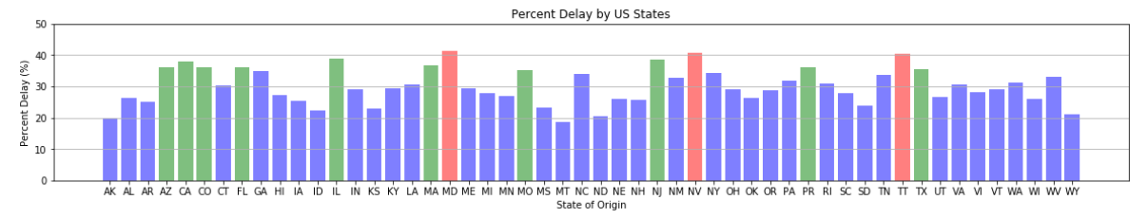
Delay Trend across US States
MD, NV and TT are the 3 origin States/Territories that have the most number of delayed flights while MT and AK has the least delays.

Slide 17
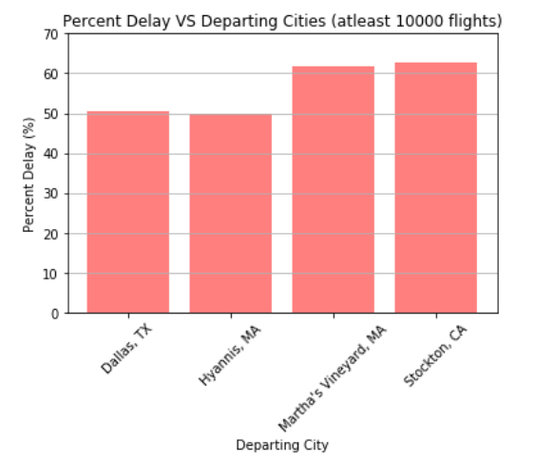
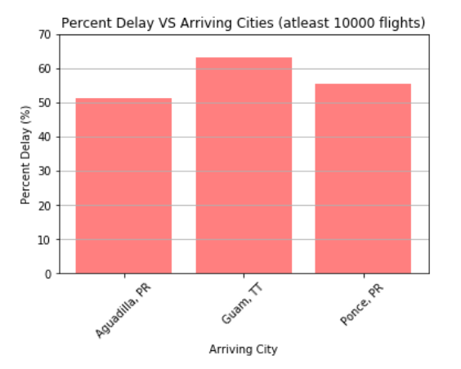
Delay VS Cities

Slide 18
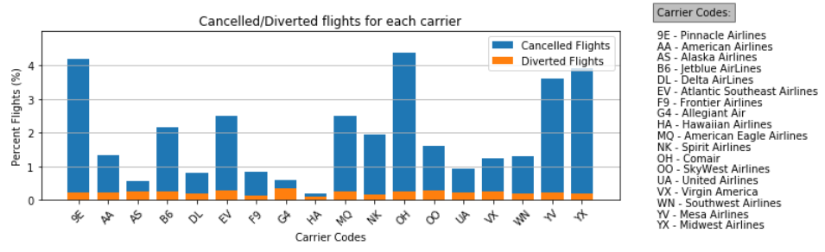
Cancelled/Diverted Flights for each carrier
9E, OH, YV and YX tops the list with nearly 4% of cancelled flights
Make a note of G4 which has more diverted flights than cancelled flights

Slide 19
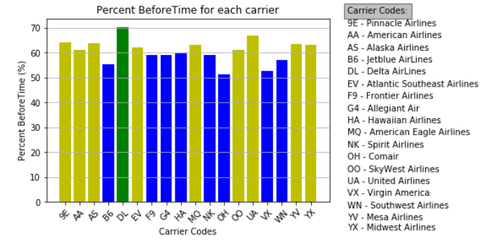
Cheer Up!
DL leads the pack with 70% flights that reach the destination before time

Slide 20
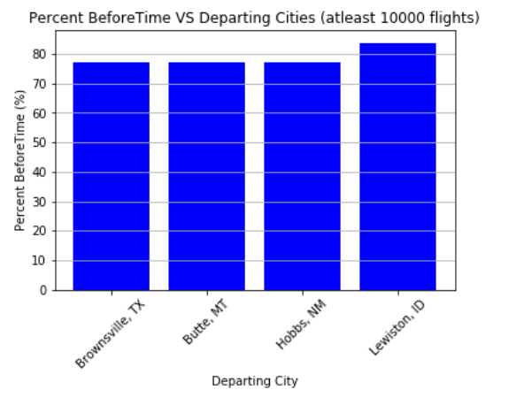
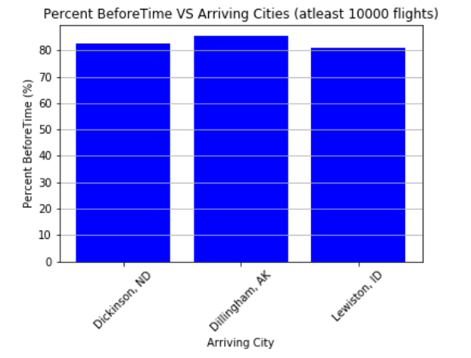
Before Time VS Cities

Slide 21
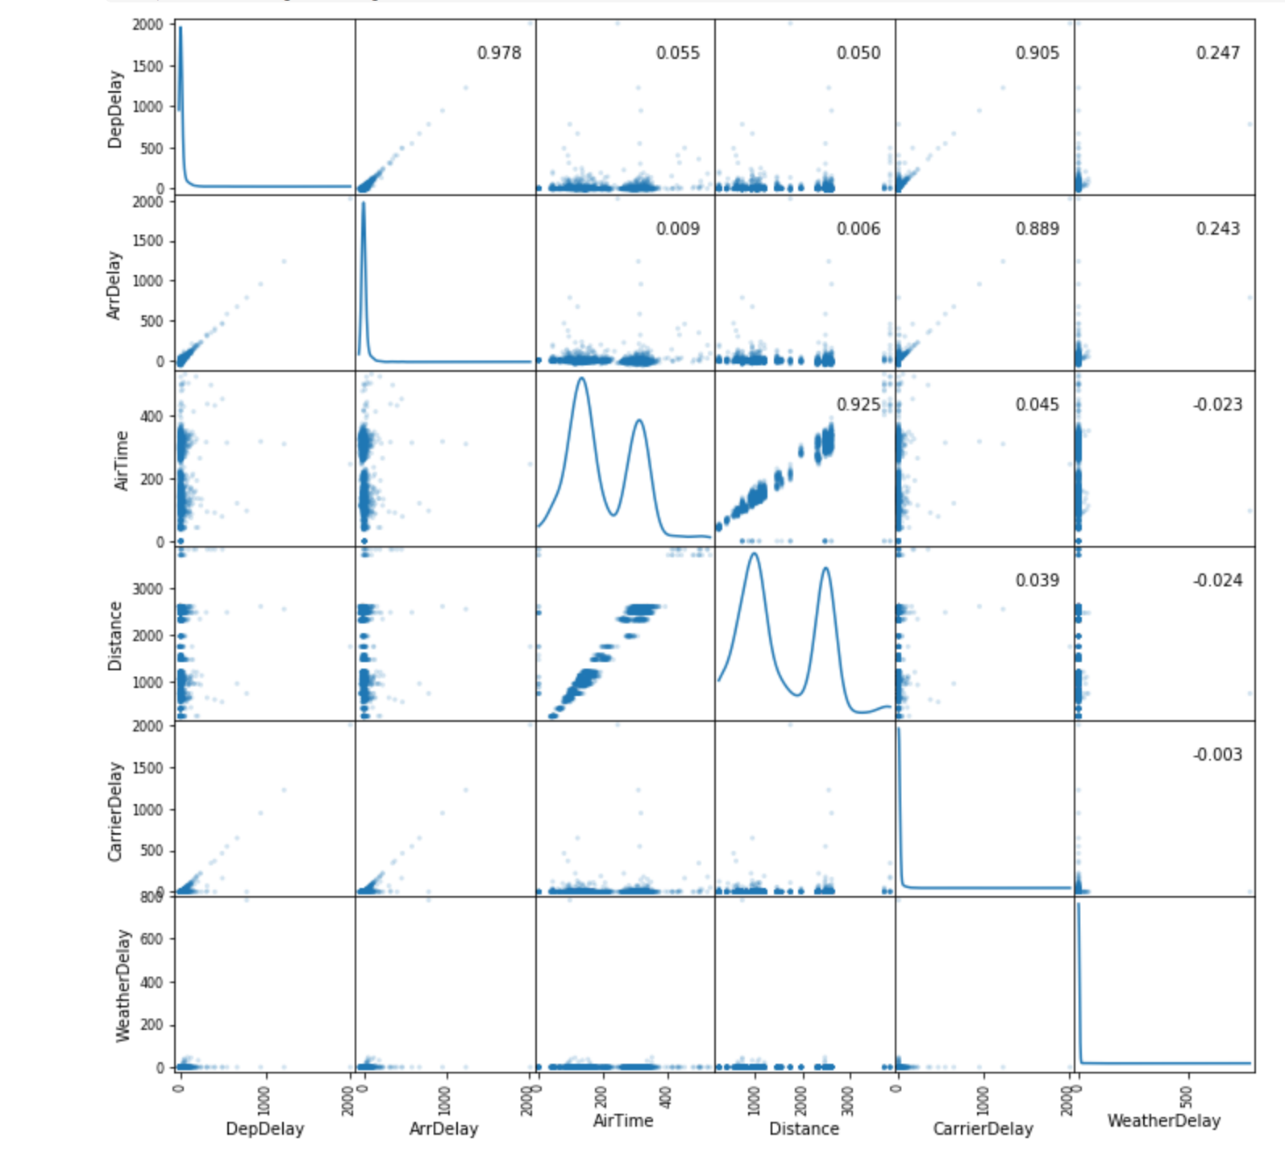
Scatter-Matrix

Slide 22
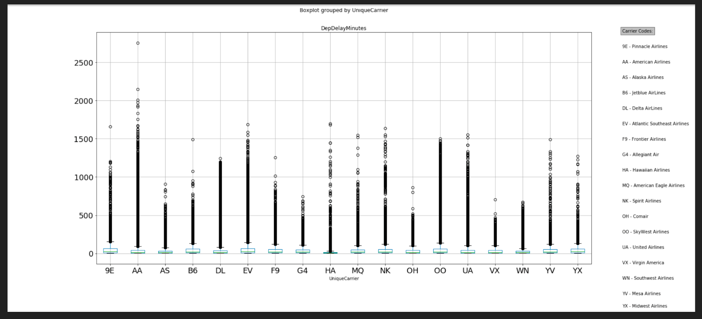
Box Plot – Carriers Vs Departure Delays

Slide 23

Data Limitations
We abstracted quarterly data by analyzing one month of data.
No reasons are given about cancellation and diversion of flights.
Provided data columns need to be abstracted, for example giving four attributes to describe date and time is excessive, for example they provided, year, month, day of month, day of weeks. It would have been better of using just one column, for example unix time.
The sheer amount of data forced us to select columns which we considered most important for our analysis.

Slide 24
Conclusions:
Departure Times: As the day progress, there seem to be an increase in departure times.
Departure Delay: Shorter departure delays for longer distance flights.
Arrival Delay: Arrival Delay correlate with departure delay, with exception of longer flight, which seems to catch up and still arrive on time. Other delays (Weather Delays, etc) seem to be uncorrelated within with general trend of delays.
MD, NV and TT are the 3 origin States/Territories that have the most number of delayed flights while MT and AK has the least delays.
Over all. there are 66 percent of flights that arrive on time.

Slide 25
Recommendations for Passengers:
Based on our analysis, we recommend to travel early in the day and after the 10th of the month.
July travels show more delays.
The probability of flights to arrive late is high for airports in the territories (PR and TT).
The probability of flights to depart late is high for DFW and Lovefield in Dallas, TX.

Slide 26

Happy Travels !!!

