Slide 1
How to lose friends and dominate FIFA – a data sciences approach
Randy Chan, Corey Kretzmer, Tom Matoushek, Matthew Warner

Slide 2
Motivation
Placeholder: Finding those players with top attributes to fill your roster does not require an extensive knowledge of the international player-base. Using a public database with updated attributes each season, it is possible to select out only top candidates to bring to your team, and crush your competition.

Slide 3
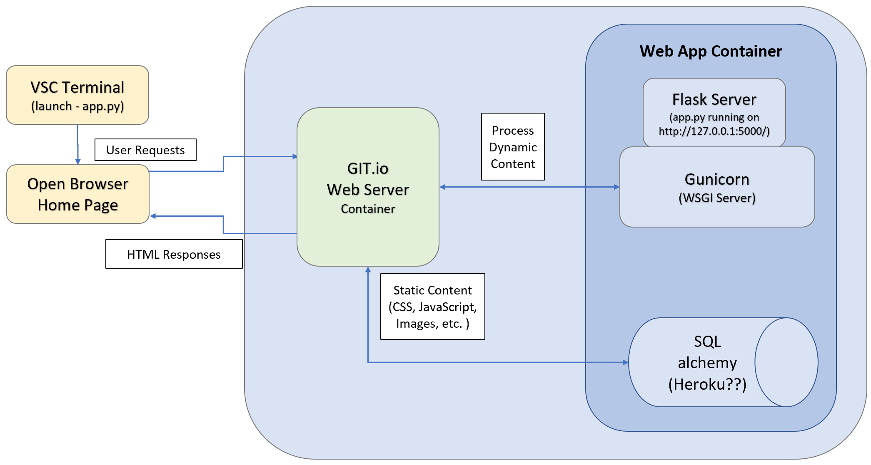
Data/App Architecture

Slide 4
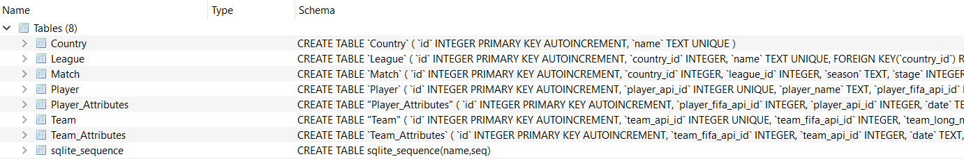
Data search and consolidation
Data was obtained from Kaggle as a SQL Database
Original database held extraneous data and duplicate records for individual players containing attributes for various seasons. For our purposes, we only needed the most recent season’s data covering player profiles and attributes.

Slide 5
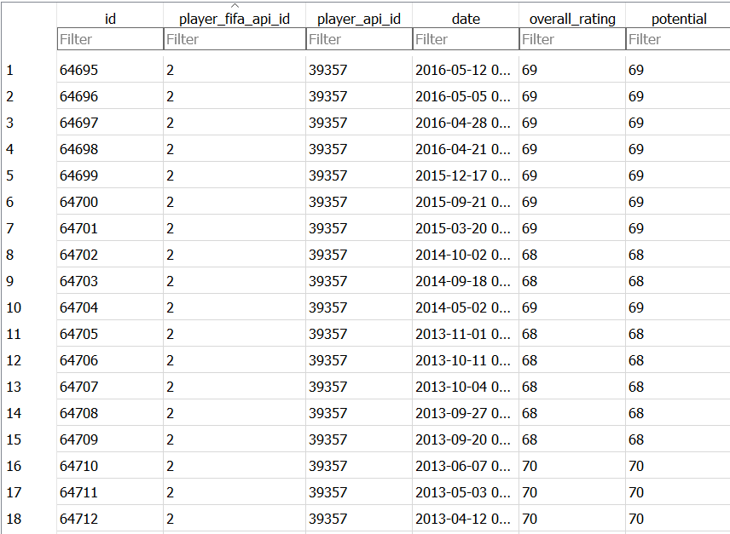
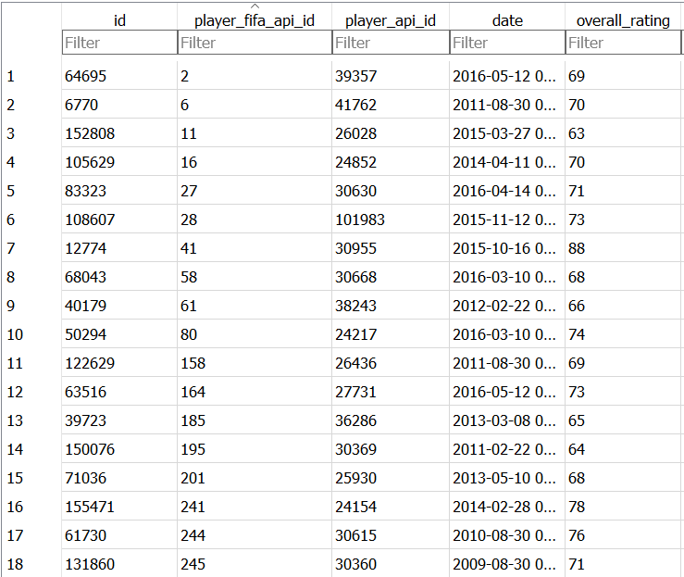
Dropped duplicate player IDs in SQL

Slide 6
Coding approach

Slide 7

Demo

