Slide 1
How to lose friends and dominate FIFA – a data sciences approach
Randy Chan, Corey Kretzmer Matthew Warner, Tom Matoushek

Slide 2
Motivation
Finding those players with top attributes to fill your roster does not require an extensive knowledge of the international player-base. Using a public database with updated attributes each season, it is possible to select out only top candidates to bring to your team, and crush your competition.

Slide 3
Data/App Architecture
Web App Container
Process Dynamic Content
Flask Server
(app.py running on http://127.0.0.1:5000/)
Github Repository
VSC Terminal
(launch - app.py)
Gunicorn
(WSGI Server)
Static Content (CSS, JavaScript, Images, etc.)
SQL Alchemy
User Request
Heroku
Open HTML Browser
Home Page
Database
HTML Response

Slide 4
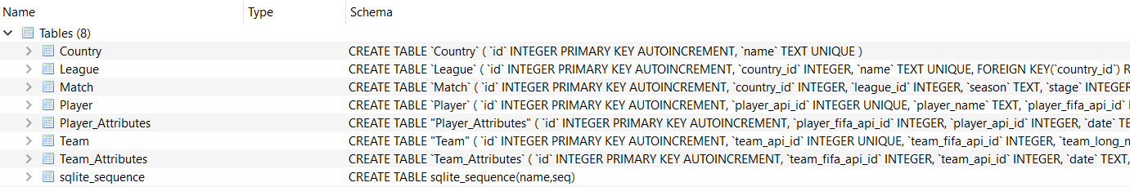
Data search and consolidation
Data was obtained from Kaggle as a SQLite Database
Original database held extraneous data and duplicate records for individual players containing attributes for various seasons. For our purposes, we only needed the most recent season’s data covering player profiles and attributes.

Slide 5
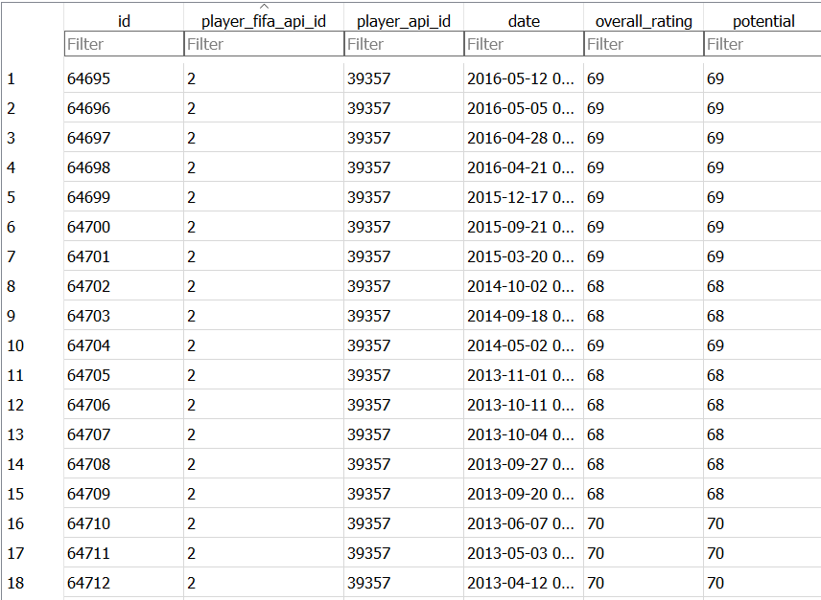
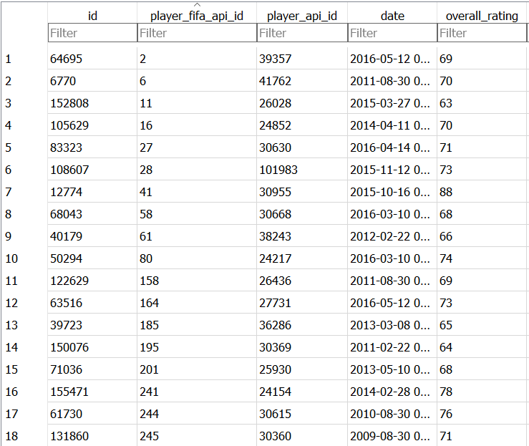
Dropping duplicates in SQL

Slide 6
Coding approach

Slide 7

Demo

