Slide 1

Using PPO for Stock Portfolio Return Maximization
Randy Chen
AE598 Final Project
Aerospace Engineering
Elevating ideas since 1944

Slide 2
Background
Hedge funds and financial corporates have heavily relied on quantitative trading
Quantitative trading algorithms help us make rational decisions based on data learned in the past
Four major components:
Strategy
Back testing
Execution
Risk management
Aerospace Engineering
Elevating ideas since 1944

Slide 3
Motivation
How can we apply existing RL algorithms to stock trading?
Stock market has a high dimensional continuous state space
Proximal policy gradient (PPO) should work!
Aerospace Engineering
Elevating ideas since 1944

Slide 4
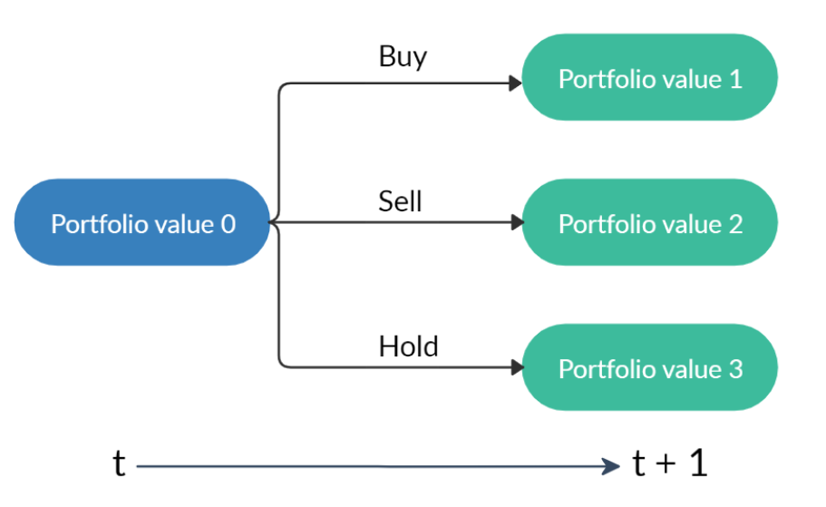

MDP Model for Stock Trading
State $s=[p, h, b]$, price, shares, remaining balance
Action $a$ = [buy, sell, hold]
Reward $r(s, a, s^{′})$
Policy $π(s)$
Q-value $Q_{π}(s,a)$
Aerospace Engineering
Elevating ideas since 1944

Slide 5

Constraints & Assumptions
Nonnegative balance $b_{t}≥0$ enforced at all time steps
Transaction cost $c_{t}$
Assume orders can be filled at the close price (stock market will not be affected by the RL agent)
Aerospace Engineering
Elevating ideas since 1944

Slide 6
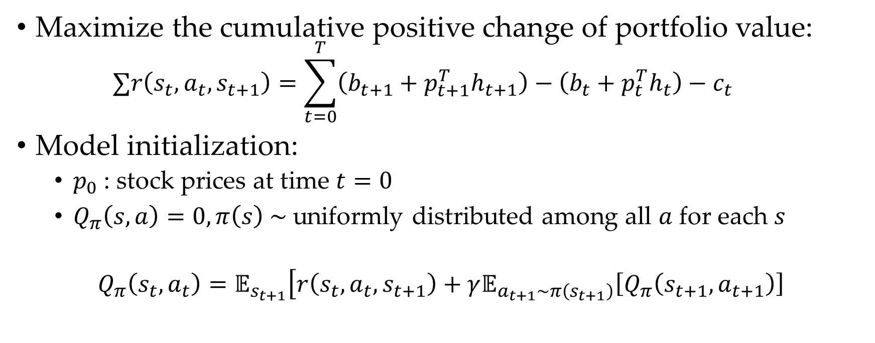
Trading Goals
Maximize the cumulative positive change of portfolio value:
$$∑r\left(s_{t},a_{t},s_{t+1}\right)=\sum_{t=0}^{T}{\left(b_{t+1}+p_{t+1}^{T}h_{t+1}\right)−\left(b_{t}+p_{t}^{T}h_{t}\right)−c_{t}}$$
Model initialization:
$p_{0}$ : stock prices at time $t=0$
$Q_{π}\left(s,a\right)=0, π\left(s\right) \sim$uniformly distributed among all $a$ for each $s$
$Q_{π}\left(s_{t},a_{t}\right)=𝔼_{s_{t+1}}\left[r\left(s_{t},a_{t},s_{t+1}\right)+γ𝔼_{a_{t+1}∼π\left(s_{t+1}\right)}\left[Q_{π}\left(s_{t+1},a_{t+1}\right)\right]\right.$
Aerospace Engineering
Elevating ideas since 1944

Slide 7
PPO Formulation
Aerospace Engineering
Elevating ideas since 1944

Slide 8
References
Aerospace Engineering
Elevating ideas since 1944

