Slide 1
Serialization for gam 150 CLUB
Randy Gaul

Slide 2
Who am I?
RTIS Sophomore – Randy Gaul
C game as Freshman
Tech director for Ancient Forest and Grumpy Monsters
Made engine in C during summer before Sophomore year
AsciiEngine – Implemented some features in this slideshow
Love architecture with clean and powerful APIs

Slide 3
Serialization - Overview
The problem
Primitives
Routines
Improvement
Generic serialization
Crazy happens

Slide 4
The Problem
So now we have game objects
However, we need to:
Save our game state
Close application
Reload previous save

Slide 5
The solution
Serialization
Translating data structures into a file format, to be later “resurrected” back into data structures.
Useful for:
Saving and loading
Level files
Archetypes

Slide 6
Primitives
Keep it simple
Write serialization routines for primitives
Serialize complex objects with primitive routines
Handling serialization in two layers like this:
Breaks problem down into simpler steps
Results in more intuitive implementation

Slide 7

Primitives
Serializing primitives:
SerializeFloat
SerializeInt
SerializeString

Slide 8
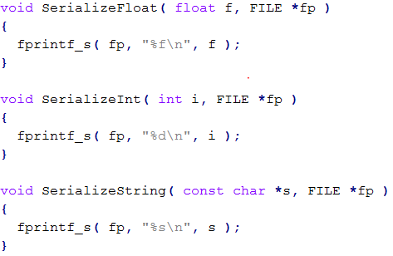
Primitives - Implementation

Slide 9
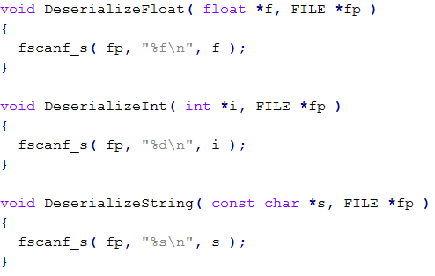
Primitives Deserialization
Deserialization is reading data to make something

Slide 10
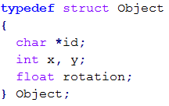
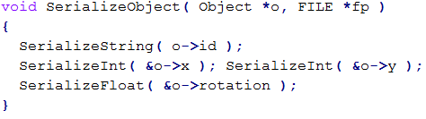
Routines by Primitives
Combine primitives to make something more complex

Slide 11
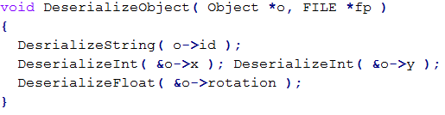
Routines by Primitives
Deserialization of Object

Slide 12

Serialization
Output file:
Magic numbers
Lets clean this up
We want our file to be prettier
Easier to modify and read by hand

Slide 13
Questions?

Slide 14
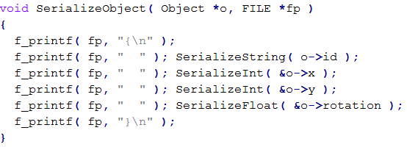
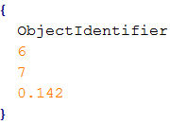
Serialization - Prettify
Slightly prettier output:

Slide 15
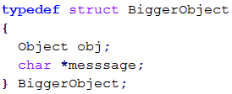
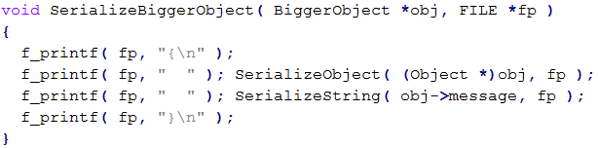
Serialization - Prettify
A little better, but what about:

Slide 16
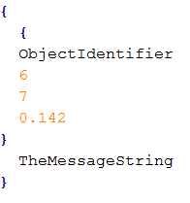
Serialization - Prettify
We now have a problem with our “prettiness”
Our serialization is not modular

Slide 17
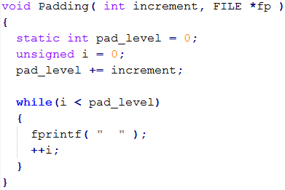
Serialization - Prettify
A working “prettiness” method
Able to adjust padding height as we go along

Slide 18
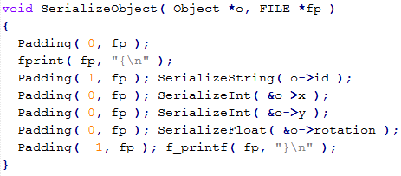
Serialization - Prettify
New routine for object:
Control pad height during routine
Only care about how much we increment

Slide 19
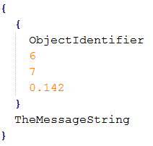
Serialization - Prettify
Fixed output for BiggerObject
Assuming we used padding in BiggerObject too

Slide 20
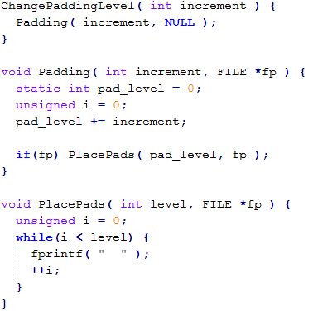
Serialization – Cleanup API
Lets cleanup all these padding calls
Rewrite our pad function

Slide 21
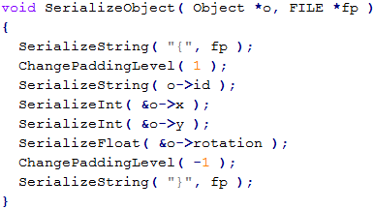
Serialization – Cleanup API
Cleaner version of SerializeObject
Use new pad functions
Call Padding( 0, fp ) in primitives

Slide 22
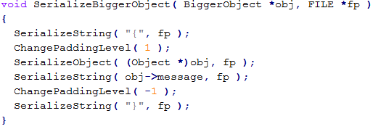
Serialization – Cleanup API
Cleaner version of serializing BiggerObject
Redundancy:
We always call:
SerializeString( “{“ ) and increment pads by 1
Same with closing bracket and -1

Slide 23
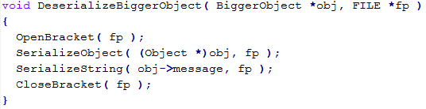
Serialization – Cleanup API
Even cleaner version:
Open bracket:
Increment pad level, place pads
Close bracket:
Decrement pad level, place pads

Slide 24
Serialization – Cleanup API
One problem:
Our prettification from left to right introduced brackets
Deserialization does not expect brackets!

Slide 25
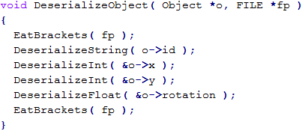
Serialization – Cleanup API
Compensate with “eat bracket” function
EatBrackets:
Use fgetc until you find ‘{‘ or ‘}’, then eat newline
Or use scanf power – mentioned in later slide

Slide 26

Serialization
Final “prettified output” of BiggerObject
Quite nice! Still room to improve:
Name of object?
Name of each data member?

Slide 27
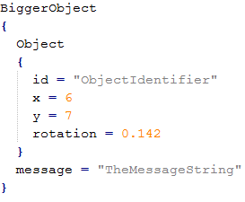
Generic Serialization
Lets see if we can make this jump
Things are going to get crazy.
Lets automate serialization so we write only a single routine for all structs!

Slide 28
Questions?

Slide 29
Generic Serialization
scanf is mighty: link
%*[flags] [width] [.precision] specifier
[]
Scanset; Reads chars as string until char is found that is not listed between []
[^ ]
Negation scanset; same as above, but reads all except for chars between ^]
*
Negation; read specifier and do not assign (skip text)

Slide 30

Generic Serialization
Given a text file, read the float 5.50:
fscanf( fp, “%*[^=]= %f”, &var );
Read in a string until = if found, do not assign this string
Read in equal sign
Read in a float and assign to &var

Slide 31
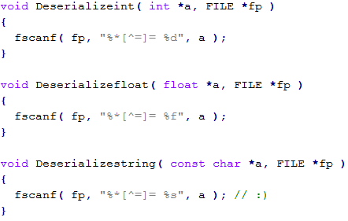
Generic Serialization
Some new primitives
Skip over text until = sign found, read in data

Slide 32
Generic Serialization
Okay prettification done
Lets automate our serialization routine
Write single routine for all structs
But how?
Macros

Slide 33
A New Way of Thinking
Tools at our disposal:
Parameterized macro
Stringize
Token pasting
Undef
Include protection
#pragma once

Slide 34
A New Way of Thinking
Overall idea
Create data file that fills out some macros
Define those macros
Include data file
Macros expand
Undef macros
Define new macros
Inlcude data file
Macros expand to something else

Slide 35
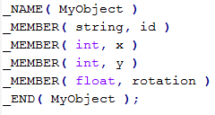
A New Way of Thinking
Data file
MyObjectData.h
Holds inputs to yet to be defined macros

Slide 36
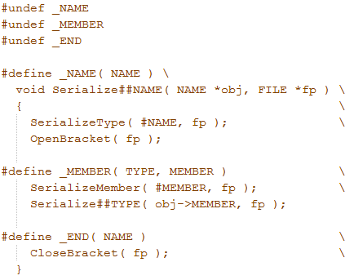
A New Way of Thinking
Defines

Slide 37
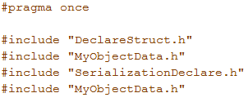
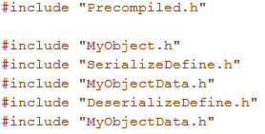
A New Way of Thinking
The new MyObject.h
MyObject.c

Slide 38
A New Way of Thinking
We’re importing data from MyObjectData
Macros expand to interpret the data:
Header file for MyObject
C file for MyObject
Serialization/Deserialization routine for MyObject
We only wrote one data file
We generated 3 files from 1
Updates to data file automatically propagate to all macro expansions

Slide 39
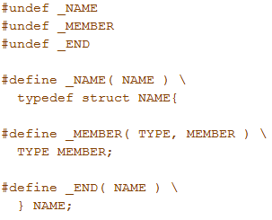
A New Way of Thinking
Lest step through it
Data file --------------→
Macros:

Slide 40
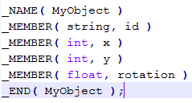
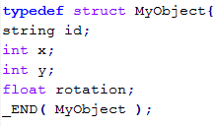
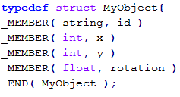
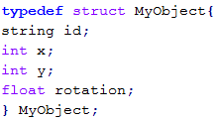
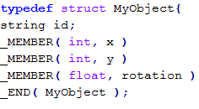
A New Way of Thinking

Slide 41
Generic Serialization
Summary:
Three files
Data
Header
C
We get:
Free serialization routines
Automatically updated when data file changes
Sample code for proof of concept: link

Slide 42
Generic… Other things?
Other things can be generalized:
Scripting language integration
Best thing ever
Factories
Generic “Variable” type
Property grid generation
More?
Serialization is enough for now

Slide 43
Final Tips
Cannot pass pointer type to macro
typedef
typedef char * string
Pass string as type to macro
Ask Doug Schilling for advice! He’s awesome
Keep things as simple as you can
Ask upper classmen questions
Email me: r.gaul@digipen.edu

Slide 44
Resources:
https://github.com/RandyGaul/Serialization_C
http://www.randygaul.net/2013/02/07/fscanf-power/
http://www.randygaul.net/2012/08/10/generic-programming-in-c/

Slide 45
Questions
Anybody have ‘em?

