Slide 1
Game object design in c for gam 150 CLUB
Randy Gaul

Slide 2
Who am I?
RTIS Sophomore – Randy Gaul
C game as Freshman
Tech director for Ancient Forest and Grumpy Monsters
Made engine in C during summer before Sophomore year
AsciiEngine
Love architecture with clean and powerful APIs

Slide 3
Engine Overview
How do you
organize all code?
What goes where?
Clear outline of what you want saves time

Slide 4
Engine Overview
Engine can be viewed as these two points:
Collection of game objects
Background
Player
Floor tiles
Enemy
Operations to perform on game objects
Create
Draw
Update
Destroy

Slide 5
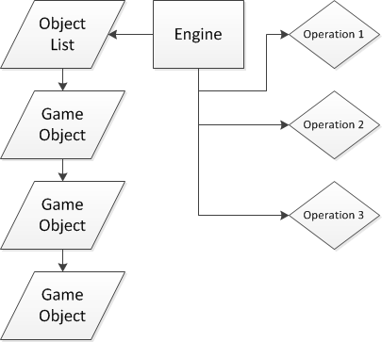
Engine Overview

Slide 6
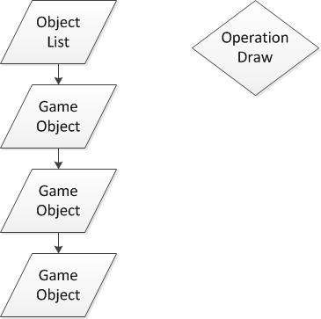
Engine Overview
Operation performs a task on a collection of objects

Slide 7
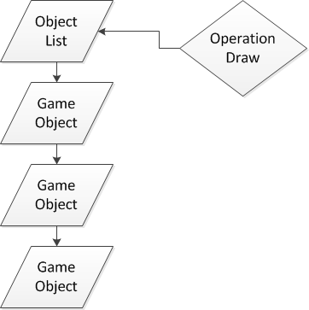
Engine Overview
Operation performs a task on a collection of objects

Slide 8
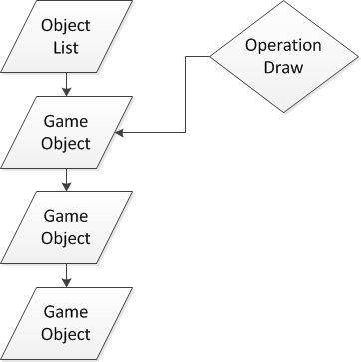
Engine Overview
Operation performs a task on a collection of objects

Slide 9
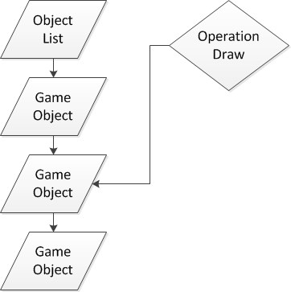
Engine Overview
Operation performs a task on a collection of objects

Slide 10
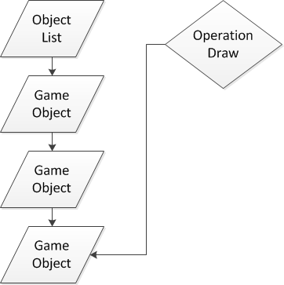
Engine Overview
Operation performs a task on a collection of objects

Slide 11
Engine Overview
Operation performs a task on a collection of objects

Slide 12
Engine Overview
How do you make a list of game objects?
Use a linked list
Brief description of a linked list:
Mechanism to store a bunch of nodes
Nodes hold data, like a pointer
Each node has a next pointer, which points to the next node in the list
The last node’s next pointer is NULL
See the Containers notes online!
Email me questions, don’t be shy

Slide 13
Questions?
Someone has to ask a question before I move on
Okay! Now I pick a random person that looks shy...

Slide 14
Game Objects in C
What is a game object?
A chunk of memory in your program
Organized as a C structure
What does a game object do?
Holds some data
Object ID
Player, enemy type, tile type
Data members
HP, pointer to image, size, anything
Functions
How to operate on the data members

Slide 15

Game Objects in C
A single game object structure
Vastly simplifies code
No longer need functions for specific object types

Slide 16
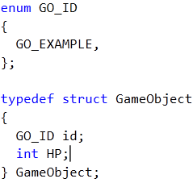
Game Objects in C
How to distinguish one object type from another?
Enum for object IDs
Run switch statement on ID

Slide 17
Game Objects in C
Any problems here?

Slide 18
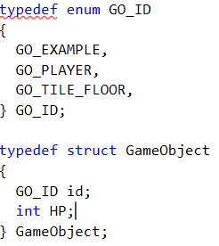
Game Objects in C
Any problems here?
How about now?

Slide 19
Game Objects in C
Any problems here?
How about now?
Every type of object we create now has HP
Does it make sense for a tile to have HP?

Slide 20
Game Objects in C
We need different types to hold different data
I recommend inheritance
Simple and effective for GAM 150
Other options do exist
Too advanced in ways you don’t want or need
Just use inheritance
Great for learning, I recommend doing inheritance at least once
Other methods don’t make much sense in C

Slide 21
Game Objects in C - Inheritance
Inheritance: is a way of placing one type of object completely inside of another.
Not actual definition
Data specific to ID type not in GameObject struct
Placed in an inherited structure

Slide 22
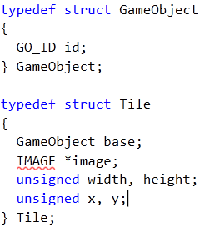
Game Objects in C - Inheritance
Here’s our game object structure

Slide 23
Game Objects in C - Inheritance
Here’s our game object structure
Here’s our Tile structure
Tile is a type of game object
Can have any number of types

Slide 24
Game Objects in C - Inheritance
GameObject struct is within the Tile struct
GameObject is base
Tile inherited from GameObject
Place data you want every object to have in the GameObject struct definition

Slide 25
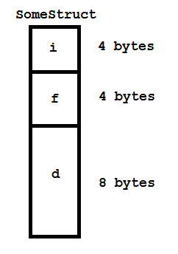
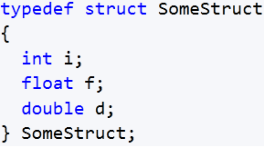
Game Objects in C - Inheritance
Why would you place a struct inside a struct?
Here’s a structure and memory diagram:

Slide 26
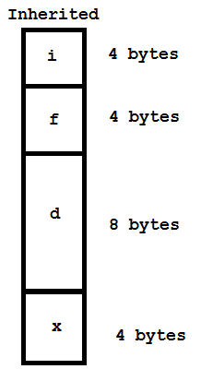
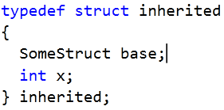
Game Objects in C - Inheritance
Now take a look at a struct with inheritance

Slide 27
Game Objects in C - Inheritance
The top portion of inherited is the base
Can treat inherited memory as base
Can typecast inherited
pointer to base pointer
Generalized code
Function takes a base
pointer, can pass an
inherited pointer casted
to base type

Slide 28
Questions?
Someone must ask a question!
Time to choose another person…

Slide 29
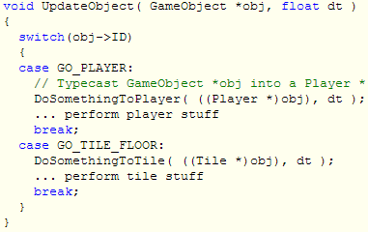
Game Objects in C - Inheritance
Now we can write some code!
Must typecast GameObject struct to appropriate type

Slide 30
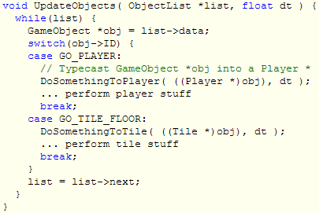
Game Objects in C - Inheritance
Linked list version

Slide 31
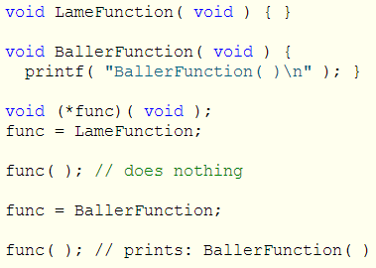
Function Pointers
A function pointer is just a pointer to a function
Can use the call operator ( ) on a function pointer

Slide 32
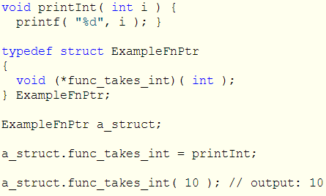
Function Pointers and Structs
Can place a function pointer into a struct
And into a game object!

Slide 33
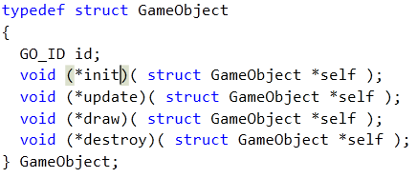
Function Pointers and Structs
Here’s a new version of a game object
Each object can be initialized, destroyed, updated and drawn
Must pass pointer of object to each function

Slide 34
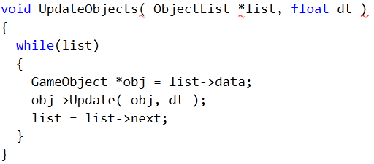
Function Pointers and Structs
Work with unknown object types:

Slide 35
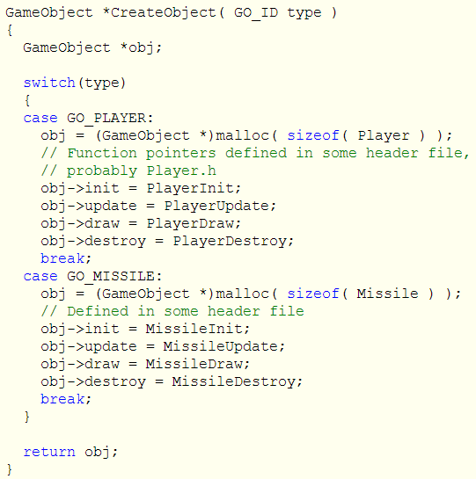
Object Creation

Slide 36
Questions?

Slide 37
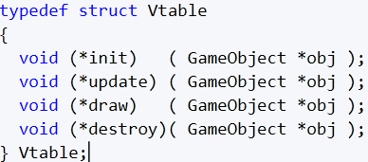
Function Pointers and Structs
Whew! Lots of function pointer code
Clean up function pointer assignment
Virtual table
An array or struct of function pointers

Slide 38
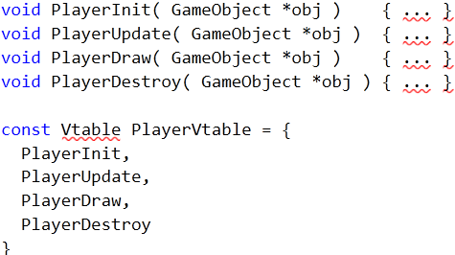
Function Pointers and Structs
Single global virtual table for unique object type

Slide 39
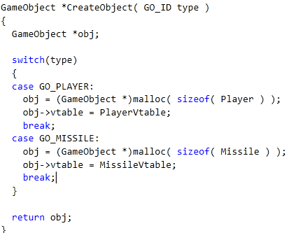
Object Creation with Vtables
What we’ve created here is called a “Factory”

Slide 40

Vtable usage
Calling a function through a vtable

Slide 41
Vtable usage
Vtable helpful for:
Cleans up assignment of function pointers
Provides single interface
Efficient memory usage
Can also have separate vtable in inherited object
Specialized functions specific to ID type
Can swap vtables at run-time
Object behavior swap == function pointer swap!

Slide 42
Object Creation - Factory
Factory should
Create objects, two recommended ways
Malloc – probably best (I used this)
Insert into Array of pre-allocated objects
Initialize vtable/func pointers
Place object into a container
Linked list?
Global list of all objects?
Maybe more than one list
Which one does each type go to?
Array?
CS230 assignments used an array of 1024 objects
Delete objects
More on this later

Slide 43
Object Destruction
Factory handles this
Don’t just free an object during logic update
Free object, then try to access it a moment later?
Set boolean to false in game object
This is called Delayed Destruction
Destroy in vtable should do:
Deallocate any resources the initialize func allocated
Reset settings, decrement counters, etc.
Set “dead” bool true
Factory should have cleanup function
Walk list of objects, free “dead” ones found

Slide 44
Questions
Anybody?

Slide 45

Vtable Array
Take vtable out of game object
Create an array of vtables
Use object ID to index into this array

Slide 46

Vtable Array
This is what the Vtable array looks like in header:
Just array of vtables:

Slide 47
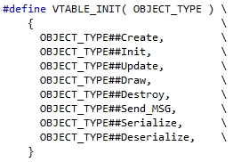
Vtable Array
VTABLE_INIT( NAME ) macro:

Slide 48
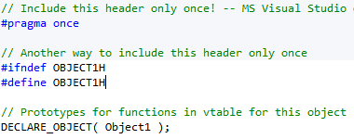

Vtable Array
Where do the function pointers come from?

Slide 49
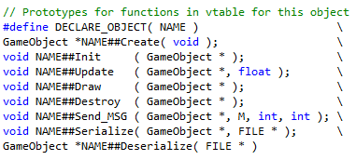
Vtable Array
DECLARE_OBJECT( TYPE ) macro
Just prototypes functions
Goes in object’s header
Object1.h; BlueEnemey.h

Slide 50

Vtable Array
Extremely fast function lookup
Very simple code
Powerful code!

Slide 51
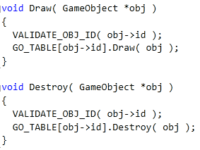
Vtable Array
More examples
Use object ID for function pointer lookup

Slide 52

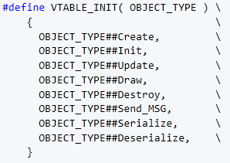

Vtable Array
One last look at constructing the array of vtables

Slide 53

Final Tips
Ask Doug Schilling for advice! He’s awesome
You’ll be typecasting from GameObject * to RandomType * a lot, maybe use a macro!
Study about linked lists
Keep things as simple as you can
Over-complexity is a sign of bad design
Ask upper classmen questions
Look at my sample code online

Slide 54
Resources:
Object Oriented C
My blog post: here
Crazy online book: here
Allen Chou’s blog: here
Sean Middleditch’s blog: here
Part two
Virtual Table in C
Generic Programming in C – macro stuff

Slide 55
Any questions?
Was any of this confusing? Ask!

