Slide 1
MESSAGING IN C for gam 150 CLUB
Randy Gaul

Slide 2
Who am I?
RTIS Sophomore – Randy Gaul
C game as Freshman
Tech director for Ancient Forest and Grumpy Monsters
Made engine in C during summer before Sophomore year
AsciiEngine
Love architecture with clean and powerful APIs

Slide 3
Lecture overview
Review Game Object Design
The problem
The solution: Messaging
Messaging Implementation in C
Questions?

Slide 4
Read the Game Object Design ppt
It should be up on Moodle in the GAM 150 Club
If not just email me, I’ll send it to you
r.gaul@digipen.edu
Next few slides are refresher

Slide 5
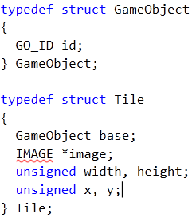
Inheritance in C - Refresher
Here’s our game object structure
Here’s our Tile structure
Tile is a type of game object
Can have any number of types

Slide 6
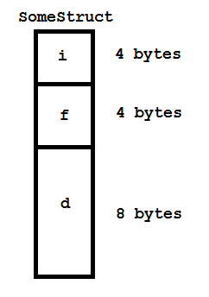
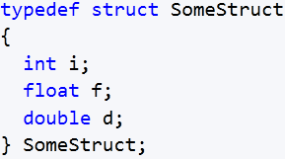
Inheritance in C - Refresher
Why would you place a struct inside a struct?
Here’s a structure and memory diagram:

Slide 7
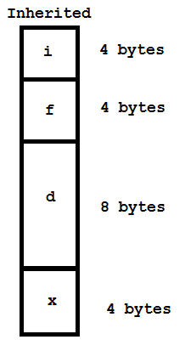
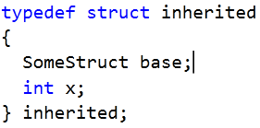
Game Objects in C - Inheritance
Now take a look at a struct with inheritance

Slide 8
Inheritance in C - Refresher
The top portion of inherited is the base
Can treat inherited memory as base
Can typecast inherited
pointer to base pointer
Generalized code
Function takes a base
pointer, can pass an
inherited pointer casted
to base type

Slide 9
The Problem
Imagine you’ve been using inheritance…
Made different kinds of objects
Each object type has a header
Player.h
Enemy1.h
Tile.h
Realize it’s really annoying to…
Typecast base to inherited
Include file to call function
Why is this annoying? Good question…

Slide 10

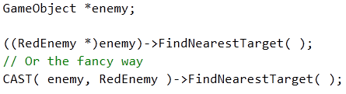

The Problem – Why it’s annoying
Lets assume we make a new object
Here’s the header:
Now lets call a RedEnemy func from base:
Cast macro:

Slide 11
The Problem – Why it’s annoying
In order to call function:
You must include file
RedEnemy.h

Slide 12
The Problem – Why it’s annoying
Imagine many objects interacting
Deal damage to one another
Run into each other
Follow patterns
Pathfinding

Slide 13
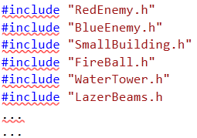
The Problem – Why it’s annoying
Imagine many objects interacting
Deal damage to one another
Run into each other
Follow patterns
Pathfinding

Slide 14
The Problem – Why it’s annoying
Things will get hectic
What file do I need for this?
3 minutes searching
What do I typecast to again?
Another 2 minutes
Minutes add up!
Don’t waste your minutes
You want to spend time making things
Searching is distracting
Productivity down the drain

Slide 15
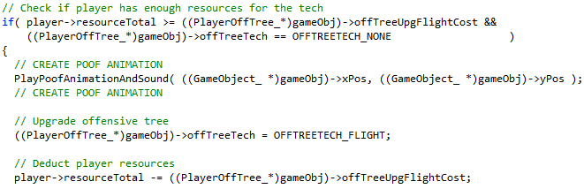
The Problem – Why it’s annoying
Horrible ugly typecasting code
Excerpt from my GAM 150 game:

Slide 16
The Solution
Needs:
Call function on inherited
No hectic searching
Minimal file inclusion
Avoid typecasting GameObject *

Slide 17
The Solution - Messaging
Send information from one place to another
Done with a special function call

Slide 18
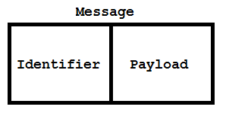
The Solution - Messaging
Diagram of a message

Slide 19
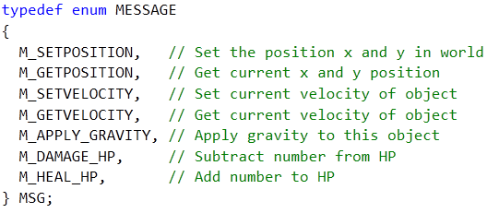
Messaging
Message identification
Enumeration – in a header file!
Document each message well!

Slide 20
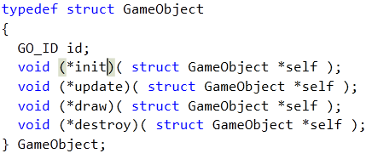
Messaging
Send message to GameObject
Here’s the old object struct

Slide 21
Messaging
Send message to GameObject
Here’s the new object struct

Slide 22
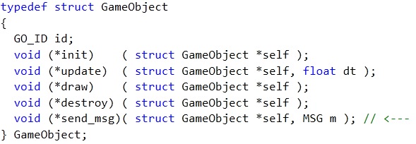
Messaging
Send message to GameObject
Here’s the new object struct

Slide 23
Messaging
Send message to GameObject
Here’s the new object struct
Just a function call in GameObject base

Slide 24

Messaging
Sending a message to an object

Slide 25
Messaging
Sending a message to an object
Compared to:
#include “file.h”
Typecasting
Searching for the two above!!!
Bad…

Slide 26
Messaging
SendMSG function
What is inside?

Slide 27
Messaging
SendMSG function
Switch statement
Aka message procedure (proc for short)

Slide 28
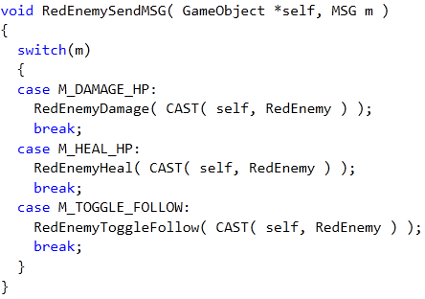
Messaging
SendMSG function
Switch statement
Aka message procedure (proc for short)
Typecast from base to derived here

Slide 29
Messaging
Awesome! We can:
Call functions on inherited
Avoid file inclusion
Minimal typecasting
But wait
Maybe we need to pass parameters
SetVelocity?
Need x and y
How can this be done?
Various types?

Slide 30
Messaging
I recommend:
Two general purpose parameters
Integers
Integers are 4 bytes
Pointer is 4 bytes
Integer can be cast to any pointer
2 ints = 8 bytes of data to pass
More than 2 integers
Unnecessary
Starts getting hectic
Pass pointer to struct instead

Slide 31
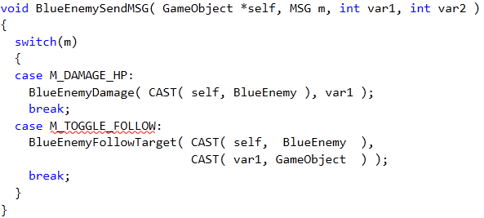
Messaging
Two general purpose ints

Slide 32


Messaging
Sending a message to an object
This time with general purpose parameters
Just pass in zero if second param unused
Send address though message:

Slide 33


Final Tips
Passing float through int params
Cannot just assign to int
Cast to pointer to float instead
#define UNUSED 0

Slide 34
Final Tips
Ask Doug Schilling for advice! He’s awesome
Keep things as simple as you can
Over-complexity is a sign of bad design
Are our messages simple?
Function call
Enum ID
Switch statement on ID
Two ints
Typecast integers if needed
Probably most complex
Ask upper classmen questions
Email me: r.gaul@digipen.edu
Document each message well!

Slide 35
Resources:
Google wndproc
Or Windows Prodecure
Windows programming same type of messaging
You’ll be doing this Sophomore year
We wrote our own windowing code in 150
CS230 covered basic windows programming
Refer to Game Object Design ppt
Game Programming Gems 4: A System for Managing Game Entities
AsciiEngine (link front page)
Implemented this exact type of messaging
Sample engine on Moodle

Slide 36
Questions
Anybody have ‘em?

