Slide 1
Simple physics (mostly) platformers for gam 150 CLUB
Randy Gaul

Slide 2
Who am I?
RTIS Sophomore – Randy Gaul
C game as Freshman
Tech director for Ancient Forest and Grumpy Monsters
Made engine in C during summer before Sophomore year
AsciiEngine – Implemented some features in this slideshow
Love architecture with clean and powerful APIs

Slide 3
I will describe
AABB collision
Integration
Jumping
Collision resolution
Slopes
One way platforms
Ladders
Moving platforms

Slide 4
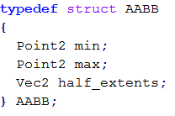
AABB Collision
AABB – Axis aligned bounding box
Bounding box – a box that bounds another shape
In our case, you’re just using boxes, not bounds
Technically AAB
Store AABB the smart way (extents optional):

Slide 5
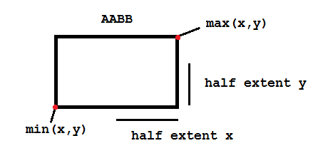
AABB Collision

Slide 6
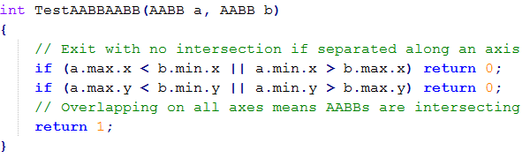
AABB Collision
Here’s the code
If you want to know more:
Look up AABB collision detection
Look up SAT – separating axis test

Slide 7
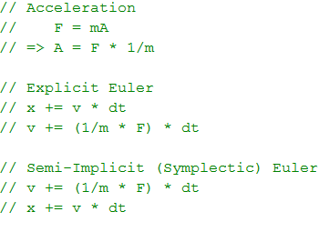
Integration
Euler integration!
Use symplectic, not explicit

Slide 8
Integration
Considerations:
Instead of (1/mass * force)
Can just use an acceleration vector
What is force?
Mass * acceleration
Gravity!
Wind
Simulating forces
Have a “accumulator” vector
Add a bunch of other forces with accumulator
Integrate with accumulator
Clear accumulator after integration and repeat

Slide 9
Questions?

Slide 10
Jumping
Just apply impulse to velocity
Add a vector to velocity
Vec2( 0. 5.0 )
How big of impulse to apply?
Guess and check
Use equation to solve for exact height
Useful to jump or throw objects exact tile heights

Slide 11
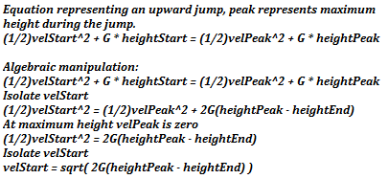

Jumping

Slide 12
Collision Resolution
Don’t actually let things collide
Collision avoidance!
The plan:
Integrate x one step forward (x before y!)
Run AABB to AABB
Find closest object collided with
AABB vs AABB from previous slide
Move object tangent to closest collidee
Move object so that it’s touching what it collided with
Zero velocity on x axis
Repeat for y

Slide 13
Collision Resolution
Previous algorithm properties:
Pros
Boxes easily stack
Easy detecting direction of impact
Objects shouldn’t intersect
Easy to implement and debug
Extremely fast
Cons
Objects cannot push other objects without special code
No “bouncing” off of things without special code

Slide 14
Collision Resolution – A Problem
If you store positions with integers you’re fine
For floating point positions:
Placing an object tangent to another:
Involves a subtraction
Introduces floating point error
Possible to still be “colliding” after resolve
Solution:
Allow a fudge factor for overlap

Slide 15

Collision Resolution – Detection Fudge
Only return a collision of the overlap is smaller than some very small constant
Try 0.001f for EPSILON, and lower until unstable

Slide 16
Friction
Want to slow down when we hit something
On x integration
Multiply y velocity by a constant less than one
Try: 0.05, 0.1, 0.5
On y integration
Multiply x velocity by a constant less than one
Try: 0.05, 0.1, 0.5
Can grab constants from objects
Each object can store a friction float

Slide 17
Slopes
Two main methods:
Integer array for heights
Linear interpolation
I will describe both

Slide 18
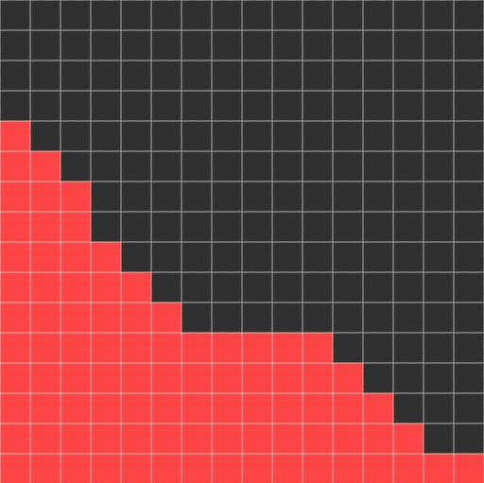
Slopes – Integer Array
Each sloped tile contains array of heights
Heights
12, 11, 10, 8, 7, 6, 5, 5, 5, 5, 5, 4, 3, 2, 1, 1
Y1 - 12
Y2- 1

Slide 19
Slopes – Integer Array
If collision in tile
Resolve y position to index in array
Set object’s y position to y index only if y position is lower
Want to be able to jump and land on slopes
Use x position (center of object) to index into height array
Considerations
What if you run into higher side first?
Can make special case – collide like solid box
Can setup tiles so this cannot happen

Slide 20
Slopes – Integer Array
Slopes affect velocity?
Store arbitrary angle to approximate slope
velx += cos(angle) * A * dt
vely += -sin(angle) * A * dt
Keep track of the “real” velocity
Apply the modified vel if collided with tile
Collide if:
Y less than height index
X extents overlap tile’s x extents

Slide 21
Slopes – Integer Array
Pros
Support arbitrary heights at each index
Very fast
Fairly simple to implement
Cons
Takes up a little more memory
Can be tedious to hand-craft each tile

Slide 22
Questions?

Slide 23
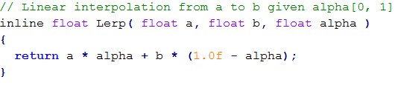
Slopes – Linear Interpolation
Calculate y heights from interpolation
alpha = object_x – tile_x / tile_width
a = left starting point of line (12 from slide 14)
b = right endpoint of line (1 from slide 14)

Slide 24
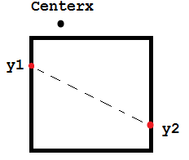
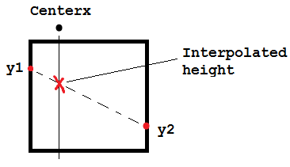
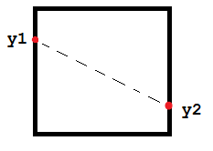
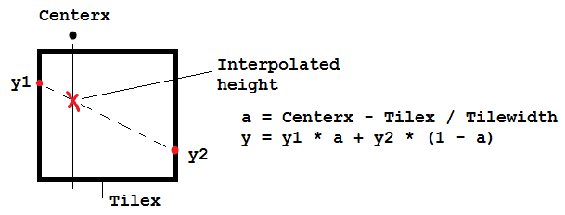
Slopes – Linear Interpolation

Slide 25
Slopes – Linear Interpolation
Pros
Supports arbitrary slopes
Still very fast
Less memory per tile
Easier to create new tiles (less information to create)
Just set y1 and y2
Cons
Single slope per tile
A bit harder to implement than integer array
Note:
Only set object’s y to interpolated h only if y is less than h
We want to able to jump and land on slopes

Slide 26
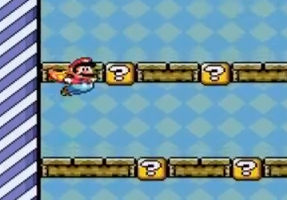
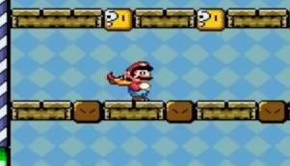
One Way Platforms

Slide 27
One Way Platforms
Special cases!
Write some code to handle AABB vs moving platform in a special way
Don’t collide x axis step
Collide y only if previously entirely above platform
Very simple
A simpler method that doesn’t work
Collide only if falling
You can start falling mid-jump
This results in unintended behavior

Slide 28
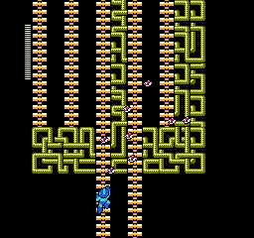
Ladders

Slide 29
Ladders
Will need two different states
Normal
On ladder
Separating states make code simpler
On ladder state:
No gravity
No left or right integration
Only move up/down
Very simple
Most code will be for exit/enter ladder state

Slide 30
Ladders
Leave and exit ladder state
To enter:
Design dependent
AABB vs AABB player to ladder TRUE && player hit UP key
Stand on top and hit down
Clamp player’s x to ladder’s x
To exit suggestions:
Player hits jump button
Player_y outside bounds of ladder y extents
Additional consideration:
Run one-way platform code
Allow to walk on top of ladders

Slide 31
Moving Platforms
Can stand on platform
Player’s and monster move when platform does
Have each platform store linked list of objects
When object collide on platform
Insert itself into platform’s list
On integrate platform, integrate objects in list too
When object leave platform
Remove self from platform’s linked list
For fast removal use: doubly linked list
Lecture and example code on moodle

Slide 32
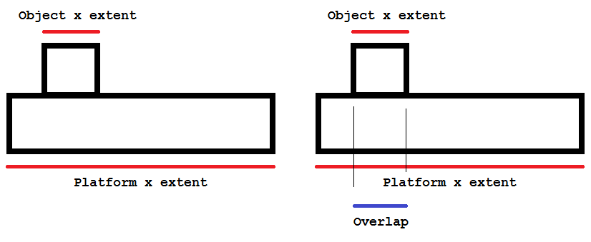
Moving Platforms - Leaving
Object’s y position changes upward
Jumps up, for example – detect this!
Object’s x extents do not overlap platform’s x extents
A picture:

Slide 33
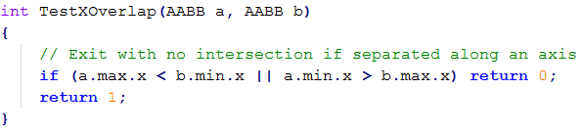
Moving Platforms - Leaving
Calculate overlap for each object in platform list
If found non-intersecting
Remove from platform’s list

Slide 34
Moving Platforms – A Problem!
What if platform moves into an object?
Want object to be “pushed”
No way to model this
Solution:
Update platforms after all other objects
All objects move about the game
Some collide into platform and register in the list
Then platform moves
Integrates it’s list of objects
Impossible for platform to run into anything

Slide 35
Final Tips
Ask Doug Schilling for advice! He’s awesome
Keep things as simple as you can
Ask upper classmen questions
Email me: r.gaul@digipen.edu

Slide 36
Resources:
http://higherorderfun.com/blog/2012/05/20/the-guide-to-implementing-2d-platformers/
http://info.sonicretro.org/Sonic_Physics_Guide
AsciiEngine (link front page)
Implemented this exact type of messaging
Sample engine on Moodle

Slide 37
Questions
Anybody have ‘em?

