Slide 1
Pointers, structures, the c macro and Containers for gam 150 CLUB
Randy Gaul

Slide 2
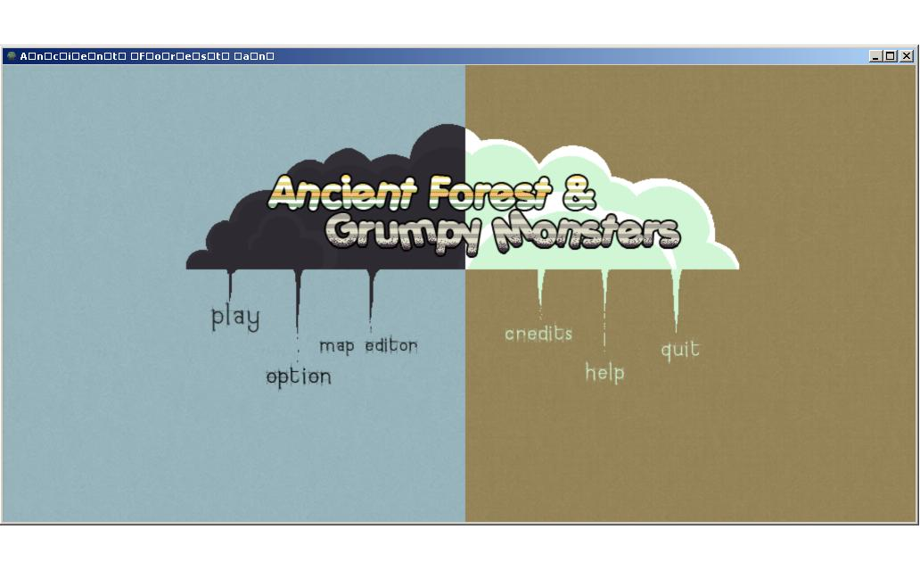
Who am I?
RTIS Sophomore – Randy Gaul
C game as Freshman
Tech director for Ancient Forest and Grumpy Monsters

Slide 3
Who am I?
Made engine in C during summer before Sophomore year
AsciiEngine
Love architecture with clean and powerful APIs

Slide 4
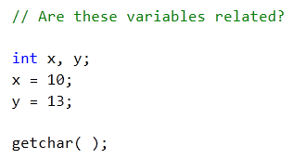
Structures
What is a struct?
Holds some data packed together in memory
Why use structures?
Prevent loose variables

Slide 5
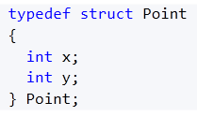
Structures
2D vector or point with struct
Use typedef
Packed in memory together
Can reference multiple variables as single unit

Slide 6
Structures
Imagine function like so:
Pass two float pointers?
Unclear how params x and y relate

Slide 7
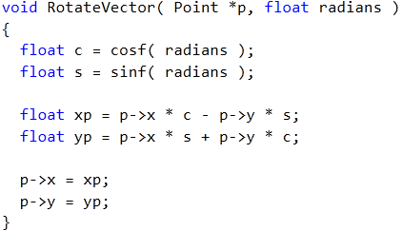
Structures
Variables need clear meaning
Structures specify relationship

Slide 8
Structures
Things that should be structures:
GameObject
ID, function pointers
Images
Pointer to image, width, height
Point2D or Vector2D
X and Y components
Passing pointer to struct is very fast
Passing many variables instead
Very slow
Hard to read code
Sloppy

Slide 9
Pointers and Structs
You should all be familiar with pointers
Arrays
Pointer arithmetic
Arrays and pointers
Looping
Implicit array decay to pointer
How to use pointer to struct
I won’t cover these topics in this lecture
If you need some help with the above just email me

Slide 10

Pointers and Structs
Imagine you need to store a level
First thing you’ll probably think of
This works, better alternatives

Slide 11
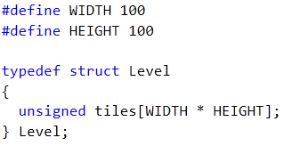
Pointers and Structs
Improved?
Need levels with different sizes?

Slide 12
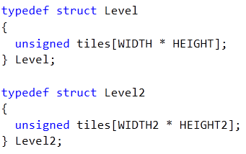
Pointers and Structs
Can define more structs…
Not best approach

Slide 13

Pointers and Structs
What function to write?
Take level as param?
Require ability to use generic level
Don’t want many level struct definitions

Slide 14
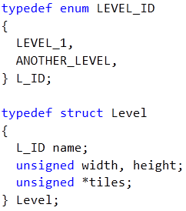
Pointers and Structs
Improved level struct

Slide 15
Pointers and Structs
Pointer to tiles
Instead of unsigned use an enum
Tiles are allocated in another area
Advantages:
Can hold any number of tiles
One level struct definition
Pass to functions generically
Must write special code to create a level

Slide 16
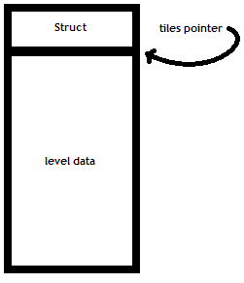
Pointers and Structs
Level struct diagram:

Slide 17
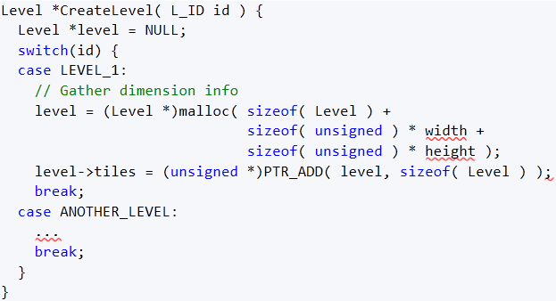
Pointers and Structs
Creation of a level
Will go over macros shortly

Slide 18
Pointers and Structs
We have
Level struct definition
Create any sized level
Generic handling
We need
Loop through level
Get a specific tile
More on this later – Macros next!

Slide 19
The C Macro
Macros are evil and bad
No they aren’t…
Programmers are
Macro is apart of preprocessor
Runs before compiler does
Utilize with directives
#ifdef, #define, #ifndef, #undef
Macros are good when you:
Use them to save time
Clean up syntax

Slide 20
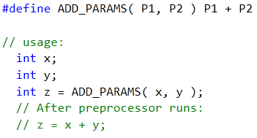
The C Macro
Can take parameters!
Text placed within P1 is “copy/pasted”
Same with P2
Macros just manipulate text
No sense of variables or syntax

Slide 21
The C Macro
Cannot have pointer to macro
Functions reside in memory as code
Preprocessor replaces macros with code
Heavy (mis)use of macros
Hard to debug
Again, no pointer to macro
Cannot step into a macro
Sometimes must output pre-processed file to debug

Slide 22

The C Macro
For parameterized macros
Split into multiple lines
Bad:
Good:
I always use at least one \
More readable

Slide 23


The C Macro
Parentheses on macro arguments
Common mistake:
Order of operations!

Slide 24
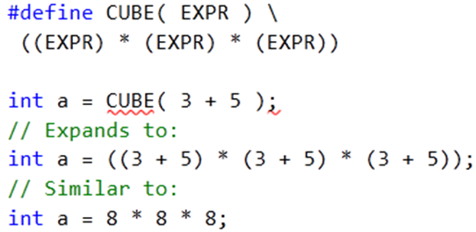
The C Macro
Parentheses on macro arguments
Done right:

Slide 25


The C Macro
PTR_ADD example from Level Creation slide
Retrieve tile from a level?

Slide 26



The C Macro
Macro parameters have no “type”
Use to create generic helpers
Float, int, double, pointer, etc.

Slide 27

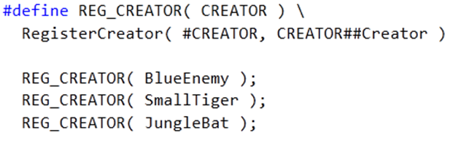
The C Macro
Cleanup your API
Good macro use:

Slide 28
Containers
A container holds data
Can hold multiple pieces of data
Insert/remove data
Loops through all data within container
How is this useful?
List of game objects
List of levels

Slide 29
Containers
Types of containers useful for GAM 150
Linked list
Only container I used in GAM 150
Use linked lists for
Everything that requires lots of insertion/removal
Searching not as good as array
Array
Use arrays for
Fast iteration and element lookup
Insertion/removal difficult and slow
Hash table?
Can index array with non-integers
“Named” elements
A bit advanced, email me later if interested

Slide 30
Containers - Array
Array uses
Put some on the stack to hold:
Image pointers
Level pointers
More! – More info in GameObject Design lecture
Arrays are powerful when used with enum

Slide 31
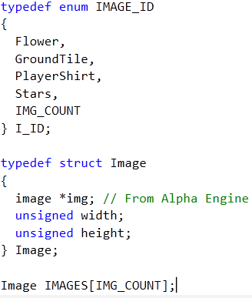
Containers - Array
Images
Each image has id
Add new ID to enum
IMG_COUNT updates
Size of the IMAGES array is updated
Can initialize IMAGES array upon game startup

Slide 32


Containers - Array
Constant time lookup
Macro variation
No real benefit to macro here, just demonstration

Slide 33
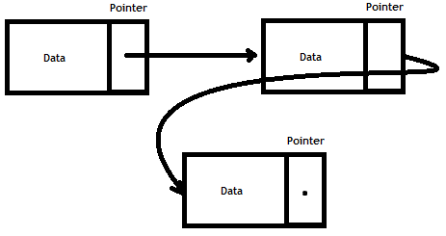
Containers – Linked List
Consists of nodes
A node holds some data
Has pointer to next node in list
Last node NULL

Slide 34
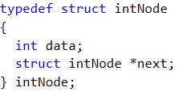
Containers – Linked List
A node structure

Slide 35
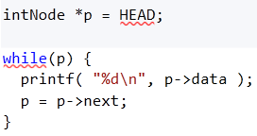
Containers – Linked List
Store pointer to first node somewhere
Call this head
Loop through a list:
Copy head pointer
Go to next pointer
Stop at NULL

Slide 36
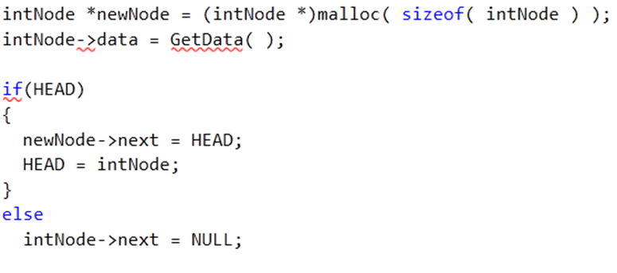
Containers – Linked List
Insert a new item into list:

Slide 37
Containers – Linked List
Use lists to store game objects
On object creation (malloc)
Insert into list of all objects
Can have multiple lists of game objects
In 150 I had:
List for projectiles
List for “normal objects”

Slide 38
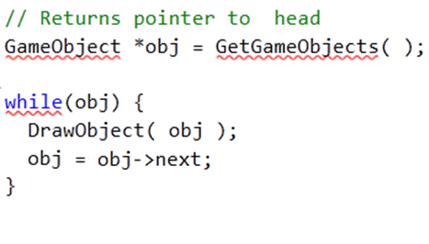
Containers – Linked List
List of all objects allows
Simple to apply an operation on each object
Example:
Draw all objects
Notes:
Check code

Slide 39
Generic Containers
Generic
The ability to reuse code in multiple situations.
Previous containers type dependent
Generic container is “typeless”
Or can be used with multiple types
Write many typed containers
One for each type
Or write one generic container

Slide 40
Generic Containers
Generic code in C
Two ways I know
Macro
Pointer typecasting
Macros
Hard to debug!
Annoying to use
Syntax limitations
Pointer typecasting
Annoying to typecast
Easier to debug

Slide 41
Generic Containers
Generic containers with macros
Will not cover in this lecture
I tried this out
Clunky, hard to debug
Two options left besides macros
Pointer casting
Copy paste code for each type
Each choice works
Make decision based on your own needs, skill, and time available

Slide 42
Generic Containers
Copy paste code for each type
Easy to implement
Requires a lot of code to be written
Pretty annoying to manage them all

Slide 43
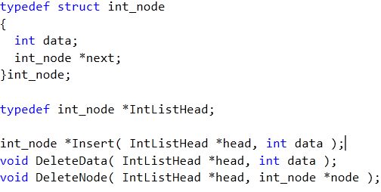
Generic Containers
Linked list for int

Slide 44
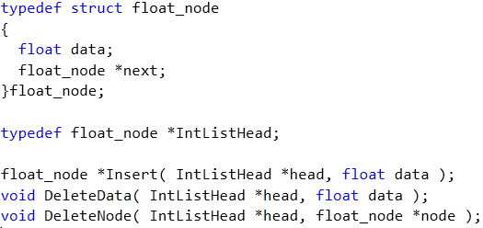
Generic Containers
Linked list for float

Slide 45
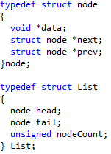
Generic Containers
Linked list for “typeless type”
Example code on moodle

Slide 46
Final Tips
Ask Doug Schilling for advice! He’s awesome
Study about linked lists
Keep things as simple as you can
Over-complexity is a sign of bad design
Ask upper classmen questions
Email me: r.gaul@digipen.edu

Slide 47
Questions?
Anyone have em?

