Slide 1
Serialization for gam 150 CLUB
Randy Gaul

Slide 2
Who am I?
RTIS Sophomore – Randy Gaul
C game as Freshman
Tech director for Ancient Forest and Grumpy Monsters
Made engine in C during summer before Sophomore year
AsciiEngine – Implemented some features in this slideshow
Love architecture with clean and powerful APIs

Slide 3
Serialization - Overview
The problem
Primitives
Routines

Slide 4
The Problem
So now we have game objects
However, we need to:
Save our game state
Close application
Reload previous save

Slide 5
The solution
Serialization
Translating data structures into a file format, to be later “resurrected” back into data structures.
Useful for:
Saving and loading
Level files
Archetypes

Slide 6
Primitives
Keep it simple
Write serialization routines for primitives
Serialize complex objects with primitive routines
Handling serialization in two layers like this:
Breaks problem down into simpler steps
Results in more intuitive implementation

Slide 7

Primitives
Serializing primitives:
SerializeFloat
SerializeInt
SerializeString

Slide 8
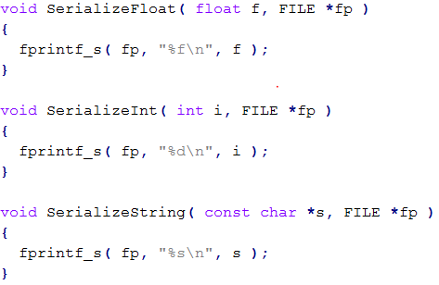
Primitives - Implementation

Slide 9
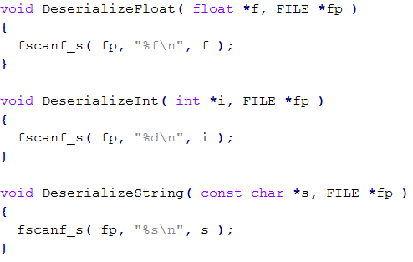
Primitives Deserialization
Deserialization is reading data to make something

Slide 10
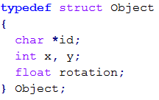
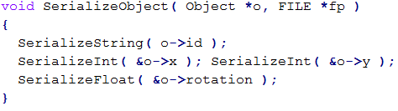
Serialization
Combine primitives to make something more complex

Slide 11
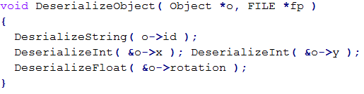
Serialization
Deserialization of Object

Slide 12

Serialization
Output file:
Magic numbers
Lets clean this up
We want our file to be prettier
Easier to modify and read by hand

Slide 13
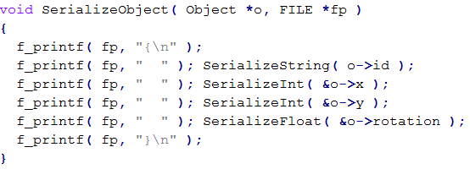
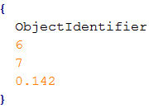
Serialization
Slightly prettier output:

Slide 14
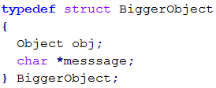
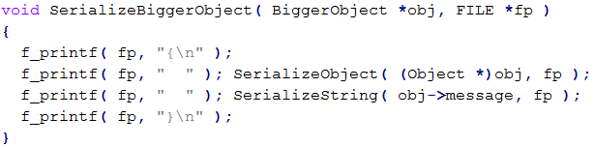
Serialization
A little better, but what about:

Slide 15
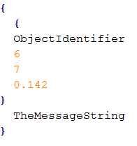
Serialization
We now have a problem with our “prettiness”
Our serialization is not modular

Slide 16
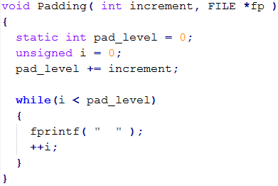
Serialization
A working “prettiness” method
Able to adjust padding height as we go along

Slide 17
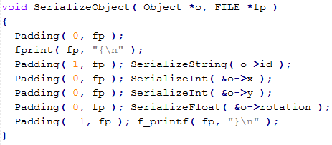
Serialization
New routine for object:
Control pad height during routine
Only care about how much we increment

Slide 18
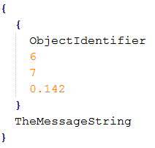
Serialization
Fixed output for BiggerObject
Assuming we used padding in BiggerObject too

Slide 19
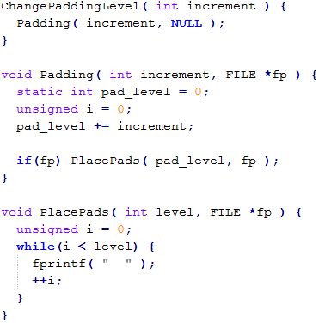
Serialization
Lets cleanup all these padding calls
Rewrite our pad function

Slide 20
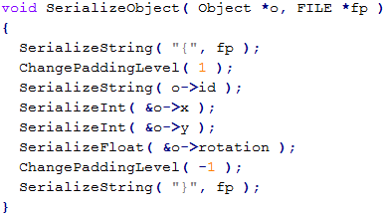
Serialization
Cleaner version of SerializeObject
Use new pad functions
Call Padding( 0, fp ) in primitives

Slide 21
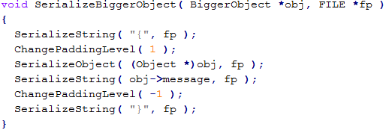
Serialization
Cleaner version of serializing BiggerObject
Redundancy:
We always call:
SerializeString( “{“ ) and increment pads by 1
Same with closing bracket and -1

Slide 22
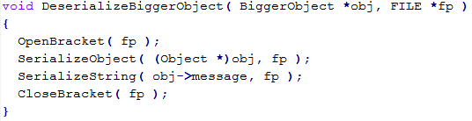
Serialization
Even cleaner version:
Open bracket:
Increment pad level, place pads
Close bracket:
Decrement pad level, place pads

Slide 23
Serialization
One problem:
Our prettification from left to right introduced brackets
Deserialization does not expect brackets!

Slide 24
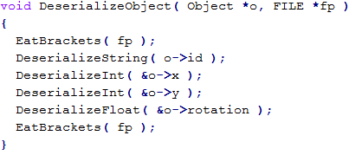
Serialization
Compensate with “eat bracket” function
EatBrackets:
Use fgetc until you find ‘{‘ or ‘}’, then eat newline

Slide 25

Serialization
Final “prettified output” of BiggerObject
Quite nice! Still room to improve:
Name of object?
Name of each data member?

Slide 26
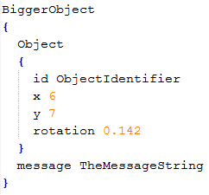
Serialization
Lets see if we can make this jump
Things are going to get crazy.

Slide 27
Final Tips
Ask Doug Schilling for advice! He’s awesome
Keep things as simple as you can
Ask upper classmen questions
Email me: r.gaul@digipen.edu

Slide 28
Resources:
http://higherorderfun.com/blog/2012/05/20/the-guide-to-implementing-2d-platformers/
http://info.sonicretro.org/Sonic_Physics_Guide
Sample engine on Moodle

Slide 29
Questions
Anybody have ‘em?

