Slide 1
Scripting Creating a simple domain specific language for gam 150 CLUB
Randy Gaul

Slide 2
Overview
Writing C code takes a long time
Some games can make use of
Lots of one off logic
High amounts of scripted sequences
Simple AI
Wouldn’t it be nice to have a tool to make all these things?

Slide 3
Domain Specific Language (DSL)
A Domain Specific Language is:
A language dedicated to a particular problem domain.
Can be a highly specialized form of a scripting language
Instead of writing C code
Write simple text files
Read text files in during runtime
No compilation required
Hotswapping

Slide 4
StarCraft Brood War
This game had a “trigger editor”
Trigger:
Collection of conditions and actions
Condition:
Some test to perform, returns boolean
Action:
Some function pointer to call
Could be anything
Create enemies, update AI, display messages, etc.

Slide 5
Stealing BW’s Triggers Design
Lets call these “triggers” events
An event has conditions and actions
If all conditions are met
Run all actions
Discard the event
Events can be constructed from files
Can write events in a text file

Slide 6
Events Example
Consider a list of events read from file:
Event1
Conditions – Player is within location “HealingArea”; “HealEnabled” is true
Actions – Heal player, decrement “HealCounter”; Set “HealEnabled” to false
Event2
Conditions – Player is not within location “HealingArea”; “HealEnabled” is false
Actions – Set “HealEnabled” to true
Event3
Conditions – “HealCounter” is at least 3
Actions – Destroy all “HealingPools” at “HealingArea”

Slide 7
Events Example – In English
We have a healing pool
Player enter pool, gets healed
Will not be healed until leaves then returns
Pool will heal 3 times
On the third the pool is destroyed

Slide 8
Scripting Languages
Scripting in a text file is powerful
Purpose of scripting is to save time
You want a scripting language
There is a drawback:
Must be able to create the language quickly
If language development:
Takes too long
Too hard to add new events
Then purpose is self-defeating

Slide 9
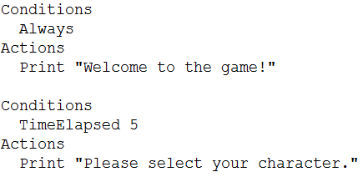
Implementation
Need very simple way to parse events from file
First up: file format

Slide 10
Implementation
Each condition can have two parameters
Params come directly after name
Strings, numbers, names, etc.
Each action can also have two parameters
Each event can hold any number of conditions or actions
Store conditions and actions in a linked list within the event itself
Link all events together

Slide 11
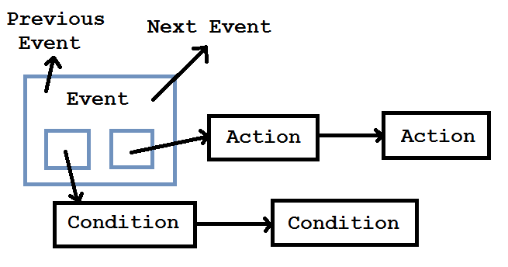
Implementation

Slide 12
Questions?

Slide 13
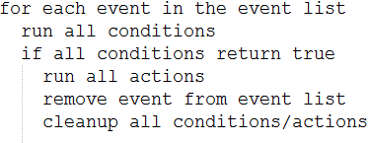
Implementation
Updating event list:

Slide 14
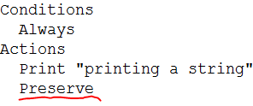
Implementation
What about events that persist?
Want to run actions more than just one time
Usually an event is deleted once it runs actions
Use a “preserve action”

Slide 15
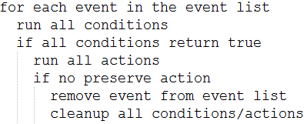
Implementation
New pseudo code for updating event list

Slide 16
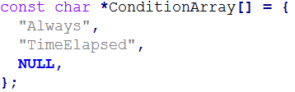
Load Events from File
Open file and look for “Conditions” string
fscanf( fp, "%s%*c", buffer );
strcmp( buffer, ”Conditions” ) == 0
Read condition name
Name associates with integer index
Save this index to lookup functions

Slide 17
Function Pointers
Each condition needs to:
Run boolean check
Read in parameters when loading from file
Cleanup after itself (free things)
Setup arrays of function pointers
One array for each of the three things above

Slide 18
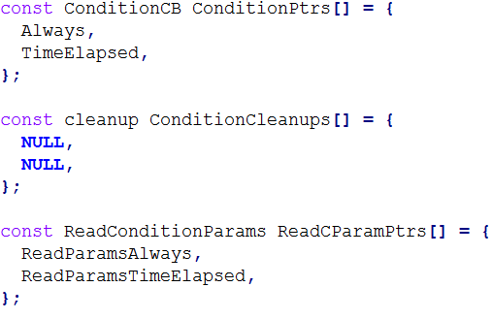
Load Events from File
Now that you have the index
Lookup function pointers (use typedefs for ptrs)

Slide 19

Load Events from File
Order of function pointer arrays must be maintained
How it works:
Get index
By match string
Save index and use in function pointer array
Example: assign the boolean check of condition:

Slide 20
Load Events from File
Same thing with actions
Array of names
Array of ActionFunctions
Array of ActionCleanups
Array of ReadActionParams
Assign function pointers while loading from file
See sample code on distance for more details

Slide 21
Questions?

Slide 22
Types of Conditions
Condition variables:
Counters; Factions, Locations (AABB or Circle); Timers; Object Count; Inventory (acquire enough money?); Kill counts; Scores, etc.
Condition comparisons:
At least; exactly; at most
Condition examples:
[Faction] bring [comparison] [number] of [type of object] to [location]
Player kills [comparison] [number] [type of object]

Slide 23
Types of Actions
Create object(s), move object to location, modify hit points, destroy objects, setup timers, victory, defeat, etc.

Slide 24
Example Events
Time elapsed is at least 10 minutes
Victory
Player owns at least 5 torches
Turn off the lights
Player owns at most 0 torches
Turn on the lights
Player kills at least 3 villagers
Spawn guards around player
Order guards to attack player

Slide 25
Demo!

Slide 26
Final Tips
Look at my sample code online
It isn’t a whole lot of code
Can be extended easily
Re-read the GameObject Design lecture
Setup global vtables
Reduce maintenance time to nearly zero
Consider yourself if the whole language will save time
Can you code it in a reasonable time?
One weekend? One week?
If longer than a week I’d say just write C code
It took me two days out of a weekend, was very worthwhile!

Slide 27
Resources:
Sample code on moodle
r.gaul@digipen.edu – my email

