Slide 1
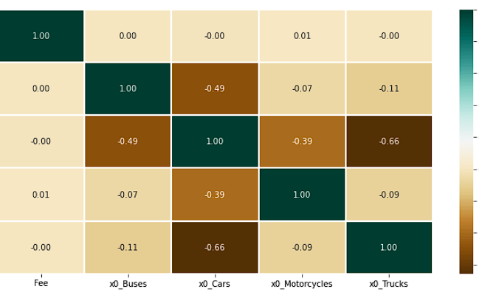
Cars are Affected by Tolls Frequently
How Does Vehicle Type Affect Revenue?
The type of vehicle correlates to the amount of revenue earned. Cars are 80% more than likely to pay for tolls
Peak times allow for greater revenue
During peak times, the revenue from tolls are increased by 30%
Offsetting the vehicle type with Subscription plans
Offering a subscription plan would help negate the loss of revenue from vehicles that use tolls less often

Slide 2
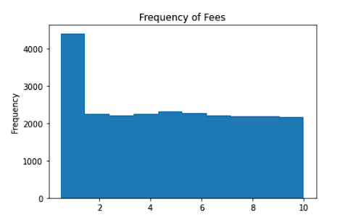
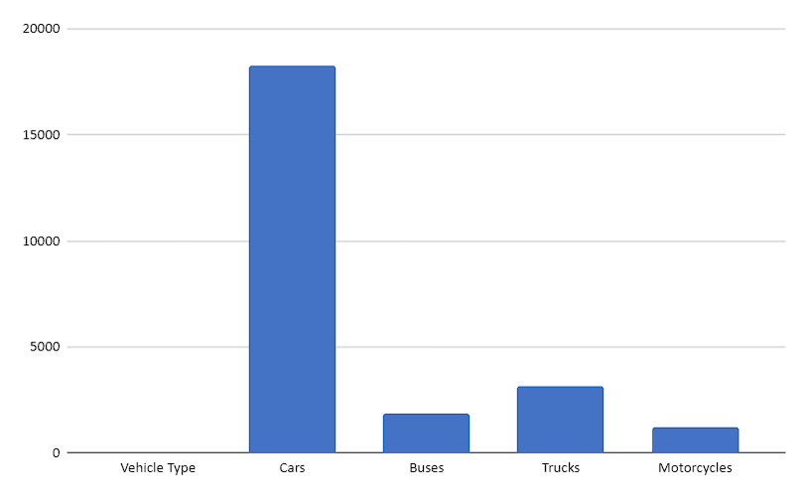
Recommendations
Create a “Toll Free” Pass for all drivers to average out the cost per vehicle type
Schedule staff and resources around peak times

