Slide 1
ABOUT ME
NAME:
BACKGROUND:
HOBBIES:
MUSIC:
FOOD:
GOALS:

Slide 2

ABOUT ME
NAME
BACKGROUND
HOBBIES
MUSIC
FOOD
GOALS

Slide 3
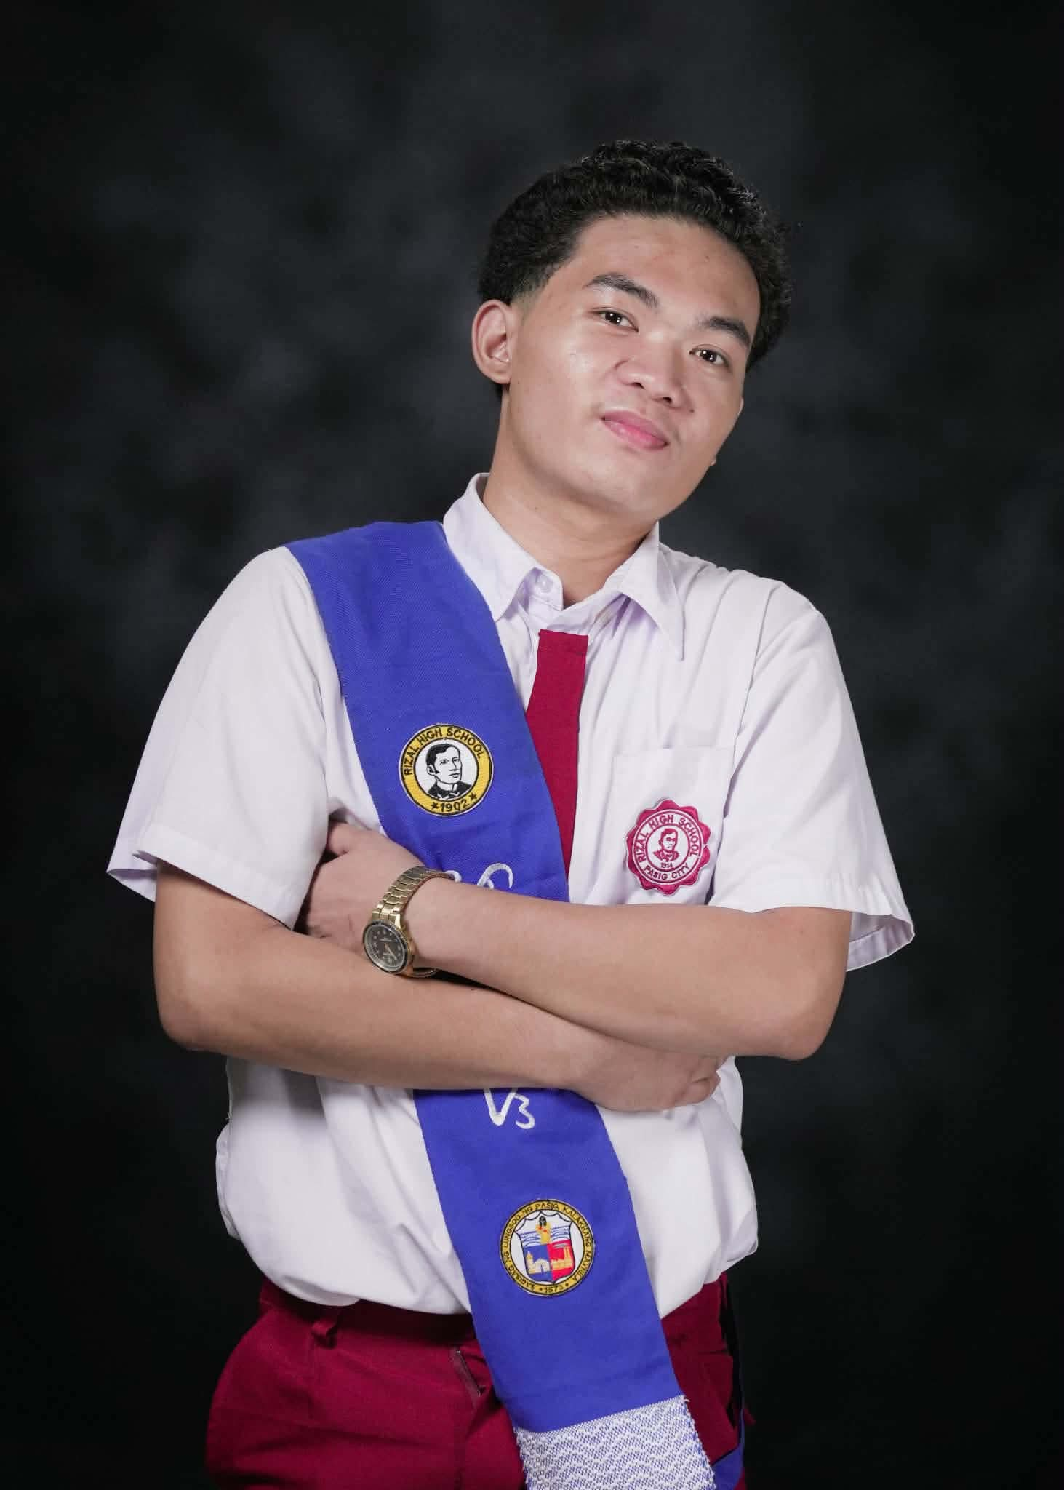
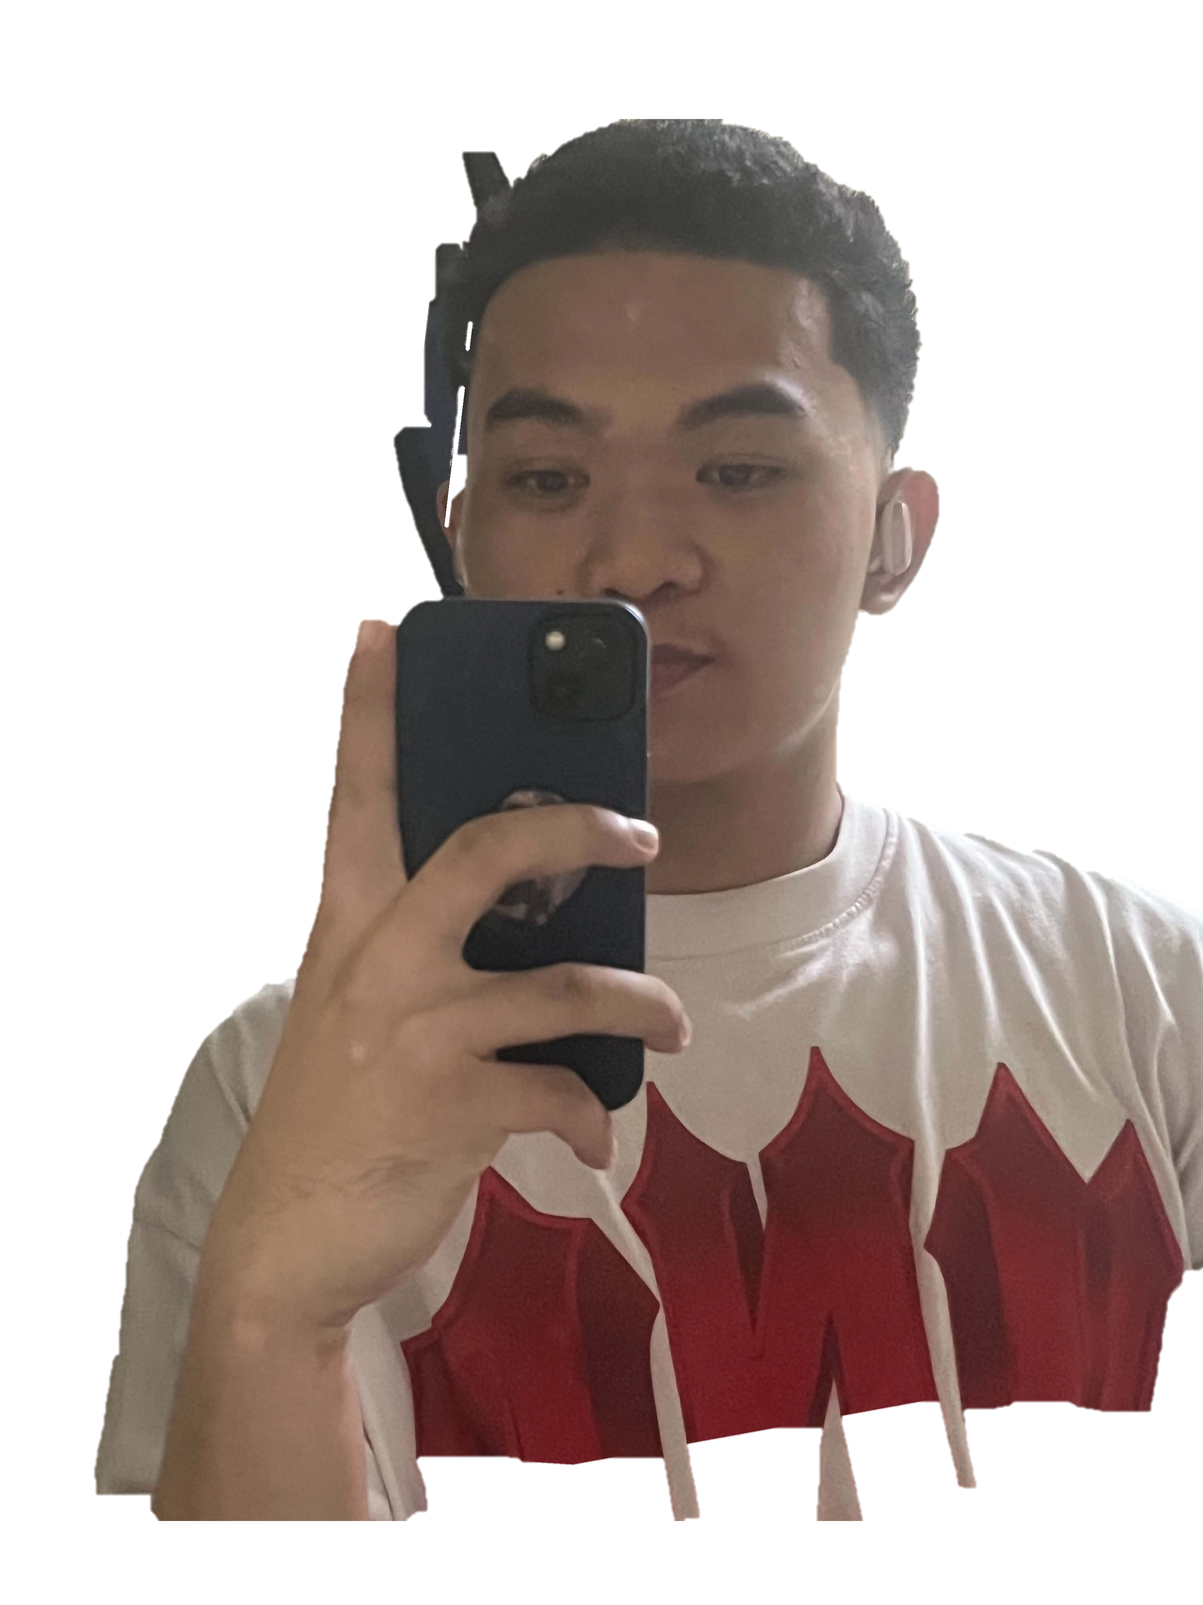
ABOUT ME
NAME
EMMARIE CHRISTIAN MACRAY GALULAN
BACKGROUND
HOBBIES
MUSIC
FOOD
GOALS

Slide 4
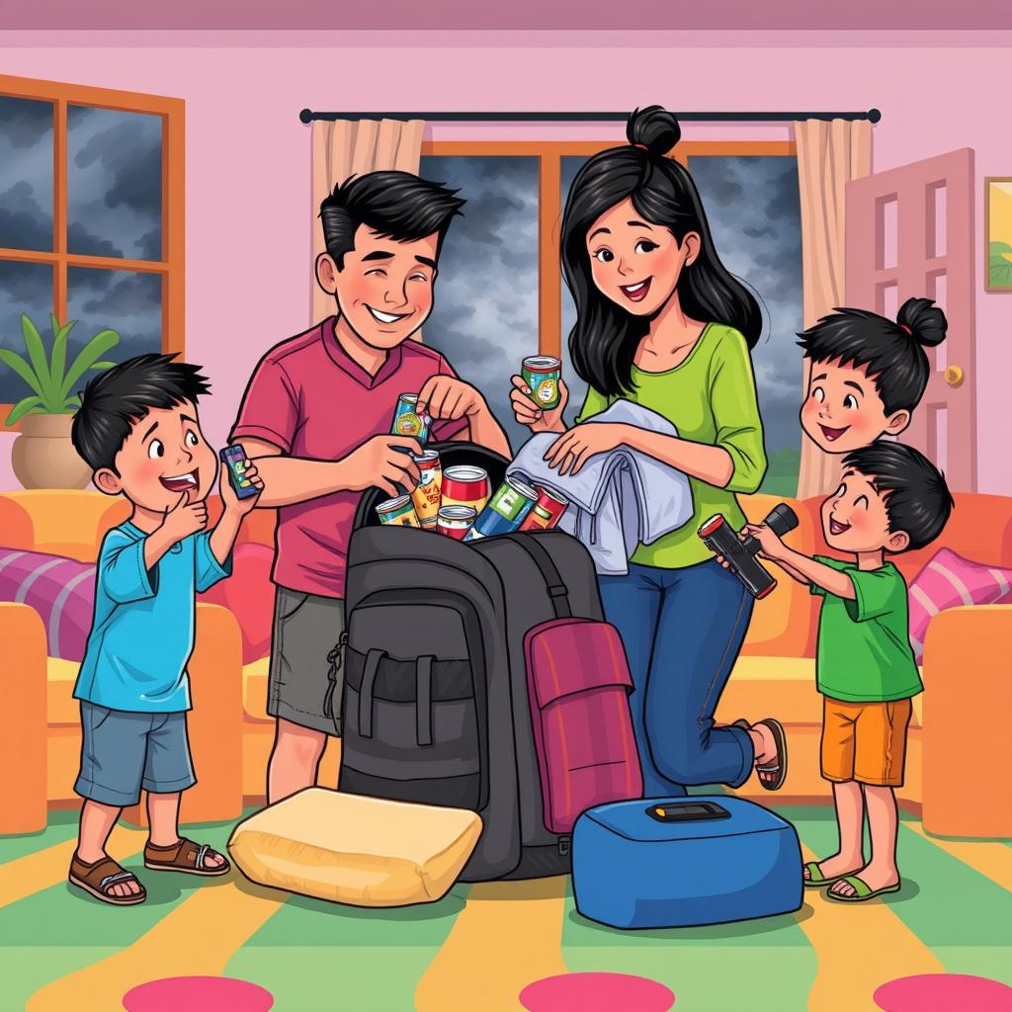
ABOUT ME
I grew up in Rosario, Pasig City, raised by a father whose hard work in shoe repair kept our family going through tough times. Living on a day-to-day basis wasn't easy, but growing up poor taught me resilience, resourcefulness, and the true value of every opportunity. Faith and strong religious values were at the heart of our household, giving us hope and grounding us no matter how difficult things got. Inspired by my family's sacrifices, I dedicated myself to my studies and proudly maintained consistent honors throughout senior high school.
NAME
BACKGROUND
HOBBIES
MUSIC
FOOD
GOALS

Slide 5

ABOUT ME
NAME
In my free time, I love staying active by playing basketball and hitting the gym to work on my physical health and discipline. When it's time to unwind and take a break, I usually spend my downtime playing video games.
BACKGROUND
HOBBIES
MUSIC
FOOD
GOALS

Slide 6

ABOUT ME
NAME
BACKGROUND
Music is a big part of my day, and I mostly listen to OPM and rap. I really admire artists like Gloc-9 and Francis M for their incredible storytelling and powerful lyrics, while bands like Ben&Ben are my go-to when I want to relax with great melodies and heartfelt songs.
HOBBIES
MUSIC
FOOD
GOALS

Slide 7
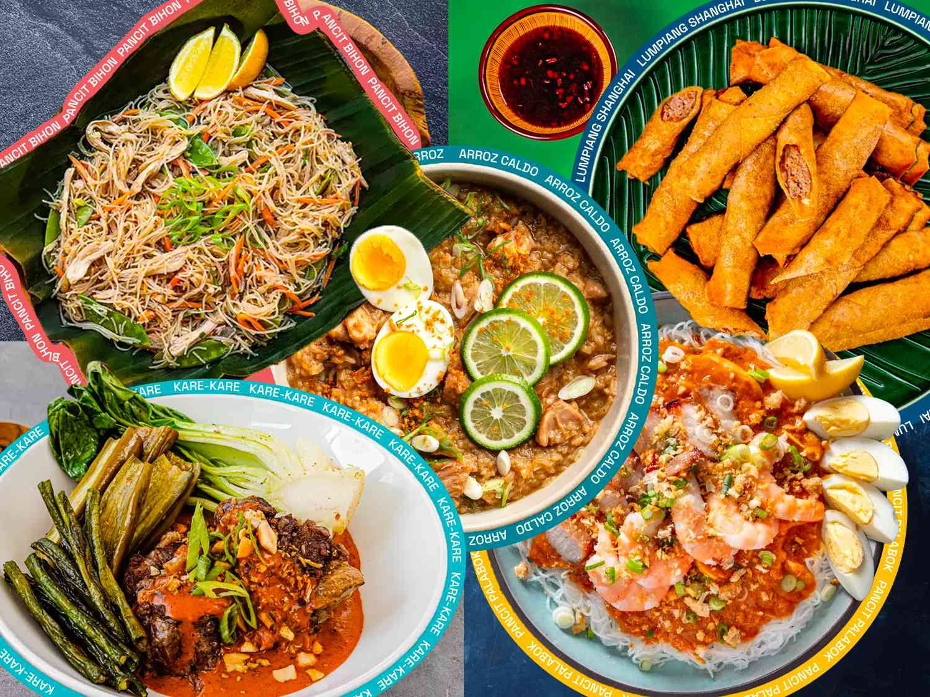
ABOUT ME
NAME
BACKGROUND
When it comes to food, nothing beats classic Filipino comfort dishes for me, my absolute favorites are adobo and sinigang. To top off any good meal, I always go for chocolate in any shape or form whenever I want something sweet.
HOBBIES
MUSIC
FOOD
GOALS

Slide 8

ABOUT ME
NAME
My ultimate goal in life is to become a successful IT graduate so I can provide for my father and give him everything he wants in return for his sacrifices. Looking to the future, I dream of living abroad, building a healthy family, and being truly rich. ,t just in money, but in happiness and peace of mind.
BACKGROUND
MUSIC
HOBBIES
FOOD
GOALS

Slide 9
ABOUT ME
NAME
BACKGROUND
MUSIC
HOBBIES
FOOD
GOALS
My ultimate goal in life is to become a successful IT graduate so I can provide for my father and give him everything he wants in return for his sacrifices. Looking to the future, I dream of living abroad, building a healthy family, and being truly rich. ,t just in money, but in happiness and peace of mind.

Slide 10
ABOUT ME
NAME
GOALS
BACKGROUND
MUSIC
HOBBIES
FOOD
THANK YOU FOR KNOWING ME
My ultimate goal in life is to become a successful IT graduate so I can provide for my father and give him everything he wants in return for his sacrifices. Looking to the future, I dream of living abroad, building a healthy family, and being truly rich. ,t just in money, but in happiness and peace of mind.

