Slide 1
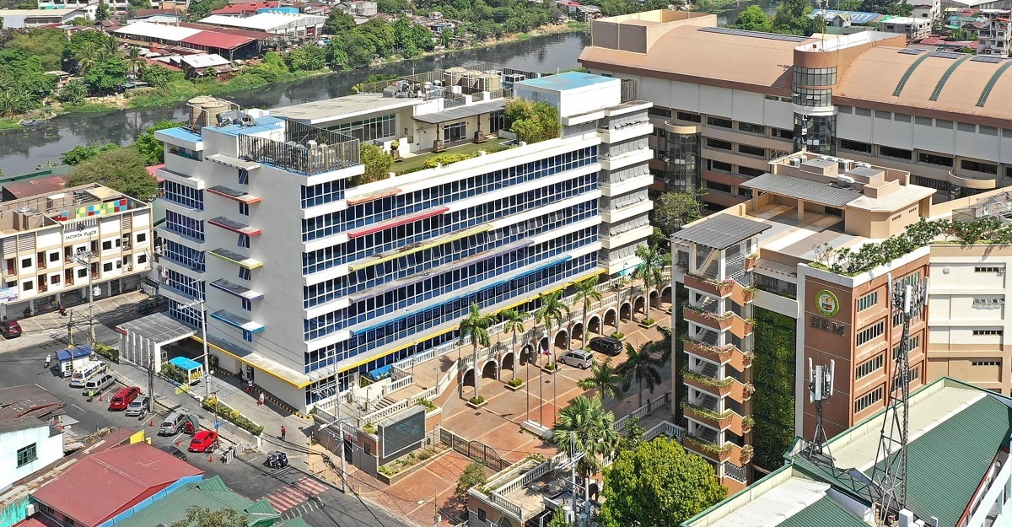
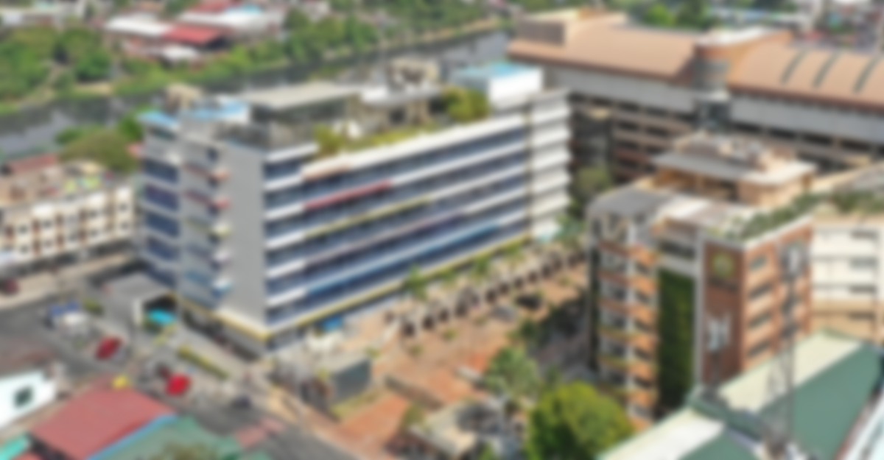


PAMANTASAN NG LUNGSOD NG PASIG
UNIVERSITY OF PASIG
INTRODUCTION TO COMPUTING
BACHELOR OF SCIENCE IN INFORMATION TECHNOLOGY
PROF. JHUN ALVAREZ

Slide 2



Built with a sleek, futuristic interface, this platform serves as an interactive hub designed to seamlessly guide students, faculty, and visitors through our academic environment. Here, you can easily explore our degree Programs, dive into detailed Subjects and course offerings, stay updated on ongoing student and departmental Research, and learn more About our mission to empower the next generation of IT professionals and tech innovators.
INTRODUCTION
UNIQUE FUNCTIONALITY
ENDING PAGE
COMP 101 INTRODUCTION TO COMPUTING

Slide 3
The vision of our website apart is its bold, futuristic design inspired by sci-fi and gaming aesthetics. Instead of a standard academic page, it uses custom neon-glowing menu buttons and a detailed high-tech background that instantly captures attention while making navigation fun and easy. Beyond its unique look, the site acts as a complete visual dashboard for the College of Computer Studies. It neatly organizes essential information—such as degree programs, subjects, research projects, and department details—under one streamlined layout that seamlessly blends modern style with official university branding.
INTRODUCTION
UNIQUE FUNCTIONALITY
ENDING PAGE
COMP 101 INTRODUCTION TO COMPUTING

Slide 4
INTRODUCTION
THE END
UNIQUE FUNCTIONALITY
ENDING PAGE
COMP 101 INTRODUCTION TO COMPUTING
The vision of our website apart is its bold, futuristic design inspired by sci-fi and gaming aesthetics. Instead of a standard academic page, it uses custom neon-glowing menu buttons and a detailed high-tech background that instantly captures attention while making navigation fun and easy. Beyond its unique look, the site acts as a complete visual dashboard for the College of Computer Studies. It neatly organizes essential information—such as degree programs, subjects, research projects, and department details—under one streamlined layout that seamlessly blends modern style with official university branding.

