Slide 1
Case Study
Randy Kim, Kati Schuerger, Will Sherman

Slide 2
Agenda
Initial exploratory data analysis (EDA)
Imputation of missing values
Additional EDA – focus on ABV & IBU
KNN Classification model for Ale/IPA

Slide 3
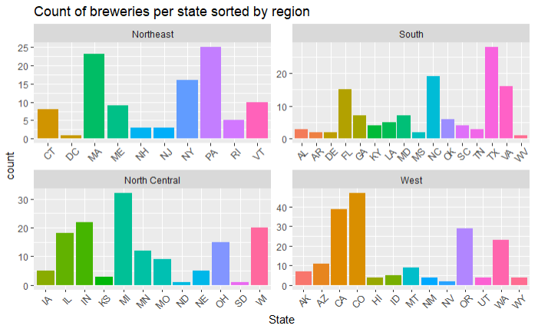
Breweries by State
Top 3
Colorado (47)
California (39)
Michigan (32)

Slide 4
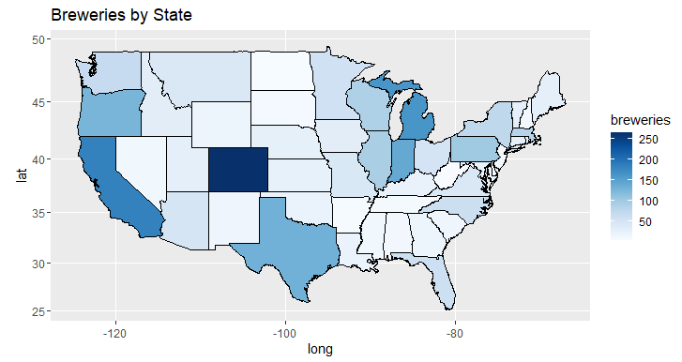
Breweries by State

Slide 5
Missing Values
Total observations in the data: 2,410
Missing values
ABV: 62 (2.6%)
IBU: 1,005 (41.7%)
Filling in the gaps
ABV: random sampling
IBU: Naïve Bayes

Slide 6
Random Sampling & Naïve Bayes
Random Sampling
62 missing data points
Random assignment of values
Imputation on the mean (range based on standard deviation)
Naïve Bayes
84.4% accuracy
Notes:
Because of the larger number of missing datapoints from IBU, taking a random sample within 1 standard deviation of the mean would have more heavily biased the analysis since that would decrease variance considerably. Therefore, we only applied this method to the small sample of missing values from ABV.
In order to incorporate random variation for IBU, we utilized naïve Bayes to fill in the missing data. Using 70-30 known ABVs, we were able to create a stable model with 84.4% average accuracy.
(extra) This allowed us to handle the large amount of categorical data (e.g. Style, State, Brewery Name, Beer Name) in addition to the numerical data (e.g. IBU, Ounces, Beer_ID). Especially important due to the fact that data was MNAR (missing not at random), with high NA rates occurring for the same brewery in multiple states.

Slide 7
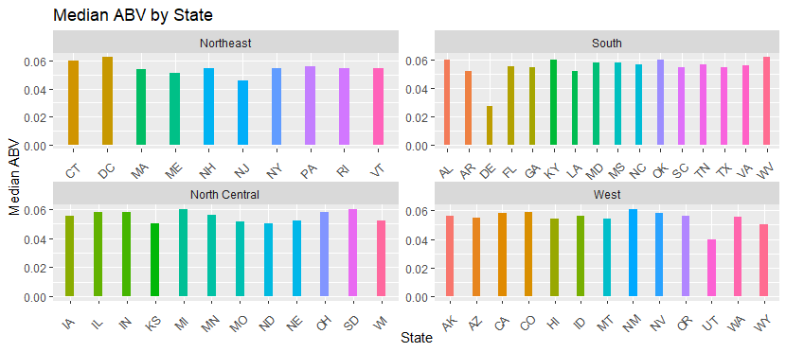
Median ABV by State
Notes:
After imputing our data, we were able to predict median ABV values for each state, seen here grouped by region. Thankfully, due to the small size of missing data, our predictions shouldn’t drastically impact the true medians.

Slide 8
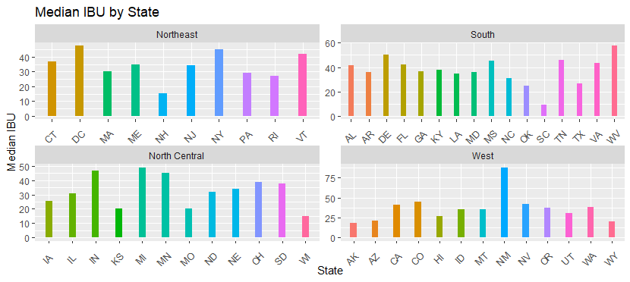
Median IBU by State
Notes:
As you can see, we also have been able to generate median IBUs for each state. These data should be viewed more skeptically since a larger portion (i.e. 40%) of data were not recorded, but rather imputed. This is particularly important for states like SD, which had no recorded IBU information.

Slide 9
States with highest ABV & IBU
Highest ABV: Colorado
Upslope Brewing Company (Boulder, CO)
Beer: Lee Hill Series Vol. 5 - Belgian Style Quadrupel Ale
Style: Quadrupel (Quad)
ABV: 12.8%
Highest IBU: Oregon
Astoria Brewing Company (Astoria, OR)
Beer: Bitter Bitch Imperial IPA
Style: American Double / Imperial IPA
IBU: 138
Notes:
Based on our result, the highest ABV is from Colorado and the name of the beer is Belgian Style Quadrupel Ale with 12.8% ABV.
And the highest IBU is from Oregon and the name of the beer is Bitter Bitch Imperial IPA with 138 IBU.

Slide 10
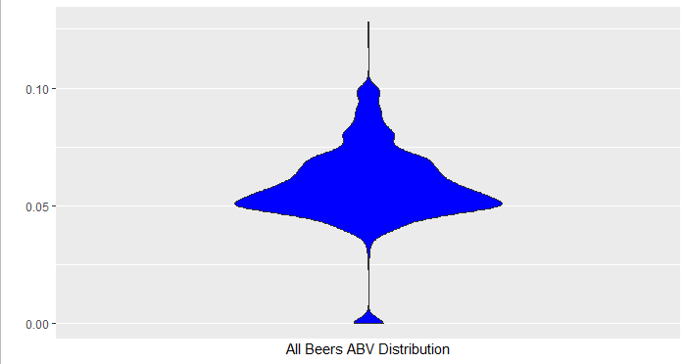
Summary Statistics of ABV
75% of the median ABVs fall between 5.6% - 5.8%
75% of ABVs fall between 5.0% - 6.7%
Budweiser is 5%
Notes:
75% of the median ABVs fall between 5.6% to 5.8%.
The graph we are showing here is the distribution before the ABV conversion. We can see that a lot of the beers are around 5% and that’s because according to the National Institute on alcohol Abuse and Alcoholism (NIAAA), a standard U.S. beer contains average of 5%.
Budweiser is averaging around 5% and we could carefully suggest to increase ABV to be more competitive with other brands.

Slide 11
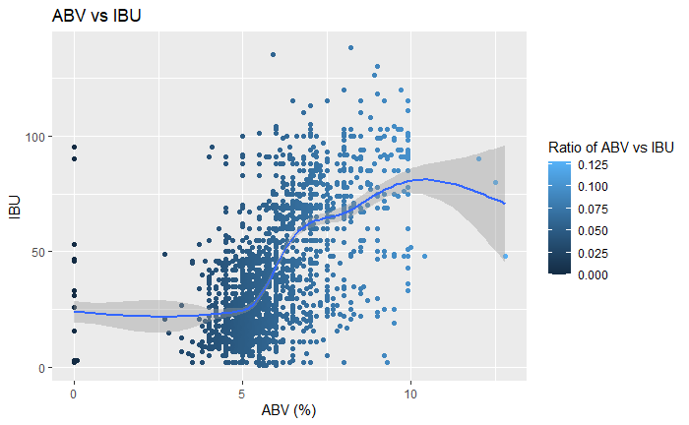
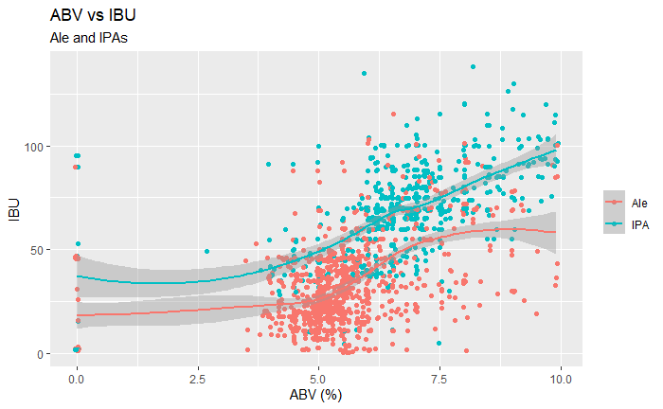
Relationship Between IBU and ABV
Notes:
We can see that there is a positive correlation between IBU and ABV. We can see a big cluster around 5% ABV and we are predicting that they are regular 12 ounces of beers which according to NIAAA, in U.S., a beer contains between 4-7% ABV, with the average being 5%. Anything above predicting to be malt liquor which averaging to be 7% ABV. We also see an imaginary wall at 10% ABV and that’s because anything higher than 10% usually is wine or hard liquor.
Just based on this, we couldn’t determine the causation so we decided to compare by Ale and IPAs and we can see that the majority of Ale has low ABV and IBU and the majority of IPA has high ABV and IBU. Budweiser has average 5% ABV and 7 IBU and we could carefully suggest to increase ABV within range of 5.6 - 5.8% and 19 -64 IBU to be in the competitive market.

Slide 12
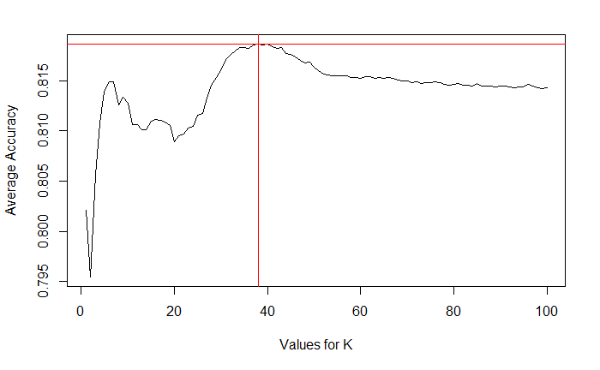
KNN Classification for Ale / IPA
Best Value for K: 38
Highest Accuracy: 81.8%
Internal CVV
Accuracy = 81.8%
Sensitivity = 85.4%
Specificity = 75.7%
(38,81.8%)

Slide 13
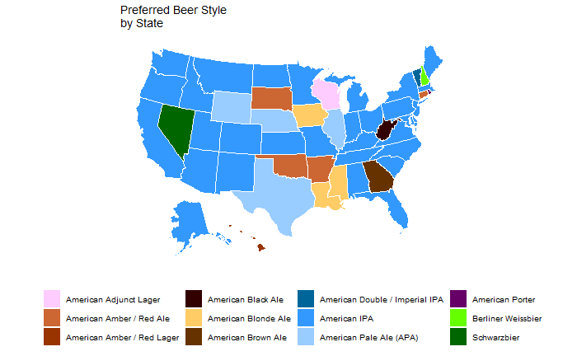
Preferred Beer Style

