Slide 1

HOSPITAL INFORMATION SYSTEM
Surgery Department
HIS
Surgery
Department
A Database-Driven Healthcare Management Platform
for Surgical Workflow Automation
CSCI305 – Database Systems
Supervisor: Dr. Ahmed Hisham Qandil
Maryam Ali
20+ Tables
13 Entities
Streamlit
Gehad Maher
Raneem Khaled
Database
Core Models
Prototype UI
Ahmed Hany
Tasnim Maged

Slide 2
Team Members
M
G
R
A
T
#1
#2
#3
#4
#5
Maryam Ali
Gehad Maher
Raneem Khaled
Ahmed Hany
Tasnim Maged
ID: 231000810
ID: 231000894
ID: 231001424
ID: 231001623
ID: 231000173

Slide 3

GitHub Repository
QR Code
github.com/Raneem30/Surgery-department
A database-driven Hospital Information System for the Surgery Department featuring ERD design,
relational mapping, SQL implementation, patient management, OR scheduling, appointments, rooms, and reports.

Slide 4




Agenda
01
Project Overview
System goals, scope, and department rationale
02
Phase One — Database Design
ERD, relational schema, primary/foreign keys, SQL
03
Phase Two — Application
Streamlit prototype, features and UI modules
04
Challenges & Conclusion
Solutions, benefits, and acknowledgements

Slide 5



Project Overview
Why Surgery Department?
20+
13
Complex multi-entity surgical workflows
Database Tables
Core Entities
Doctors, OR rooms, patients, medications
M:N
UI
Full scope of relational database design
Relationships Resolved
Streamlit Prototype
Covers the most critical hospital operations
Surgery workflows involve the most complex multi-department coordination in a hospital — making it the ideal subject for a comprehensive database-driven system.

Slide 6
PHASE ONE
Database Design
& Implementation
ERD · Relational Schema · SQL

Slide 7
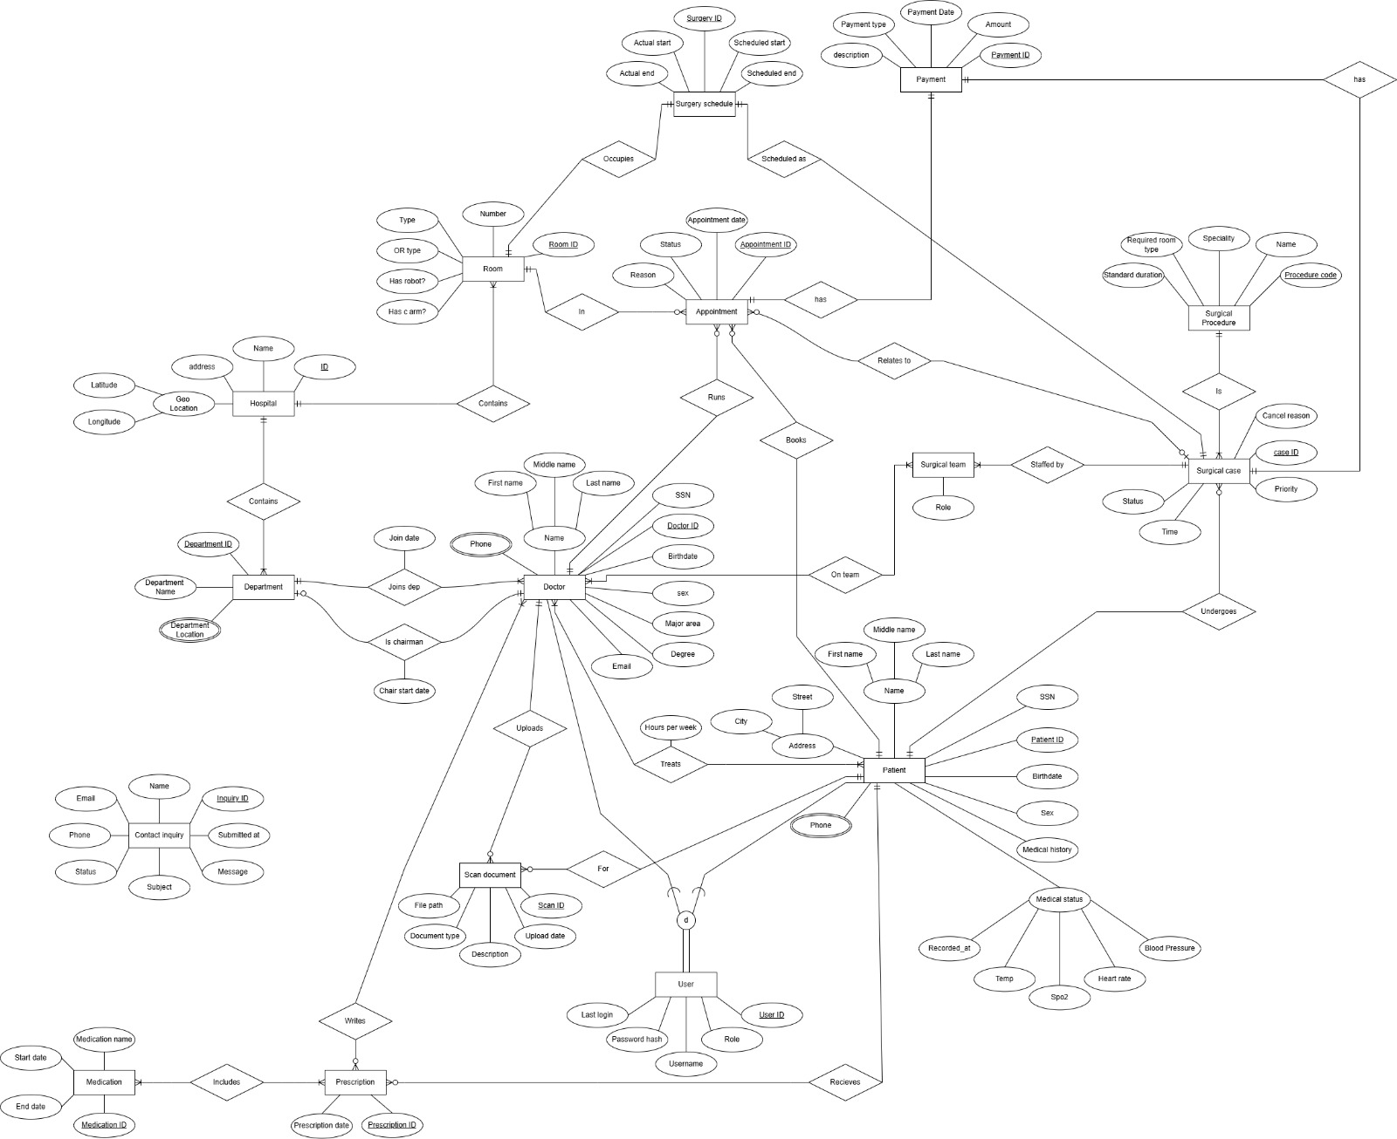
Entity-Relationship Diagram (ERD)
[ ERD Diagram ]
Insert ERD screenshot here

Slide 8
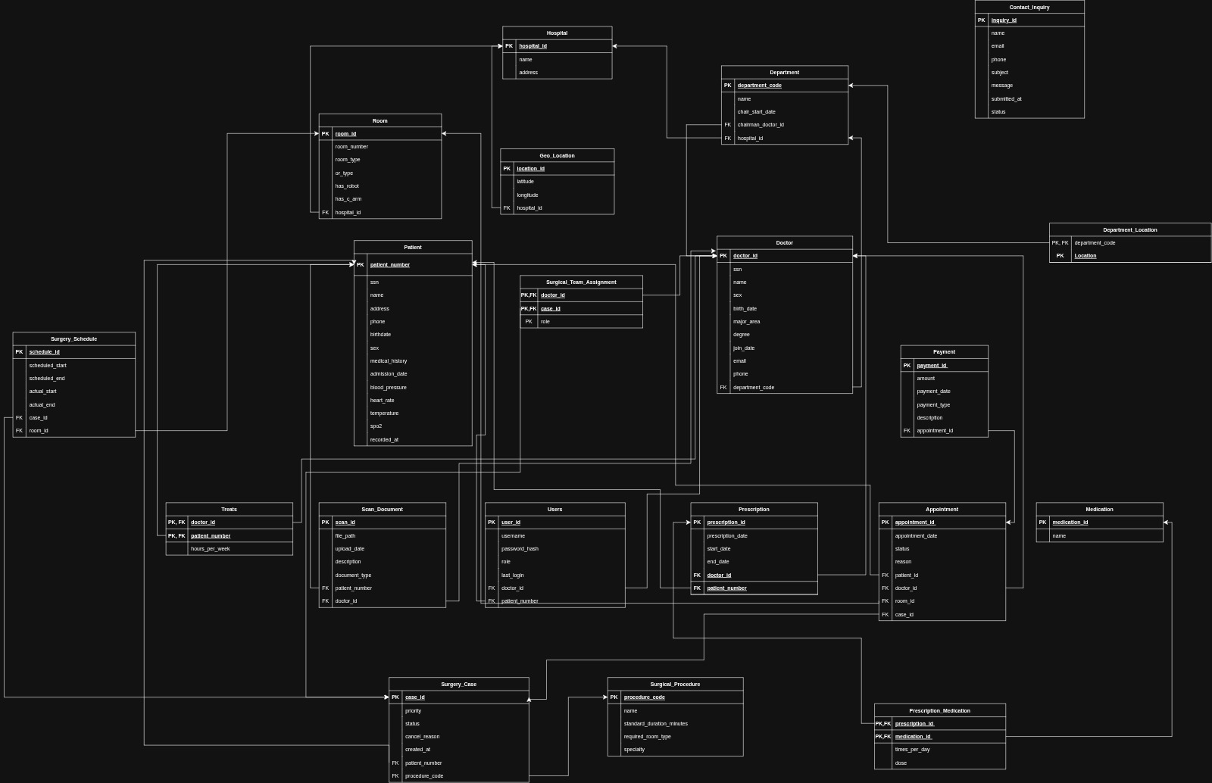



Relational Schema Mapping
[ Relational Schema Diagram ]
Strong entities become tables
M:N relationships become junction tables
Insert schema mapping screenshot here
Foreign keys connect related tables
Composite keys represent relationship tables

Slide 9
Primary & Foreign Keys
Primary Keys
Foreign Keys
Patient → patient_number
Doctor.department_code → Department
Doctor → doctor_id
Department.hospital_id → Hospital
Department → department_code
Department.chairman_doctor_id → Doctor
Hospital → hospital_id
Room.hospital_id → Hospital
Room → room_id
Appointment.patient_number → Patient
Appointment → appointment_id
Appointment.doctor_id → Doctor
Surgery_Case → case_id
Appointment.room_id → Room
Prescription → prescription_id
Appointment.case_id → Surgery_Case
Payment → payment_id
Prescription.doctor_id → Doctor
Medication → medication_id
Prescription.patient_number → Patient
Surgery_Schedule → schedule_id
Payment.appointment_id → Appointment
Scan_Document → scan_id
Surgery_Case.patient_number → Patient
Users → user_id
Surgery_Schedule.case_id → Surgery_Case
Treats → (doctor_id, patient_number)
Scan_Document.patient_number → Patient
Prescription_Medication → (prescription_id, medication_id)
Surgery_Case.procedure_code → Surgical_Procedure
Surgical_Team_Assignment → (doctor_id, case_id)
Users.doctor_id → Doctor

Slide 10
Composite Keys & Constraints
Treats
🔑 patient_number + doctor_id
Tracks doctor-patient treatment relationships
Prescription_Medication
🔑 prescription_id + medication_id
Junction table for prescriptions and medications
Surgical_Team_Assignment
🔑 case_id + doctor_id + role
Assigns doctors with roles to surgery cases
Department_Location
🔑 department_code + location
Handles multi-valued location for departments
Composite keys enforce uniqueness across multiple columns and represent many-to-many relationship tables.

Slide 11
PHASE TWO
Application Features
& UI Prototype
Streamlit · Python · PostgreSQL

Slide 12




Application Prototype
The current interface is implemented using Streamlit to demonstrate the main system modules and workflows, including patient management, doctor management, appointments, rooms, and reports.
Patients Management
Doctors Management
Appointments Booking
Rooms Management
Reports Generator
Tech Stack: Python · Streamlit · PostgreSQL · psycopg2

Slide 13
Home Dashboard
250
35
120
2
Total Patients
Doctors
Appointments
Available Rooms
★ Sample data for presentation/demo purposes only
Navigation
Dashboard Features
🏠 Home
Real-time statistics overview
👤 Patients
👨‍⚕️ Doctors
Navigation to all management modules
📅 Appointments
Quick access to reports
🚪 Rooms
System status monitoring
📊 Reports

Slide 14
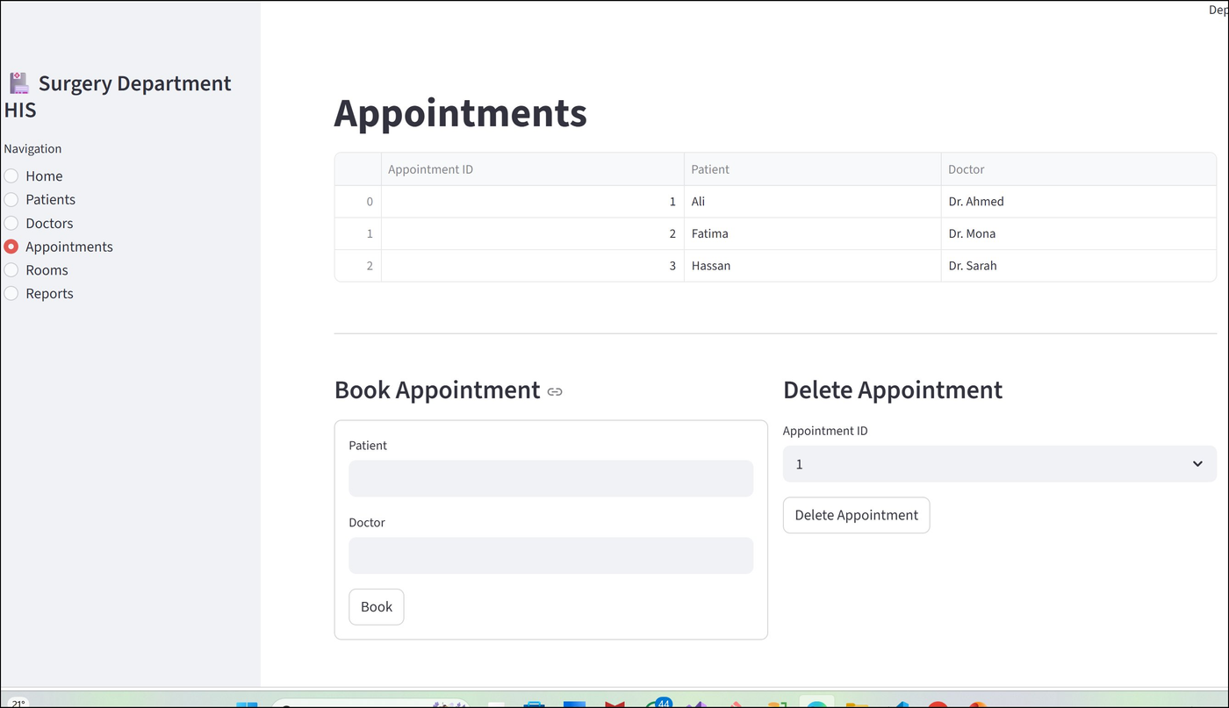
Appointments Booking
Module Features
View all patients with patient_number
Add new patient records
Delete patient by patient_number
Medical condition tracking
Linked to appointments & surgery cases
Patients Management

Slide 15
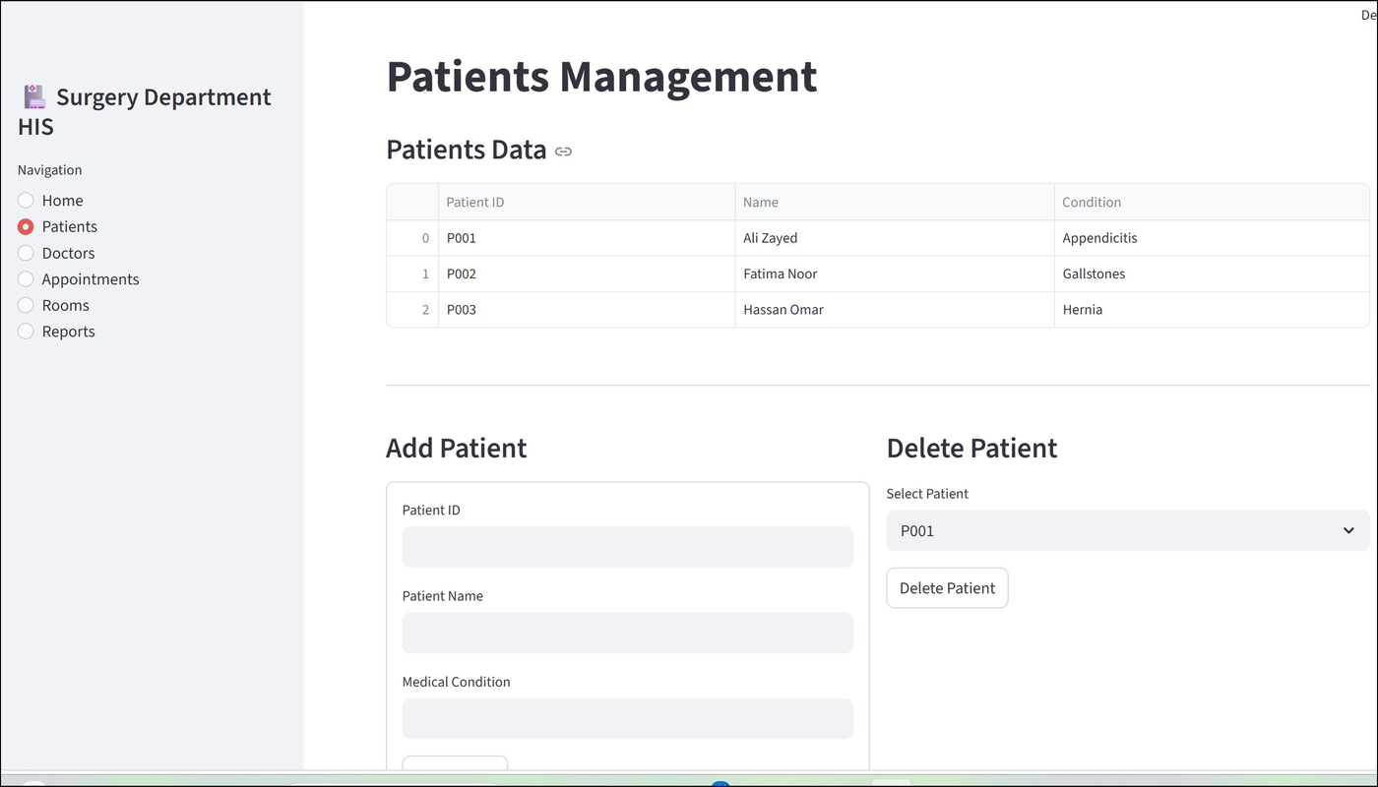
Patients Management
Module Features
View all doctors with doctor_id
Add new doctor profiles
Delete doctor records
Specialization tracking
Department assignment via department_code
Doctors Management

Slide 16
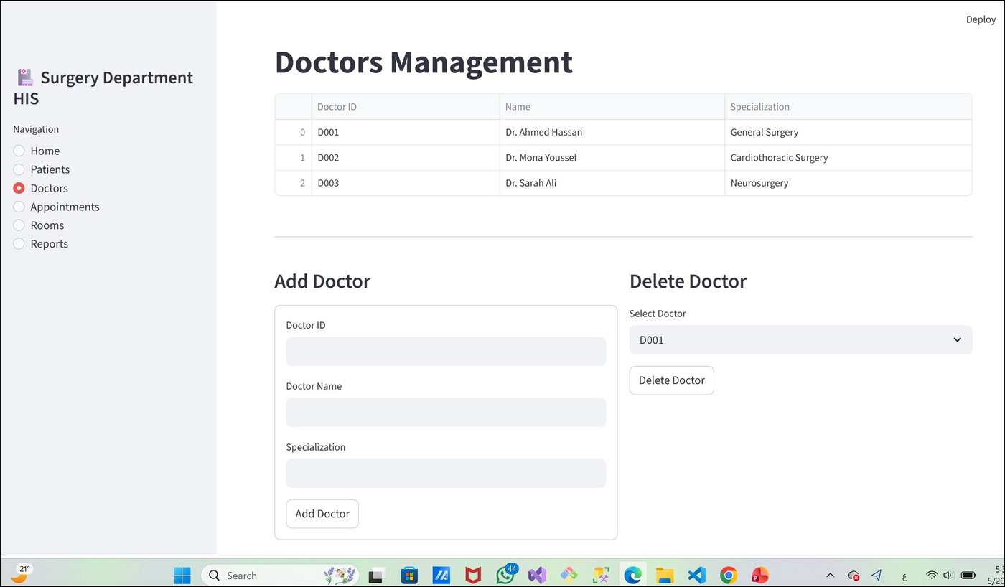
Doctors Management
Module Features
View appointments with patient_number
Book appointment: patient + doctor
Delete appointment by appointment_id
Linked to Surgery_Case via case_id
Payment tracking integration
Appointments Booking

Slide 17
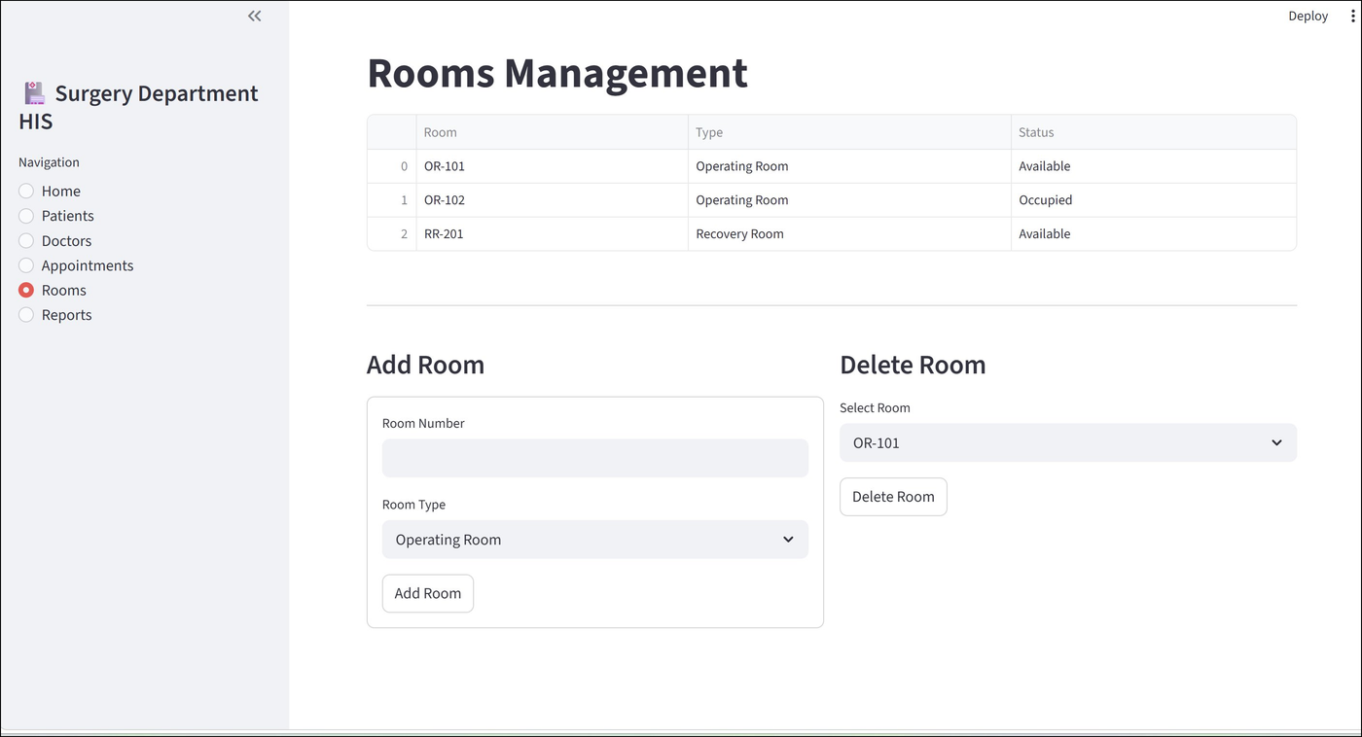
Rooms Management
Module Features
View all rooms with room_id
Add Operating / Recovery rooms
Delete rooms by room_id
Room type classification
Availability status tracking
Rooms Management

Slide 18
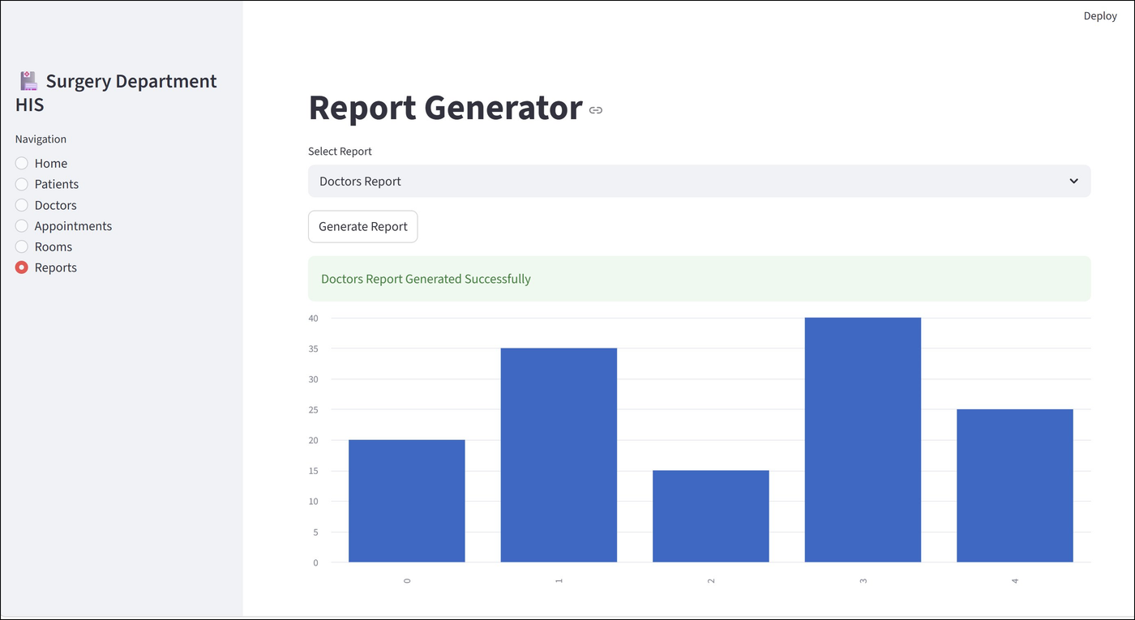
Reports Generator
Demo Analytics
250
Total Patients
35
Doctors
120
Appointments
2
Available Rooms
★ Sample data only
Demo Analytics Preview

Slide 19

Challenges & Solutions
Complex M:N Relationships
Junction tables (Treats, Prescription_Medication, Surgical_Team_Assignment) with composite primary keys
→
Correct Key Naming
Used patient_number (not patient_id) and department_code (not dept_id) to match real schema requirements
→
OR Scheduling Conflicts
Room availability tracked via Surgery_Schedule with case_id and room_id foreign keys
→
Prototype vs Production
Streamlit used for rapid demo; full system designed for PostgreSQL backend with proper FK constraints
→

Slide 20

Conclusion
This project successfully demonstrates the full lifecycle of database-driven application development — from conceptual ERD design through relational schema mapping, SQL implementation, and Streamlit prototype delivery.
Comprehensive patient & doctor data modelling with correct key naming
Operating room scheduling and surgical team coordination
Role-based access with user authentication (Users table, user_id PK)
End-to-end appointment booking with Payment management
Demo analytics dashboard for hospital administration reporting

Slide 21
THANK YOU
Questions & Discussion
Maryam Ali · Gehad Maher · Raneem Khaled · Ahmed Hany · Tasnim Maged
github.com/Raneem30/Surgery-department

