Slide 1

[ SIH 1313 ]IoT-Based System to Prevent Under-Loading & Overloading of Railway Wagons
CORE COURSE PROJECT
Presented by :
K. RANESH KADHIR - 23AC039
DEPARTMENT OF ECE
CHENNAI INSTITUTE OF TECHNOLOGY( Autonomous)

Slide 2

TABLE OF CONTENT
Introduction
Literature survey
Objective
Abstract
System Overview
Problem identification
System Design
Methodology
Software Role
Result Analysis
Conclusion
Reference
DEPARTMENT OF ECE
CHENNAI INSTITUTE OF TECHNOLOGY( Autonomous)

Slide 3
INTRODUCTION
Improper loading of railway wagons leads to significant financial losses and operational inefficiencies.
Overloading damages railway infrastructure, poses safety risks, and attracts heavy penalties.
Under-loading results in inefficient resource utilization and increased transportation costs.
This project presents an IoT-based system for real-time monitoring and weight assessment of railway wagons, ensuring efficient load management and compliance with regulations.
DEPARTMENT OF ECE
CHENNAI INSTITUTE OF TECHNOLOGY( Autonomous)

Slide 4
LITERATURE SURVEY
Conventional weight monitoring methods rely on manual inspection, which is error-prone and time-consuming.
Current railway policies enforce penalties for overloading but lack preventive mechanisms.
IoT technology provides automation, real-time data analytics, and cloud integration, making it an effective solution for load monitoring.
Various sensor-based systems have been proposed, but most lack integration with cloud-based visualization and alert systems.

Slide 5
OBJECTIVE
Develop an IoT-powered railway wagon monitoring system to prevent under-loading and overloading.
Implement sensors and cloud-based platforms to provide real-time tracking and visualization of load conditions.
Automate the process of weight assessment and alert generation to improve operational efficiency and compliance with railway guidelines.
DEPARTMENT OF ECE
CHENNAI INSTITUTE OF TECHNOLOGY( Autonomous)

Slide 6
ABSTRACT
The project focuses on the development of a smart railway wagon monitoring system using IoT technology.
The system consists of load cells and sensors that measure weight and transmit data to a cloud-based dashboard (ThingSpeak).
Based on predefined weight categories, the system identifies underweight, normal weight, and overweight conditions.
A Telegram Bot was planned to provide real-time alerts, but implementation challenges were encountered due to technical limitations.
The system enhances railway logistics, reduces human errors, and ensures compliance with loading regulations.
DEPARTMENT OF ECE
CHENNAI INSTITUTE OF TECHNOLOGY( Autonomous)

Slide 7
PROBLEM IDENTIFICATION
Overloading of railway wagons results in structural damage, increased maintenance costs, and regulatory penalties.
Under-loading causes inefficiencies, leading to financial losses and poor resource utilization.
Manual weight-checking methods are slow, unreliable, and prone to errors.
There is a need for an automated, real-time monitoring system to address these challenges and optimize railway logistics.
DEPARTMENT OF ECE
CHENNAI INSTITUTE OF TECHNOLOGY( Autonomous)

Slide 8
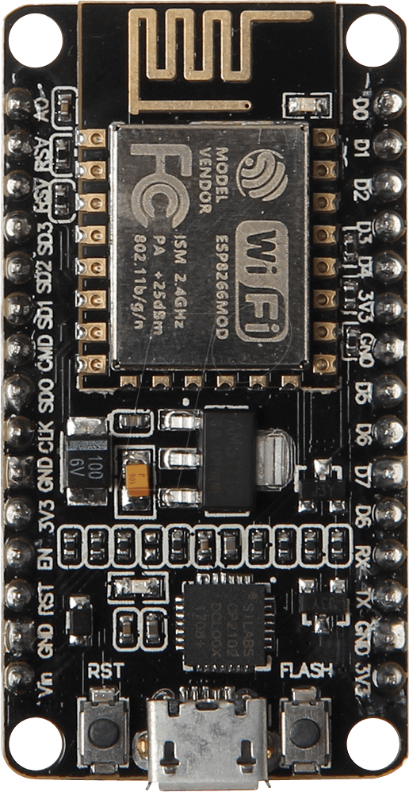
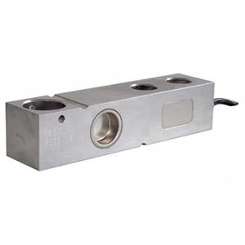
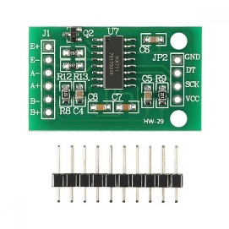
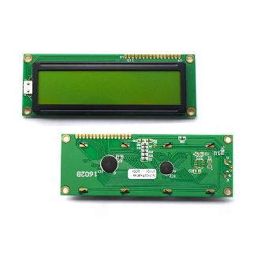


BLOCK DIAGRAM
Load Cell
HX 711
LCD 16X2 ( I2C )
ESP8266
TELEGRAM

Slide 9
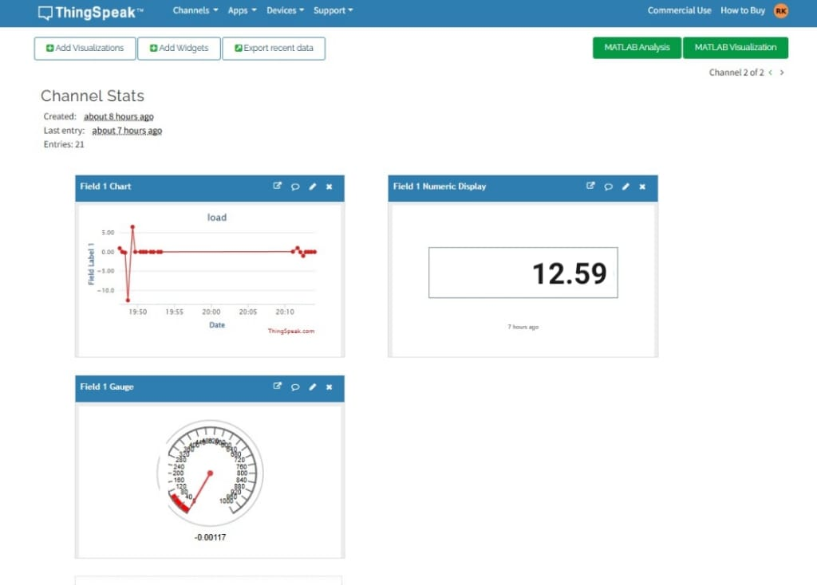
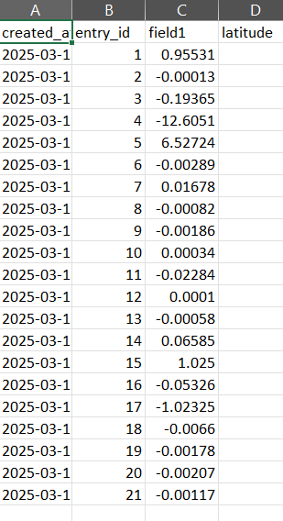
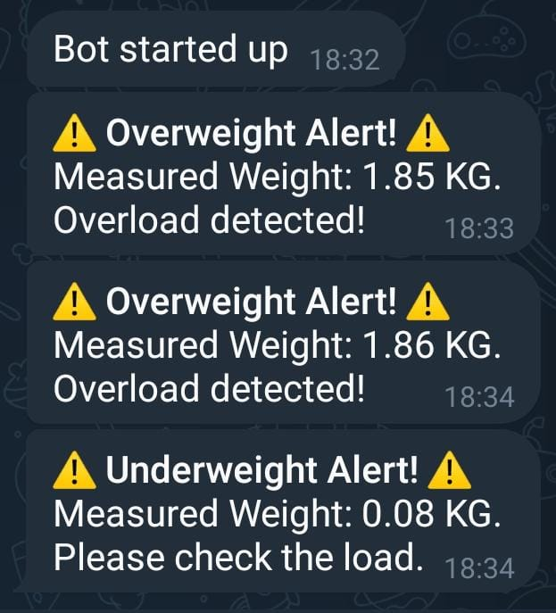
THE OUTPUT

Slide 10
METHODOLOGY
The Load Cell detects weight changes and converts the mechanical load into electrical signals.
The HX-711 sensor amplifies and digitizes the signal for processing.
The ESP8266 WiFi module transmits the data to ThingSpeak, where it is stored and analyzed.
The ThingSpeak dashboard categorizes the weight into different conditions:
0 - 300 kg → Underweight (Requires load adjustment)
300 - 500 kg → Normal Weight (Optimal load)
500 - 1000 kg → Overweight (Requires immediate attention)
A Telegram Bot was designed to send alerts, but due to technical challenges, it was not fully integrated.

Slide 11
SOFTWARE ROLE
ThingSpeak Cloud Platform:
Receives weight data from the IoT system and processes it in real-time.
Provides a visual representation of weight variations, aiding in decision-making.
Enables remote access to load condition reports, reducing the need for manual inspection.
Telegram Bot (Planned Feature):
Designed to send automated alerts indicating underweight, normal weight, or overweight conditions.
Encountered technical difficulties in implementing the messaging functionality due to library errors.
Future improvements will focus on resolving these issues to achieve full functionality.

Slide 12
RESULT ANALYSIS
The system successfully captured and transmitted real-time weight data using IoT components.
ThingSpeak effectively visualized weight conditions, enabling remote monitoring.
Telegram Bot was intended for real-time alerts but faced integration challenges.
The project provides a foundation for future enhancements, including improved alert systems and industrial-scale deployment.

Slide 13
SENSOR RESPONSE
The Load Cell accurately detected weight variations and transmitted data with minimal lag.
Real-time updates allowed for immediate identification of load conditions.\
The system demonstrated high accuracy in distinguishing between under-loading, normal loading, and overloading scenarios.
Future enhancements can include multi-sensor integration to improve measurement precision.

Slide 14
CONCLUSION
This IoT-based railway wagon monitoring system automates weight assessment, ensuring compliance with loading regulations.
Minimizes financial losses and improves operational efficiency.
Reduces reliance on manual monitoring, enhancing accuracy and reliability.
Future improvements include fixing the Telegram Bot functionality and scaling the system for widespread use in railway logistics.

Slide 15
THANK YOU

