Slide 1
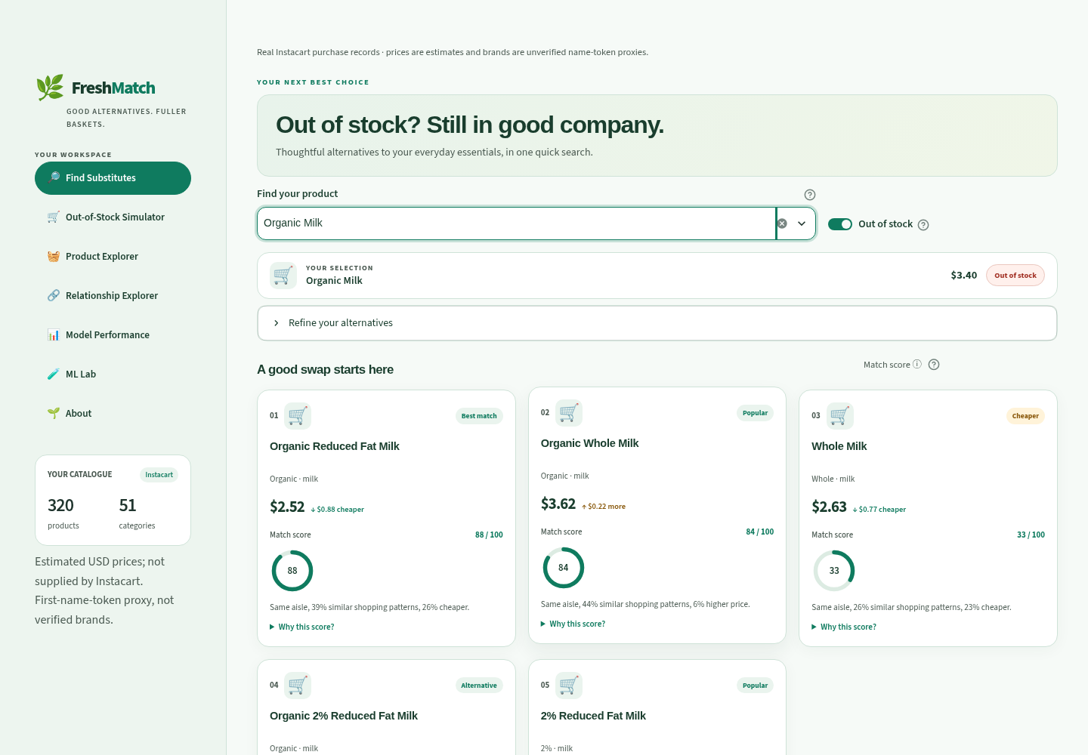
GROCERY SUBSTITUTION WORKBENCH
THE REAL-DATA APP
FreshMatch
Explainable grocery swaps
using machine learning
Real purchase records. Clear comparisons.
A working app you can inspect.
PROJECT TEAM
K. Darshan Sai · RA2311027010002
J. Ranga Mokshagna · RA2311027010003
P. Bharat Sai · RA2311027010007
Python · XGBoost · LambdaMART · Streamlit
FreshMatch · Real Instacart study
01 / 10
Notes:
Introduce FreshMatch as an explainable grocery substitution workbench. The current demonstration uses real Instacart product and purchase records. Our experiment selects 320 products and 3,000 households; this is a bounded research sample, not the full retail universe. Prices are estimates and brand strings are name-token proxies. The screenshots in this presentation were freshly captured from the real-data app.

Slide 2
FRESHMATCH / PROBLEM
A missing item should not end the basket
01
02
03
A shopper needs milk
Several choices exist
A useful swap is
needed
→
→
The preferred product is
unavailable.
Names and prices alone are
not enough.
Show relevant, available
alternatives.
Our goal
Find plausible alternatives, explain the match, and let the user control price and
availability.
FreshMatch · Real Instacart study
02 / 10
Notes:
Example: a shopper wants organic milk and their preferred item is unavailable. We suggest same-aisle candidates, show an estimated price difference, and explain suitability. Products bought together are often complements, not replacements, so co-purchase alone is not our substitute rule. We do not promise nutritional equivalence, dietary safety or actual sales recovery.

Slide 3
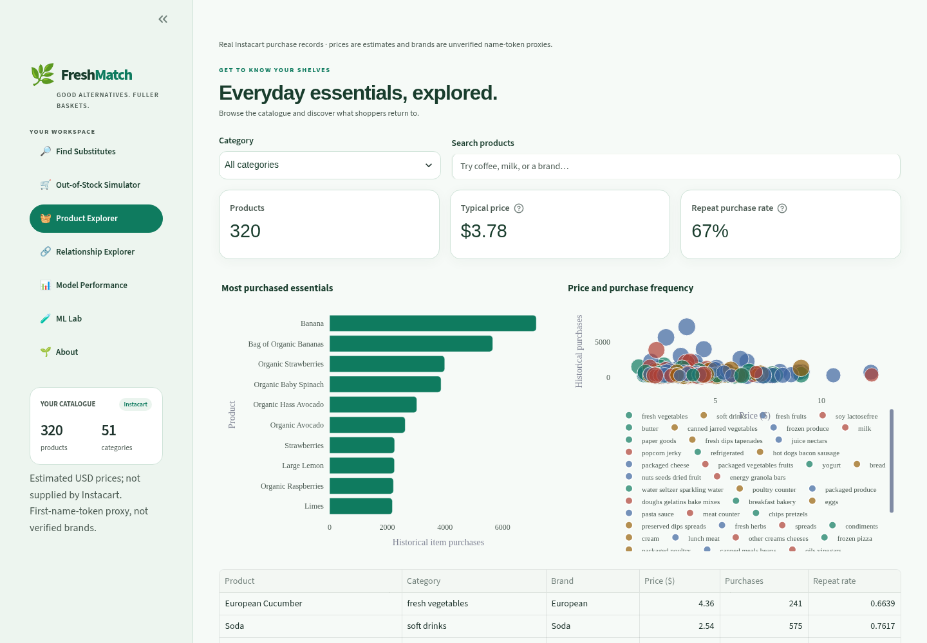
FRESHMATCH / DATASET
Real Instacart records, with a clear study sample
49,688
320
products in the source
products in this study
3,000
49,760
sampled households
historical baskets
3,000 final baskets are held out.
The selected catalogue spans 51 aisles.
Real purchases; estimated prices and brand proxies.
Product Explorer · current real-data catalogue
FreshMatch · Real Instacart study
03 / 10
Notes:
The source has 49,688 products across 134 aisles. We sample whole households, then select 320 products by historical purchase frequency. Each household’s last available prior order is held out; earlier prior orders form history. The experiment uses 49,760 historical baskets and 3,000 final baskets from 3,000 households. Source hashes are recorded. These are not Kaggle’s hidden competition test labels. Instacart does not contain observed prices or verified brands.

Slide 4
FRESHMATCH / PIPELINE
From basket history to an explained recommendation
01
02
03
04
05
Validate
records
Learn
relationships
Train and
compare
Apply user
filters
Explain the
result
→
→
→
→
CSV schemas and
source hashes
Names, shopping
context and
co-purchase
Six classifiers and
a behavioral ranker
Same aisle, price
cap
and unavailable
items
Ranked alternatives
with clear reasons
Signals used by the models
Product information
Shopping behavior
Relative fit
Category and TF-IDF name similarity
Context, lift and reorder patterns
Estimated price and popularity ratios
FreshMatch · Real Instacart study
04 / 10
Notes:
Data validation checks schemas, identifiers, references and LFS content. Historical baskets feed Apriori and FP-Growth complement mining and pair-feature construction. Weak heuristic labels train suitability models; an independent behavioral ranking experiment learns historical switching. Eligibility, price and availability filters are applied when serving candidates. The notebook writes portable inference artifacts consumed by Streamlit. Historical features remain shared across households, so evaluation is transductive.

Slide 5
FRESHMATCH / MODELS
Two learning tasks: suitability and behavior
SUITABILITY
BEHAVIORAL RANKING
Six models, the same evaluation
rules
LambdaMART
Random Forest · Gradient Boosting
Logistic Regression · XGBoost
MLP · Soft voting
Learns which alternatives appear
in later purchase records.
8,840 training groups
147,340 candidate rows
Main app: calibrated XGBoost
Selected by training-CV average precision.
Scores follow rule-based training labels.
Selected on validation NDCG@5:
depth 2, 160 trees.
FreshMatch · Real Instacart study
05 / 10
Notes:
The six classifiers are Random Forest, Gradient Boosting, Logistic Regression, XGBoost, MLPClassifier and RF/GB/XGB soft voting. Training-CV average precision chooses XGBoost for the main app; sigmoid calibration maps outputs to weak-label frequencies, not acceptance probabilities. LambdaMART uses XGBRanker with rank:ndcg on historical switches. Four configurations compete on validation NDCG@5; depth 2 and 160 trees are selected. No test scores choose either deployed classifier or ranker configuration.

Slide 6
FRESHMATCH / EVALUATION
Train, choose and test on separate groups
Suitability models: keep products separate
2,036 train pairs
266 test pairs
1,532 pairs removed
Training with three validation folds
Train and test use different products
Pairs crossing the split are removed
Behavioral ranker: keep households separate
2,100 train households
450 validation households
450 test households
Historical switches fit the ranker
384 events choose the configuration
365 events from 163 households
Limits: only 5 test pairs labelled as good swaps; history features still use all households.
FreshMatch · Real Instacart study
06 / 10
Notes:
Classifier partitions are product-disjoint at both endpoints and purge crossing pairs. Seeded category-balanced assignments use label counts only to guarantee at least five examples of each class per retained partition. The outer test has 266 pairs but only five positive weak labels, so classification scores are fragile. Behavioral households split 70/15/15: 2,100 train, 450 validation, 450 reserved test. There are 384 validation and 365 test switching events; only 163 reserved test households generate qualifying events. Historical features use all households: transductive rather than fully inductive evaluation.

Slide 7
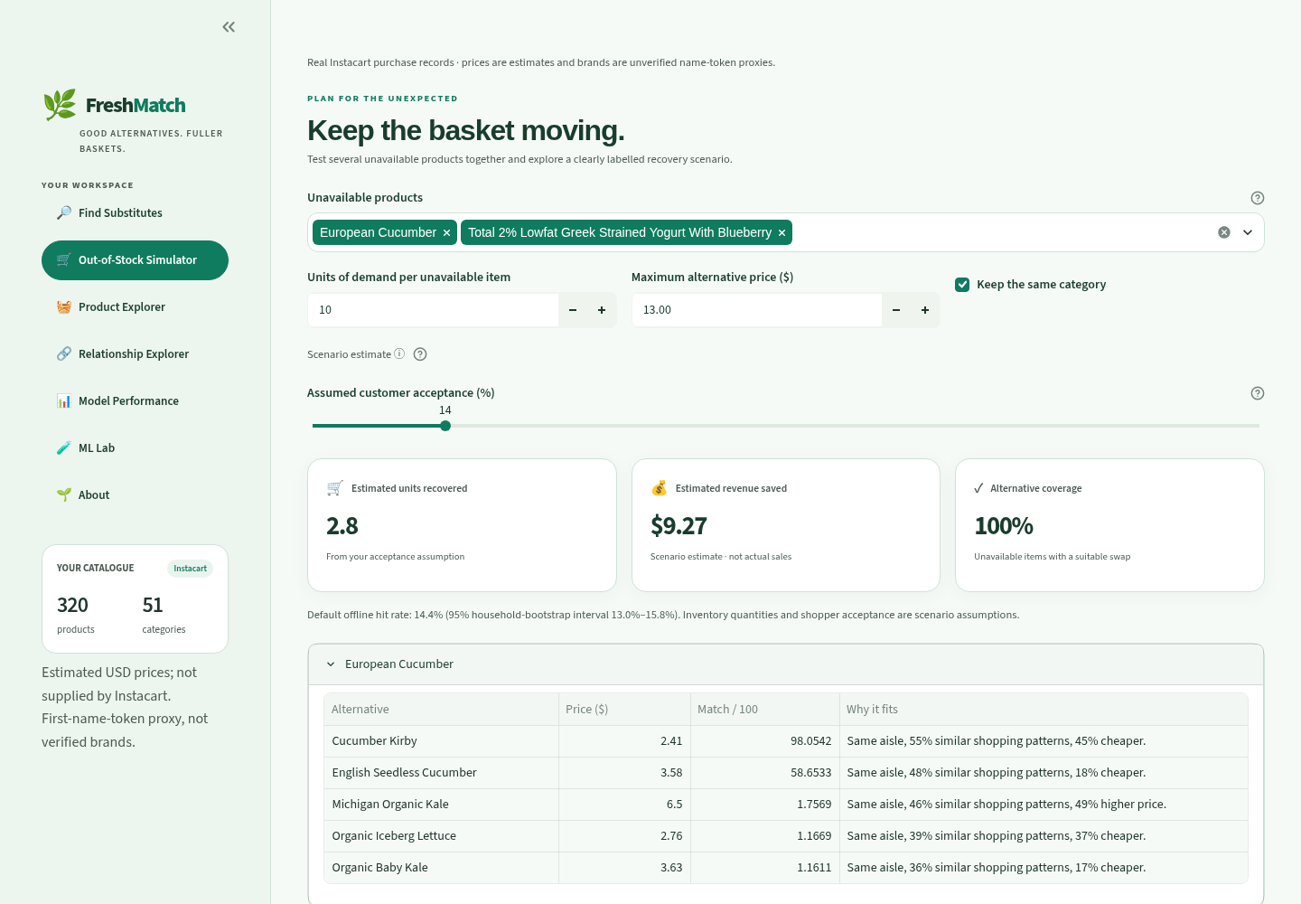
FRESHMATCH / APP DEMO · SHOPPER PAGES
Find a swap, then test a stockout scenario
Find Substitutes
Search, filter and read the reason
for each suggested alternative.
Stockout Simulator
Explore an assumed recovery scenario.
FreshMatch · Real Instacart study
07 / 10
Notes:
The screenshots are actual captures of the current real-data app. Find Substitutes searches Organic Milk, ranks eligible alternatives and shows model sensitivities, estimated price differences and exports. Out-of-Stock Simulator excludes multiple products and uses an explicitly chosen acceptance assumption to estimate units/revenue; it is not observed recovery. Product Explorer, shown on the data slide, adds category and purchase-frequency views. Main-card scores are suitability, not purchase probabilities.

Slide 8
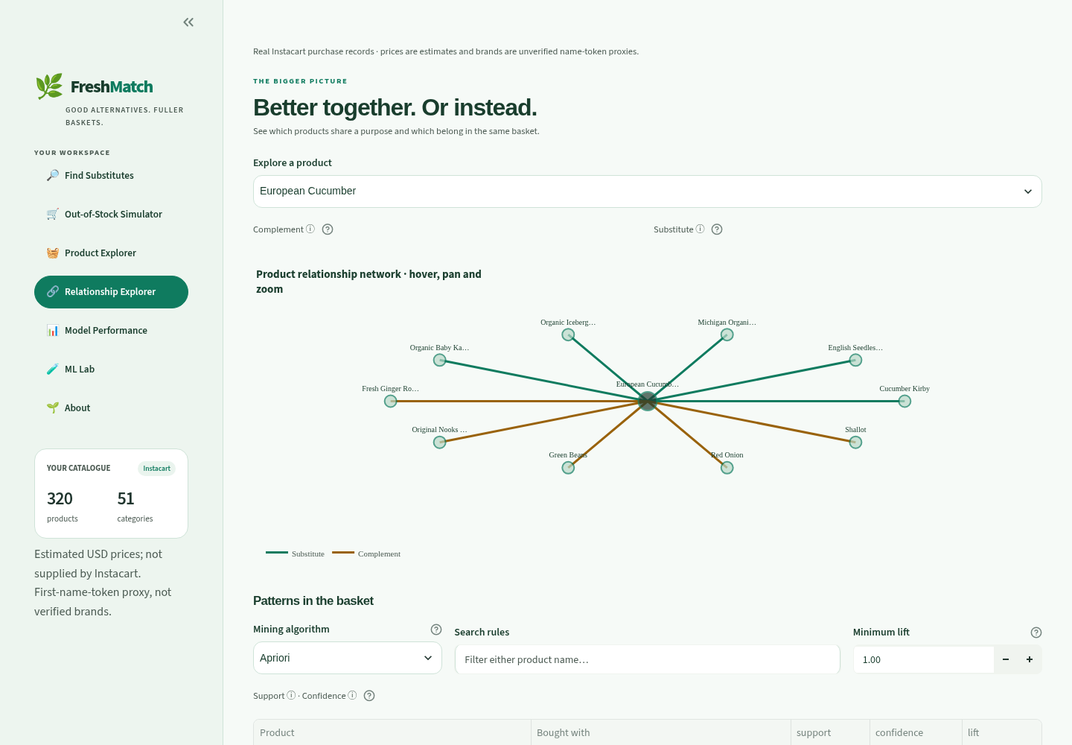
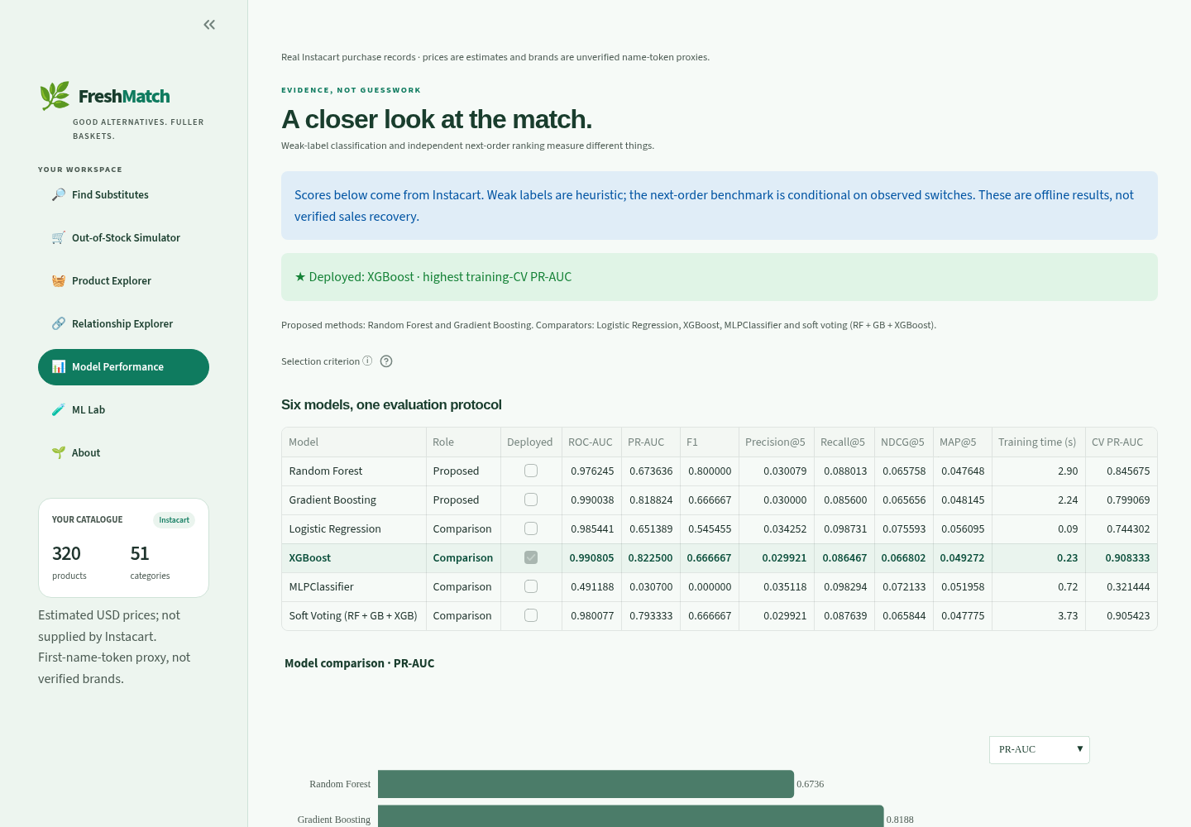
FRESHMATCH / APP DEMO · EVIDENCE PAGES
Show the relationship—and the evidence behind it
Different relationships
Complements are bought together.
Substitutes are possible replacements.
Model Performance
Compare results, errors and feature influence.
FreshMatch · Real Instacart study
08 / 10
Notes:
Relationship Explorer separates complements (frequently purchased together) from predicted eligible alternatives. Main-card occlusion sensitivities compare one feature with its training median; they are not additive or causal explanations. Model Performance compares six models, ROC/PR, confusion matrices, permutation importance and future ranking baselines. These screenshots are genuine real-data app captures. ML Lab is shown on the next slide. About records the method, team and limitations.

Slide 9
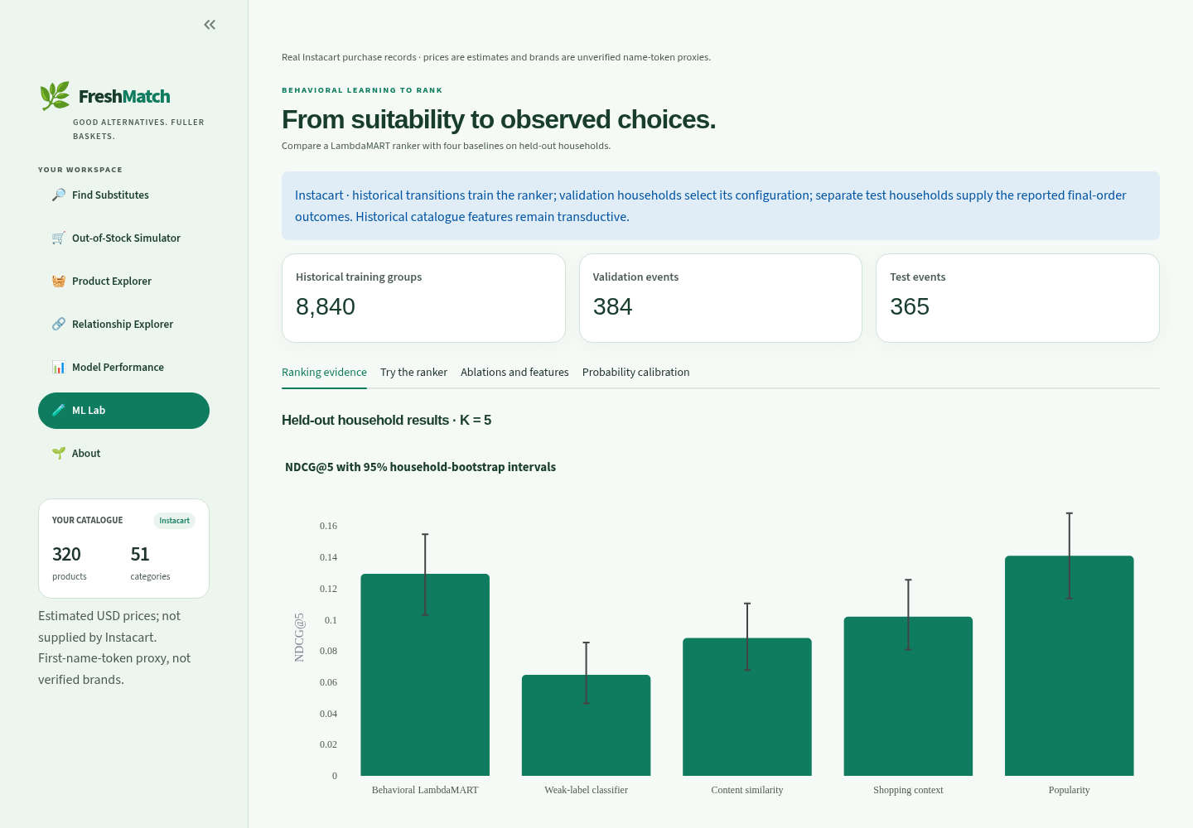
FRESHMATCH / REAL-DATA RESULTS
The ranker improves on suitability; popularity still leads
Ranking quality (NDCG@5) · higher is better
Behavioral ranker
0.1294
Suitability model
0.0647
Name similarity
0.0883
Shopping context
0.1019
Popularity
0.1409
36.7% target coverage
Same 365 test events · observed purchase switches
Better candidate coverage is the next priority.
FreshMatch · Real Instacart study
09 / 10
Notes:
All five methods below use the same 365 held-out switching events and eligible candidate pools. NDCG@5 rewards placing observed relevant products nearer the top; higher is better. Behavioral LambdaMART is 0.1294 and the weak-label classifier is 0.0647. Their paired household-bootstrap difference is +0.0647 with 95% interval [+0.0437,+0.0859]. Popularity is higher at 0.1409, so we do not claim the learned ranker is best. Only 36.7% of events have any relevant target inside eligibility; excluded targets remain in metric denominators. These are proxy switches, not confirmed substitutions or causal recovered sales.

Slide 10
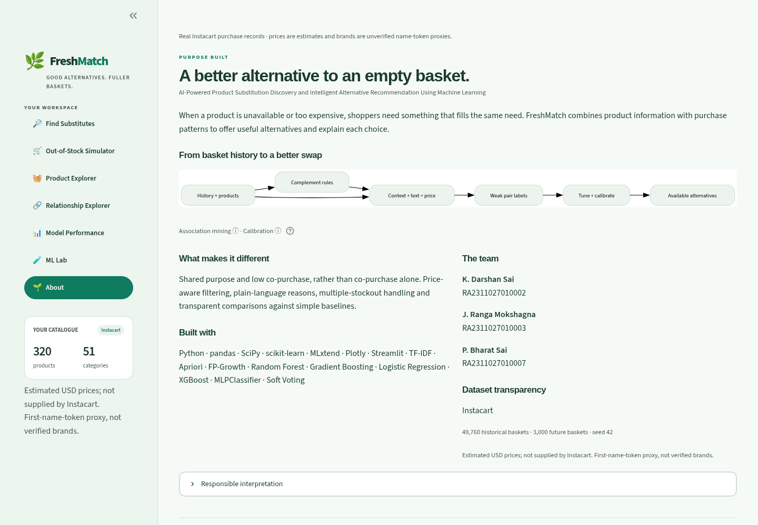
FRESHMATCH / CONCLUSION
A working research project, with clear next steps
23 tests passed
Seven working pages · reproducible real-data run
What works
Real purchase data, explained suggestions and transparent
evaluation.
What comes next
Wider candidate coverage, expert labels and real price /
ingredient data.
Limits to remember
Prices are estimates; dietary safety and actual sales
recovery are unverified.
Thank you. Questions?
FreshMatch · Real Instacart study
10 / 10
Notes:
Conclude with evidence rather than an inflated success claim. All 23 local tests pass, covering all seven app pages plus splits, input data, scores and uncertainty. The project is reproducible and uses real purchase records. The next experiment should address candidate eligibility/coverage; additional expert substitute labels, observed price/pack-size/ingredient information and prospective acceptance testing are needed. Brand tokens and estimated prices are not verified retail data. The About page makes those boundaries visible. Invite questions.

