Slide 1
Feature selection

Slide 2
What is feature selection?
Consider our training data as a matrix where each row is a vector and each column is a dimension.
For example consider the matrix for the data x₁=(1, 10, 2), x₂=(2, 8, 0), and x₃=(1, 9, 1)
We call each dimension a feature or a column in our matrix.

Slide 3
Feature selection
Useful for high dimensional data such as genomic DNA and text documents.
Methods
  Univariate (looks at each feature independently of others)
    Chi-square
    Pearson correlation coefficient
    F-score
    Signal to noise ratio
  Multivariate (considers all features simultaneously)
    Dimensionality reduction algorithms(PCA, SVD, MDS, ICA)
    Linear classifiers such as support vector machine
    Recursive feature elimination

Slide 4
Feature selection
Methods are used to rank features by importance
Ranking cut-off is determined by user
Univariate methods measure some type of correlation between two random variables. We apply them to machine learning by setting one variable to be the label (y_{i}) and the other to be a fixed feature (x_{ij} for fixed j)

Slide 5
Chi-square test
Contingency table
We have two random variables:
  Label (L): 0 or 1
  Feature (F): Categorical
Null hypothesis: the two variables are independent of each other (unrelated)
Under independence
  P(L,F)= P(D)P(G)
  P(L=0) = (c1+c2)/n
  P(F=A) = (c1+c3)/n
Expected values
  E(X1) = P(L=0)P(F=A)n
We can calculate the chi-square statistic for a given feature and the probability that it is independent of the label (using the p-value).
Features with very small probabilities deviate significantly from the independence assumption and therefore considered important.
Feature=A
Feature=B
Label=0
Observed=c1
Expected=X1
Observed=c2
Expected=X2
Label=1
Observed=c3
Expected=X3
Observed=c4
Expected=X4

Slide 6
χ² Test of Independence Between 2 Categorical Variables
Notes:
37
9

Slide 7
χ² Test of Independence
1. Shows If a Relationship Exists Between 2 Qualitative Variables, but does Not Show Causality
2. Assumptions
  Multinomial Experiment
  All Expected Counts ≥ 5
3. Uses Two-Way Contingency Table

Slide 8
Conducting Chi-Square Analysis
Determine the expected frequencies
Create a table with observed frequencies, expected frequencies, and chi-square values using the formula:
(O-E)²
E
Find the degrees of freedom: (c-1)(r-1)
Find the chi-square statistic in the Chi-Square Distribution table
If chi-square statistic > your calculated chi-square value, you do not reject your null hypothesis and vice versa.

Slide 9
χ² Test of Independence Contingency Table
1. Shows # Observations From 1 Sample Jointly in 2 Qualitative Variables
Levels of variable 2
Levels of variable 1
Notes:
40

Slide 10
χ² Test of Independence
Hypotheses & Statistic
1. Hypotheses
  H₀: Variables Are Independent
  H_{a}: Variables Are Related (Dependent)
Notes:
41

Slide 11
χ² Test of Independence
Hypotheses & Statistic
1. Hypotheses
  H₀: Variables Are Independent
  H_{a}: Variables Are Related (Dependent)
2. Test Statistic
Observed count
Expected count
EPI809/Spring 2008
Notes:
41

Slide 12
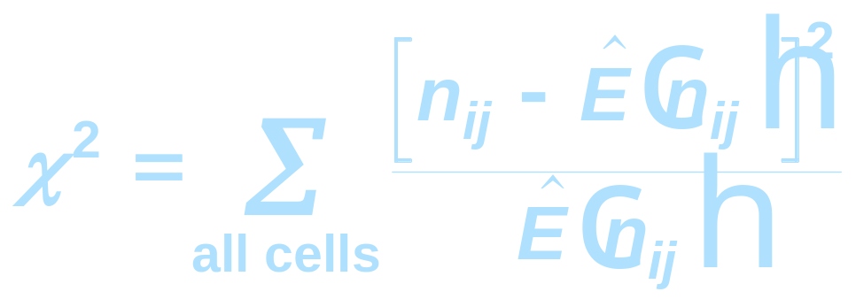
χ² Test of Independence
Hypotheses & Statistic
1. Hypotheses
  H₀: Variables Are Independent
  H_{a}: Variables Are Related (Dependent)
2. Test Statistic
Degrees of Freedom: (r - 1)(c - 1)
Observed count
Expected count
Rows Columns
EPI809/Spring 2008
Notes:
41

Slide 13
χ² Test of Independence Expected Counts
1. Statistical Independence Means Joint Probability Equals Product of Marginal Probabilities
2. Compute Marginal Probabilities & Multiply for Joint Probability
3. Expected Count Is Sample Size Times Joint Probability
EPI809/Spring 2008
Notes:
f
a
f

Slide 14
Expected Count Example
Marginal probability =
112
160
EPI809/Spring 2008
Notes:
43

Slide 15
Expected Count Example
Marginal probability =
112
160
78
160
Marginal probability =
EPI809/Spring 2008
Notes:
43

Slide 16
Expected Count Example
112
160
78
160
112
160
Joint probability =
Marginal probability =
78
160
Marginal probability =
EPI809/Spring 2008
Notes:
43

Slide 17
Expected Count Example
112
160
78
160
112
160
Joint probability =
Marginal probability =
112
160
78
160
Expected count = 160·
78
160
Marginal probability =
= 54.6
EPI809/Spring 2008
Notes:
43

Slide 18
Expected Count Calculation
EPI809/Spring 2008
Notes:
43

Slide 19
Expected Count Calculation
112x78
160
112x82
160
48x78
160
48x82
160
EPI809/Spring 2008
Notes:
43

Slide 20
χ² Test of Independence
Example on HIV
You randomly sample 286 sexually active individuals and collect information on their HIV status and History of STDs. At the .05 level, is there evidence of a relationship?
EPI809/Spring 2008
Notes:
44

Slide 21
χ² Test of Independence Solution
EPI809/Spring 2008
Notes:
47

Slide 22
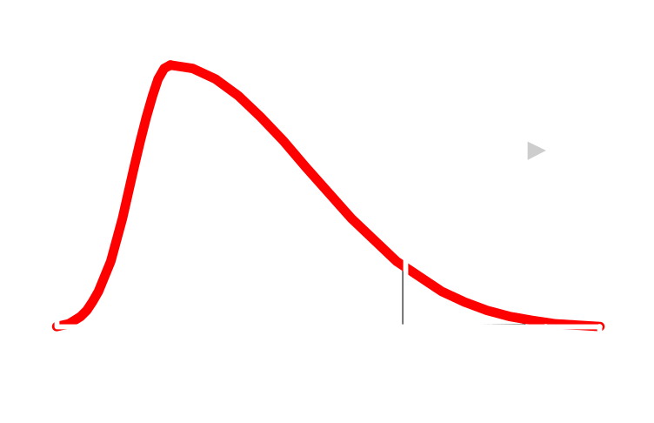
χ² Test of Independence Solution
H0:
Ha:
α =
df =
Critical Value(s):
Test Statistic:
Decision:
Conclusion:
EPI809/Spring 2008
Notes:
47

Slide 23
χ² Test of Independence Solution
H0: No Relationship
Ha: Relationship
α =
df =
Critical Value(s):
Test Statistic:
Decision:
Conclusion:
EPI809/Spring 2008
Notes:
47

Slide 24
χ² Test of Independence Solution
H0: No Relationship
Ha: Relationship
α = .05
df = (2 - 1)(2 - 1) = 1
Critical Value(s):
Test Statistic:
Decision:
Conclusion:
EPI809/Spring 2008
Notes:
47

Slide 25
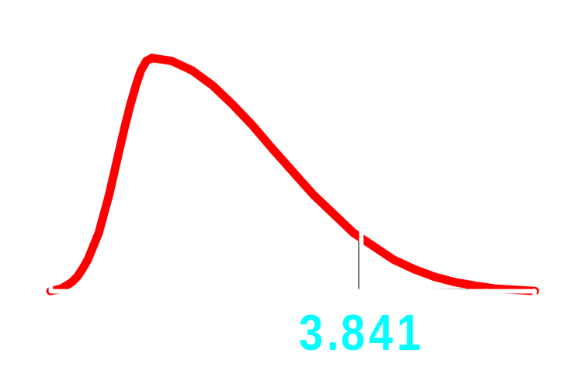
χ² Test of Independence Solution
H0: No Relationship
Ha: Relationship
α = .05
df = (2 - 1)(2 - 1) = 1
Critical Value(s):
Test Statistic:
Decision:
Conclusion:
α = .05
EPI809/Spring 2008
Notes:
47

Slide 26
χ² Test of Independence Solution
✓
E(n_{ij}) ≥ 5 in all cells
116x132
286
154x116
286
170x132
286
170x154
286
EPI809/Spring 2008
Notes:
45

Slide 27
χ² Test of Independence Solution
EPI809/Spring 2008
Notes:
12

Slide 28
χ² Test of Independence Solution
H0: No Relationship
Ha: Relationship
α = .05
df = (2 - 1)(2 - 1) = 1
Critical Value(s):
Test Statistic:
Decision:
Conclusion:
χ² = 54.29
α = .05
EPI809/Spring 2008
Notes:
47

Slide 29
χ² Test of Independence Solution
H0: No Relationship
Ha: Relationship
α = .05
df = (2 - 1)(2 - 1) = 1
Critical Value(s):
Test Statistic:
Decision:
Conclusion:
χ² = 54.29
Reject at α = .05
α = .05
EPI809/Spring 2008
Notes:
47

Slide 30
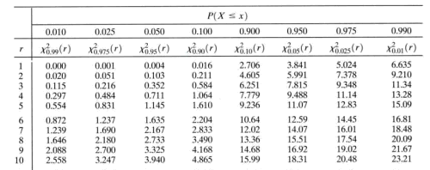
Chi square test table
χ²_{α=0.05} = 3.841

Slide 31
χ² Test of Independence Solution
H0: No Relationship
Ha: Relationship
α = .05
df = (2 - 1)(2 - 1) = 1
Critical Value(s):
Test Statistic:
Decision:
Conclusion:
χ² = 54.29
Reject at α = .05
α = .05
There is evidence of a relationship
EPI809/Spring 2008
Notes:
47

Slide 32
Multivariate feature selection
Consider the vector w for any linear classifier.
Classification of a point x is given by wTx+w0.
Small entries of w will have little effect on the dot product and therefore those features are less relevant.
For example if w = (10, .01, -9) then features 0 and 2 are contributing more to the dot product than feature 1. A ranking of features given by this w is 0, 2, 1.

Slide 33
Multivariate feature selection
The w can be obtained by any of linear classifiers we have see in class so far
A variant of this approach is called recursive feature elimination:
  Compute w on all features
  Remove feature with smallest w_{i}
  Recompute w on reduced data
  If stopping criterion not met then go to step 2

Slide 34
Why dimensionality reduction?
Some features may be irrelevant
We want to visualize high dimensional data
“Intrinsic” dimensionality may be smaller than the number of features

Slide 35
PCA Algorithm
PCA algorithm:
  1. X ← Create N x d data matrix, with one row vector x_{n} per data point
  2. X subtract mean x from each row vector x_{n} in X
  3. Σ ← covariance matrix of X
  Find eigenvectors and eigenvalues of Σ
  PC’s ← the M eigenvectors with largest eigenvalues

Slide 36
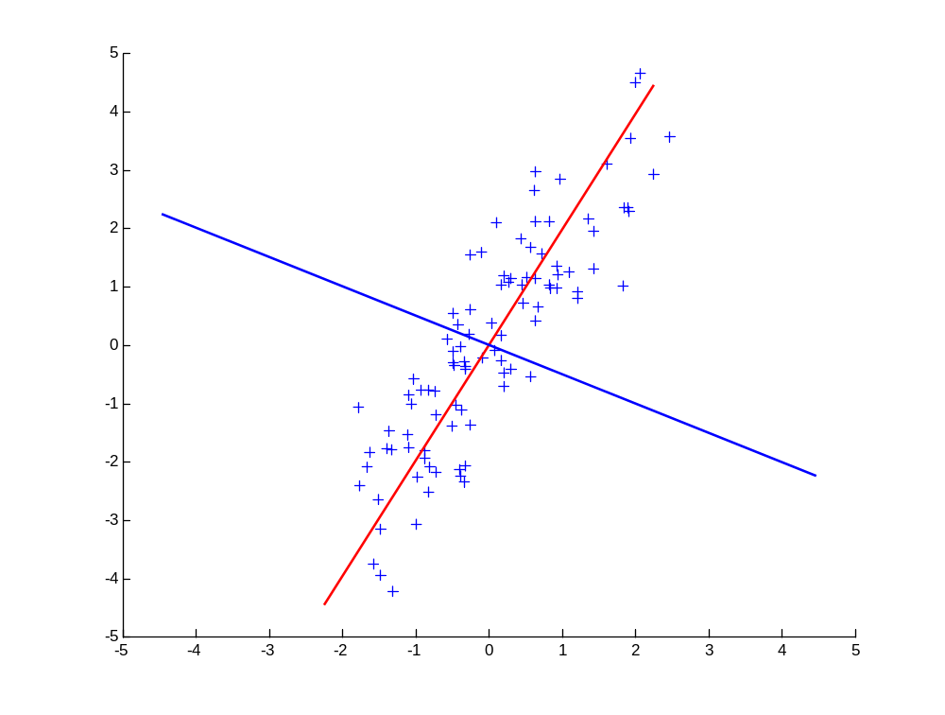
Principal Components
1st principal vector
Gives best axis to project
Minimum RMS error
Principal vectors are orthogonal
2nd principal vector

Slide 37
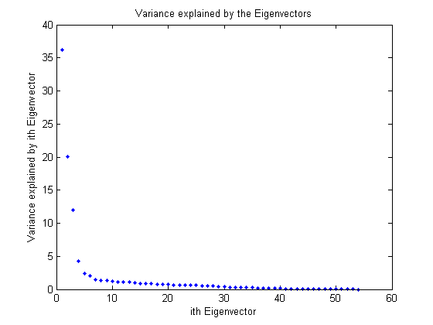
How many components?
Check the distribution of eigen-values
Take enough many eigen-vectors to cover 80-90% of the variance

Slide 38
Feature selection in practice
NIPS 2003 feature selection contest
  Contest results
  Reproduced results with feature selection plus SVM
Effect of feature selection on SVM
Comprehensive gene selection study comparing feature selection methods
Ranking genomic causal variants with SVM and chi-square

Slide 39
Limitations
Unclear how to tell in advance if feature selection will work
  Only known way is to check but for very high dimensional data (at least half a million features) it helps most of the time
How many features to select?
  Perform cross-validation

