Slide 1
TNSDC - GENERATIVE AI FOR ENGINEERING
FINAL PROJECT
SUBMITTED BY:
RANGAPRIYA R

Slide 2
PROJECT TITLE- Time Series Forecasting with Recurrent Neural Networks

Slide 3
AGENDA
Problem Statement
Project Overview
End Users
Value Proposition
Solution
Modelling
Results

Slide 4
PROBLEM STATEMENT:
Stock market investors and traders face the challenge of accurately predicting future stock prices, which is crucial for making informed investment decisions. Traditional time series forecasting methods often struggle to capture the complex patterns and dependencies present in stock price data, leading to unreliable predictions. There is a need for a robust forecasting solution that can effectively leverage historical stock price data to generate accurate predictions for future stock prices.

Slide 5
PROJECT OVERVIEW:
Our project aims to develop a time series forecasting model using Recurrent Neural Networks (RNNs) to predict future stock prices based on historical data. By analyzing past trends and patterns in stock prices, we seek to build a predictive model that can provide valuable insights for investors and traders. The model will be trained on historical stock price data from the Yahoo Finance dataset and evaluated based on its ability to accurately forecast future stock prices.

Slide 6
END USERS:
The end users of our time series forecasting model include:
Individual Investors
Financial Analysts
Trading Firms
who rely on accurate stock price predictions to make investment decisions. Additionally, institutional investors, portfolio managers, and algorithmic traders will benefit from improved forecasting accuracy to optimize their trading strategies and maximize returns.

Slide 7
VALUE PROPOSITION:
Our time series forecasting model offers several key benefits to investors and traders. Firstly, it enhances decision-making by providing reliable predictions of future stock prices, empowering users to make more informed and data-driven investment choices. Secondly, it improves risk management by enabling users to identify potential market downturns or volatility spikes and adjust their portfolio allocations accordingly, thereby minimizing downside risk. Thirdly, it increases profitability by identifying profitable trading opportunities and optimizing the timing and execution of trades based on predicted stock price movements. Overall, our model facilitates more effective resource allocation in the stock market, allowing users to capitalize on opportunities while mitigating risks and maximizing returns.

Slide 8
SOLUTION:
Our solution involves developing an RNN-based time series forecasting model that can effectively capture the temporal dependencies and patterns present in stock price data. By preprocessing the historical stock price data and training the RNN model on sequential input-output pairs, we aim to build a robust forecasting model capable of generating accurate predictions for future stock prices..

Slide 9
MODELLING:
The modelling phase involves the following steps:
Preprocessing: Prepare historical stock price data, including relevant features like open, high, low, close prices, and trading volume.
Model Design: Create and train the RNN architecture, adjusting hyperparameters, and optimizing performance through techniques like cross-validation and grid search.
Evaluation: Assess the model's forecasting accuracy using metrics like Mean Absolute Error (MAE) and Root Mean Squared Error (RMSE).

Slide 10
RESULTS:
Upon completion of the project, we expect to achieve significant improvements in stock price forecasting accuracy compared to traditional methods. Our RNN-based forecasting model will be capable of generating reliable predictions of future stock prices, providing valuable insights for investors and traders. By leveraging advanced deep learning techniques, our solution aims to empower users with actionable intelligence to navigate the dynamic and unpredictable stock market landscape.

Slide 11
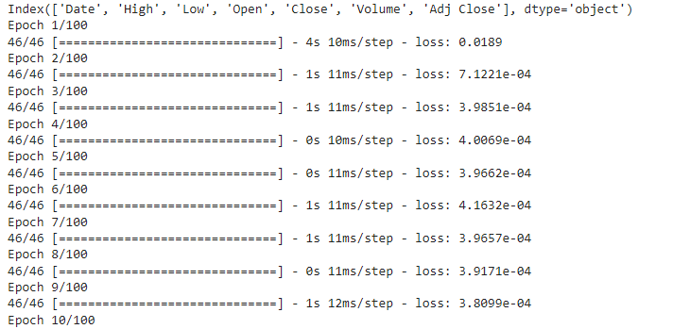
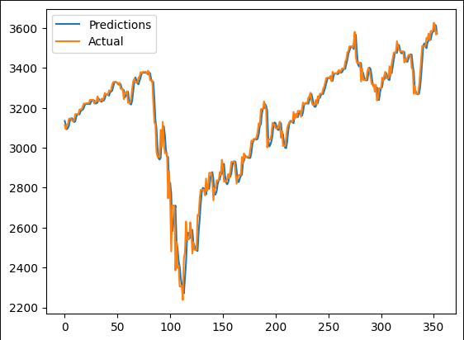
OUTPUT:

Slide 12
THANK YOU
PROJECT LINK:
https://github.com/RangapriyaR/GENERATIVE-AI-Rangapriya

