Slide 1

ANALYSIS OF AMCAT DATA
BY
R.Akanksha

Slide 2
About me
Background : B.Sc (Data Science)
Why I want to learn Data Science – Data science skills are in high demand across industries, offering great job opportunities and career advancement . It helps you analyze data to make better decisions, solve problems, and create value for businesses and society.
Any work experience – Fresher
Linkin - https://www.linkedin.com/in/rangapuram-akanksha/
GitHub - https://github.com/RangapuramAkanksha

Slide 3
Agenda
Introduction :
The dataset is released by AMCAT which is an organization will conduct test for the engineering students who seeking job.
The test results was shared with recruiters they will conduct the direct interview for students who performed well.
Objective :
Based on students performance on AMCAT test, engineering background find out salary, job titles, job locations, employment roles.

Slide 4
Business Problem:
Many companies struggle to find the right candidates who will perform well in the job based on their qualifications, test scores, and personal traits.
Objective:
The objective is to analyze AMCAT data (which includes students' academic performance, skills assessment, and personality traits) to build a predictive model.
This model will help companies identify candidates who are most likely to excel in specific job roles, improving hiring efficiency and job fit.

Slide 5
Libraries I have Used:
Data Cleaning Steps:
Understanding the Data
2. Handling Missing Values
3. Correcting Data Types
4. Handling Outliers
5. Standardizing Categorical Variables
6.Dealing with Duplicates
7. Feature Engineering
8. Handling Inconsistent Data
9. Consistency Checks
10. Final Verification
Pandas
NumPy
Matplotlib
Seaborn

Slide 6
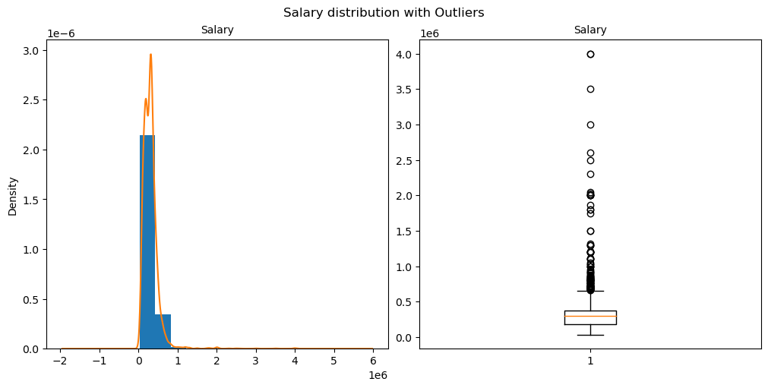
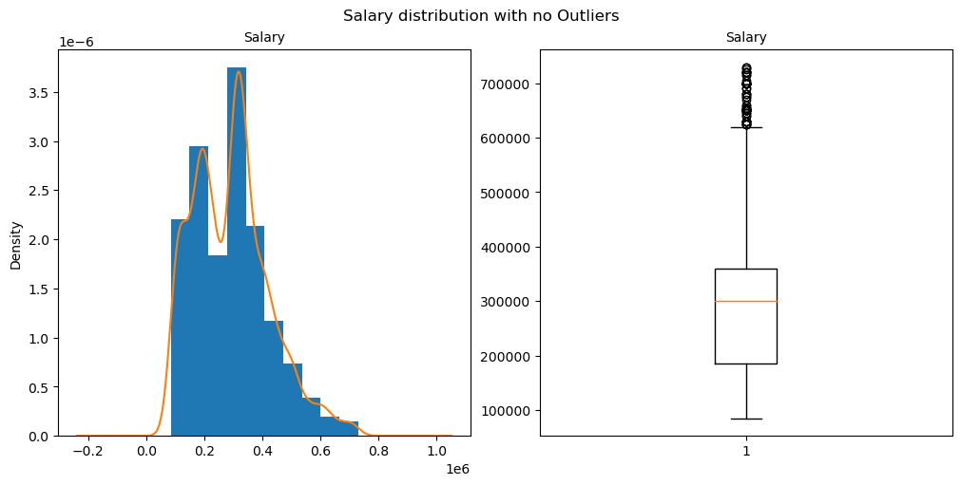
Handling Outliers in Target column : Salary
Before Outliers
After Outliers

Slide 7
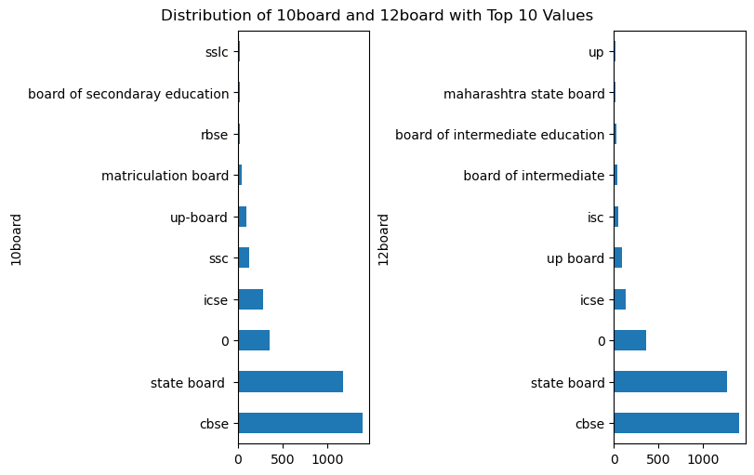
Univariate Analysis : Categorical ​
Most of students studied their 10th and intermediate in cbse .

Slide 8
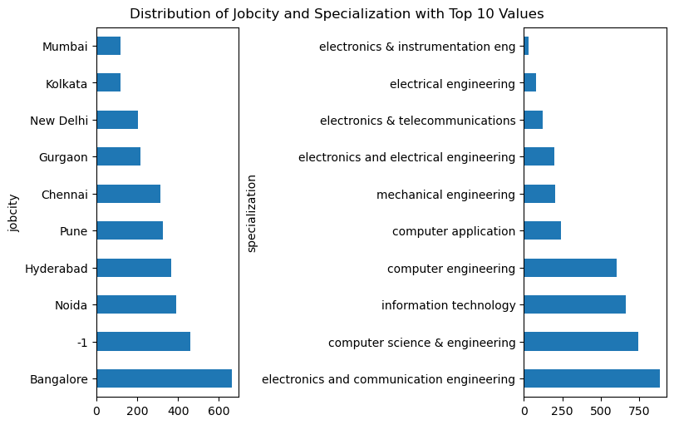
Univariate Analysis : Categorical
Job city : Most of the students got job in Bangalore.
Specialization : Most of the students completed their degree in electronic and communication engineering.

Slide 9
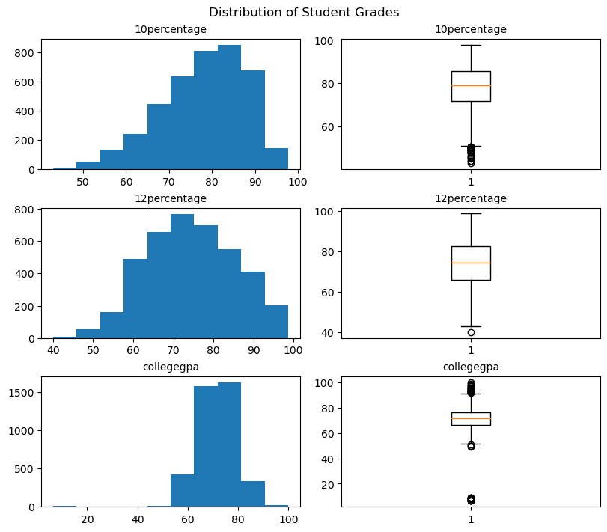
Univariate Analysis : Numerical
Most of students did well in 10th and 12th grades, with most scores between 70% and 90%. However, college GPAs show more variation, with some students doing much better or worse than others.

Slide 10
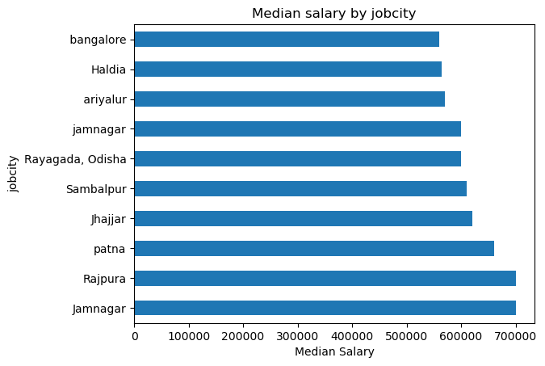
Bivariate Analysis : Numerical​ vs Categorical
Students who got job in Jamnagar and Rajpura are get same average salary and higher than other cities.

Slide 11
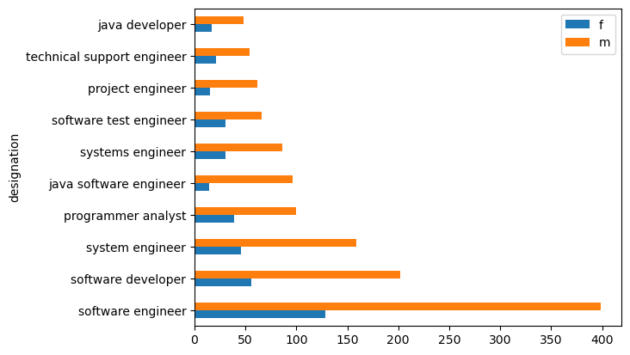
Bivariate Analysis : Categorical vs Categorical​
Males are higher than Females in any designation and software engineer have highest employees both male and female .

Slide 12
Conclusion : ​
Students who got job in Jamnagar and Rajpura are get same average salary and higher than other cities.
Males are higher than Females in any designation and software engineer have highest employees both male and female .
Most of students did well in 10th and 12th grades, with most scores between 70% and 90%. However, college GPAs show more variation, with some students doing much better or worse than others.
Job city : Most of the students got job in Bangalore.
Specialization : Most of the students completed their degree in electronic and communication engineering.
Most of students studied their 10th and intermediate in cbse .

Slide 13

THANK YOU

