Slide 1
JavaScript
A long journey in ES6
RangaVittala SR
Assistant Professor
Dept. Of ISE
NMIT

Slide 2
Know your Course
Subject Name |  | WebTechnology
Subject Code |  | 17ISL67
Teaching Hours | Lecture | 0 Hours
 | Tutorial | 2 Hours
 | Practical | 2 Hours
Evaluation Method | CIE | 50 Marks
 | SEE | 50 Marks
Credits |  | 2
Course Type |  | Laboratory Mandatory

Slide 3
more info. about the Course
Evaluation Method | CIE | 50 Marks | Course Project – 20 Marks Test – 20 Marks Contineous Evaluation – 10 Marks
 | SEE | 50 Marks – Test
Test |  | Contains a problem statement, telling some set of tasks to be carried out.
Test type in SEE |  | Contains two Parts Part A Part B One program form each should be executed
Resourse |  | http://speakingjs.com/es5/index.html http://exploringjs.com/es6/index.html
Anything Missing here ?

Slide 4
Course Outcome
Students will be able to
CO1 | Implement Functions, Recursion, Conditional Statements and loops in javascript
CO2 | Implement Array, Date, String, Math, Validation with regular expressions using javascript
CO3 | Implement HTML DOM, Drawing, Object, Events, Searching and Sorting Algorithm using javascript
CO4 | Demonstrate NodeJs modules, Http, express, Mongodb, promise

Slide 5
About the Course
What are the prerequisites for this Course?
NO JavaScript knowledge is required - you'll learn it from scratch!
You also need NO programming experience other than basic web development knowledge (e.g. how the web works? If don’t know – lets see that too!!!)
Basic HTML and CSS knowledge is recommended but not a must-have.
To whome this Course is for?
Beginner web development students who have no or only little JavaScript experience
Everyone interested in learning JavaScript and all about how it works

Slide 6
Course Project

Slide 7
Too far to go
Lets Start

Slide 8
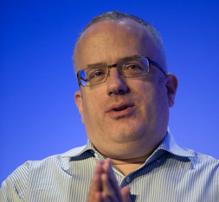
JavaScript
A cross-platform, object-oriented scripting language developed by Netscape.
Created by Netscape programmer Brendan Eich
JavaScript is a dynamic, weakly typed programming language which is compiled at
runtime. It can be executed as part of a webpage in a browser or directly on any
machine (“host environment”).
Weakly typed languages assign types (like 'number') to variables (data containers) at runtime
JavaScript was created to make webpages more dynamic (e.g. change content on a
page directly from inside the browser). Originally, it was called LiveScript but due to
the popularity of Java, it was renamed to JavaScript.
Dynamic - code is not pre-compiled but instead evaluated, compiled and executed at runtime

Slide 9
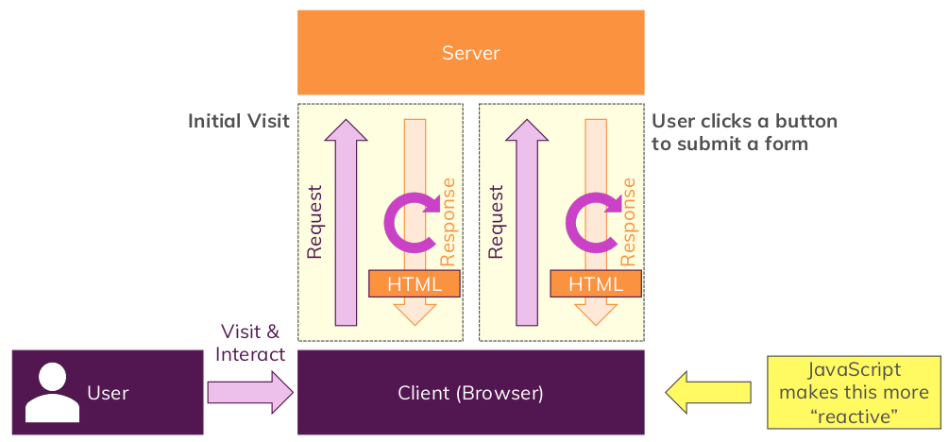
How the web works?

Slide 10
JavaScript vs Java
JavaScript
JavaScript is used for front-end web development (for example field level validation in a HTML form).
Interpreted (not compiled) by the client.
Object-oriented. No distinction between types of objects. Inheritance is through the prototype mechanism, and properties and methods can be added to any object dynamically.
Variable data types are not declared (loose typing).
Cannot automatically write to hard disk.
Java
Java is used as a back-end language within a web environment.
Compiled bytecodes downloaded from the server, executed on the client.
Class-based. Objects are divided into classes and instances with all inheritance through the class hierarchy. Classes and instances cannot have properties or methods added dynamically.
Variable data types must be declared as Java maintains strong type checking.
Cannot automatically write to hard disk.

Slide 11
JavaScript Engine
A JavaScript engine is a computer program that executes JavaScript (JS) code. The first JavaScript engines were mere interpreters, but all relevant modern engines utilize just-in-time compilation for improved performance. - Looper, Jen
Typically developed by web browser vendors.
It runs in concert with the rendering engine via the Document Object Model.
Since ECMAScript (ES) is the standardized specification of JavaScript, ECMAScript engine is another name for these engines.

Slide 12
JavaScript Engine
V8 from Google is the most used JavaScript engine. Google Chrome and the many other Chromium-based browsers use it, as do applications built with CEF, Electron, or any other framework that embeds Chromium. Other uses include the Node.js runtime system.
SpiderMonkey is developed by Mozilla for use in Firefox and its forks. The GNOME Shell uses it for extension support.
JavaScriptCore is Apple's engine for its Safari browser. Other WebKit-based browsers also use it. KJS from KDE was the starting point for its development.
Chakra is the current engine of the Microsoft Edge browser, forked from the same-named engine of Internet Explorer.
Facebook created the Hermes engine for Android apps using the React Native framework.

Slide 13
ECMA Script
ECMA is an international standards association for information and communication systems. It acquired its current name in 1994.
The organization was founded in 1961 to standardize computer systems in Europe.
This standardized version of JavaScript, called ECMAScript.
Netscape was working with European Computer Manufacturers Association (ECMA) to deliver a standardized, international programming language based on core JavaScript.
Companies can use the open standard language to develop their implementation of JavaScript.
The first version of the ECMA standard was documented in the ECMA-262 specification.
The ECMA-262 standard is also approved by the ISO (International Organization for Standardization) as ISO-16262.

Slide 14
Relation of JavaScript with ECMA Script
Javascript is the language. ES (Ecmascript) is the standard governing Javascript.
JavaScript version | Relationship to ECMA version
JavaScript 1.1 | ECMA-262 is based on JavaScript 1.1.
JavaScript 1.2 | ECMA-262 was not complete when JavaScript 1.2 was released.
JavaScript 1.3 | JavaScript 1.3 is fully compatible with ECMA-262.
JavaScript 1.4 (Works on Netscape server only) | -
JavaScript 1.5 | JavaScript 1.5 is compatible with ECMA-262 Edition 3

Slide 15
Is there new Esxs?
Each version of ES contains newer features and implementations than the previous ones.
ES6
With this release, JS has made the developers life easy in many ways and reached the expectations of a modern programming language. Features in this include :-
Let and Const keywords
For..of
Default Parameters
Rest and Spread operators (…)
Arrow functions
Promises
Classes, and more

Slide 16
Hi, Anyalternative?
1. CoffeeScript
2. Dart
3. TypeScript
4. ClojureScript
5. Opal
6. Elm
7. Kaffeine
8. Roy

