Slide 1

RangeShiftR
Overview
Damaris Zurell, Anne Malchow
https://bit.ly/Potsdam-Macroecology
@ZurellLab
Notes:
1
<number>

Slide 2
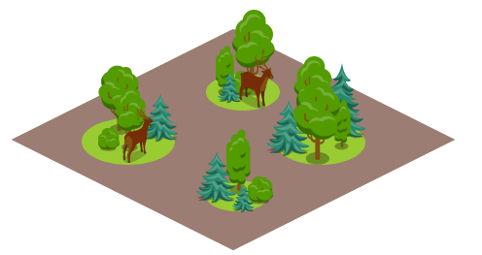
Spatially explicit population models
Simulating local population dynamics and dispersal
Local population dynamics described by population model, e.g. logistic growth or matrix population model
Dispersal described by dispersal kernel or movement simulator
Landscape can be
described as:
patch-matrix landscapes
patch types of different quality
grid cells of different quality

Slide 3

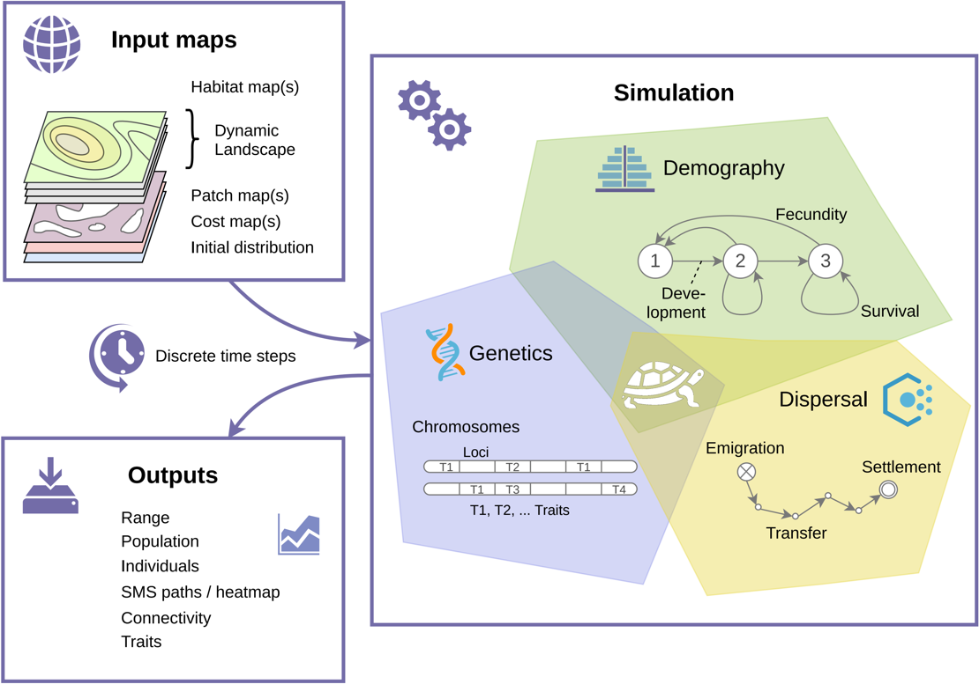

RangeShifter -
An individual-based eco-evolutionary
modelling platform
Malchow et al. (2021) Ecography. DOI: 10.1111/ecog.05689 .
Building on Bocedi et al. (2014) Methods Ecol Evol 5: 388-396. & Bocedi et al. (2021) Ecography. DOI: 10.1111/ecog.05687.
Notes:
Open source
Flexibly to adapt to any species, system, or region
Facilitate model optimisation and comparison,
Integrate model validation and monitoring
Facilitate transparency and collaboration
Enable cost-effective design and evaluation of management solutions
<number>

Slide 4
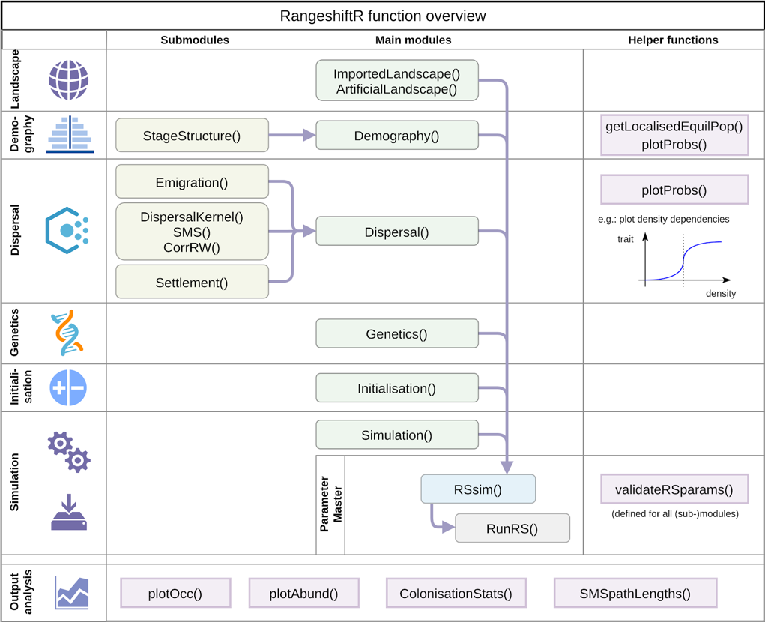
R-package: RangeShiftR
Malchow et al. (2021) Ecography. DOI: 10.1111/ecog.05689 .
Building on Bocedi et al. (2014) Methods Ecol Evol 5: 388-396. & Bocedi et al. (2021) Ecography. DOI: 10.1111/ecog.05687.
Notes:
Open source
Flexibly to adapt to any species, system, or region
Facilitate model optimisation and comparison,
Integrate model validation and monitoring
Facilitate transparency and collaboration
Enable cost-effective design and evaluation of management solutions
<number>

Slide 5
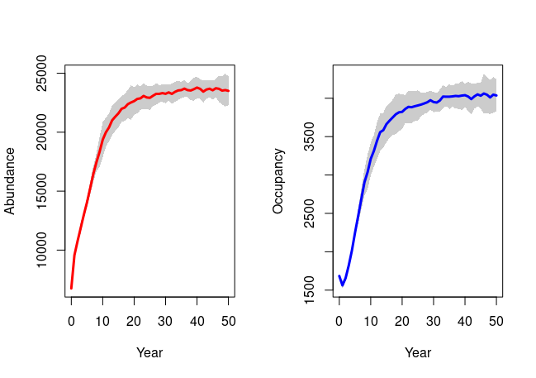
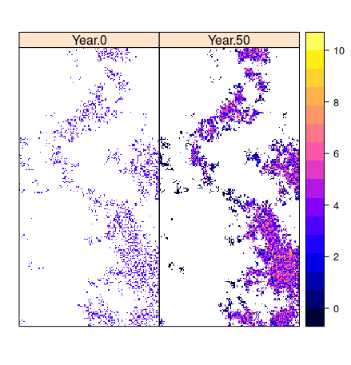
Practical 1: Getting started with RangeShiftR
Break-out rooms of 4-5 participants per group
Time: 15 mins
Script:
IBS2022_RS_workshop/code/Prac1_RangeShiftR_GettingStarted.R

Slide 6
Break: 15 mins

