Slide 1


RangeShiftR
Damaris Zurell, Anne Malchow
https://damariszurell.github.io
@ZurellLab
Pictures from www.undekade-biologischevielfalt.de
Notes:
1

Slide 2
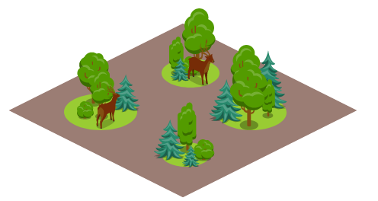
Spatially explicit population models
Simulating local population dynamics and dispersal
Local population dynamics described by population model, e.g. logistic growth or matrix population model
Dispersal described by dispersal kernel or movement simulator
Landscape can be described as patch-matrix landscapes, patch types of different quality, of grid cells of different quality

Slide 3

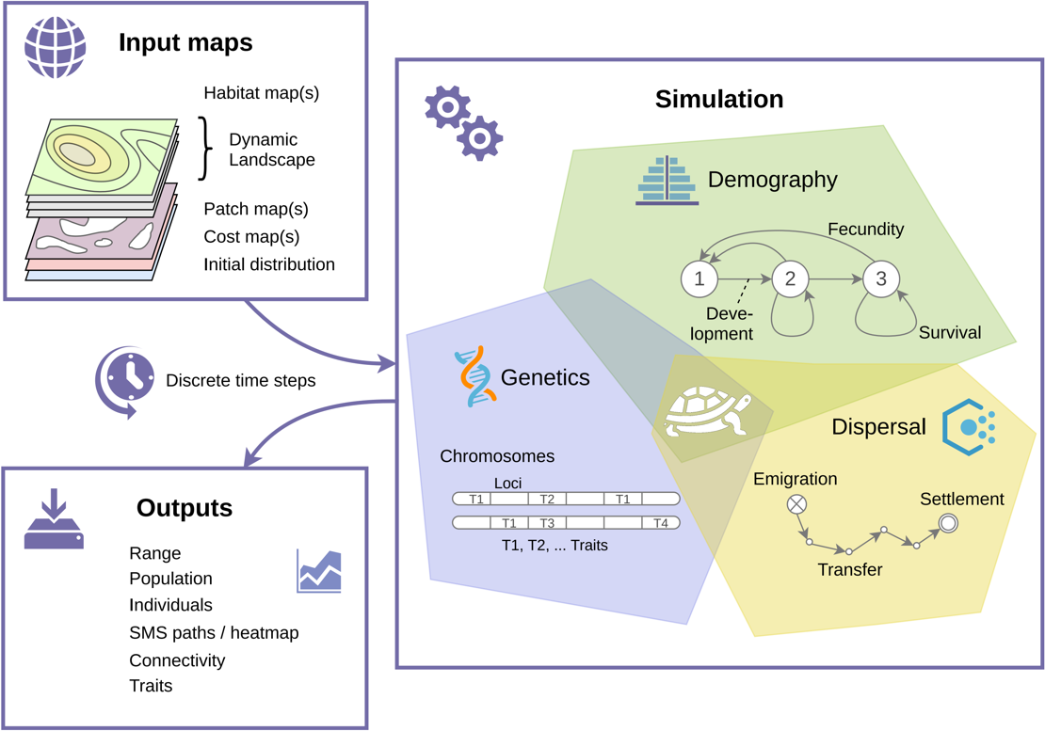

Spatially explicit population models
An individual-based eco-evolutionary modelling platform
Malchow et al. (2021) Ecography. DOI: 10.1111/ecog.05689 .
Building on Bocedi et al. (2014) Methods Ecol Evol 5: 388-396. & Bocedi et al. (2021) Ecography. DOI: 10.1111/ecog.05687.
Notes:
Open source
Flexibly to adapt to any species, system, or region
Facilitate model optimisation and comparison,
Integrate model validation and monitoring
Facilitate transparency and collaboration
Enable cost-effective design and evaluation of management solutions

Slide 4
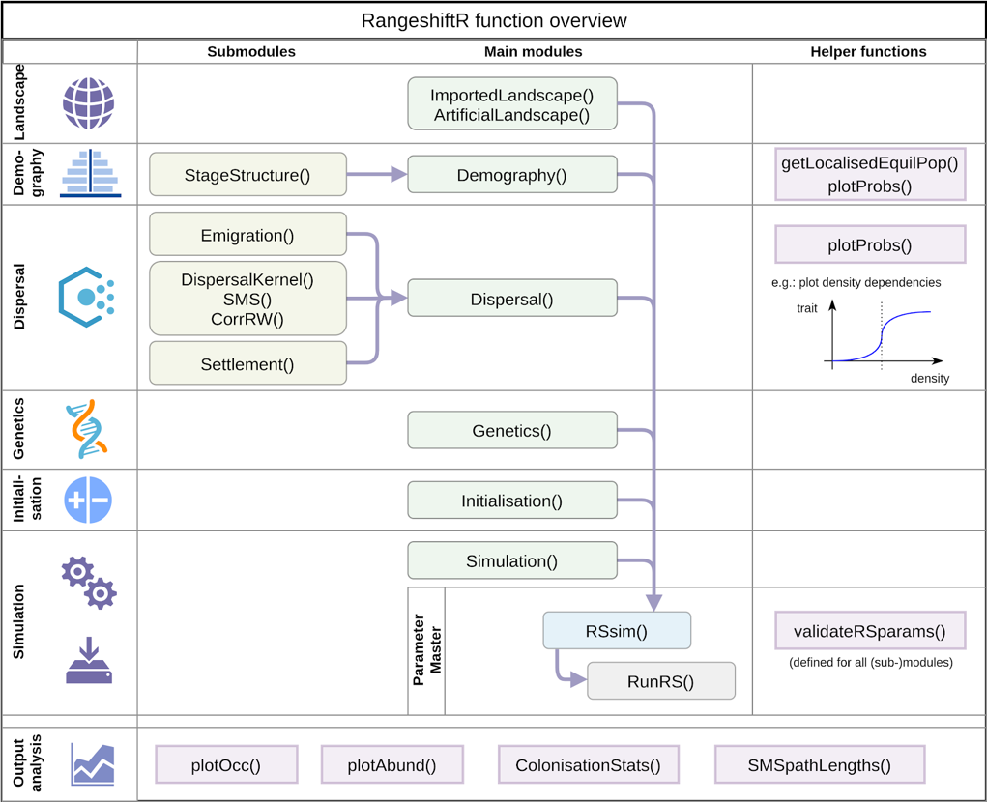
Spatially explicit population models
Malchow et al. (2021) Ecography. DOI: 10.1111/ecog.05689 .
Building on Bocedi et al. (2014) Methods Ecol Evol 5: 388-396. & Bocedi et al. (2021) Ecography. DOI: 10.1111/ecog.05687.
Notes:
Open source
Flexibly to adapt to any species, system, or region
Facilitate model optimisation and comparison,
Integrate model validation and monitoring
Facilitate transparency and collaboration
Enable cost-effective design and evaluation of management solutions

Slide 5
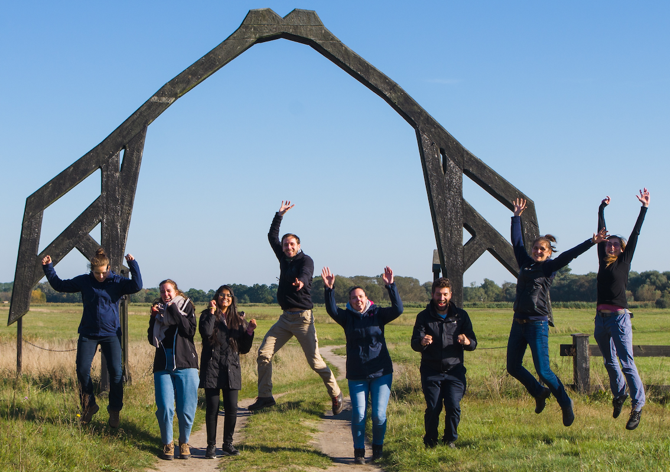

Thank you for your interest
Contact:
Damaris Zurell
Ecology & Macroecology
University of Potsdam
https://damariszurell.github.io
Email: damaris.zurell@uni-potsdam.de
@ZurellLab

