Slide 1

Real-Time Hackathon Engagement Platform
Interactive quizzes • Live surveys • Instant analytics
Built with Azure Functions • Azure Static Web Apps • Azure Table Storage
HackBuzz
1 / 11

Slide 2
The Challenge
Why hackathons need better engagement tools
😴
📋
❓
Low Engagement
Manual Processes
Participants lose focus during long hackathon sessions without interactive breaks
Paper surveys and spreadsheet tracking create overhead for organisers
How do you keep
participants engaged
and collect meaningful
feedback — in real time?
📊
🔧
No Real-Time Insights
One-Off Solutions
Feedback is collected after the event, missing the chance to adapt in the moment
Custom tools are built per event and discarded — no reusable platform exists
HackBuzz is the answer.
HackBuzz
2 / 11

Slide 3
What is HackBuzz?
A reusable, real-time engagement platform for hackathon events
HackBuzz is a single deployable app that lets you run engaging live quizzes with countdown timers & winner announcements, collect anonymous participant feedback, and generate professional PDF reports — all in real time.
🎯
📊
📈
Live Quiz
Smart Survey
Analytics
AI-generated questions
Countdown timers
Winner podium with confetti
Anonymous feedback
Star ratings & multi-select
One-submission enforcement
Real-time dashboards
PDF & Excel export
Chart.js visualisations
HackBuzz
3 / 11

Slide 4
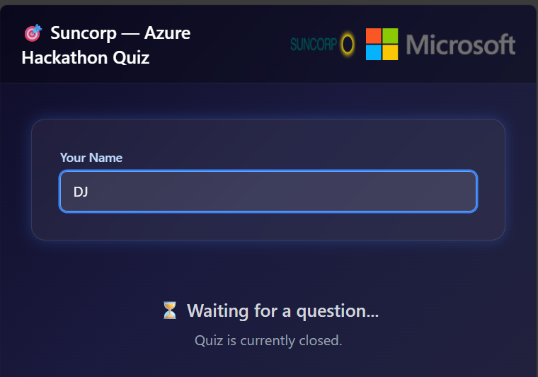
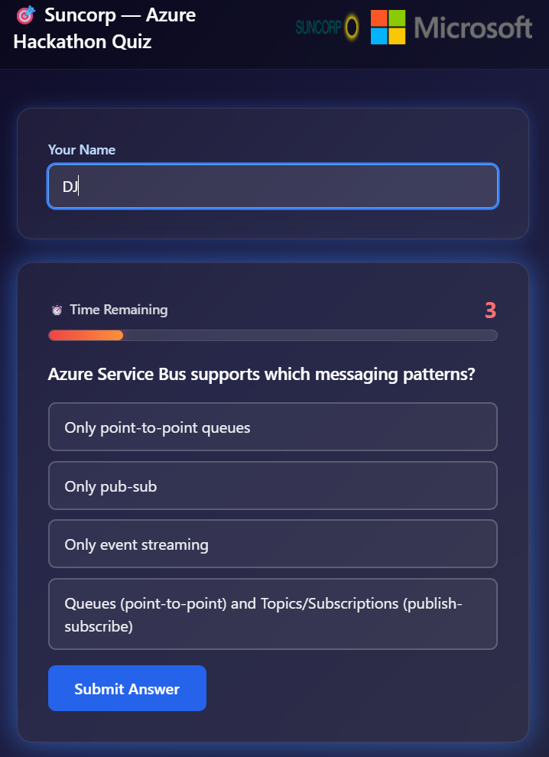
How It Works
A seamless flow from quiz to survey to insights
1
Admin Creates a Question
Manually craft or use AI to auto-generate Azure-level quiz questions
2
Participants Answer Live
3-2-1 countdown, timed responses with crossfit-style audio beeps
① Join & Wait
3
Winner Announced
Top 3 podium with trophy animation, confetti, and time splits
4
Survey Collected
Anonymous feedback with star ratings, chip selectors, and free text
5
Reports Generated
Export PDF summaries & Excel data with Chart.js visualisations
② Answer Questions
HackBuzz
4 / 11

Slide 5
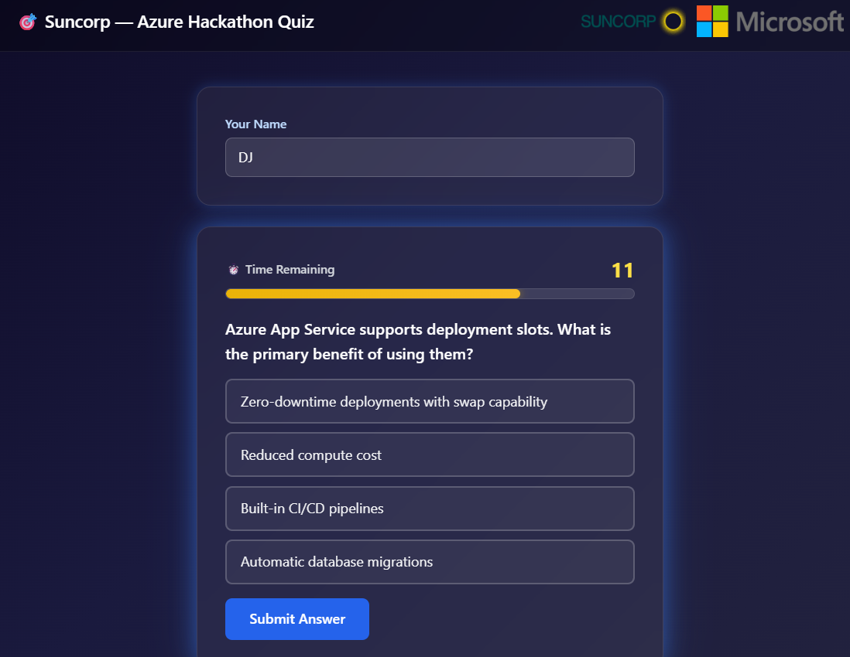
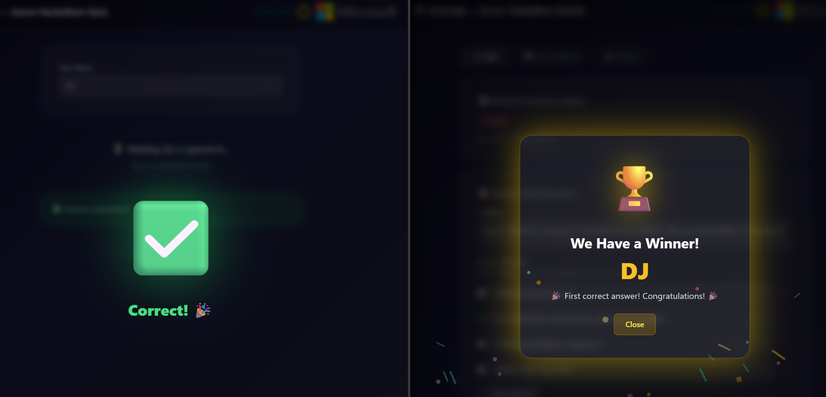
Live Quiz Experience
Participants engage with timed questions and instant feedback
① Join & Wait for Question
② Answer Before Time Runs Out
Key Features
🤖 AI-generated questions (90+ Azure topics)
🔊 Crossfit-style 3-2-1 audio beeps
⏱️ Configurable countdown (5–120 seconds)
🏆 Top 3 podium with confetti & trophies
🔀 Randomised answer order
✅ Instant correct/incorrect overlay
③ Correct/Incorrect Feedback & Winner
HackBuzz
5 / 11

Slide 6
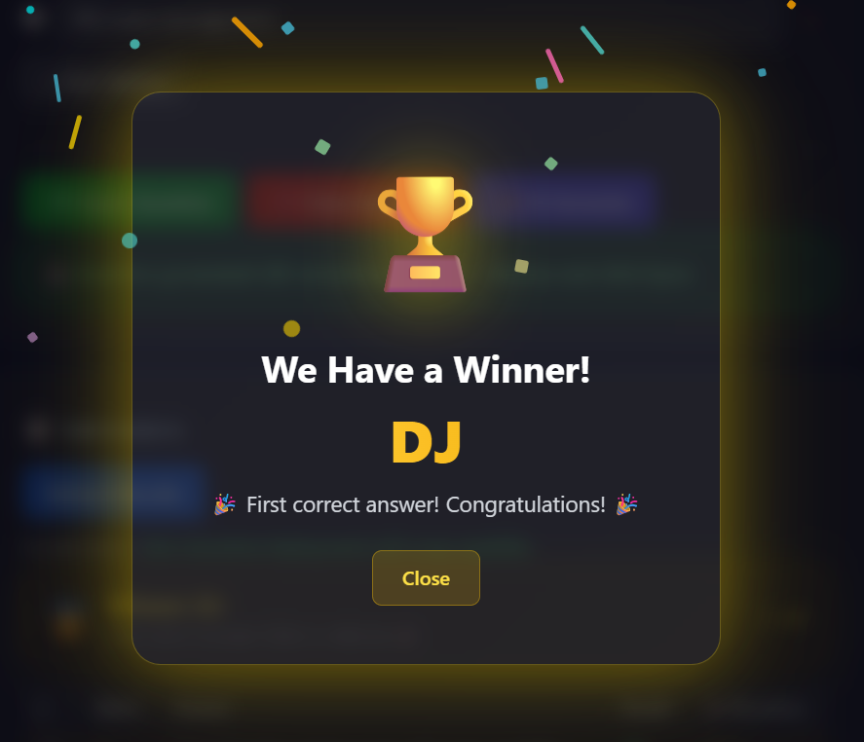
Winner Celebration
Trophy animations, confetti, and instant recognition
🏆
The Moment
Everyone Loves
🥇 Fastest correct answer wins
🎊 Confetti animation on screen
⏱️ Response time tracked to the millisecond
📊 Real-time submission counter
🎵 Audio countdown with dramatic reveal
HackBuzz
6 / 11

Slide 7
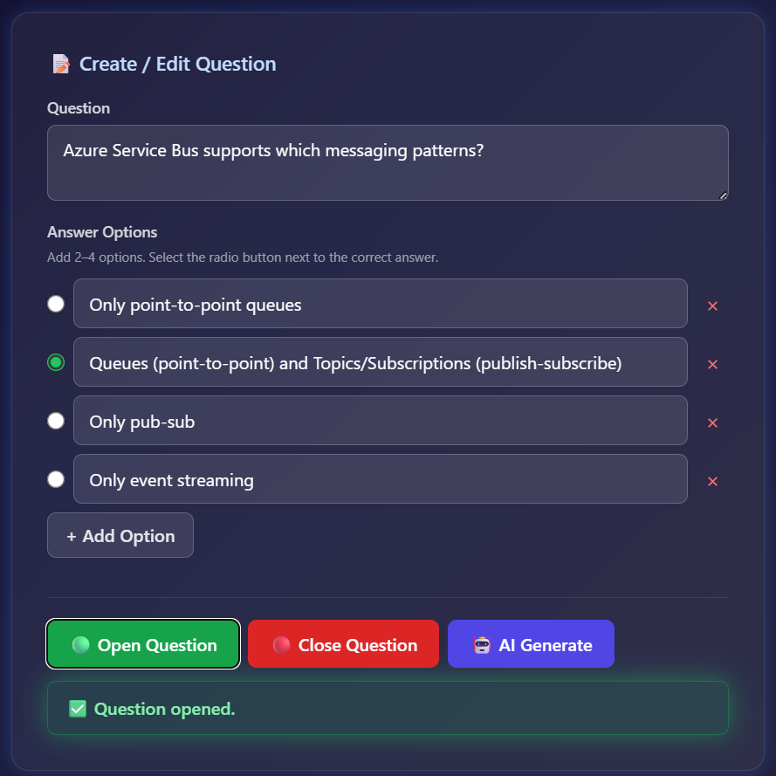
Admin Dashboard
Full control over quizzes, surveys, and settings from one panel
🎯 Quiz Management
› Create/edit multiple-choice questions
› AI Generate with one click
› Open, close & manage live questions
› Real-time response tracking
📊 Survey Control
› Open/close survey toggle
› View all responses & charts
› Export PDF reports & Excel data
⚙️ Settings
› Custom branding & logo upload
› Organisation & hackathon name
› Configurable timer duration
HackBuzz
7 / 11

Slide 8
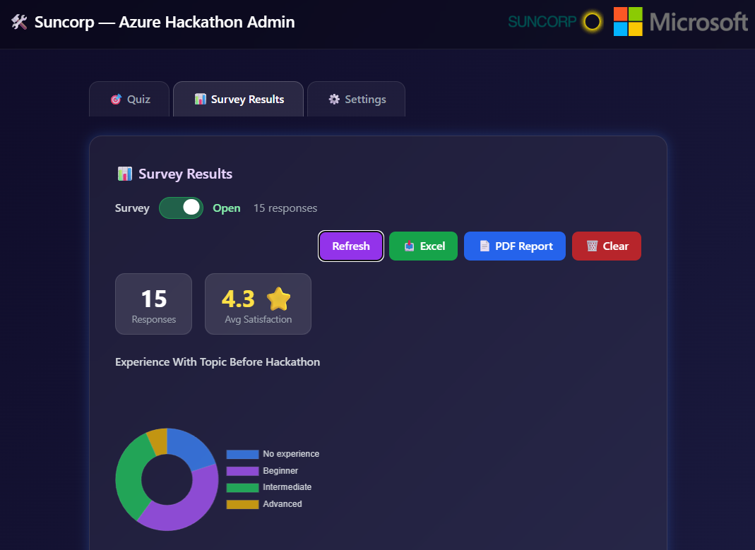
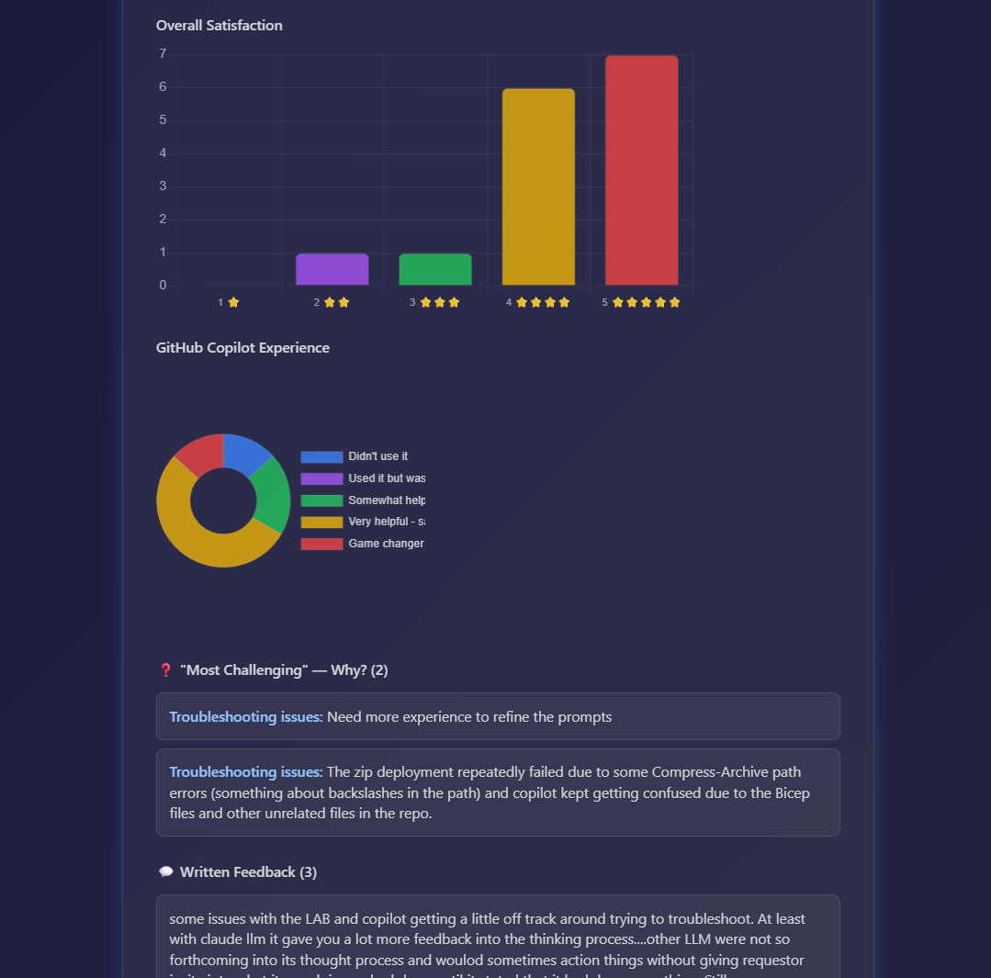
Survey & Analytics
Collect anonymous feedback and generate instant reports
Survey Dashboard with Charts & Export
Detailed Results & Written Feedback
⭐ Star Ratings
🎯 Chip Selectors
📝 Free-Text Fields
📄 PDF Export
📥 Excel Export
🎖️ Completion Badge
HackBuzz
8 / 11

Slide 9
Architecture
Simple, serverless, and fully deployable on Azure
🖥️
⚡
💾
Frontend
API Layer
Data Store
Azure Static Web Apps
Azure Functions (Node.js)
Azure Table Storage
▶
▶
▸ Vanilla HTML/CSS/JS
▸ 14 RESTful endpoints
▸ QuizState & Submissions
▸ index.html — Participant Quiz
▸ Admin auth via HTTP header
▸ SurveyResponses & SurveyState
▸ admin.html — Admin Dashboard
▸ Real-time quiz state management
▸ AppSettings & Branding
▸ survey.html — Anonymous Survey
▸ AI question generation
▸ Zero database management
Node.js 20+
Azure Functions v4
Azure Table Storage
Chart.js
HTML/CSS/JS
Azure Static Web Apps
HackBuzz
9 / 11

Slide 10
Version 2.0 Roadmap
v2.0
Planned features from our GitHub backlog
🖥️
🎯
📊
🚀
Platform & UX
Quiz Enhancements
Survey Power-ups
Engagement
#1
Modernise UI to Astro
#3
Quiz Rounds
#8
Custom Survey Builder
#10
Real-time Notifications
Component-based architecture with partial hydration
Themed sections with per-round leaderboards
Drag & drop editor with NPS, Likert & more
WebSocket push via Azure Web PubSub
#7
Theme Builder
#2
Challenge Timer
#6
Email Survey
#9
QR Code Join
Custom colours, fonts & preset themes
Time-boxed challenges with live countdown
Bulk email surveys via Azure Comms Services
Scan to instantly join — project on big screen
#4
Landing Page
#5
Participant Registration
Markdown-driven welcome page for participants
Registration flow with attendance tracking
HackBuzz
10 features planned • All tracked on GitHub Issues
10 / 11

Slide 11
Thank You!
Questions & Discussion
Engage • Compete • Learn
© 2026 Microsoft Customer Success
HackBuzz
11 / 11

