Slide 1
Functions
Christopher Brown
Computer Science 2
January 10, 2024
To showcase one of the subjects I learned in compsci 1 I will use the subject of functions. I have used functions
From the mid point of the class to the end. I ended my final project using classes.

Slide 2
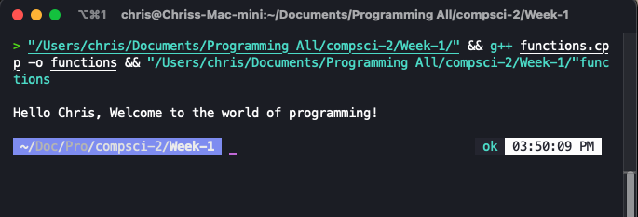
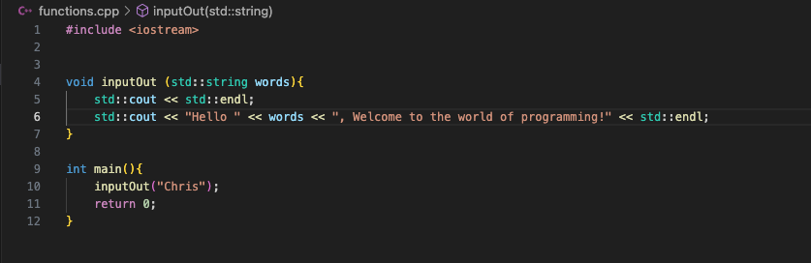
Simple Functions
I am not new to the use of or the definition of functions, I have previously used them in other programming classes and even further back in the days I played around with PHP. Now is not any different I can use a function over and over again without a need to recode an entire section of code. To demonstrate the use of function I will create a few snips and simple functions to show here.
The most basic of functions is basically hello world, however, I will take it a step further in this example.
Output:
Code:
I did a bit more to this basic function, I included some additional arguments when running the program, like passing in a name to display when the program is run.

Slide 3
Return Functions
While learning about these functions, the important part is the return type for the function that is being used. Main, I believe, is always int. The return value in the main function represents the exit value when the program ends. There are several other return types. Below is the list of what I have learned.
- int :: returns an integer data type
- float :: Returns a single precision floating point
- double :: Double precision precision floating point
- char :: Character type
- bool :: Boolean type (True or False)
One last one that I used often when creating a program was: the `void` type, this one has no return, and the function executes and outputs in the same space. You can pass things in, but nothing will be returned. In the previous slide that is the return type I used to demonstrate the basic function. `void inputOut()`.

Slide 4
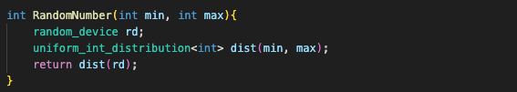
My Functions
Along the lines I have created some functions that I really enjoyed making, some that I will use in the future of classes to come and hopefully even beyond classes. The first function I will showcase is one I used to create a random number that I had more control over. I understand that we have the function `rand()` but I did not like the results it produced.
I used this function in game that we were tasked to complete for one of our projects, the game is called the `Game of Nim`. It was a pretty fun program to complete, I created the hardmode in this game and if you choose hardmode it seem impossible to win. I searched for the program I created for the computer to play itself, but I would have to rewrite it as it seems. This function was used in several places during the game run.

Slide 5
My Functions

