Slide 1
Elite Parent Preserving Evolutionary Neural Architecture Search for Image Classification Mid-term Report
Bowen Zheng, Shijie Chen, Shuxin Wang
Southern University of Science and Technology
June. 5 2019

Slide 2
System Design

Slide 3
CNN architecture

Slide 4
CNN architecture
Max Pool
Normal Cell
Normal Cell
Max Pool
Normal Cell
Max Pool
Input Image
Normal Cell
GAP
FC100
FC10
Softmax
(3*32*32)
(64*16*16)
(128*8*8)
(256*4*4)
(512*1*1)

Slide 5
CNN architecture
 | Operation
(0, 2) | 3
(0, 3) | 0
(0, 4) | 0
(1, 2) | 0
(1, 3) | 7
(1, 4) | 1
(2, 3) | 7
(2, 4) | 0
(3, 4) | 5
0
1
Normal cell component:
0: zero
1: identity
2: 3x3 average pooling
3: 3x3 max pooling
4: 1x1 conv
5: 3x3 depthwise-separable conv
6: 3x3 dilated conv
7: 3x3 conv
3
1
7
2
7
3
5
4

Slide 6
CNN architecture
Constraint:
In the same cell stack, every convolution layer outputs with the same channel size. In different cell stacks, this channel size is increased by depth.
eg: 64, 128, 256
In cells, all operations do not change the image size. Image size only changes at max pooling layer.
When using convolution operations, all operation follows:
ReLU-> Conv-> BN
When using depthwise seperable convolution operations, execute it twice

Slide 7
Elite Parent Preserving Evolutionary Algorithm

Slide 8
Quickly Review

Slide 9
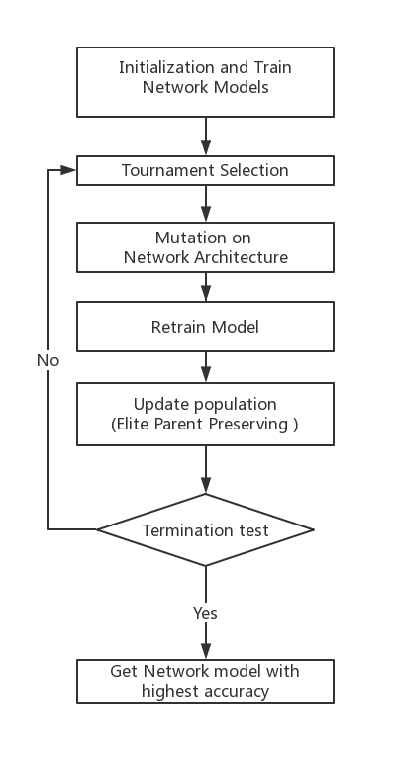

Slide 10
Network Initialization
 | Operation
(0, 2) | 0
(0, 3) | 0
(0, 4) | 0
(1, 2) | 0
(1, 3) | 0
(1, 4) | 0
(2, 3) | 0
(2, 4) | 0
(3, 4) | 0
0
1
Randomly generate a legal network architecture.
Initialize age and life span of the individual
Train the NN and get its accuracy.
2
3
4
5

Slide 11
Network Initialization
 | Operation
(0, 2) | 3
(0, 3) | 0
(0, 4) | 0
(1, 2) | 0
(1, 3) | 7
(1, 4) | 1
(2, 3) | 7
(2, 4) | 0
(3, 4) | 0
0
1
Randomly generate a legal network architecture.
Initialize age and life span of the individual
Train the NN and get its accuracy.
3
1
7
2
7
3
4
5

Slide 12
Network Initialization
 | Operation
(0, 2) | 3
(0, 3) | 0
(0, 4) | 0
(1, 2) | 0
(1, 3) | 7
(1, 4) | 1
(2, 3) | 7
(2, 4) | 0
(3, 4) | 0
0
1
Randomly generate a legal network architecture.
Initialize age and life span of the individual
Train the NN and get its accuracy.
3
1
7
2
7
3
1
4
1
5

Slide 13
Network Initialization
Randomly generate a legal network architecture.
Initialize age and life span of the individual
Train the NN and get its accuracy.
model.age = 1
model.life = DEFAULT_LIFESPAN

Slide 14
Network Initialization
Randomly generate a legal network architecture.
Initialize age and life span of the individual
Train the NN and get its accuracy.
model.accuracy = model.train_NAS()

Slide 16
Mutation Operation
2
3
4
Mutation
Add edge
2
3
4
3
7
3
7
5
5
5

Slide 17
Mutation Operation
2
3
4
Mutation
Delete edge
2
3
4
3
7
7
5
5

Slide 18
Mutation Operation
2
3
4
Mutation
Change Operation
2
3
4
3
7
5
7
5
5

Slide 20
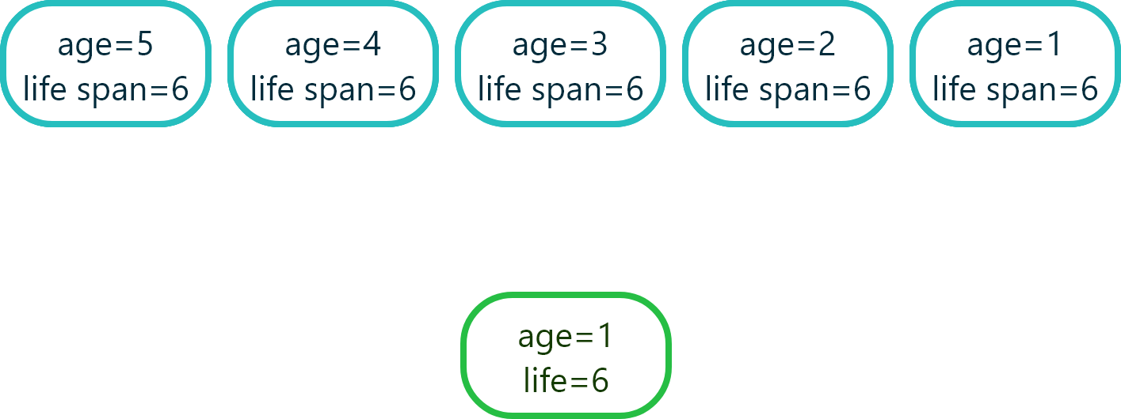
Update population (Elite Parent Preserving )
Mutate and Retrain

Slide 21

Update population (Elite Parent Preserving )
Mutate and Retrain

Slide 22
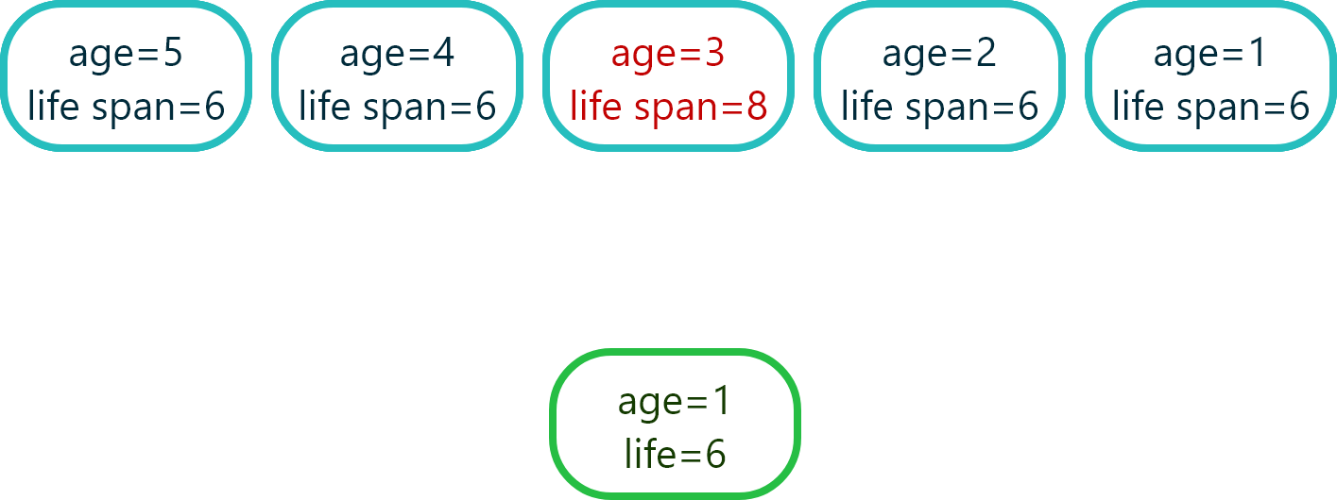
Update population (Elite Parent Preserving )
Mutate and Retrain

Slide 23
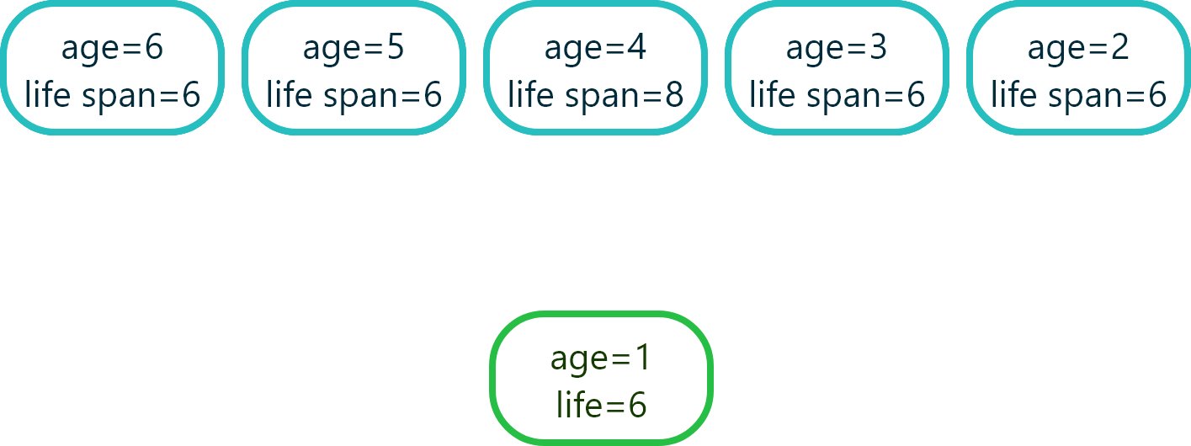
Update population (Elite Parent Preserving )
Mutate and Retrain

Slide 24
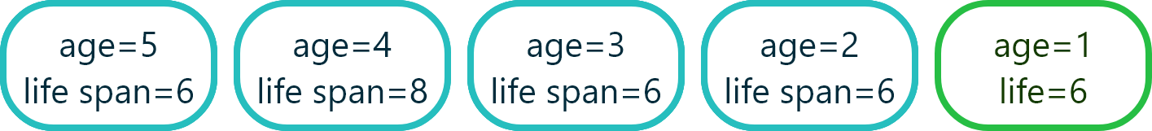
Update population (Elite Parent Preserving )

Slide 25
Based on an existing
network architecture
Heuristic Mutation

Slide 26

Based on an existing network architecture
0
1
Normal cell component:
0: zero
1: identity
2: 3x3 average pooling
3: 3x3 max pooling
4: 1x1 conv
5: 3x3 depthwise-separable conv
6: 3x3 dilated conv
7: 3x3 conv
1
7
2
7
1
3
ResNet
7
1
4
7
5
1
7
6

Slide 27
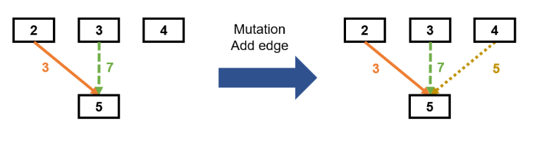
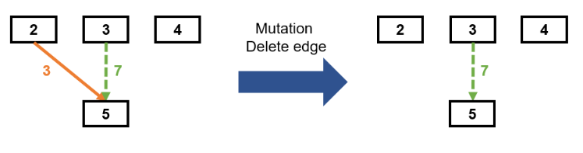
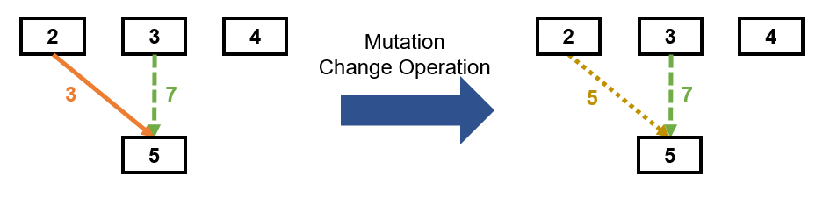
Heuristic Mutation
15%
15%
70%

Slide 28
Heuristic Mutation
Normal cell component:
1: identity
2: 3x3 average pooling
3: 3x3 max pooling
4: 1x1 conv
5: 3x3 depthwise-separable conv
6: 3x3 dilated conv
7: 3x3 conv
40%
12%
48%

Slide 29
Experiment Result

Slide 30
Experiment Specification
Dataset: CIFAR10
Population size: 10
Default lifetime: 10
Sample size: 5
Total Generations: 30
Batch size: 100
Learning Rate: 0.001
Epoch: 20
Stack depth: 2
Number of channels: 32 for stack1, 64 for stack2 and 128 for stack3

Slide 31
Result
0
1
70% accuracy on CIFAR-10
Normal cell component:
0: zero
1: identity
2: 3x3 average pooling
3: 3x3 max pooling
4: 1x1 conv
5: 3x3 depthwise-separable conv
6: 3x3 dilated conv
7: 3x3 conv
2
5
2
6
4
3
6
4
4
5
6
1
1
1
7

Slide 32
Future Work

Slide 33
Future Work
Weight Sharing of Neural Networks
Heuristic Mutation Operation
More Efficient Performance Estimation
Find Proper Size of a Cell

