Slide 1
Elite Parent Preserving Evolutionary Neural Architecture Search for Image Classification Final Report
Bowen Zheng, Shijie Chen, Shuxin Wang
Southern University of Science and Technology
June. 5 2019

Slide 2
System Design

Slide 3
CNN architecture

Slide 4
CNN architecture
Max Pool
Normal Cell
Normal Cell
Max Pool
Normal Cell
Max Pool
Input Image
Normal Cell
FC10
GAP
Softmax
FC100
(3*32*32)
(64*16*16)
(128*8*8)
(256*4*4)
(512*1*1)
Changes:
Cell stack depth: 2->1
Hidden state num: 5->4

Slide 5
CNN architecture
 | Operation
(0, 2) | 3
(0, 3) | 0
(0, 4) | 0
(1, 2) | 0
(1, 3) | 7
(1, 4) | 1
(2, 3) | 7
(2, 4) | 0
(3, 4) | 5
0
1
Normal cell component:
0: zero
1: identity
2: 3x3 average pooling
3: 3x3 max pooling
4: 1x1 conv
5: 3x3 depthwise-separable conv
6: 3x3 dilated conv
7: 3x3 conv
3
1
7
2
7
3
5
4

Slide 6
CNN architecture
Constraint:
In the same cell stack, every convolution layer outputs with the same channel size. In different cell stacks, this channel size is increased by depth.
eg: 64, 128, 256
In cells, all operations do not change the image size. Image size only changes at max pooling layer.
When using convolution operations, all operation follows:
ReLU-> Conv-> BN
When using depthwise seperable convolution operations, execute it twice

Slide 7
Elite Parent Preserving Evolutionary Algorithm

Slide 8
Quickly Review

Slide 9
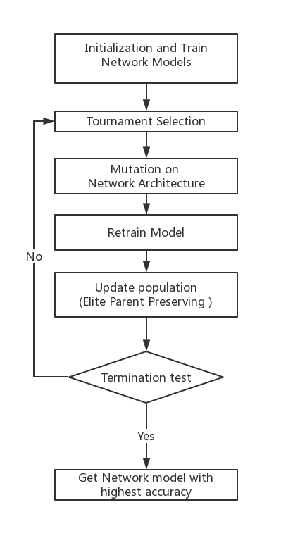

Slide 10
Network Initialization
 | Operation
(0, 2) | 0
(0, 3) | 0
(0, 4) | 0
(1, 2) | 0
(1, 3) | 0
(1, 4) | 0
(2, 3) | 0
(2, 4) | 0
(3, 4) | 0
0
1
Randomly generate a legal network architecture.
Initialize age and life span of the individual
Train the NN and get its accuracy.
2
3
4
5

Slide 11
Network Initialization
 | Operation
(0, 2) | 3
(0, 3) | 0
(0, 4) | 0
(1, 2) | 0
(1, 3) | 7
(1, 4) | 1
(2, 3) | 7
(2, 4) | 0
(3, 4) | 0
0
1
Randomly generate a legal network architecture.
Initialize age and life span of the individual
Train the NN and get its accuracy.
3
1
7
2
7
3
4
5

Slide 12
Network Initialization
 | Operation
(0, 2) | 3
(0, 3) | 0
(0, 4) | 0
(1, 2) | 0
(1, 3) | 7
(1, 4) | 1
(2, 3) | 7
(2, 4) | 0
(3, 4) | 0
0
1
Randomly generate a legal network architecture.
Initialize age and life span of the individual
Train the NN and get its accuracy.
3
1
7
2
7
3
1
4
1
5

Slide 13
Network Initialization
Randomly generate a legal network architecture.
Initialize age and life span of the individual
Train the NN and get its accuracy.
model.age = 1
model.life = DEFAULT_LIFESPAN

Slide 14
Network Initialization
Randomly generate a legal network architecture.
Initialize age and life span of the individual
Train the NN and get its accuracy.
model.accuracy = model.train_NAS()

Slide 16
Mutation Operation
2
3
4
Mutation
Add edge
2
3
4
3
7
3
7
5
5
5

Slide 17
Mutation Operation
2
3
4
Mutation
Delete edge
2
3
4
3
7
7
5
5

Slide 18
Mutation Operation
2
3
4
Mutation
Change Operation
2
3
4
3
7
5
7
5
5

Slide 20
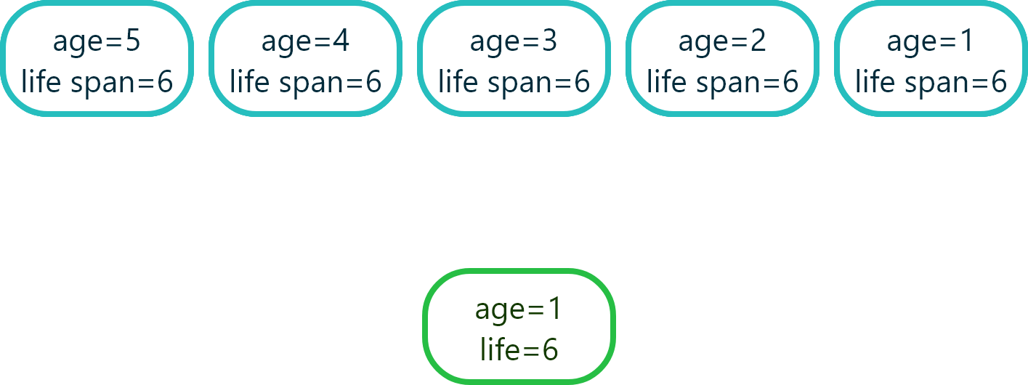
Update population (Elite Parent Preserving )
Mutate and Retrain

Slide 21

Update population (Elite Parent Preserving )
Mutate and Retrain

Slide 22
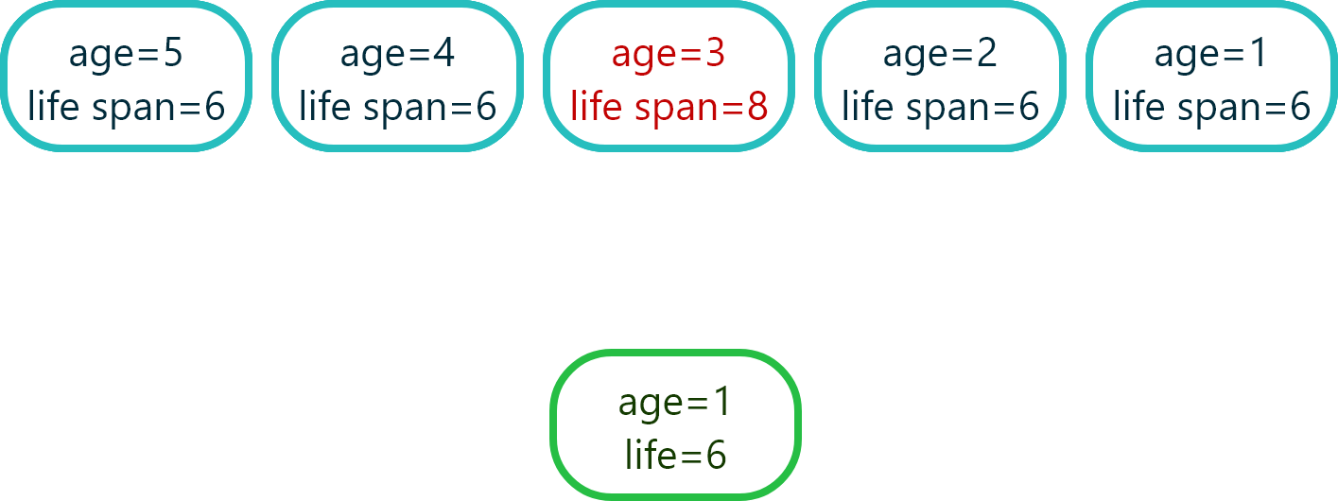
Update population (Elite Parent Preserving )
Mutate and Retrain

Slide 23
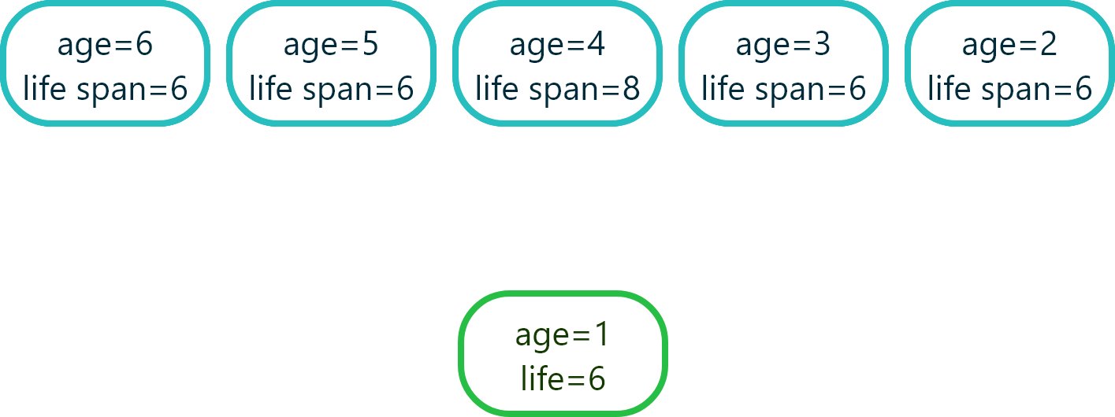
Update population (Elite Parent Preserving )
Mutate and Retrain

Slide 24
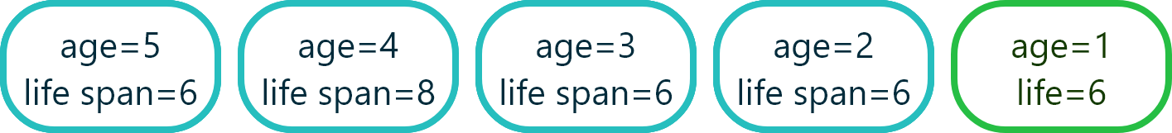
Update population (Elite Parent Preserving )

Slide 25
Based on an existing
network architecture
Heuristic Mutation

Slide 26

Based on an existing network architecture
0
1
Normal cell component:
0: zero
1: identity
2: 3x3 average pooling
3: 3x3 max pooling
4: 1x1 conv
5: 3x3 depthwise-separable conv
6: 3x3 dilated conv
7: 3x3 conv
1
7
2
7
1
3
ResNet
7
1
4
7
5
1
7
6

Slide 27
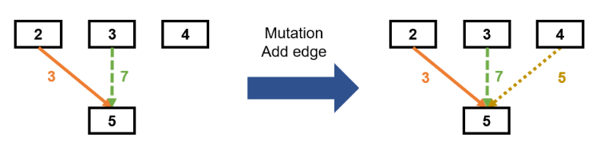
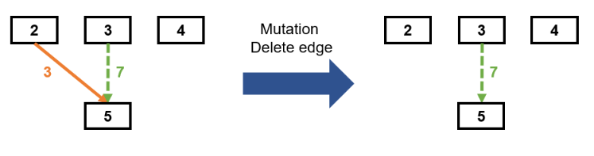
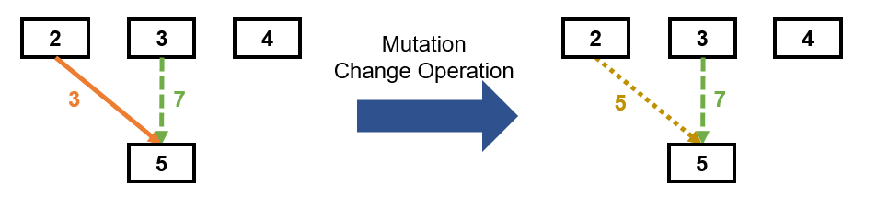
Heuristic Mutation
15%
15%
70%

Slide 28
Heuristic Mutation
Normal cell component:
1: identity
2: 3x3 average pooling
3: 3x3 max pooling
4: 1x1 conv
5: 3x3 depthwise-separable conv
6: 3x3 dilated conv
7: 3x3 conv
40%
12%
48%

Slide 29
Experiment Result

Slide 30
Experiment Specification
Dataset: CIFAR10
Population size: 10
Default lifetime: 10
Tournament size: 5
Total Generations: 30
Batch size: 400
Learning Rate: 0.001
Epoch: 40
Stack depth: 2
Number of channels: 64 for stack1, 128 for stack2, 256 for stack3 and 512 for stack4

Slide 31
Initial Structure
0
1
On CIFAR-10
About 40min per individual
71% test accuracy
88% training accuracy
1
7
Normal cell component:
0: zero
1: identity
2: 3x3 average pooling
3: 3x3 max pooling
4: 1x1 conv
5: 3x3 depthwise-separable conv
6: 3x3 dilated conv
7: 3x3 conv
2
7
1
3
7
1
4
7
5
1
7
6

Slide 32
Result
0
1
On CIFAR-10
About 40min per individual
76% test accuracy
91% training accuracy
3
7
Normal cell component:
0: zero
1: identity
2: 3x3 average pooling
3: 3x3 max pooling
4: 1x1 conv
5: 3x3 depthwise-separable conv
6: 3x3 dilated conv
7: 3x3 conv
1
2
6
2
1
3
7
4
4
1
7
5
1
6

Slide 33
Future Work

Slide 34
Future Work
Weight Sharing of Neural Networks
Save training time
Heuristic Mutation Operation
Try to mutate based on architectural knowledge
More Efficient Performance Estimation
Learn how to decide a early stop.

Slide 35
Thank you!

