Slide 1
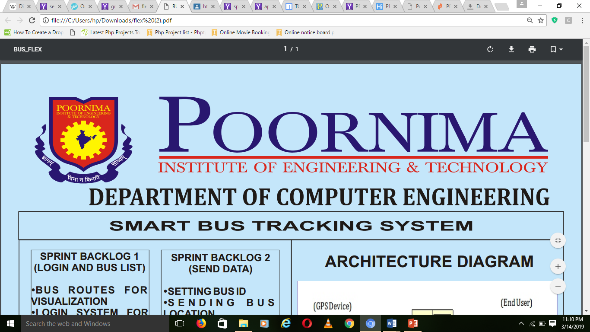
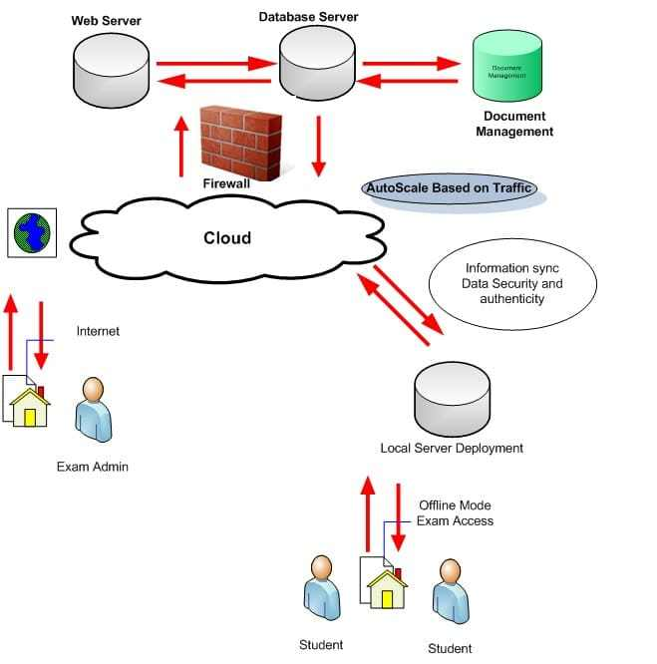
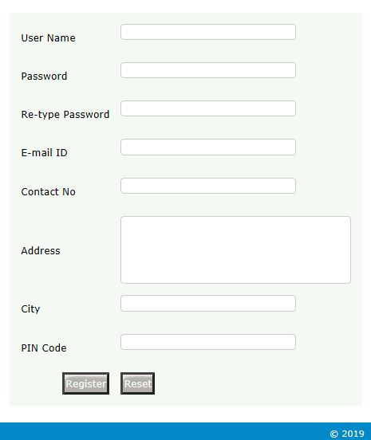
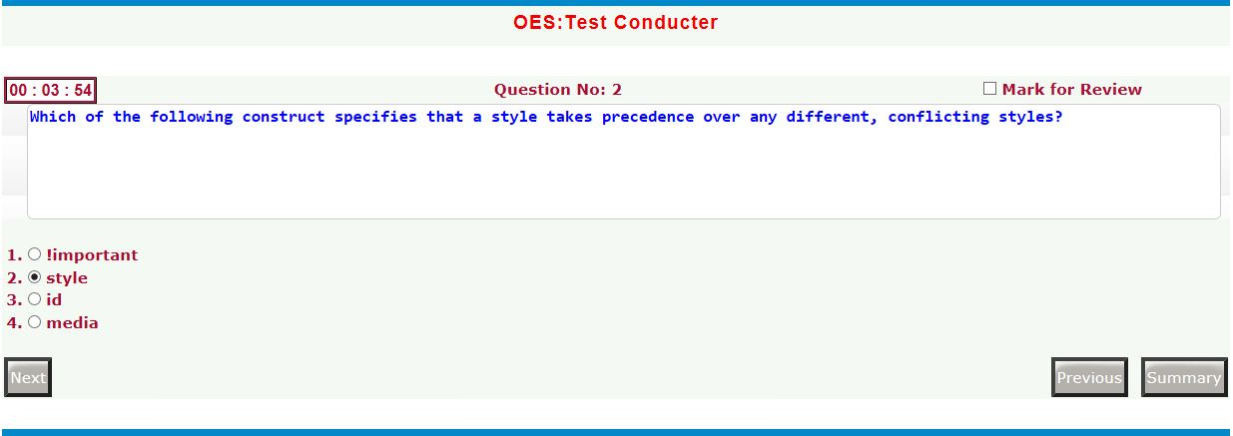
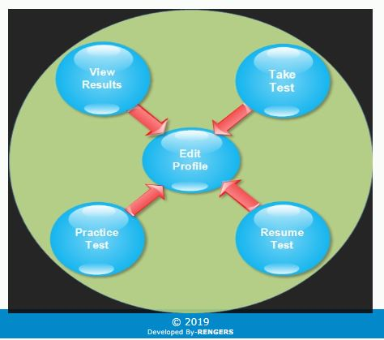
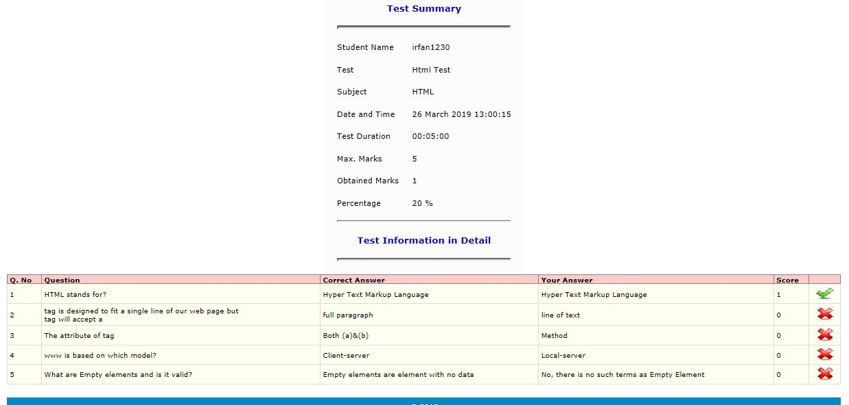
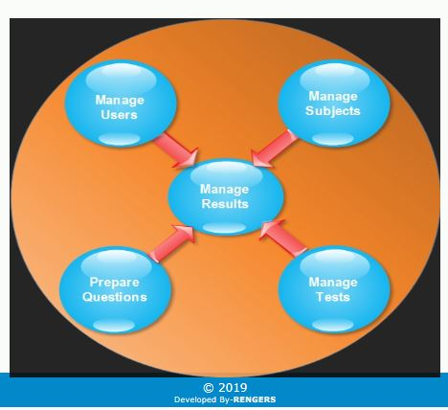
Online Examination System
SPRINT BACKLOG 1
SPRINT BACKLOG 2
ARCHITECTURE DIAGRAM
Registration Page Using
User Name
Password
E-Mail Id
Contact No
Address
Test Conductor
Show Test Time
Mark For Review
Next Question
Previous Question
Summary
+
SPRINT BACKLOG 3
SPRINT BACKLOG 4
Admin panel
1.Manage Users
2.Manage Subject
3.Manage Test
4. Question Prepare
5. Manage Result
APPLICATION
Test Summary
Test Type , Subject
Date & Time, Duration
Percentage & Ob. Marks
Right & Wrong Question
Score
Take Test
Edit Profile
View Result
PROJECT GUIDE :
MS. SHRUTI BIJAWAT
8CS PR 2018_19_40
IRFAN (PIET15CE043) , SOURABH GUPTA (PIET15CE108)

