Slide 1
Internship presentation
G ASHISH, CSE 2
160120733094

Slide 2
AGENDA
Introduction
Internship details
Objectives
Tasks
Learnings
Results
Conclusion

Slide 3
INTRODUCTION
Pupil first is an online learning platform for student developers to up-skill themselves for challenging jobs in software development and in emerging technologies. To enable this, students are guided step-by-step through an intensive learning framework designed jointly by the team at Pupil first and industry professionals.
Students learn to build products from scratch - starting from fundamentals, and advancing all the way to building a working application that follows industry best practices.
It is a minor degree in advanced web development provided by AICTE LITE program. It is based on national model curriculum designed and maintained by industry experts and has a proven career pathway in the software development industry

Slide 4
Internship Details
Web Development Course has been divided into two phases WD-101 and WD-201, The first phase has all about been about learning fundamentals of web development like HTML, CSS and JavaScript, making a capstone project in order to qualify to WD-201.
WD-201 is an extension for WD-101, by focusing mainly on server-side programming using Node.js and Express.js as backend frameworks with the use of PostgreSQL databases. WD201 Course has been classified into 10 levels along with a capstone project ,total 11 levels where each level helps us to learn and implement necessary features in our project. In Capstone project we will able to build a website from scratch with the help of fundamentals that we have learnt in wd201.

Slide 5
objectives
The programme is based on national model curriculum designed and maintained by industry experts and has a proven career pathway in the software development industry
The platform aims to equip student developers to up-skill themselves for challenging jobs in software development and in emerging technologies.
Students are guided step-by-step through an intensive learning framework designed jointly by the team at Pupilfirst and industry professionals.
Students learn to build products from scratch - starting from fundamentals, and advancing all the way to building a working application that follows industry best practices.

Slide 6
TASKS

Slide 7
Timelines
SEP – OCT 2022
NOV - 2022
Started WD-101 and Completed WD-101 capstone project and started WD-201
Completed 1-5 Levels of WD-201 by learning various technologies
DEC - 2022
JAN - 2023
Completed 6-10 Levels of WD-201 and Completed level-10 by building a multi user To-do Application and started working on final capstone project.
Completed capstone project by building a Online Voting Platform

Slide 8
WD 101
In the beginning of the course we learnt about, Introduction to web and getting familiar with command line Interface, and also we learnt about HTML and styling of web pages.
We got familiar with Tailwind CSS, A front-end Framework used to design both static and dynamic web pages.
Moving forward with the course we have learnt about JavaScript and its functions.
In the end of WD-101, We were familiar about planning, designing and developing of static web pages by building a registration form, which was the capstone project after 8 levels of learning.

Slide 9
WD 201
Level-1
In the beginning of the course we learnt about, basics of Node.js, and maintenance of code quality using eslint .
Level-2
In this level I have learnt about Node Package Manager and how and why it is used in Node.js development. We also created a Node.js program to read HTML from a file and render it in different URLs in our web browser. And all of this will be done using the inbuilt functions in Node.js.
Level-3
In this level I have learnt about the key concepts of Node.js such as event loop, call backs, promises and synchronization.

Slide 10
WD 201
Level-4
In this level I have learnt about various methodologies such as unit and integration testing using jest framework, It is a JavaScript testing framework designed to ensure correctness of any JavaScript codebase.
Level-5
In this level, started to build a todo application by learning about databases simultaneously. We also learnt about PostgreSQL databases while working with the application.
Level-6
In this level, I have learn about how to connect the frontend with backend using Express.js framework, and Started building web application using express.js

Slide 11
WD 201
Level-7
In this level, I have learnt about how to render dynamic content in web page with the help of EJS Templating.
Level-8
In this level, I have learnt about how to add user interface for todo application which consists of accepting new todo, listing todos, delete a todo.
Level-9
In this level, I have learn about how to create stunning web pages by using Tailwind CSS, Bootstrap, JSON and Jquery.
And also learnt about performing CRUD operations on the PostgreSQL database, working with APIs’ and the importance of CSRF tokens.

Slide 12
WD 201
Level-10
In this level, I have learnt about how to Associate tables with sequelize migrations, addition of middleware functionalities with the help of passport.js, inclusion of cookies and sessions, and implementing flash messages and sequelize validations while building a todo application.
Level-11
This Level gave me opportunity to develop a web application from scratch using the concepts that have been covered throughout this course.
I have built a Online Voting Platform project from scratch using Node.js, Express.js, TailwindCSS, PostgresSql.

Slide 13
LEARNINGS

Slide 14
Learnt to create static web pages using HTML, CSS and JavaScript and we have learnt to take input from the While completing WD-101
Got an exposure about server-side programming with Node.js backend framework.
Learnt about express.js, Passport.js, Tailwind CSS frameworks while completing WD-201.
Understood about working of PostgreSQL databases and designing Schema for our application as per the requirements.
Gained an understanding about session management, Cookies, middleware and deploying applications to web.
Learnt how to schedule tasks and complete a work within stringent timeframe.

Slide 15
RESULTS

Slide 16
WD-101
WD-201
Developed a static Registration form and deployed it on GitHub pages
Developed a multi-user to-do application with login, signup, creating, deleting and scheduling a to-do features in the application
Developed a multi-user Online Voting Platform

Slide 17
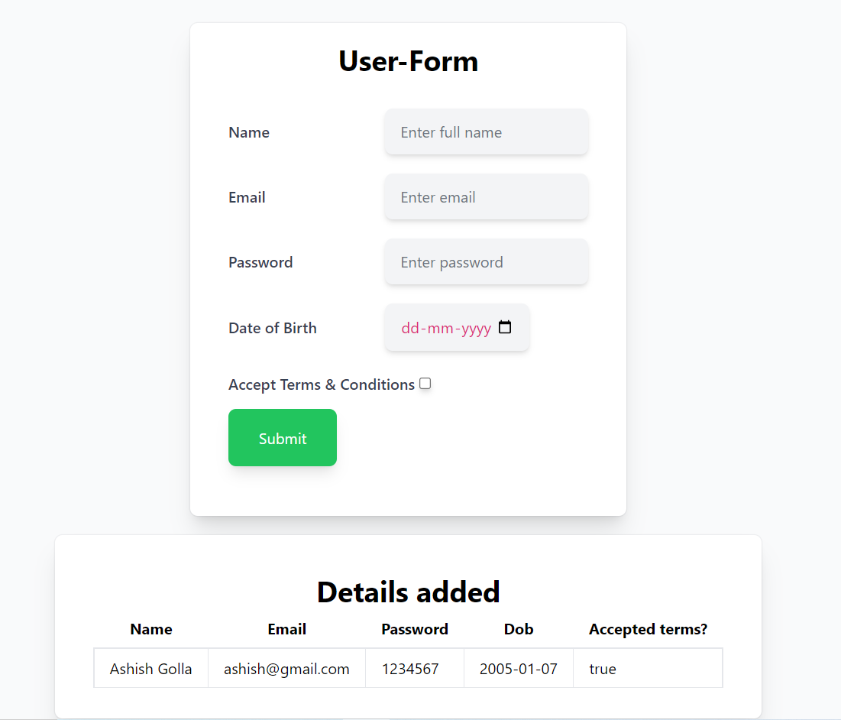
WD 101
Website link:
https://ns011618.github.io/ns.github.io/

Slide 18
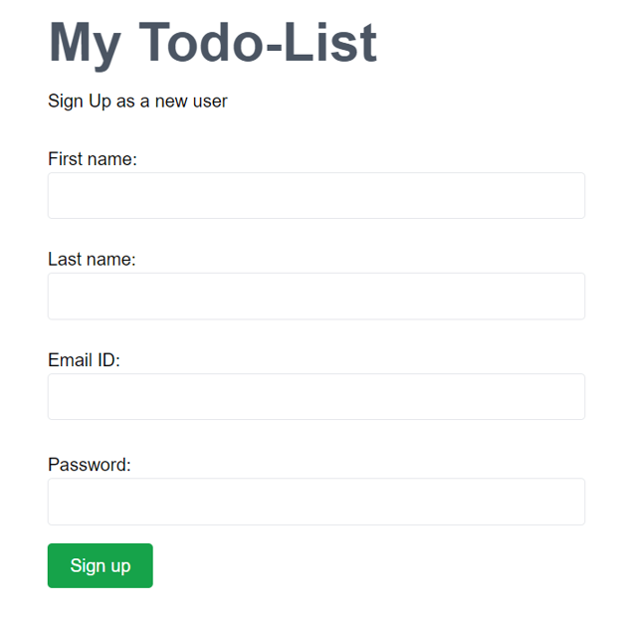
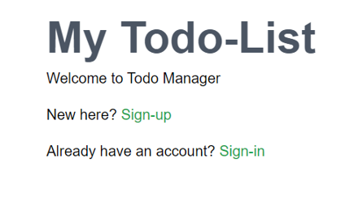
WD 201
Website link:
https://ns011618.github.io/ns.github.io/

Slide 19
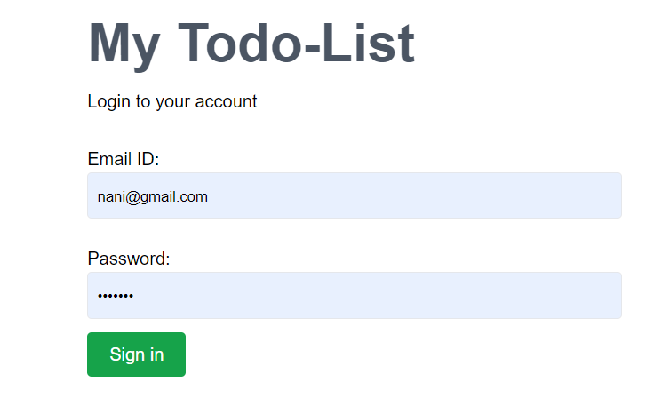
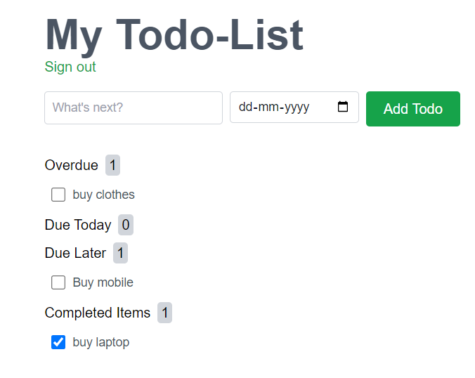
WD 201
Website link:
https://ns011618.github.io/ns.github.io/

Slide 20
Online voting platform
An admin should be able to sign up
Admins can create elections
Admins can create a ballot of questions in an election
Admins can register voters
Admins can launch an election
Elections should have a publicly accessible URL
Voters
Admin Should be able to view running results of an election
Ending Election
All Users

Slide 21
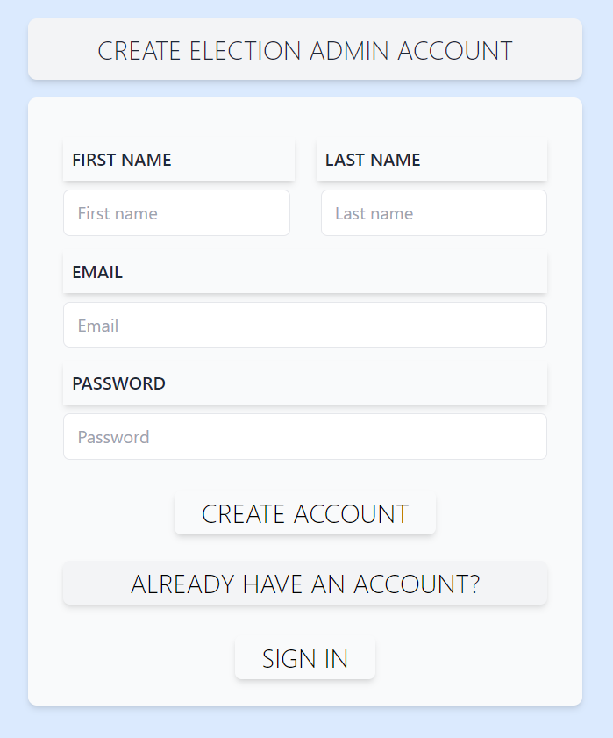
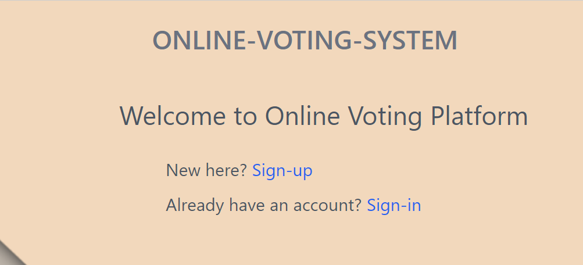
WD 201
Website link
https://final-project-wd-11.onrender.com

Slide 22
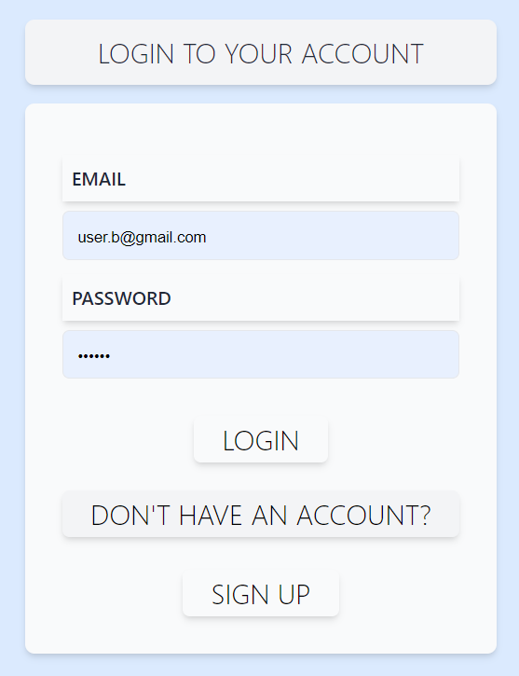
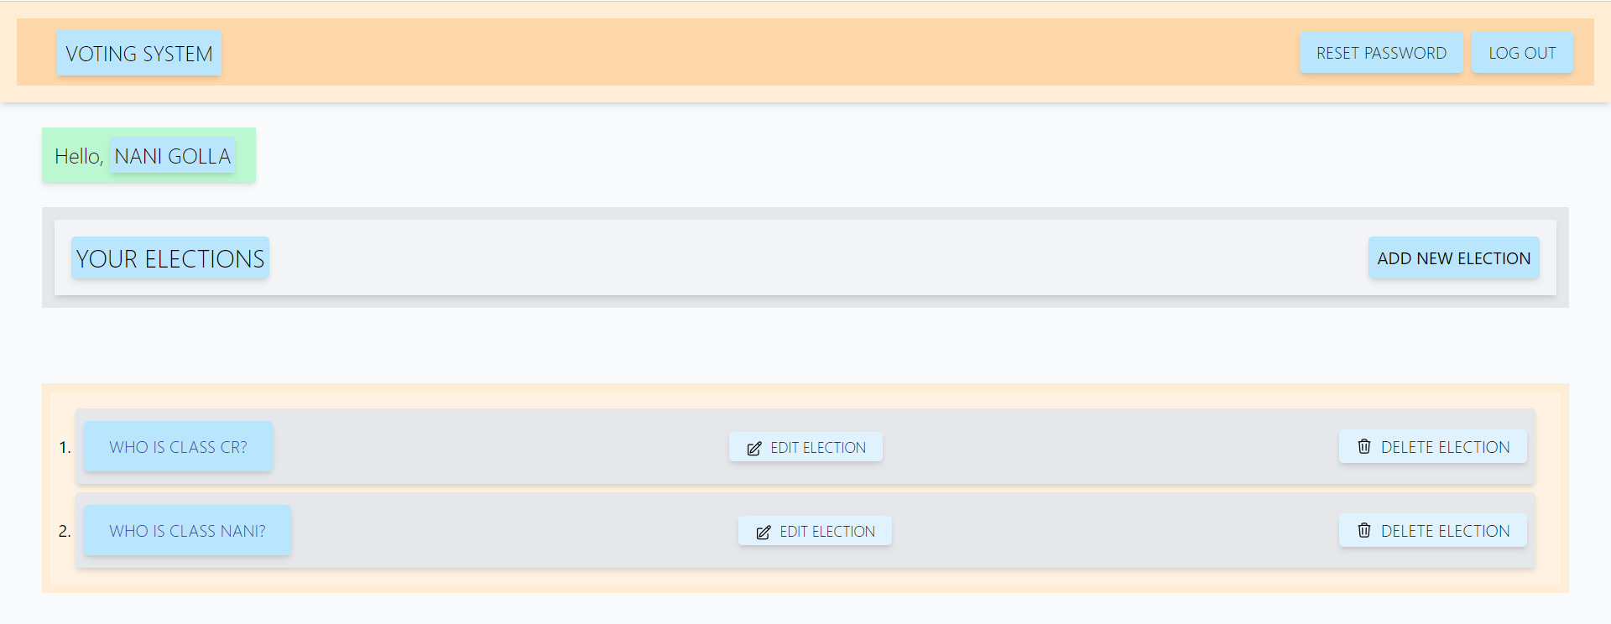
WD 201
Website link
https://final-project-wd-11.onrender.com

Slide 23
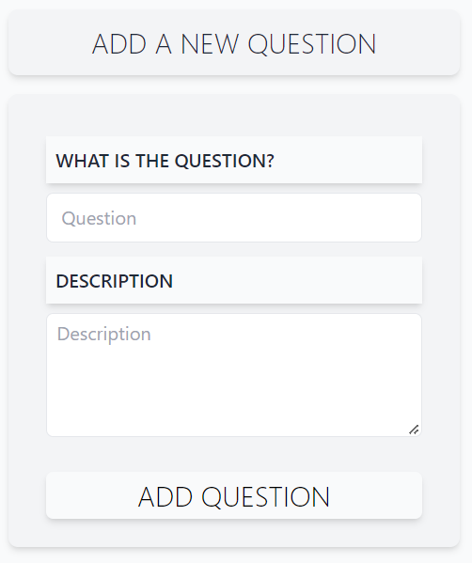
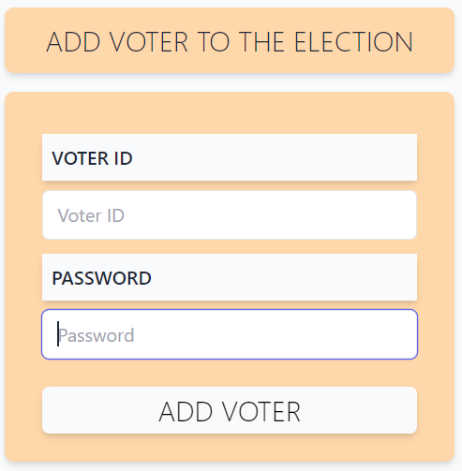
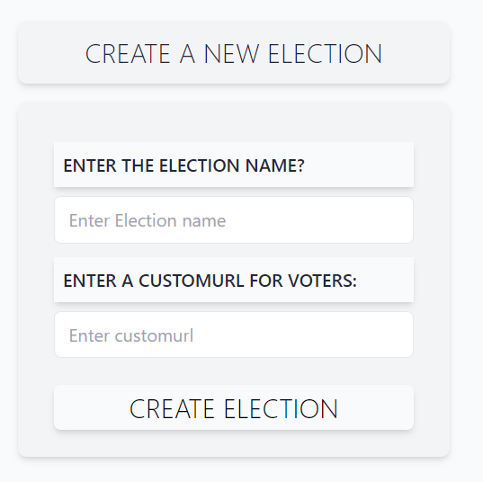
WD 201
Website link
https://final-project-wd-11.onrender.com

Slide 24
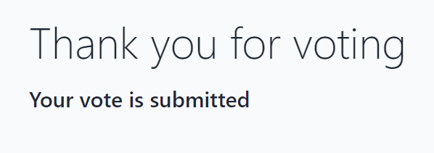
WD 201
Website link
https://final-project-wd-11.onrender.com

Slide 25
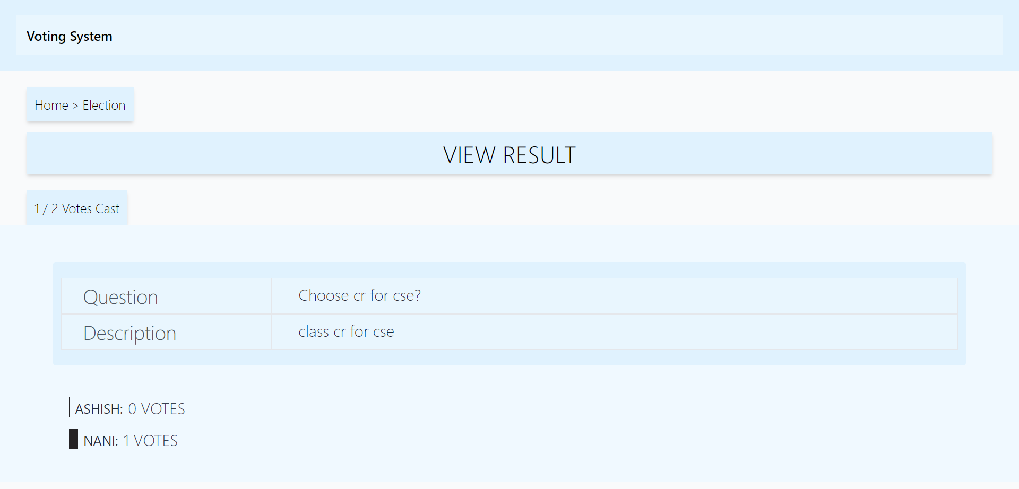
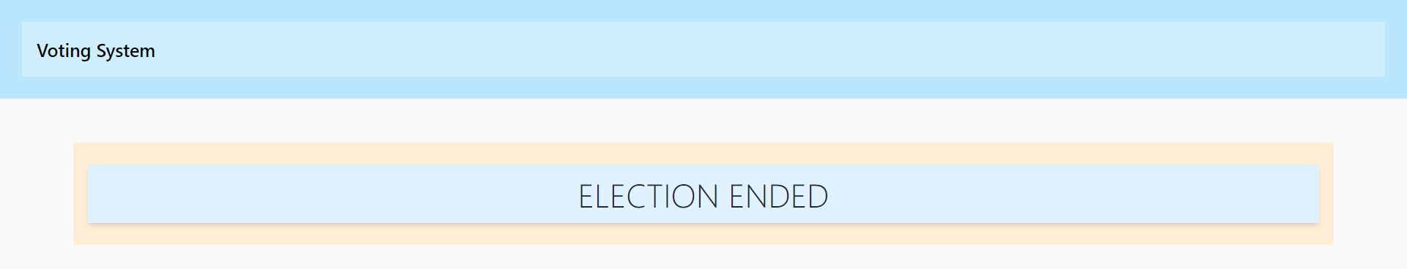
WD 201
Website link
https://final-project-wd-11.onrender.com

Slide 26
conclusion
The internship had been a great learning experience for me. I have learnt about vast set of technologies used in developing of secure and reliable web applications. I have also learnt about implementing software development life cycle methodologies and various testing tools and strategies while working with project.

Slide 27
Thank You
G ASHISH, CSE2
160120733094

