Slide 1


Internship(20CSI03)
Ameya Intelligent Machine labs
BY :
G. Rangha Vardhan - 160120748302
VII SEM,CSE-AI& ML
Notes:
1
1

Slide 2

List of Contents
Company Details
About Company
Identified Problem
Problem Statement
Proposed System
Outputs
Conclusion

Slide 3
Company Details
Name: Ameya Intelligent Machine labs LLP
Founded: 09 April 2021,
Headquarters: Hyderabad
LLP Identification Number: AWW-6466
Director: Santhi Raj Konda
Class of Company: Private
Age of Company: 2 years 6 months 29 days

Slide 4
Ameya
Ameya Labs is a dedicated IT services firm that delivers high-quality software solutions to businesses. Their comprehensive services cover all project phases, from inception to deployment, including ideation, solution design, development, testing, and ongoing support. As a member of the AWS Partner Network, they specialize in Cloud Services, offering Cloud Migration, Cloud Architecture, Cloud Full Stack Development, and Terraform solutions.
Their primary aim is to enhance their clients' business operations
and streamline their technological needs, ultimately facilitating ease of doing business. Learn more at www.ameyalabs.com

Slide 5
Identified Problems
The exponential growth in Electric Vehicle (EV) adoption has led to an increasing demand for efficient and eco-conscious EV services. As EVs become more mainstream, addressing these unique service requirements has become pressing challenge.
The surge in EV adoption necessitates innovative solutions to cater to the specific needs of EV users, such as efficient charging infrastructure, reliable service delivery, and sustainable energy practices. Meeting these challenges head-on is crucial to ensuring the seamless integration of EVs into the broader transportation landscape and fostering a sustainable and eco-conscious future.

Slide 6
Tasks
Problem Statement
To design a frontend ERP (Enterprise Resource Planning) Dashboard using React.js in order to simplify and ease the work of admin.
To design a frontend web Application for CRM ( customer Relationship Management ) using ReactJS
To design a frontend web Application (Dashboard) for the Service Engineers to Provide Services to the customers based on the raised tickets

Slide 7
Proposed Solution
To tackle the growing demand for efficient and eco-conscious Electric Vehicle (EV) services, our solution is a tailored Customer Relationship Management (CRM) application. This CRM optimizes customer data management, enhances the customer experience, and strengthens relationships. It serves as an innovative response to the evolving needs of EV owners and promotes sustainability and service excellence.

Slide 8






Tech stack used
IDE used: Vs Code

Slide 9
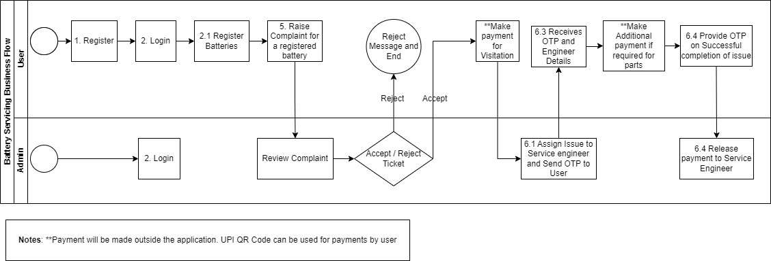
Methodology

Slide 10
Work Flow of EV-Mech application
Ev – Mech application there are 3 main Roles
1. Users (Customers)
2. Service Engineers
3. Admin
Users :
1. Login / Signup
2. Register Battery
3. Raise Complaint / Ticket
4. Service Engineer Provides Service
5. Customer Review – Ticket Closed

Slide 11
Work Flow of EV-Mech application
Service Engineer :
1. Register as authenticated Service Engineer
2. Admin assigns tickets
3. Provide Service
4. Get Review from the user
5. Get Paid for the work
Admin :
1.When user Raises a ticket – verify Location and assigns nearby Service Engineer
2. check Ticket Status
3. Got feedback from customer
4. Based on Review Pays service Engineer
5. If Work Done – Closes the Ticket

Slide 12
Tasks and Outputs
Week – 1 :
- Understanding the workflow of the Project
- Getting familiarising with the Project Idea
- Understanding the working terminology and how to implement those things
Week – 2 :
- Designed Sample Webpages using ‘FIGMA’ tool without
Writing the Actual code
Sample designs for the Web - Applications

Slide 13
Week – 3 :
- Shared a React-Template
- They gave 1 week time to Understand the code inside the template
- During this week they also asked to get familiar with the ReactJs Concepts
Weeks – (4 – 5 ) :
- Our Goal to implement all the required pages related to user(Customer ).
- To verify are we able to fetch the data from the server.
- Making Api calls and Designing UI for the ‘user role’
Week – (6 - 7) :
- Our Goal to implement all the required pages related to Service Engineer.
- To verify are we able to fetch the data from the server.
- Making Api calls and Designing UI for the ‘Service Engineer role’

Slide 14
Weeks – (8 - 9 ) :
- Our Goal to implement all the required pages related to Admin.
- To verify are we able to fetch the data from the server.
- Making Api calls and Designing UI for the ‘Admin role’
Week – (10 ) :
- Our Goal to verify Whether all the Pages related to “User”, “Service Engineer” and “Admin” are working Properly and making changes to UI as per the client Requirements
- To verify are we able to fetch the data from the server.
- Making Api calls and Designing UI for the ‘All the roles’
Weeks – (11 - 12 ) :
- Our Goal to Migrate the Entire code to newer Version of ReactJs
V 18.2.0
- Verifying all the Api calls are Working perfectly.

Slide 15
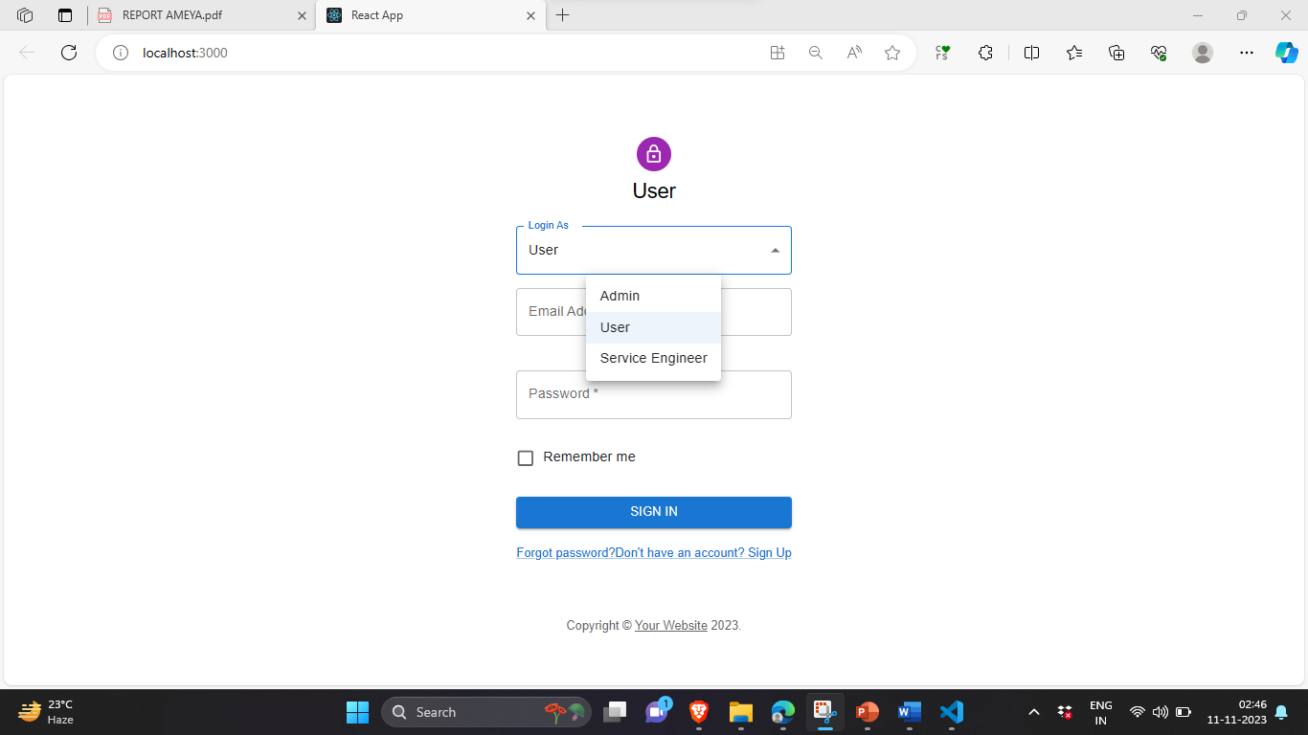
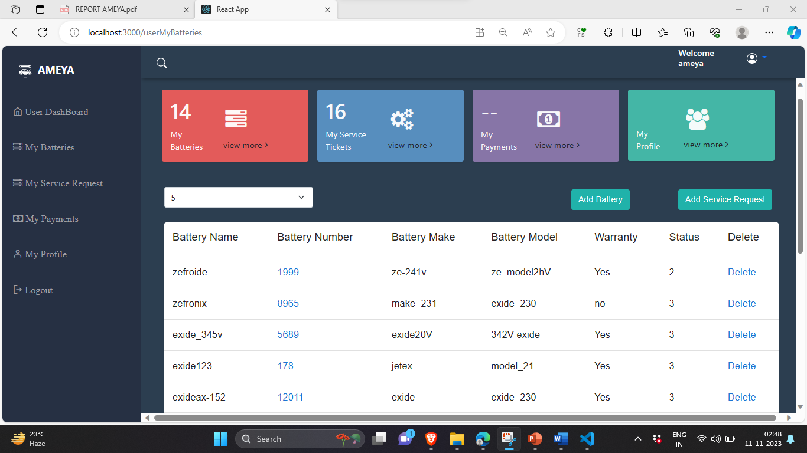
Outputs

Slide 16
Conclusion
During my internship at Ameya Labs, I learned the MERN stack and implemented a Fully functional Reactjs application that is used in real-life.
Finally, I implemented an ERP dashboard using React for the Ev – Mech application.
These projects have given me a valuable opportunity to apply my skills in web development to real-world problems. I have learned a great deal about the MERN stack, and I have gained experience in building and deploying complete and functional web applications.
I have also learned how to integrate different components to create a seamless user experience, and I have developed user-friendly and informative interfaces.
I’ve also learnt how to work in a team environment and experienced the work culture in the IT field.
Additionally I also learnt how to properly use git while collaborating with different team members.
I am grateful for the opportunity to have interned at ‘Ameya Labs’. I have learned a great deal from my colleagues, and I am proud of the work that I have accomplished. I am confident that the skills and experience that I have gained during my internship will be valuable to me in my future career as a web developer.

Slide 17
Thank you

