Slide 1
Post-Processing with OpenGL ES 2.0
Hua Thi Le - le.huathi@gameloft.com
Jul 9th 2012

Slide 2
Contents
Post-processing concepts
Framebuffer Object
Common post-processing techniques

Slide 3
Contents
Post-processing concepts
Framebuffer Object
Common post-processing techniques

Slide 4
Post-processing concepts
Why use post-processing?
How to do it?

Slide 5
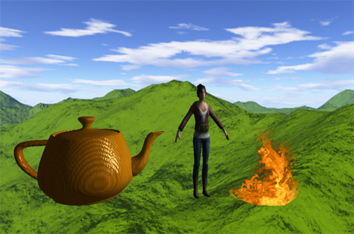
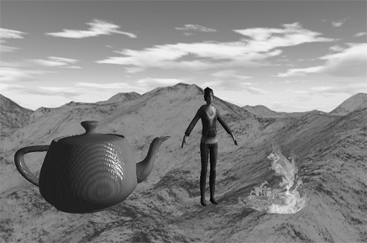
Why use post-processing ?
Purpose: apply a global effect on the whole scene

Slide 6



How to do post-processing
Normal rendering:
Screen
Pipelines for
each object
What’s pipeline?

Slide 7




How to do post-processing
Render to textures -> process -> render to screen
Rendered textures
Screen / textures
Pipelines for
each object
Pipeline for
whole screen
How to render this?
How to process it?

Slide 8
How to do post-processing
Step 1: Rendering to textures
Use an off-screen Frame Buffer Object
Result: textures (color, depth, scissor)
Rendered textures
Screen / textures
Pipelines for
each object
Pipeline for
whole screen

Slide 9
How to do post-processing
Step 2: Draw a quad with specific processing
Input: textures from step 1
Processing: in fragment shader
Output: other textures or screen
Rendered textures
Screen / textures
Pipelines for
each object
Pipeline for
whole screen

Slide 10
How to do post-processing
Step 2 (continue)
Step 2 can loop a few times
The last step must draw to screen
Rendered textures
Screen / textures
Pipelines for
each object
Pipeline for
whole screen

Slide 11
Contents
Post-processing concepts
Framebuffer Object
Common post-processing techniques

Slide 12
Framebuffer Object
Render to default framebuffer:
Index stream
Transformations
Vertex stream
Attributes
Vertex shader
Varying
Primitive Assembly
Clipping
Backface Culling
Rasterization
Interpolation
Early Depth Test
Uniforms
Uniforms
Textures
Lights
MVP matrix
Non-varying values
Uniforms
Varying
Fragment Shader
Screen
(Default framebuffer)
Depth test
Alpha test
Stencil test
Scissor test
Screen
Blending

Slide 13
Framebuffer Object
Render to FBO :
Replace the back-buffer render target with an off-screen target
Index stream
Transformations
Vertex stream
Attributes
Vertex shader
Varying
Primitive Assembly
Clipping
Backface Culling
Rasterization
Interpolation
Early Depth Test
Uniforms
Uniforms
Textures
Lights
MVP matrix
Non-varying values
Uniforms
Varying
Fragment Shader
Framebuffer Object
Screen
(Default framebuffer)
Blending
Depth test
Alpha test
Stencil test
Scissor test

Slide 14
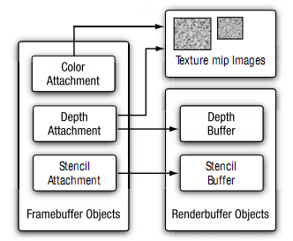
Framebuffer Object
FBO structure:
Attachment: attach (register)
to get rendering result
3 attachment types:
Color
Depth
Stencil
2 object types:
Texture Object
Renderbuffer Object
Can have more than 1 color attachment
Depth attachment can be texture object or renderbuffer object

Slide 15


Framebuffer Object
Render to FBO:
Note: MUST initialize FBO and textures
outside the render function
Framebuffer object
Color texture
Color attachment
Depth attachment
Pipelines for
each object
Depth texture
ready to use
in step 2

Slide 16


Framebuffer Object
Step 2: Draw textures to screen / other textures:
(-1,1,0)
(0,0)
Screen / textures
(1,-1,0)
(1,1)
attribute
Vertex
Shader
Fragment
Shader
Color texture
uniform
Depth texture

Slide 17
Framebuffer Object (coding)
Create FBO
Set current FBO to use
Return to system default framebuffer
Attach objects to FBO (textures, renderbuffers)
Render objects to FBO
Delete FBO

Slide 18
Framebuffer Object (coding)
Create FBO:
Set current FBO to use:
Return to system default framebuffer (screen):
GLuint fboId;
glGenFramebuffers(1, &fboId);
glBindFramebuffer(GL_FRAMEBUFFER, fboId);
glBindFramebuffer(GL_FRAMEBUFFER, 0);

Slide 19
Framebuffer Object (coding)
Attach color texture to FBO:
//generate color texture
glGenTextures(1, &colorTexId);
glBindTexture(GL_TEXTURE_2D, colorTexId);
glTexParameteri(GL_TEXTURE_2D, GL_TEXTURE_MAG_FILTER, GL_LINEAR);
glTexParameteri(GL_TEXTURE_2D, GL_TEXTURE_MIN_FILTER, GL_LINEAR);
glTexParameteri(GL_TEXTURE_2D, GL_TEXTURE_WRAP_S, GL_CLAMP_TO_EDGE);
glTexParameteri(GL_TEXTURE_2D, GL_TEXTURE_WRAP_T, GL_CLAMP_TO_EDGE);
//initialize an empty texture with screen width & height
glTexImage2D(GL_TEXTURE_2D, 0, GL_RGBA, width, height, 0, GL_RGBA, GL_UNSIGNED_BYTE, NULL);
//attach texture to GL_COLOR_ATTACHMENT0
glBindFramebuffer(GL_FRAMEBUFFER, fboId);
glFramebufferTexture2D(GL_FRAMEBUFFER, GL_COLOR_ATTACHMENT0, GL_TEXTURE_2D, colorTexId, 0);
//bind system default texture
glBindTexture(GL_TEXTURE_2D, 0);

Slide 20
Framebuffer Object (coding)
Attach depth texture to FBO:
//generate depth texture – same as color texture
glGenTextures(1, &depthTexId);
glBindTexture(GL_TEXTURE_2D, depthTexId);
glTexParameteri(GL_TEXTURE_2D, GL_TEXTURE_MAG_FILTER, GL_LINEAR);
glTexParameteri(GL_TEXTURE_2D, GL_TEXTURE_MIN_FILTER, GL_LINEAR);
glTexParameteri(GL_TEXTURE_2D, GL_TEXTURE_WRAP_S, GL_CLAMP_TO_EDGE);
glTexParameteri(GL_TEXTURE_2D, GL_TEXTURE_WRAP_T, GL_CLAMP_TO_EDGE);
//initialize an empty texture with screen width & height
glTexImage2D(GL_TEXTURE_2D, 0, GL_DEPTH_COMPONENT, width, height, 0, GL_DEPTH_COMPONENT, GL_UNSIGNED_INT, NULL);
//attach texture to GL_DEPTH_ATTACHMENT
glBindFramebuffer(GL_FRAMEBUFFER, fboId);
glFramebufferTexture2D(GL_FRAMEBUFFER, GL_DEPTH_ATTACHMENT, GL_TEXTURE_2D, depthTexId, 0);
//bind system default texture
glBindTexture(GL_TEXTURE_2D, 0);

Slide 21
Framebuffer Object (coding)
Render objects to FBO:
Delete FBO:
//bind the target FBO
glBindFramebuffer(GL_FRAMEBUFFER, fboId);
//render each objects in list object
for(vector<Object*>::iterator it=m_vObjects.begin();it!=m_vObjects.end();++it)
{
(*it)->Render(globalTime, &m_maProjection, pmaView, &m_camera);
}
//draw post-effect
glDeleteFramebuffers(1, &fboId);

Slide 22
Contents
Post-processing concepts
Framebuffer Object
Common post-processing techniques

Slide 23
Common techniques
Black-white
Blur
Bloom
Depth of field (DOF)
Edge detection
Shadow
Complex reflection
Snow

Slide 24
Black - white
Run step 2 once
Simple grayscale in fragment shader
vec4 color = texture2D(u_texture, v_uv);
float t = 0.3 * color.r + 0.59 * color.g + 0.11 * color.b;
//float t = 0.33 * color.r + 0.33 * color.g + 0.34 * color.b;
gl_FragColor = vec4(t, t, t, 1.0);

Slide 25
Blur
Apply a blur filter for each pixel
uniform colorTexture;
uniform step;
varying v_uv;
void main(void)
{
color1 = sampling2Dfrom(colorTexture, v_uv);
color2 = sampling2Dfrom(colorTexture, (v_uv.x + step.x, v_uv.y));
color3 = sampling2Dfrom(colorTexture, (v_uv.x - step.x, v_uv.y));
color4 = sampling2Dfrom(colorTexture, (v_uv.x, v_uv.y + step.y));
color5 = sampling2Dfrom(colorTexture, (v_uv.x, v_uv.y - step.y));
color6 = sampling2Dfrom(colorTexture, (v_uv.x + step.z, v_uv.y + step.w));
color7 = sampling2Dfrom(colorTexture, (v_uv.x - step.z, v_uv.y + step.w));
color8 = sampling2Dfrom(colorTexture, (v_uv.x - step.z, v_uv.y - step.w));
color9 = sampling2Dfrom(colorTexture, (v_uv.x + step.z, v_uv.y - step.w));
gl_FragColor = (color1 * 2.0 + color2 + color3 + color4 + color5 + color6 + color7 + color8 + color9) * 0.1;
}

Slide 26
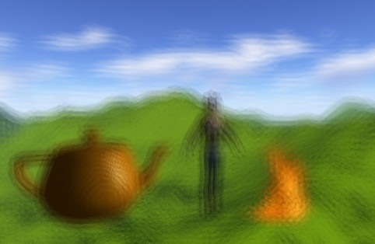
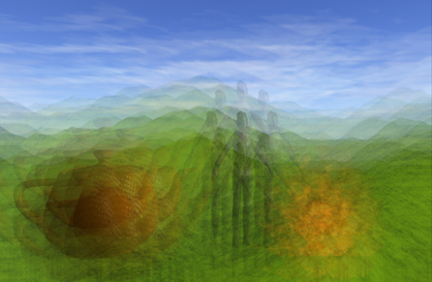
Blur (cont.)
Pass step to shader by a multiplier k
if((i32Location = glGetUniformLocation(program, "step")) != -1)
{
float x = 1.0f / pESContext->width;
float y = 1.0f / pESContext->height;
float z = sqrt(2.0f) / 2.0f * x;
float w = sqrt(2.0f) / 2.0f * y;
glUniform4f(i32Location, k * x, k * y, k * z, k * w);
}
k = 1.0
k = 63.0

Slide 27
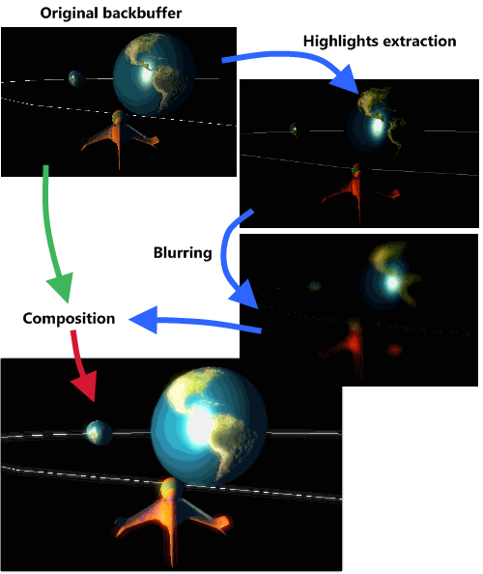
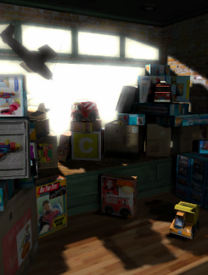
Bloom
Bloom: overexpose effect

Slide 28
Bloom
Implement: 3 steps
Pre-bloom: extract the bright part
Blur: blur this bright part several times (common is 5)
Post-bloom: blend initial color buffer with blur result
Need more FBO to do bloom
Sample code:
g_postEffPreBloom.DrawPostEffect(esContext, &fbo2, fbo1.fbo_color, fbo1.fbo_depth, 0, 0);
g_postEffBlur.DrawPostEffect( esContext, &fbo3, fbo2.fbo_color, fbo2.fbo_depth, 0, 5 );
g_postEffBlur.DrawPostEffect( esContext, &fbo2, fbo3.fbo_color, fbo3.fbo_depth, 0, 17 );
g_postEffBlur.DrawPostEffect( esContext, &fbo3, fbo2.fbo_color, fbo2.fbo_depth, 0, 31 );
g_postEffBlur.DrawPostEffect( esContext, &fbo2, fbo3.fbo_color, fbo3.fbo_depth, 0, 43 );
g_postEffBlur.DrawPostEffect( esContext, &fbo3, fbo2.fbo_color, fbo2.fbo_depth, 0, 63 );
g_postEffPostBloom.DrawPostEffect( esContext, NULL, fbo1.fbo_color, fbo3.fbo_color, 0, 0 );
Why ?
How many
FBO ?

Slide 29
Bloom
Sample code for pre-bloom: highlights extraction
Post-bloom: mix the original texture with blurred texture
uniform sampler2D colorTex;
uniform float limit;
varying mediump vec2 v_texCoords;
void main(void)
{
vec3 color = sampling2Dfrom(colorTexture, v_texCoords).rgb;
float brightness = 0.3 * color.r + 0.59 * color.g + 0.11 * color.b;
float val = step(limit, brightness); //Extract bright fragment
gl_FragColor = vec4(color * val, 1.0);
}

Slide 30
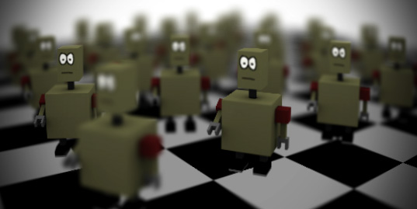
Depth of field
Blur things that out-of-focus

Slide 31
Depth of field
Implement: 2 steps
Blur: several times (common is 3)
DOF: combine original and blur with depth buffer
Sample code:
g_postEffBlur.DrawPostEffect(esContext, &fbo2, fbo1.fbo_color, fbo1.fbo_depth, 0, 5);
g_postEffBlur.DrawPostEffect(esContext, &fbo3, fbo2.fbo_color, fbo1.fbo_depth, 0, 9);
g_postEffBlur.DrawPostEffect(esContext, &fbo2, fbo3.fbo_color, fbo1.fbo_depth, 0, 16);
g_postEffDOF.DrawPostEffect(esContext, NULL, fbo1.fbo_color, fbo1.fbo_depth, fbo2.fbo_color, 0);

Slide 32
Depth of field
For better result, use different blur shader algorithm
Sample code:
//Get uv coordinate of related fragment
uv2 = v_uv + vec2(u_blurStep.x,0.0);
uv3 = v_uv + vec2(u_blurStep.z, u_blurStep.w);
uv4 = v_uv + vec2(0.0, u_blurStep.y);
uv5 = v_uv + vec2(-u_blurStep.z, u_blurStep.w);
uv6 = v_uv + vec2(-u_blurStep.x, 0.0);
uv7 = v_uv + vec2(-u_blurStep.z, -u_blurStep.w);
uv8 = v_uv + vec2(0.0, -u_blurStep.y);
uv9 = v_uv + vec2(u_blurStep.z, -u_blurStep.w);
//Blur the blurred texture
color1 = sampling2Dfrom(colorTexture, v_uv);
color2 = sampling2Dfrom(colorTexture, uv2);
color3 = sampling2Dfrom(colorTexture, uv3);
color4 = sampling2Dfrom(colorTexture, uv4);
color5 = sampling2Dfrom(colorTexture, uv5);
color6 = sampling2Dfrom(colorTexture, uv6);
color7 = sampling2Dfrom(colorTexture, uv7);
color8 = sampling2Dfrom(colorTexture, uv8);
color9 = sampling2Dfrom(colorTexture, uv9);

Slide 33
Depth of field
For better result, use different blur shader algorithm
Sample code:
//Calculate mix factor for each fragment
float d1 = CalculateMixFactor(v_uv);
float d2 = CalculateMixFactor(uv2);
float d3 = CalculateMixFactor(uv3);
float d4 = CalculateMixFactor(uv4);
float d5 = CalculateMixFactor(uv5);
float d6 = CalculateMixFactor(uv6);
float d7 = CalculateMixFactor(uv7);
float d8 = CalculateMixFactor(uv8);
float d9 = CalculateMixFactor(uv9);
float total = 2.0 + d2 + d3 + d4 + d5 + d6 + d7 + d8 + d9;
gl_FragColor = (2.0 * color1 + color2 * d2 + color3 * d3 + color4 * d4 + color5 * d5 + color6 * d6 + color7 * d7 + color8 * d8 + color9 * d9) / total;

Slide 34
Depth of field
Sample code to calculate mix factor
Sample code:
Uniform u_dof_near ; //same as near plan of projection - need to be put in uniform
Uniform u_dof_far ; //same as far plan of projection - need to be put in uniform
Uniform u_dof_clarity; //Set clarity point from C++ code
float CalculateMixFactor(vec2 uv)
{
//Get fragment's depth value from depth buffer
float depth = sampling2Dfrom(depthTexture, uv).x;
//Calculate z
float z = -u_dof_far * u_dof_near / (depth * (u_dof_far - u_dof_near) - u_dof_far);
//Calculate mix factor between z and clarity point
float factor = clamp(abs(z - u_dof_clarity) / u_dof_fade, 0.0, 1.0);
return factor;
}

Slide 35
Depth of field
DoF shader is similar to blur shader but need one more step to mix blur textured with original scene
Sample code:
vec4 colorOriginal = sampling2Dfrom(originalSceneTexture, v_uv);
vec4 colorBlur = (2.0 * color1 + color2 * d2 + color3 * d3 + color4 * d4 + color5 * d5 + color6 * d6 + color7 * d7 + color8 * d8 + color9 * d9) / total;
gl_FragColor = mix(colorOriginal,colorBlur, d1);

Slide 36

Questions & Answers

