Slide 1

Adora
Protecting Israeli Consumers Online
Software Entrepreneurship Workshop
Project #15002932
Rani Maman · Guy Yad Shalom
Supervisor: Dror Margalit
Notes:
Hi everyone — we're Rani and Guy, project 15002932. Our project is Adora: a Chrome extension that protects Israeli online shoppers from dropshipping scams in real time. Today we'll walk you through the problem, our solution, a live-style demo, the architecture, and how we compare to the alternatives.

Slide 2

Meet Dora
Most of our users start exactly here.
Dora
Online shopper
Dora enjoys browsing Facebook in the evening and often clicks on ads that look trustworthy, local, and professional. When she sees a polished Hebrew website with a “closing sale” discount, it feels like a safe deal.
01
Sees the ad
02
Trusts the site
03
Buys at 11× the price
Sponsored Facebook ad:
"Closing sale 80% off"
Polished Hebrew shop,
countdown timer, big discount,
Professional images (AI generated)
Same product on AliExpress
for a fraction of the cost
Adora · Software Entrepreneurship Workshop · Project #15002932
Notes:
Meet Dora — our representative user. She's 58, lives in Tel Aviv, and spends every evening scrolling Facebook. She's the typical Israeli online shopper: not naive, but trusting, and loves a good deal. One evening she sees a sponsored ad — "Closing sale, 80% off". She clicks through to a clean Hebrew shop with reviews and a countdown timer, and she buys. What she doesn't know: the same product is on AliExpress for roughly 11× less. That's the gap Adora was built to close.

Slide 3
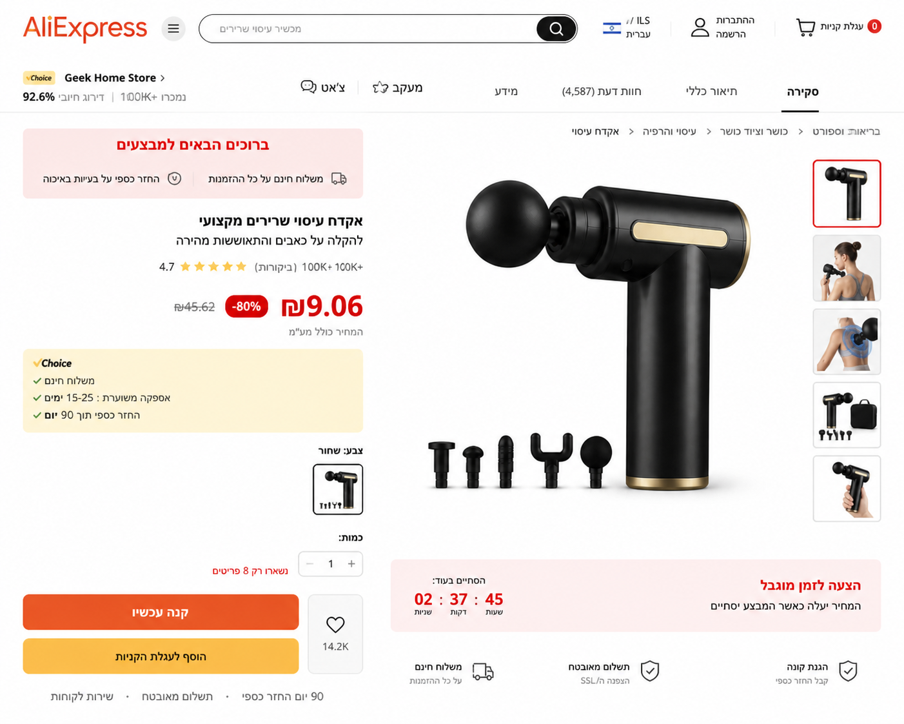
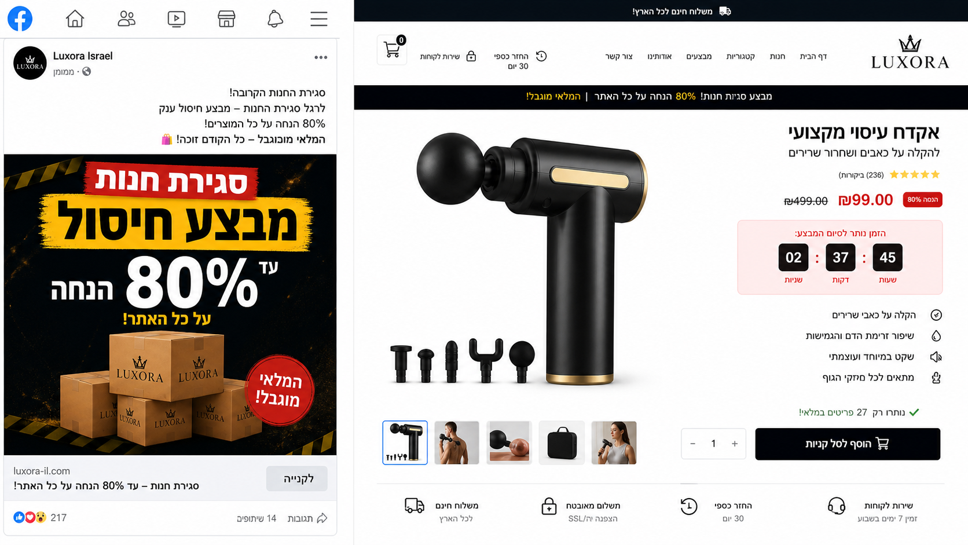
The Hidden Price Trap
ISRAELI SITE
Massage Gun · ₪99
ALIEXPRESS
Same product · ₪9.06
≈ 11× more
expensive
Hundreds of dropshipping ads launched in Israel every day.
Adora · Software Entrepreneurship Workshop · Project #15002932
Notes:
This is the exact ad Dora saw — Luxora Israel selling a massage gun for ₪99, with a closing-sale banner and an 80%-off pitch. On the right is the same product on AliExpress for ₪9.06 — roughly 11× cheaper at the source. The two stats below summarize the broader pattern: hundreds of new Israeli dropshipping ads run every day, and almost no shopper price-checks against AliExpress, Temu or Amazon before paying. That gap, on a routine purchase, is what Adora attacks.

Slide 4
Our Solution: Adora
A system that spots dropshipping ads in real time and shows where the same product is cheaper - Your lighthouse for online shopping.
01
02
03
Collect
Analyze
Alert + Suggest
Israeli ads · daily
AI risk score
Cheaper source
We scrape Meta Ad Library every day and store every Israeli shopping ad. We watch the same feed Dora scrolls.
Each landing page is scored by Gemini 2.5 Flash + rule-based checks: urgency wording, fake reviews, mismatched seller info, AliExpress price match.
Risky stores get a heads-up banner with a price comparison to AliExpress / Temu / Amazon - before checkout, not after.
22K trusted Israeli & global domains shipped inside the extension - Adora skips the noise and only intervenes on real risk.
Adora · Software Entrepreneurship Workshop · Project #15002932
Notes:
Adora is a Chrome extension backed by an AI service. It works in three steps: (1) we collect Israeli shopping ads from Meta Ad Library every day; (2) for every ad we score the landing page with Gemini and a rules engine — looking for urgency wording, fake review patterns, mismatched seller info, and the AliExpress price for the same product; (3) when the user lands on a risky page, we surface a heads-up banner with cheaper alternatives — before checkout. We also ship a 21,779-domain whitelist so we never get in the way of Amazon, IKEA, KSP, etc.

Slide 5
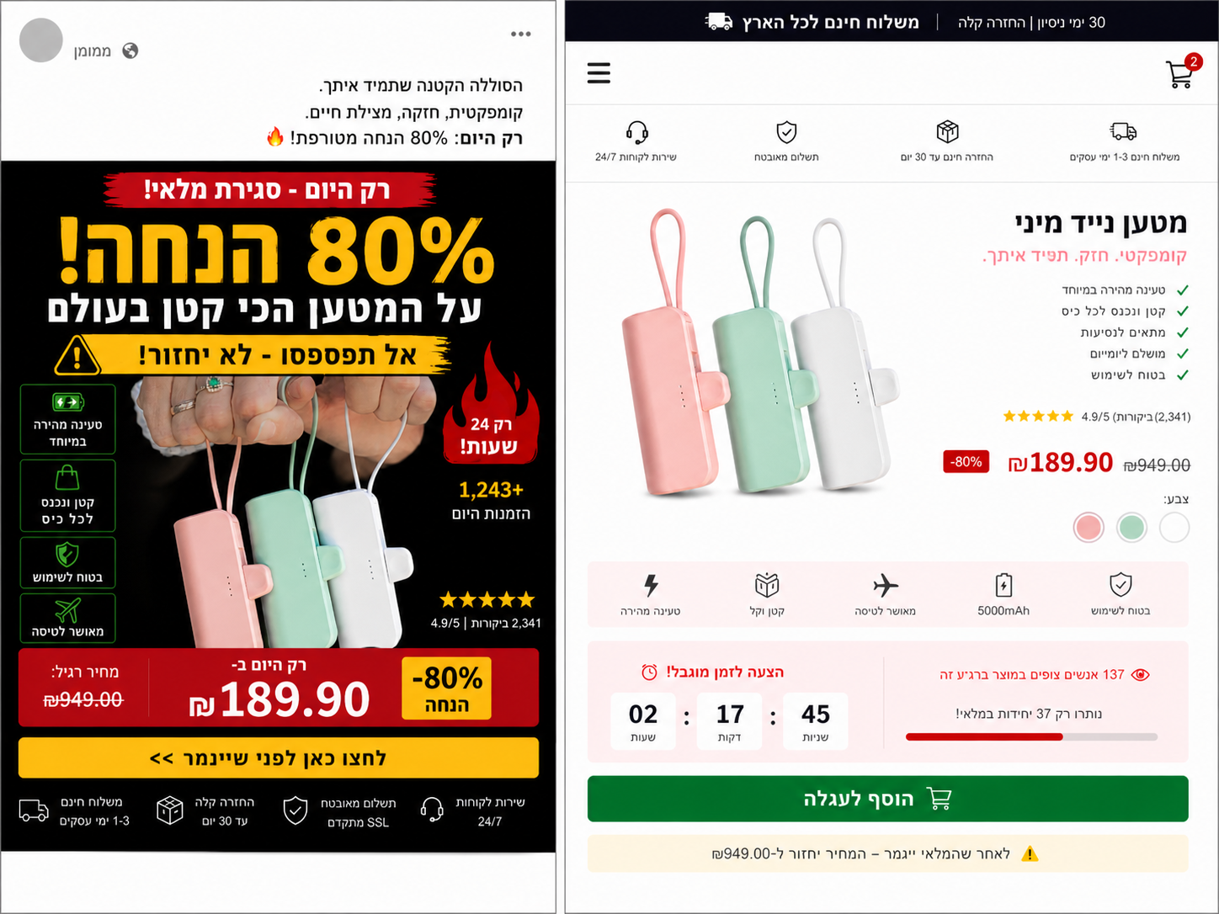
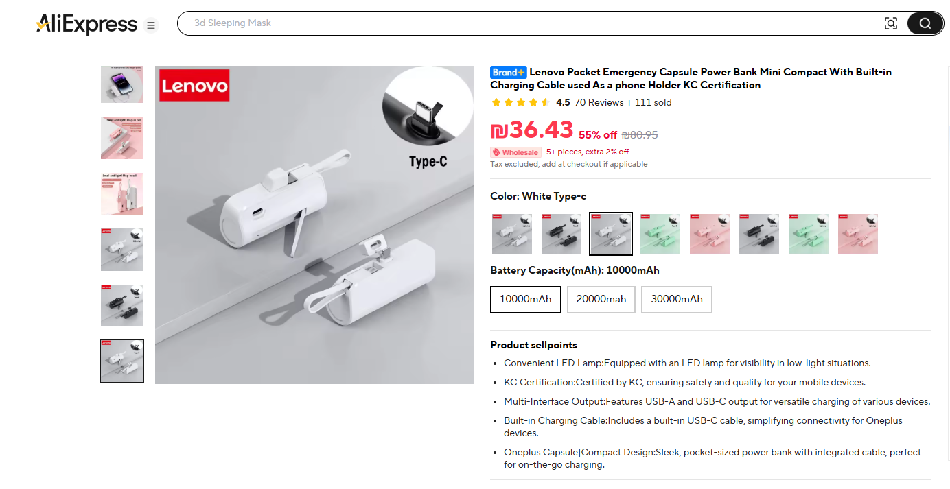
Demo - Spotting The Trap
A second real example: a mini power bank advertised at 80% off.
FB AD + ISRAELI SITE
ALIEXPRESS
Same power bank · ₪36
"Closing sale"
80% off
Countdown timer
Fake reviews
Urgency framing
Anchor pricing
Fake scarcity
AI-Generated reviews
These are the exact patterns Adora's analyzer is trained to detect.
Adora · Software Entrepreneurship Workshop · Project #15002932
Notes:
Quick second example so you see this isn't a one-off. On the left: a Facebook ad and Israeli site selling a mini Lenovo-style power bank for ₪189.90, claiming 80% off and a closing sale. On the right: the same product on AliExpress for around ₪36. Below the images we've highlighted the four patterns our analyzer flags on this exact page: urgency framing, anchor pricing, fake countdown, and Hebrew-styled trust signals.

Slide 6
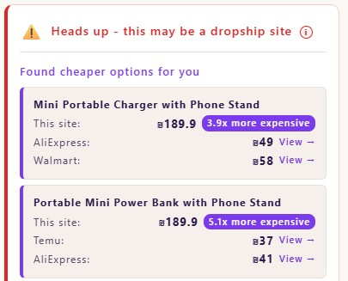
Demo - Adora In Action
What Dora now sees the moment she lands on the risky page.
1
Heads-up banner
3
Savings highlighted
We tell users early - before checkout, not after.
"3.9× more expensive" - user reads one number.
2
Cheaper alternatives
4
Total money saved
Direct links to the same product on AliExpress, Walmart, Temu.
An indicator that tells the user the amount of money he saved over time.
Live demo.
Adora · Software Entrepreneurship Workshop · Project #15002932
Notes:
This is what Dora sees the moment she lands on the risky page. (1) A heads-up banner appears in-page — before checkout. (2) She can tap it to see why the site was flagged. (3) Right below, we show the same product on AliExpress, Walmart, and Temu — with one-click links. (4) The savings ratio is highlighted in plain language: "3.9× more expensive". A live demo is available against the production VM.

Slide 7
Architecture - User flow
01
02
03
04
User browses
Extension scans
Backend scores
Verdict in-page
Israeli E-commerce site
Domain + page signals
Python · Postgres · LLM
Banner + alternatives
User opens any ad-driven shop in Chrome.
Whitelist (22K) → local cache → API call only if needed.
Risk score, evidence, and cheaper-source match.
Warning + price comparison and direct product links
or silent if safe.
Adora · Software Entrepreneurship Workshop · Project #15002932
Notes:
At runtime, Adora is four steps. (1) Dora browses a site. (2) Our extension scans the domain — first against an embedded 21K-domain whitelist, then a local cache, then the backend. (3) The backend returns a risk score, the evidence, and a cheaper-source match. (4) The verdict is rendered in-page — a banner with alternatives, or nothing if the site is safe. Cached domain checks run under 200ms; full AI analysis under three seconds; the whitelist alone shortcuts ~21K calls.

Slide 8
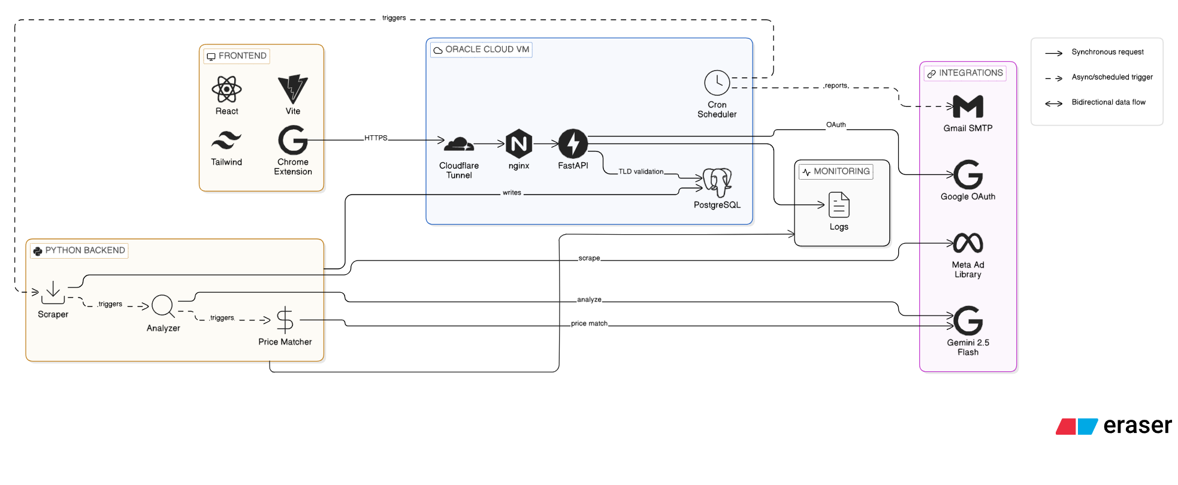
Architecture - Tech Stack
How those four steps actually run in production.
Stack
Frontend
Chrome MV3 · React · Vite · Tailwind
Backend
Python on Oracle Cloud · Cloudflare Tunnel
Playwright Scraping · OAuth 2.0
Python Scripts and cron jobs
Data
PostgreSQL · 22K-domain whitelist · JSON logs and Gmail SMTP monitoring
AI / Sources
Gemini 2.5 Flash API · Meta Ad Library
Adora · Software Entrepreneurship Workshop · Project #15002932
Notes:
On the left is the actual production architecture diagram. On the right, the stack itself: frontend is a Chrome MV3 extension with React, Vite and Tailwind; the backend is FastAPI on an Oracle Cloud VM behind a Cloudflare Tunnel; data lives in PostgreSQL with structured JSON logs; AI is Gemini 2.5 Flash, scraping is Firecrawl, and our ad source is the Meta Ad Library. Two engineering touches worth calling out: the tunnel URL is auto-discovered — we don't rebuild the extension when the VM restarts — and the embedded 21K-domain whitelist means we make zero API calls on safe sites.

Slide 9
Summary
What we built, why it matters, what's next.
Problem
Solution
Evidence
Israeli shoppers like Dora face hundreds of Hebrew-styled dropshipping ads daily, with prices up to 11× the AliExpress source - and no warning before checkout.
A Chrome extension + AI backend that scores risk in real time and offers a cheaper alternative, on the page itself, in the moment of purchase.
Live system on Oracle Cloud · Real data - Hundreds of ads already detected, stored in our database
Community-powered protection
From a tool that protects one user, to a network that gets smarter with every shopper.
01
Community reports
02
Savings insights
03
Feedback loop
Users help expand the database by reporting suspicious stores and cheaper alternatives.
Adora estimates how much each user saved over time by choosing the cheaper alternative.
Users confirm whether warnings and cheaper links were helpful - feeding the model.
Thank you · Questions?
Adora · Software Entrepreneurship Workshop · Project #15002932
Notes:
To summarize: the problem is that Israeli shoppers face hundreds of polished Hebrew dropshipping ads every day, and the price gap is brutal — 11× was a real number we saw today. Our solution is a Chrome extension plus an AI backend that scores risk in real time and surfaces a cheaper alternative before checkout. The evidence is a live system on Oracle Cloud, a 21K-domain whitelist, daily Meta ad ingestion, and two real cases we reproduced in this presentation. What's next is community-powered: user reports, savings insights, and a feedback loop. Thank you — happy to take questions.

