Slide 1
MCA Major Project Mid Term Evaluation
BookEasy (Ticket booking system)
Under the guidance of
Dr Arpana Sinhal
Department of Computer Applications
Faculty of Science, Technology and Architecture
Manipal University Jaipur
By
Rani Kumari
23FS20MCA00116
2023-25

Slide 2
Outlines
Introduction
Motivation
Process model
Software requirement specification
Data flow diagram
Output
Conclusion
Future scope

Slide 3
1. Introduction
The Online Ticket Booking System is a web-based platform that allows users to book tickets for various services such as movies, flights, buses, trains, concert etc.
It eliminates the need for physical queues, making the booking process convenient and efficient.
The system integrates secure payment gateways and real-time seat availability to enhance user experience.
The Online Ticket Booking System is a web-based platform designed to simplify the process of booking tickets for various services like movies, flights, buses, trains, and events. By eliminating the need for physical queues, it offers a more convenient and efficient booking experience. The system features secure payment gateways and real-time seat availability to ensure smooth and hassle-free transactions.

Slide 4
2. Motivation
In today’s fast-paced digital world, convenience, speed, and accessibility are top priorities for users when it comes to planning travel or entertainment. Traditional methods of booking tickets—be it for buses, trains, flights, movies, concerts, or dining—often involve long queues, manual errors, limited access, and inefficient time management.
The motivation behind developing an Online Ticket Booking System is to provide a unified digital platform where users can easily search, compare, reserve, and purchase tickets across multiple categories—anytime, anywhere. By automating the booking process and integrating multiple service providers into one centralized system, the project aims to:
Eliminate long wait times and manual processing
Enable secure and real-time bookings
Improve user experience with personalized and dynamic content
Reduce operational costs and workload for service providers
Support future scalability and integration with third-party APIs (e.g., Google Maps, UPI/PayPal, etc.)

Slide 5
3. Process Model: Incremental Model
Why Use the Incremental Model?
Divides the system into smaller, manageable increments (or modules).
Each increment delivers a working version of the system.
Feedback-based improvements are possible before the next release.
Phases of Incremental Model:
Increment 1 – User Authentication & Profile Management
User Registration/Login
Role-based access (User/Admin)
Increment 2 – Ticket Search & Selection
Browse events, movies, or travel options
Filter and sort based on price, availability, and category
Increment 3 – Booking & Payment
Seat selection and reservation
Secure online payment integration
Increment 4 – Notifications & Ticket Management
Email/SMS confirmations
Ticket cancellation and refund processing
Increment 5 – Reports & Admin Panel
User activity tracking
Sales and revenue reports
Each phase builds upon the previous one, ensuring a fully functional system by the end.

Slide 6
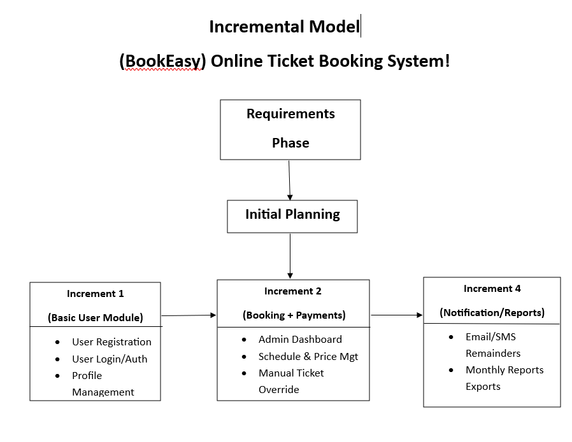

Slide 7
4. Software Requirement Specification (SRS)
1. Introduction
1.1 Purpose
This document provides a detailed description of the requirements for the Online Ticket Booking System. It will facilitate users to search, book, view, and manage various tickets online.
1.2 Scope
This system allows users to book:
Transportation (Bus, Train, Flight)
Hotels
Entertainment (Concert, Theatre, Movies)
Dining (Table reservations, Food events)
The system will handle real-time availability, booking, cancellation, payments, and notifications.
1.3 Definitions, Acronyms, Abbreviations
SRS: Software Requirement Specification
OTP: One-Time Password
API: Application Programming Interface
UI: User Interface

Slide 8
4. Software Requirement Specification (SRS)
2. Overall Description
2.1 Product Perspective
The system is an integrated web and mobile platform with the following modules:
User Module
Booking Engine
Payment Gateway
Admin Dashboard
Service Provider Module
2.2 User Characteristics
Regular Users: Search and book tickets.
Admin Users: Manage schedules, pricing, reports.
Service Providers: Update availability and offerings.
2.3 Constraints
Must be available 24/7
Must support at least 1000 concurrent users
2.4 Assumptions & Dependencies
Stable internet connection required
Depends on third-party APIs for schedules and payments

Slide 9
4. Software Requirement Specification (SRS)
Functional Requirements:
User Management: Login, Registration, Profile Editing
Ticket Booking: Search, Select, and Book Tickets
Payment Integration: Secure Payment Processing
Notifications: Booking Confirmation & Reminders
Admin Dashboard: Manage Users & Transactions
Non-Functional Requirements:
Scalability: Handles multiple users simultaneously
Security: Data encryption, Secure Payment Gateways
Performance: Fast response time and database optimization
Usability: User-friendly UI/UX design

Slide 10
4. Software Requirement Specification (SRS)
4. External Interface Requirements
4.1 User Interfaces
Simple and clean UI with intuitive navigation
Booking calendar and seat selection interfaces
Live availability and pricing display
4.2 Hardware Interfaces
Hosted on cloud servers (AWS/Azure)
Supports mobile and desktop browsers
4.3 Software Interfaces
Payment Gateway APIs (Razorpay, PayPal)
SMS/Email Notification APIs
External APIs for schedules (e.g., train/flight)

Slide 11
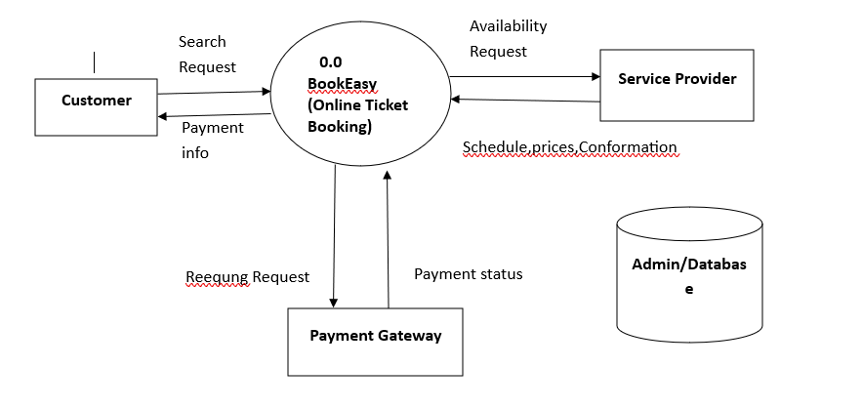
5. Data Flow Diagram (DFD)
0 Level Diagram

Slide 12
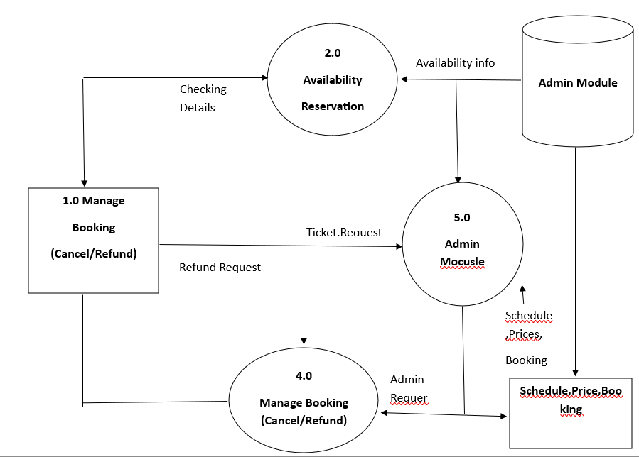
5. Data Flow Diagram (DFD)
1 Level Diagram

Slide 13
6. Output
1. E-Ticket / Booking Confirmation
Displays ticket details after successful booking.
Includes: Ticket ID, user name, travel/event details, seat/room info, amount paid, date & time.
Can be downloaded or emailed as a PDF or QR code.
2. Booking History Page
List of all past and upcoming bookings for the user.
Filterable by type: Bus, Train, Flight, Movie, Concert, Dining, Hotel.
Includes options for "Cancel", "Reschedule", or "Download Ticket".
3. Payment Status
Shows confirmation of payment success or failure.
Includes transaction ID, amount, and payment method.
Automatically updates the ticket booking status.

Slide 14
6. Output
4. Admin Dashboard Reports
Daily/weekly/monthly reports of:
Total bookings
Revenue generated
Cancellations
Most popular booking types
Graphical view (bar/pie charts) for better analytics.
5. Notification Output
On-screen confirmation messages.
Email/SMS alerts for booking, cancellation, refund, or reminders.
6. Invoice Generation
For bookings requiring receipts (flights, hotels, etc.)
Includes company logo, tax breakdown, and invoice number.

Slide 15
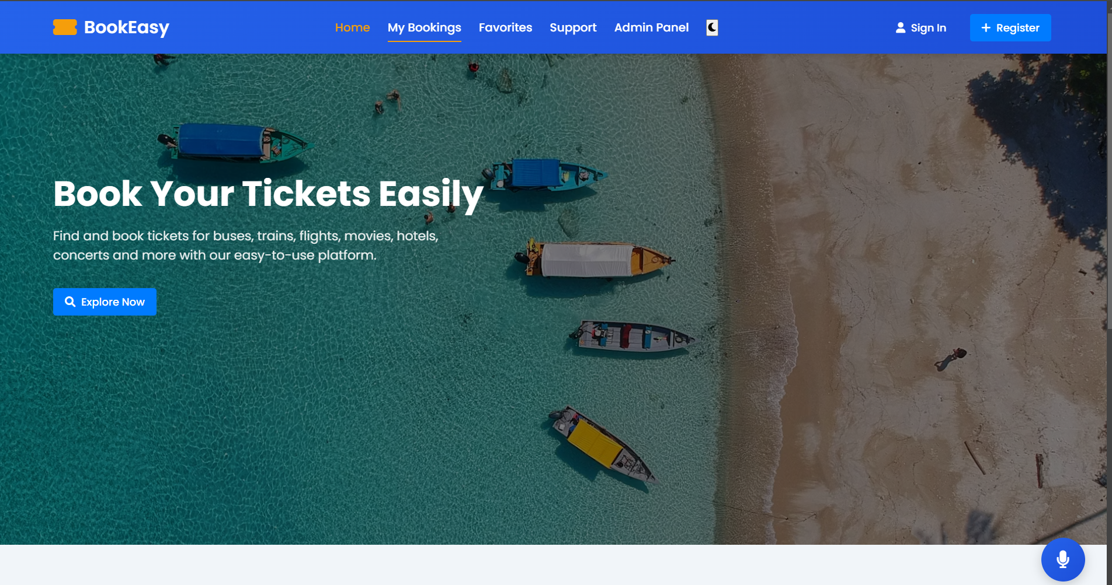

Slide 16
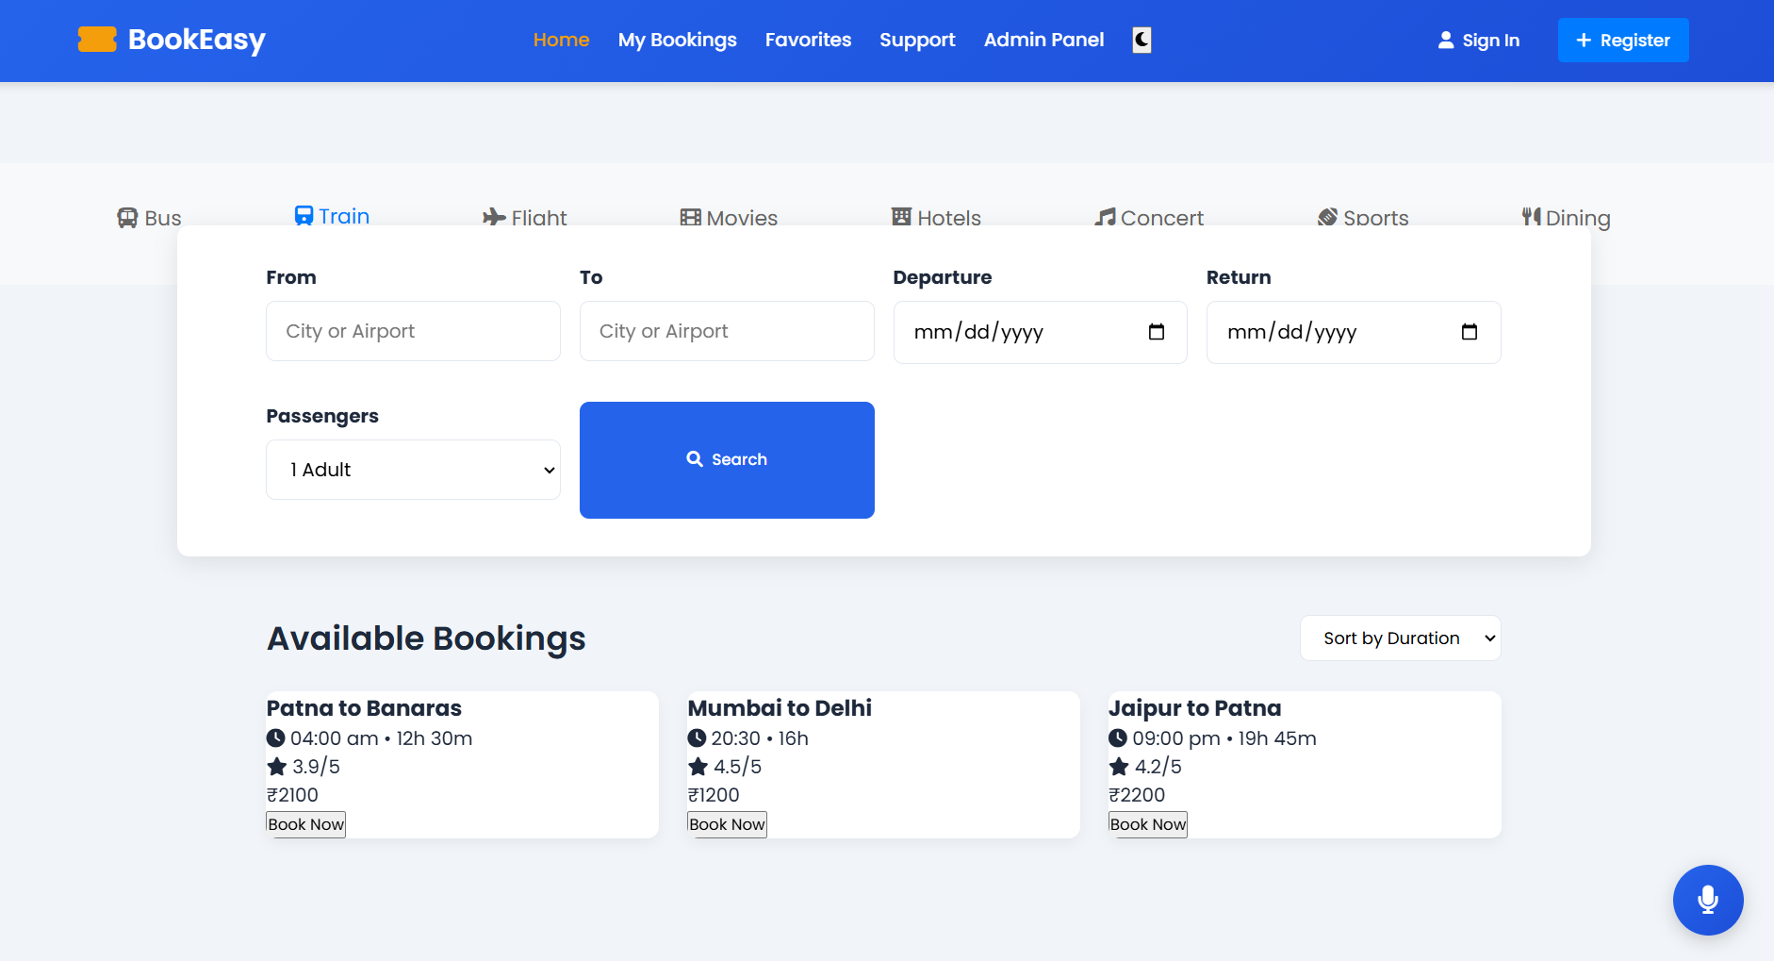

Slide 17
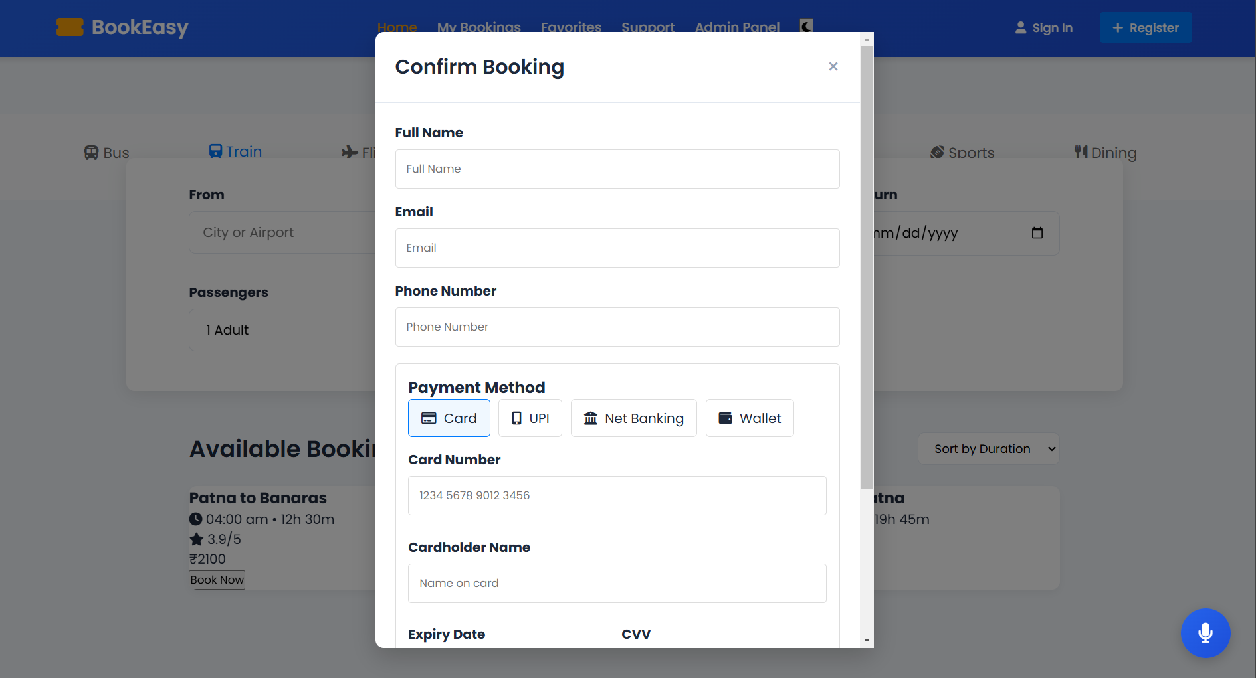

Slide 18
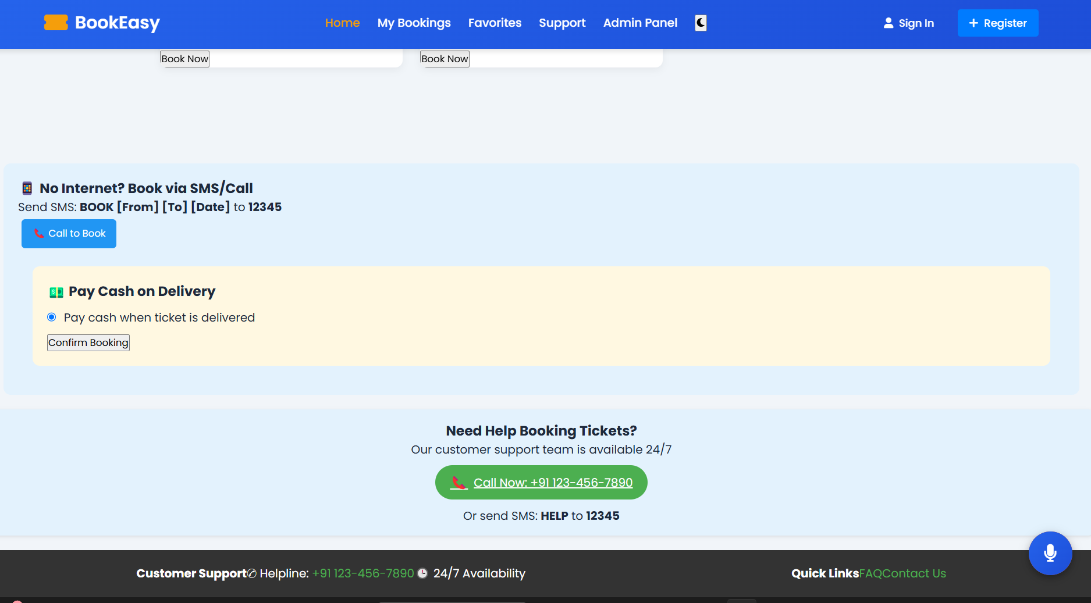

Slide 19
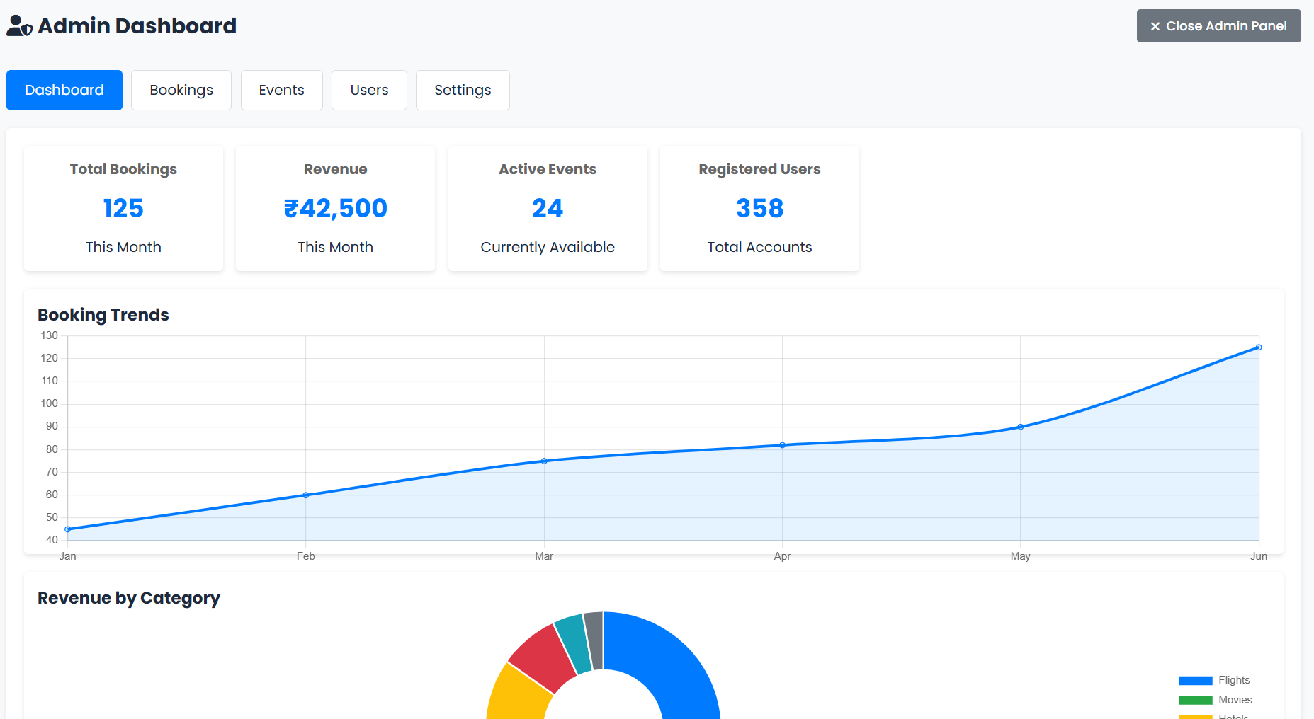

Slide 20
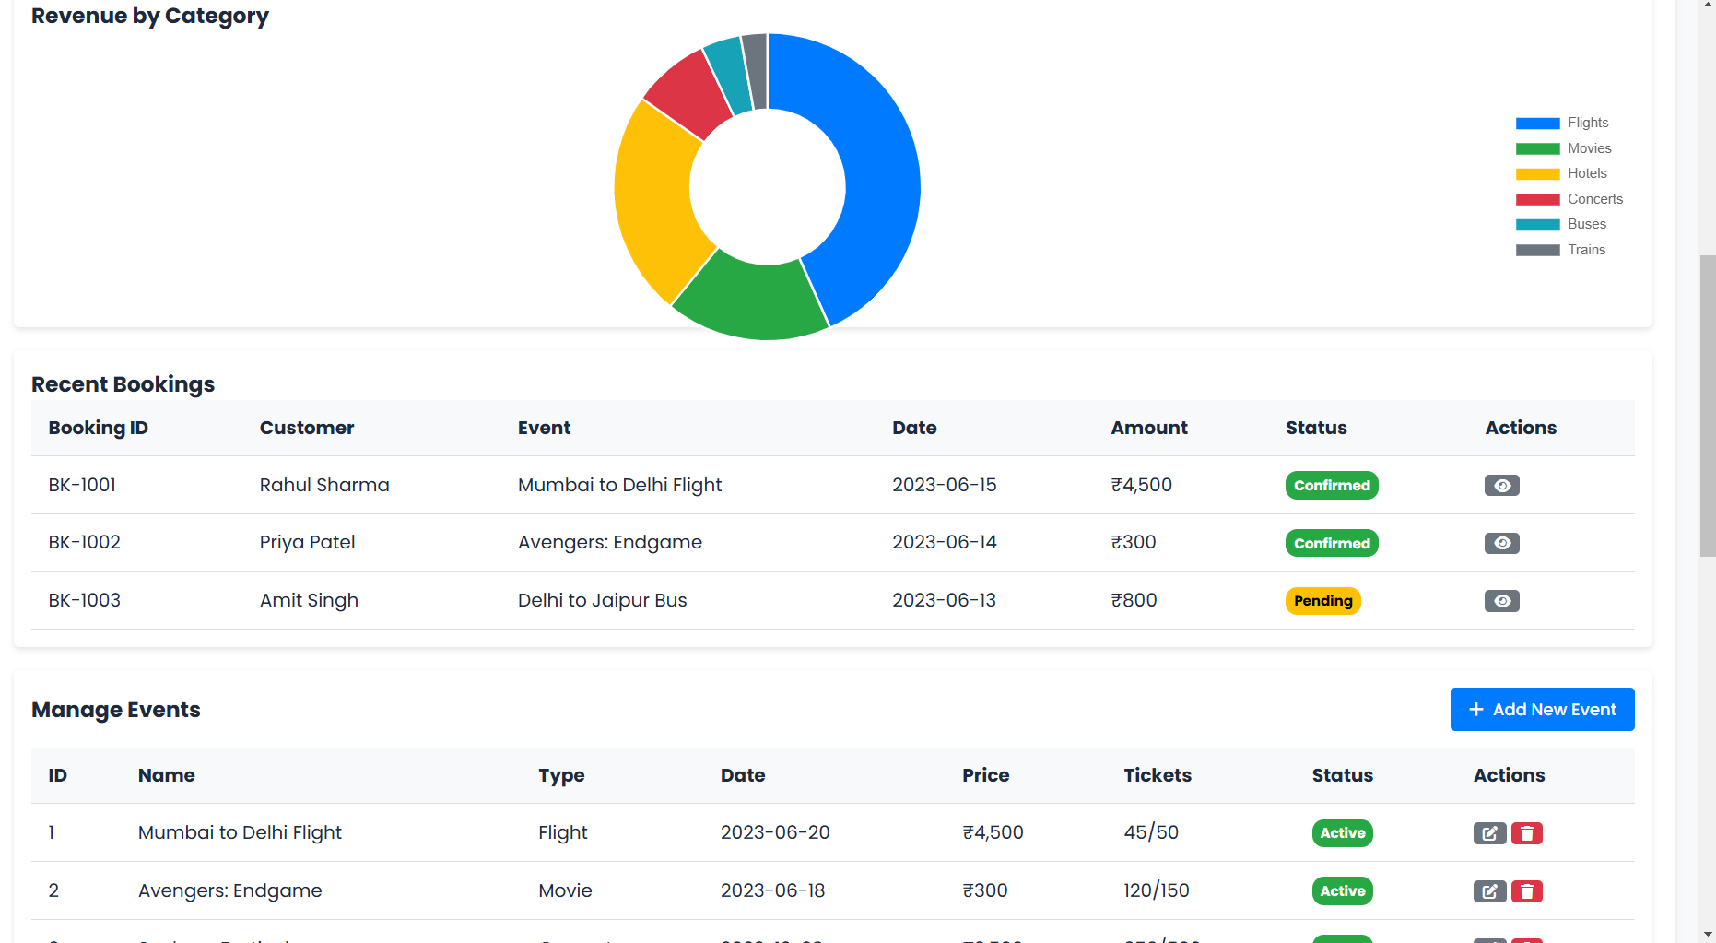

Slide 21
7. Conclusion
The Online Ticket Booking System provides a centralized and efficient platform for users to book various services such as bus, train, flight, hotel, dining, movies, and concerts from the comfort of their home. By digitizing the traditional booking process, the system offers a user-friendly interface, real-time availability, secure payments, and automated ticket generation.
This project not only simplifies the customer experience but also enables service providers to manage their schedules, pricing, and bookings more effectively. Through the use of modern development models like the Incremental Model, the system can be built and improved progressively, ensuring stability and flexibility.
The Incremental Model ensures continuous system improvements.
Reduces risk of failures by delivering features in phases.
Provides a seamless ticket booking experience with secure transactions.

Slide 22
8. Future Scope
1. AI & Personalization
Smart Recommendations based on user behavior, travel history, and preferences.
AI-based dynamic pricing for predicting the best time to book.
Chatbots for 24/7 customer service and booking assistance.
2. Global & Multi-Language Support
Expansion to international bookings.
Support for multi-language and multi-currency transactions.
Geo-localized content and offers for better user experience.
3. Emergency & Health Integration
Real-time health/safety alerts for destinations.
Travel insurance, refund automation during emergencies or cancellations.
4. Subscription Models & Memberships
Premium users get early access, discounts, or exclusive offers.
Monthly/yearly travel passes or dine-out plans.

