Slide 1

01 / 11
Intellivation AB
Building AI products that improve everyday lives
We are a Swedish AI startup. We build intelligent consumer products, deliver AI projects for partners, and help businesses implement AI. One belief drives us: AI should improve real lives, not just enterprise dashboards.
4 Products in Portfolio
Eskilstuna, Sweden
Org: 559579-9932

Slide 2
Intellivation AB
02 / 11
WHO WE ARE
PILLAR 1 · OUR OWN PRODUCTS
An AI startup that builds and ships
Consumer AI we own and scale
CalorAI and Realify are built by Intellivation AB, owned by Intellivation AB, and scaled by us. These are the products where we capture long-term value.
PILLAR 2 · AI PARTNERSHIPS & DELIVERY
Intellivation AB was incorporated in 2026, but the work started long before. We build AI-powered products where the intelligence is the product. Not a wrapper, not a chatbot add-on. We also take on client and partner projects to stay close to real business problems and fund product development.
Co-ventures and technical delivery
We are a technical co-venture partner on Almukhtabar (News Lab) and delivered JuraCare end-to-end. We build production AI in real domains.
PILLAR 3 · AI CONSULTANCY
🎯 Vision
⚡ Mission
Revenue today, insights for tomorrow
Make AI accessible and genuinely useful for ordinary people.
Build, ship, and scale AI products with proven traction.
Strategic AI consulting for Swedish businesses. Revenue that funds product development and keeps us close to real enterprise AI challenges.

Slide 3
Intellivation AB
03 / 11
THE PROBLEM SPACE
$4T
AI is ready. Adoption is not.
Annual global cost of diet-related chronic disease. Just one of the problem spaces.
The technology exists. The gap is that most people and businesses cannot access it in a form that is frictionless, trustworthy, or specific enough to change behaviour.
80%
$15B+
78%
Nutrition app abandonment in 30 days
Health & fitness app market 17% CAGR
Swedish SMEs wanting but lacking AI
🥗
Health: 1B+ people failing at nutrition tracking
Existing apps require 10+ minutes/day of manual logging. 80% of users quit within 30 days.
1B+
17%
2026
People managing diet-related conditions
CAGR health & fitness apps
Year we are shipping
🎭
Trust: AI-generated content is indistinguishable
Deepfakes of public figures, AI videos for children. The internet has a reality crisis.
🏢
Business: Swedish SMEs cannot implement AI alone
78% want to adopt AI but lack in-house expertise. Dominated by expensive consultancies.

Slide 4




Intellivation AB
04 / 11
PROJECT PORTFOLIO
Four products. Just the beginning.
OWNED BY INTELLIVATION AB · LIVE
CO-VENTURE · LIVE
BUILT AND OPERATED BY INTELLIVATION · LIVE
OWNED BY INTELLIVATION AB · R&D
CalorAI
Almukhtabar
JuraCare
Realify
AI nutrition app with computer vision food tracking, 30+ nutrient analysis, AI coach, and social gamification.
AI-powered newsroom editor and publishing workspace. Structured editorial workflow with AI writing assistance.
AI legal assistant trained on Swedish law. Instant answers, document analysis, compliance monitoring.
AI and real content detection platform. Labels AI-generated videos for adults, filters for children, with authenticity stamps.
120K+ Downloads
newslb.com
juracare.se
In Development
4.6★ Rating
Live
Live
Stealth
500K+ Meals

Slide 5
Intellivation AB
05 / 11
🥗
6 WAYS TO LOG A MEAL
📸
Snap a photo
🎥
Live video scan
OWNED BY INTELLIVATION AB · LIVE · HEALTHTECH
CalorAI AI Nutrition Tracker
🖼️
Upload image
⌨️
Type food name
🎤
Voice command
💾
Saved meals
Log meals in under 10 seconds using computer vision. CalorAI identifies food automatically, estimates portions, and tracks 30+ nutrients. No manual entry needed.
30+ NUTRIENTS TRACKED AUTOMATICALLY
🟡
Vitamins
⚙️
Minerals
🧬
Macros
D, C, B12, A, K
Iron, Calcium, Zinc
Protein, Carbs, Fat
120K+
500K+
4.6★
Downloads
Meals Logged
Google Play
💧
Hydration
🐟
Omega-3
🔥
Energy
Daily water
EPA & DHA
TDEE & BMR
Computer Vision
ML
Mobile App
NLP Coach
Google Play
🏆 Social Hub & Gamification — leaderboards, badges, shared meals, 3x retention. 🧠 AI Nutrition Coach — 24/7 personalised guidance.

Slide 6
Intellivation AB
06 / 11
📰
CORE EDITORIAL WORKFLOW
✍️
Write and Edit
CO-VENTURE · LIVE
Draft articles with AI support for rewriting, tone adjustment, and readability improvement.
Almukhtabar
🤖
AI Assist
Generate summaries, headlines, and social snippets to match the story intent in seconds.
المختبر AI Newsroom Editor
An AI-powered newsroom editor and publishing workspace built for writing, shaping, and releasing stories with clarity and speed. Intellivation is the technical co-venture partner behind the platform, live at newslb.com.
✅
Review and Approve
Role-based access and review flow to move content safely from draft to publish.
This project demonstrates our ability to deliver full AI product development end-to-end. From concept to production-grade software in a specialised domain.
🗂️
Organise and Publish
Tags, categories, and metadata keep the archive searchable. Consistent content release.
Editorial AI
NLP
Web Platform
Publishing
Workflow
🌐 Live at newslb.com — a production platform where Intellivation is an active co-venture technical partner.

Slide 7
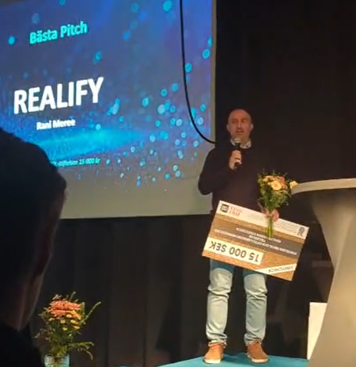
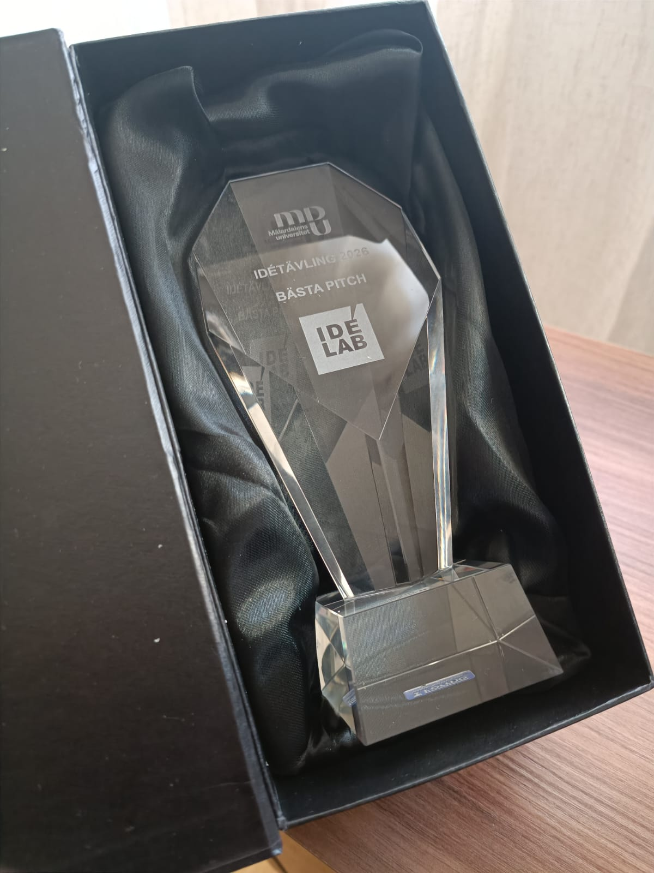
Intellivation AB
07 / 11
🔍
THREE-AUDIENCE SOLUTION
👁️ For Adults
OWNED BY INTELLIVATION AB · R&D
A simple AI or real label with a confidence score on every video or image. Full transparency so you always know what you are actually watching.
Realify Reality Check for the Internet
👧 For Children
Flagged AI content is filtered before children see it. Kids should not have to question whether what they are watching is even real. That is our job.
We live in a world full of AI-generated content. It affects how we perceive reality and more importantly, how our children do. Realify detects what is real and what is AI-generated, then acts on that distinction for different audiences.
⭐ For Celebrities & Public Figures
An electronic authenticity stamp, only the real person can add it. When you see a public figure online, you can instantly verify if they approved it.
A simple label — AI or real — with a confidence score. For children, filtered protection. For public figures, an authenticity stamp only they can add.
🏆 Bästa Pitch · IdéLab 2026 · Mälardalens Universitet
🔭 Current stage: R&D and concept validation. Intellivation's next major owned product after CalorAI.
AI Detection
Computer Vision
Deepfake Detection
Content Safety
R&D
Winner of Best Pitch at IdéLab 2026.

Slide 8
Intellivation AB
08 / 11
COMPANY TIMELINE
From first line of code to four live products.
Late 2024
CalorAI development begins. Solo founder, no funding.
Early 2025
CalorAI MVP live on Google Play. First organic users.
2025
CalorAI grows from 10K to 120K+ downloads. Zero paid acquisition.
Jan 2026
Intellivation AB incorporated. Realify R&D begins. JuraCare project started.
Feb 2026
Almukhtabar development started as a co-venture.
April 2026
JuraCare launched at juracare.se.
May 2026
Almukhtabar launched at newslb.com.
June 2026
CalorAI iOS launch. Sting Core application.

Slide 9
Intellivation AB
09 / 11
BUSINESS MODEL
Three revenue streams. Recurring at core.
📱
🏢
🎯
CalorAI Premium
AI Product Delivery
AI Consultancy
Freemium to subscription. Free tier drives scale; premium unlocks AI coach, full nutrients, meal planning, and offline mode.
End-to-end AI product development for clients and partners. JuraCare and Almukhtabar are proof. We build and ship production AI.
AI strategy, architecture, and implementation for Swedish SMEs and enterprises. Revenue today that funds our owned product roadmap.
100–150 SEK / month
Project-based pricing
1,000 SEK / hour
2026 — Foundation
2027 — Scale
2028 — Platform
Monetise traction
Grow owned products
Multi-product AI company
Launch CalorAI premium, deliver 2-3 client projects, begin Realify validation.
CalorAI to 1,000 paying users, Realify MVP, first hire.
B2B integrations, team of 2-3, recognised Swedish AI brand. Target: 1M+ SEK.

Slide 10
Intellivation AB
10 / 11
THE TEAM
🚀
4 products built before the company was even registered
Technical founder who ships
CalorAI, JuraCare, Almukhtabar, and Realify were all developed before Intellivation AB was formally incorporated. That is the most credible proof of execution ability possible.
🧠
Full-stack AI from research to production
From model architecture to production engineering to app distribution to user growth, without an external team. This speed is a core strategic advantage.
RM
🌍
Diverse domain experience
Health, legal, media, trust and safety. Each domain deepens our AI platform capabilities.
Rani Meree
Founder · CEO · CTO
AI / ML
Computer Vision
NLP
Mobile Dev
Product Strategy
Actively seeking a commercial co-founder in growth, sales, and BD.
Full-Stack

Slide 11
11 / 11
LET'S BUILD TOGETHER
Intellivation AB
👤 Rani Meree — Founder and CEO
📧 info@intellivation.io
🌐 intellivation.io
📱 +46 70 045 67 18
🏢 Org: 559579-9932

