Slide 1
PROJECT AND DATA MANAGEMENT PLAN
DEVELOPING AN AI BASED COUNSELLING MODEL FOR MENTAL SUPPORT
STUDENT ID : 22077318
PROJECT THEME AND BACKGROUND:
Mental health issues like stress, anxiety, and depression are increasingly common, yet traditional services often face barriers like high costs and long waiting times. Many existing mental health apps offer generic advice or require payment, leaving a gap for accessible, free support. My project aims to fill this gap by developing an AI-driven counselling model
that provides anonymous, real-time, and empathetic mental health support. Using advanced machine learning and natural language processing, the AI will offer personalized guidance
and early interventions, available 24/7, and help reduce the stigma around mental health.
RESEARCH QUESTIONS:
How can AI be effectively integrated into mental health counselling systems to enhance accessibility and provide real-time support?
What are the ethical considerations when using AI for mental health counselling?
Can AI-based mental health support provide personalized interventions based on users' emotions and behaviour?
What are the limitations of an AI-based counselling model in comparison to traditional face-to-face therapy?
How can an AI model ensure the privacy and security of sensitive mental health
data?
How can user feedback be incorporated into the development of an AI-based counselling system to improve its effectiveness?
How can the AI model be evaluated for accuracy and effectiveness in providing mental health support?
PROJECT OBJECTIVES :
The aim of this project is to create an AI-driven counseling model that delivers accessible and immediate mental health assistance utilizing natural language processing (NLP) and sentiment analysis. This system will focus on identifying and interpreting user emotions, providing customized interventions, and offering resources for additional professional help when necessary. Furthermore, the project intends to develop the AI model in an ethical manner, prioritizing privacy, data security, and user confidence. The ultimate objective is to establish a scalable solution that addresses the mental health care disparity, especially for those who encounter obstacles in obtaining conventional therapy.

Slide 2
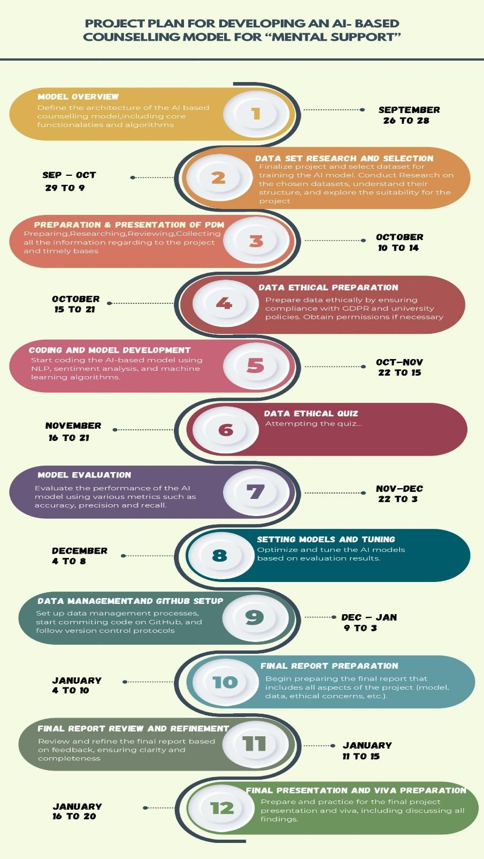
PROJECT TASK LIST AND PROJECT TIME LINE
-------USING INFOGRAPHICS ----------
REFERENCE LISTS
BOOKS:
a) 1) Artificial Intelligence in Behavioural and Mental Health Care -David D Luxton

Slide 3
2) AI and the Risk of Human Extinction: How AI Will Transform Human Nature -Martin M.
Theophilus
b) 3) Mental Health Informatics- M. S. Johnson
Online resources:
AI and Mental Health: A Comprehensive Overview
Kaggle for collection of data with lot of datasets related to mental health for analysis and prediction of mental health problems
Research papers:
Ghosh, S., et al. (2020). "AI in Mental Health: A Survey." Journal of AI Research
Lee, H. & Shin, J. (2021). "Using NLP for Mental Health Support." International Journal of AI and Data Science”
Data Management Plan
Overview of the Dataset
An overview of the dataset
This project's dataset is made up of combined data that was acquired from Kaggle's "Combined Data" and "Mental Health Dataset." This combined dataset offers a thorough view of user statements and mental health indicators, which is intended to aid in the creation of an AI-based counselling model.
Data Sources:
Combined Data: Comprises unique identifiers, user statements, and their corresponding statuses.
Mental Health Dataset: Features attributes such as gender, occupation, treatment history, and various mental health indicators.
Access to Datasets: both accessed from Kaggle
Combined Data: dataset1_link ; Mental Health Dataset: dataset2_link
DATA COLLECTION:
The main data sources utilized for this project include:
Kaggle Datasets: Data was sourced from Kaggle, allowing for the inclusion of a diverse array of mental health factors.
Data Integration: The datasets were combined through a left join to create the final dataset, which will serve as the basis for analysis and model training.

Slide 4
META DATA:
metadata | Dataset_1 | Dataset_2
format | csv | csv
size | 30.01 MB | 30.55 MB
Number of records | 53043 | 292364
Expected use | Context for mental health analysis | Primary source for evaluating mental health indicators
DOCUMENT CONTROL:
GitHub Repository: https://github.com/RaniPanneru/final_project.git
I am using GitHub where code will be committed on a weekly basis to GitHub to maintain version control and monitor development progress, with GitHub serving as the platform for managing versions of all code files, thereby enhancing collaboration and tracking of code changes
DATA STORAGE AND SECURITY
Data Storage Solutions: The integrated dataset will be housed on GitHub and will undergo weekly backups to OneDrive to guarantee data security and redundancy.
User Privacy Protection: All confidential information within the dataset will be anonymized to safeguard user privacy, and communications will be conducted via encrypted channels.
Secure Data Sharing: The sharing of data with supervisors and evaluators will be carried out through secure methods, including private repositories on GitHub.
ETHICAL CONSIDERATION:
GDPR Compliance: All data will be anonymized to eliminate any personally identifiable information (PII), thereby ensuring adherence to GDPR regulations.
Ethical Policies: The project follows the ethical standards established by the University of Hertfordshire concerning the management of sensitive data.
Permission for Data Use: Both datasets are accessible to the public on Kaggle and may be
employed for research purposes, provided that the necessary permissions are secured when required.
Ethical Data Collection: The datasets are sourced from credible origins, guaranteeing ethical practices in data collection, which include obtaining user consent and implementing data anonymization.

