Slide 1
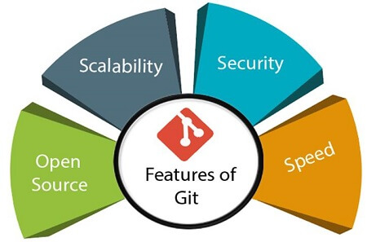
Git
Git is a modern and widely used distributed version control system in the world. It is developed to manage projects with high speed and efficiency. The version control system allows us to monitor and work together with our team members at the same workspace.
you to understand the distributed version control system Git via the command line as well as with GitHub.
What is Git?
Git is an open-source distributed version control system. It is designed to handle minor to major projects with high speed and efficiency. It is developed to co-ordinate the work among the developers. The version control allows us to track and work together with our team members at the same workspace.
Git is foundation of many services like GitHub and GitLab, but we can use Git without using any other Git services. Git can be used privately and publicly.
Git was created by Linus Torvalds in 2005 to develop Linux Kernel. It is also used as an important distributed version-control tool for the DevOps.
Git is easy to learn, and has fast performance. It is superior to other SCM tools like Subversion, CVS, Perforce, and ClearCase.

Slide 2
Git
Advantages of Git
Free and open source
Git is released under GPL’s open source license. It is available freely over the internet. You can use Git to manage property projects without paying a single penny. As it is an open source, you can download its source code and also perform changes according to your requirements.
Fast and small
As most of the operations are performed locally, it gives a huge benefit in terms of speed. Git does not rely on the central server; that is why, there is no need to interact with the remote server for every operation. The core part of Git is written in C, which avoids runtime overheads associated with other high-level languages. Though Git mirrors entire repository, the size of the data on the client side is small. This illustrates the efficiency of Git at compressing and storing data on the client side.
Implicit backup
The chances of losing data are very rare when there are multiple copies of it. Data present on any client side mirrors the repository, hence it can be used in the event of a crash or disk corruption.
Security
Git uses a common cryptographic hash function called secure hash function (SHA1), to name and identify objects within its database. Every file and commit is check-summed and retrieved by its checksum at the time of checkout. It implies that, it is impossible to change file, date, and commit message and any other data from the Git database without knowing Git.
No need of powerful hardware
In case of CVCS, the central server needs to be powerful enough to serve requests of the entire team. For smaller teams, it is not an issue, but as the team size grows, the hardware limitations of the server can be a performance bottleneck. In case of DVCS, developers don’t interact with the server unless they need to push or pull changes. All the heavy lifting happens on the client side, so the server hardware can be very simple indeed.
Easier branching
CVCS uses cheap copy mechanism, If we create a new branch, it will copy all the codes to the new branch, so it is time-consuming and not efficient. Also, deletion and merging of branches in CVCS is complicated and time-consuming. But branch management with Git is very simple. It takes only a few seconds to create, delete, and merge branches.

Slide 3
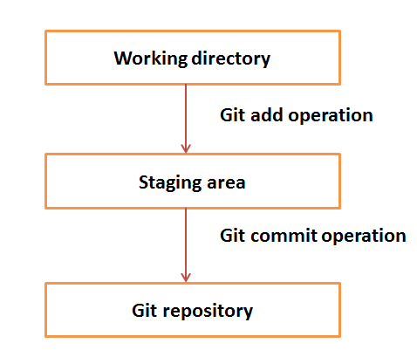
Git Terminologies
Local Repository
Every VCS tool provides a private workplace as a working copy. Developers make changes in their private workplace and after commit, these changes become a part of the repository. Git takes it one step further by providing them a private copy of the whole repository. Users can perform many operations with this repository such as add file, remove file, rename file, move file, commit changes, and many more.
Working Directory
The working directory is the place where files are checked out. In other CVCS, developers generally make modifications and commit their changes directly to the repository. But Git uses a different strategy. Git doesn’t track each and every modified file. Whenever you do commit an operation, Git looks for the files present in the staging area. Only those files present in the staging area are considered for commit and not all the modified files.
Let us see the basic workflow of Git.
Step 1 − You modify a file from the working directory.
Step 2 − You add these files to the staging area.
Step 3 − You perform commit operation that moves the files from the staging area. After push operation, it stores the changes permanently to the Git repository.

Slide 4
Git Terminologies
Blobs
Blob stands for Binary Large Object. Each version of a file is represented by blob. A blob holds the file data but doesn’t contain any metadata about the file. It is a binary file, and in Git database, it is named as SHA1 hash of that file. In Git, files are not addressed by names. Everything is content-addressed.
Trees
Tree is an object, which represents a directory. It holds blobs as well as other sub-directories. A tree is a binary file that stores references to blobs and trees which are also named as SHA1 hash of the tree object.
Commits
Commit holds the current state of the repository. A commit is also named by SHA1 hash. You can consider a commit object as a node of the linked list. Every commit object has a pointer to the parent commit object. From a given commit, you can traverse back by looking at the parent pointer to view the history of the commit. If a commit has multiple parent commits, then that particular commit has been created by merging two branches.
Branches
Branches are used to create another line of development. By default, Git has a master branch, which is same as trunk in Subversion. Usually, a branch is created to work on a new feature. Once the feature is completed, it is merged back with the master branch and we delete the branch. Every branch is referenced by HEAD, which points to the latest commit in the branch. Whenever you make a commit, HEAD is updated with the latest commit.
Tags
Tag assigns a meaningful name with a specific version in the repository. Tags are very similar to branches, but the difference is that tags are immutable. It means, tag is a branch, which nobody intends to modify. Once a tag is created for a particular commit, even if you create a new commit, it will not be updated. Usually, developers create tags for product releases.

Slide 5
Git Terminologies
Clone
Clone operation creates the instance of the repository. Clone operation not only checks out the working copy, but it also mirrors the complete repository. Users can perform many operations with this local repository. The only time networking gets involved is when the repository instances are being synchronized.
Pull
Pull operation copies the changes from a remote repository instance to a local one. The pull operation is used for synchronization between two repository instances. This is same as the update operation in Subversion.
Push
Push operation copies changes from a local repository instance to a remote one. This is used to store the changes permanently into the Git repository. This is same as the commit operation in Subversion.
HEAD
HEAD is a pointer, which always points to the latest commit in the branch. Whenever you make a commit, HEAD is updated with the latest commit. The heads of the branches are stored in .git/refs/heads/ directory.
Revision
Revision represents the version of the source code. Revisions in Git are represented by commits. These commits are identified by SHA1 secure hashes.
URL
URL represents the location of the Git repository.

Slide 6
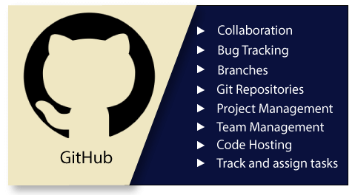
GIT HUB
GitHub is a Git repository hosting service.
GitHub is an American company.
It hosts source code of your project in the form of different programming languages and keeps track of the various changes made by programmers.
GitHub also facilitates with many of its features, such as access control and collaboration. It provides a Web-based graphical interface.
It offers both distributed version control and source code management (SCM) functionality of Git.
It also facilitates with some collaboration features such as bug tracking, feature requests, task management for every project.

Slide 7
GIT HUB
Features of GitHub
GitHub is a place where programmers and designers work together. They collaborate, contribute, and fix bugs together. It hosts plenty of open source projects and codes of various programming languages.
Some of its significant features are as follows.
Collaboration
Integrated issue and bug tracking
Graphical representation of branches
Git repositories hosting
Project management
Team management
Code hosting
Track and assign tasks
Conversations
Wikisc

Slide 8
GIT HUB
Benefits of GitHub
GitHub can be separated as the Git and the Hub. GitHub service includes access controls as well as collaboration features like task management, repository hosting, and team management.
The key benefits of GitHub are as follows.
It is easy to contribute to open source projects via GitHub.
It helps to create an excellent document.
You can attract recruiter by showing off your work. If you have a profile on GitHub, you will have a higher chance of being recruited.
It allows your work to get out there in front of the public.
You can track changes in your code across versions.

Slide 9
Configuring and connecting to a remote repository
Below are the steps on how you can connect to a GitHub repository.
From the command line, move to the directory you want to contain your Git repository.
Type the following command to configure your Git username, where <your name> will be your GitHub username.
git config --global user.name "<your name>“
After entering the above command, you should be returned to the command prompt. Next, enter your e-mail address by typing the following command, where <your e-mail> is your e-mail address.
git config --global user.email "<your e-mail>"

Slide 10
Git vs GitHub
Git | GitHub
Git is a distributed version control tool that can manage a programmer's source code history. | GitHub is a cloud-based tool developed around the Git tool.
A developer installs Git tool locally. | GitHub is an online service to store code and push from the computer running the Git tool.
Git focused on version control and code sharing. | GitHub focused on centralized source code hosting.
It is a command-line tool. | It is administered through the web.
It facilitates with a desktop interface called Git Gui. | It also facilitates with a desktop interface called GitHub Gui.
Git does not provide any user management feature. | GitHub has a built-in user management feature.
It has minimal tool configuration feature. | It has a market place for tool configuration.

Slide 11
Git Commands
Task | Git commands
Create a new local directory: | git init
Add a specific file to staging (Git) or after a new file is created | git add <filename>
Add all changes to staging (Git) or all new files | git add –all or git add .
Commit changes locally: | git commit -m '<message>'
Connect your local repository to a remote server: | git remote add origin <server_URL>
Push changes to your remote repository: | git push <remote_name> <branch_name> usually: git push origin master

Slide 12
Git Commands
Task | Git commands
Copy a remote repository to your local system: | git clone <URL_to_repository>
List the status of the files you've changed and those you still need to add or commit: | git status
Create a new branch | git checkout -b <branch_name>
Switch from one branch to another: | git checkout <branch_name>
List all the branches/bookmarks in your repo with an indication of the one you are on: | git branch
Delete the feature branch | git branch -d <branch_name>

Slide 13
Git Commands
Task | Git commands
Push the branch/bookmark to your remote repository: | git push origin <branch_name>
Fetch and merge changes on the remote server to your working directory: | git pull or git pull origin <branch_name>
Merge two different revisions into one: | git merge
Show all changes made since the last commit: | git diff

