Slide 1
Web Server
Web Server is used for hosting the web application on a centralized location and can be access from any location. It is responsible for handling all the requests that are coming from clients, it process them and provide the responses.
IIS (Internet Information Service)
IIS stands for Internet Information Service. IIS is a web server developed by Microsoft and used to host the Web application. It has its own ASP.NET Process Engine to handle the request. So, when a request comes from client to server, IIS takes that request and process it and send response back to clients.
IIS supports many system services that use the most common Internet protocols including HTTP, FTP, HTTPS and SMTP.

Slide 2
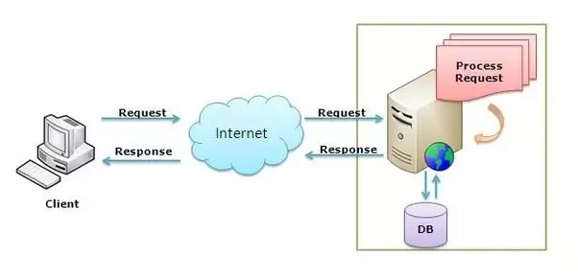
Web Server

Slide 3
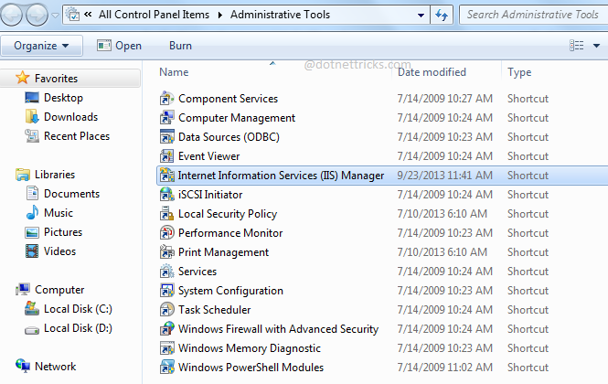
Check IIS Installation
First Way to open IIS:
Go to run and type inetmgr command and press enter, it opens IIS configuration manager if it is installed to your machine.
Second way to open IIS:
Go to control panel and then Administrative Tools; where you will find the shortcut for IIS as shown in below fig.

Slide 4
History of IIS
IIS 1.0
IIS 1.0 was initially released as a free add-on for Windows NT 3.51.
IIS 2.0
IIS 2.0 was included with Windows NT 4.0.
IIS 3.0
IIS 3.0 was included with Service Pack 2 of Windows NT 4.0, introduced the Active Server Pages dynamic scripting environment.
IIS 4.0
IIS 4.0 was released as part of an "Option Pack" for Windows NT 4.0.
IIS 5.0
IIS 5.0 shipped with Windows 2000 and introduced additional authentication methods, management enhancements including a new MMC-based administration application, support for the WebDAV protocol, and enhancements to ASP. IIS 5.0 also dropped support for the Gopher protocol.
IIS 5.1
IIS 5.1 was shipped with Windows XP Professional, and was nearly identical to IIS 5.0 on Windows 2000.
IIS 6.0
IIS 6.0 was included with Windows Server 2003 and Windows XP Professional x64 Edition, added support for IPv6 and included a new worker process model that increased security as well as reliability.

Slide 5
History of IIS
IIS 7.0
IIS 7.0 was a complete redesign and rewrite of IIS, and was shipped with Windows Vista and Windows Server 2008. IIS 7.0 included a new modular design that allowed for a reduced attack surface and increased performance. It also introduced a hierarchical configuration system allowing for simpler site deploys, a new Windows Forms-based management application, new command-line management options and increased support for the .NET Framework. IIS 7.0 on Vista does not limit the number of allowed connections as IIS on XP did, but limits concurrent requests to 10 (Windows Vista Ultimate, Business, and Enterprise Editions) or 3 (Vista Home Premium). Additional requests are queued, which hampers performance, but they are not rejected as with XP.
IIS 7.5
IIS 7.5 was included in Windows 7 (but it must be turned on in the side panel of Programs and Features) and Windows Server 2008 R2. IIS 7.5 improved WebDAV and FTP modules as well as command-line administration in PowerShell. It also introduced the best practices analyzer tool and process isolation for application pools.
IIS 8.0
IIS 8.0 is only available in Windows Server 2012 and Windows 8. IIS 8.0 includes Application Initialization, centralized SSL certificate support, and multicore scaling on NUMA hardware, among other new features.
IIS 8.5
IIS 8.5 is included in Windows Server 2012 R2 and Windows 8.1. This version includes Idle worker-Process page-out, Dynamic Site Activation, Enhanced Logging, ETW logging, and Automatic Certificate Rebind.
IIS 10.0
IIS 10 is included in Windows Server 2016 and Windows 10. This version includes support for HTTP 2

Slide 6
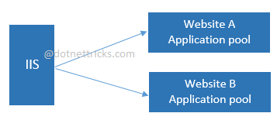
Application Pool in Internet Information Service (IIS)
Application Pool in IIS
An Internet Information Services (IIS) application pool is a set of URLs that is routed to one or more worker processes. Application pools responsible for to isolate one or more applications into their own process. For example you have two different website like website-A and website-B and want to deploy on same server, then application pool isolate your website means website-A run on one application pool and website-B run on another application pool.
It provides a convenient way to administer a set of web sites and applications and their corresponding worker processes. Process boundaries separate each worker process; therefore, a web site or application in one application pool will not be affected by application issues in other application pools. Application pools significantly increase both the reliability and manageability of a Web infrastructure.

Slide 7
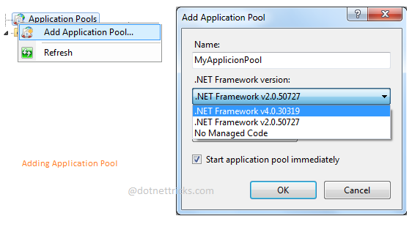
Create Application Pool in IIS
You can also create your own application pool with custom settings.
Key Points About Application Pool
Provides isolation between different web applications.
Every web application has individual worker process.
Improve manageability of web application.
Provides better performance.

Slide 8
Create Application Pool in IIS
Different Type of Application Pool Available in IIS 7.0 and IIS 7.5
There are two types’ .NET integration modes for ASP.NET application, that identified that how IIS processes an incoming request to the sites, applications and web services that run in that application pool.
Integrated Mode
Integrated mode makes ASP.NET an integral part of IIS. Now the IIS server functionality is split into more than 40 modules that break the IIS and ASP.NET functionality into pieces. Modules such as StaticFileModule, BasicAuthenticationModule, FormsAuthentication, Session, Profile and RoleManager are part of the IIS pipeline. FormsAuthentication, Session, Profile and RoleManager were previously part of ASP.NET and didn't have anything to do with IIS.
Classic Mode
Classic mode models the IIS 6.0 model in which ASP.NET is an ISAPI add-on to IIS. This mode is available for backward compatibility but lacks many of the features in the new integrated mode. In Classic mode, IIS has its own pipeline that can only be extended by creating an ISAPI extension, which has a well-deserved reputation for being difficult to develop. ASP.NET is run as an ISAPI extension that is just one part of the IIS pipeline.

Slide 9
IIS RESET
IIS RESET
IIS RESET command stops all IIS services with its components. In fact, it does not kill any worker processes, and running components. Like any windows services, the command just sends a message – “Stop running as soon as possible” – to shutdown IIS services gracefully.
Disadvantage of IIS Reset
HTTP.SYS will lose existing client-connections after running IISRESET.
All incoming requests will need to establish new connections again.
Web browsers can’t connect the IIS server during restarting IIS means all requests will be missed.
A worker process can’t keep any data – cached objects & binaries

Slide 10
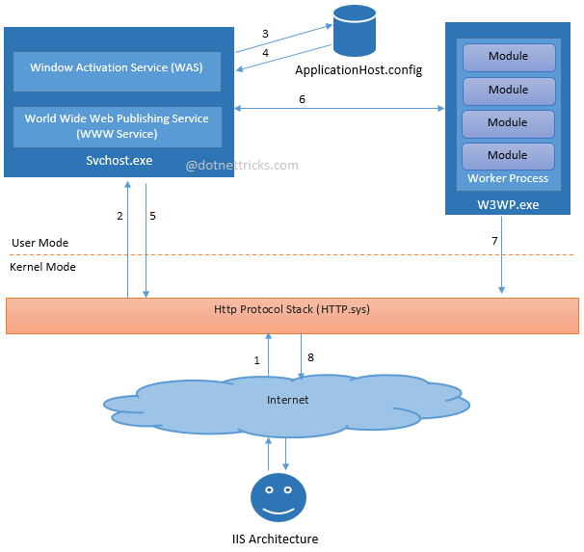
IIS Architecture
IIS has two main layers - Kernel Mode and User Mode. The Kernel Mode contains the HTTP.SYS and User Mode contains WAS and W3 service. The subsection of both are shown in fig.

Slide 11
IIS ArchitectuDifferent Security Settings Available in IIS re
IIS provides a variety of authentication schemes:
Anonymous (enabled by default)
Basic
Digest
Integrated Windows authentication (enabled by default)
Client Certificate Mapping

Slide 12
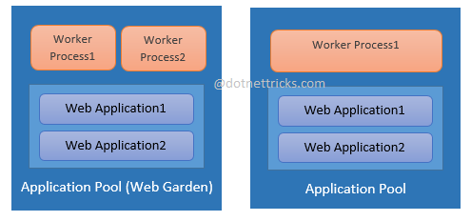
Web Garden and Web Farm in IIS
Web Garden
By default, each application pool runs with a single worker process (W3Wp.exe). When an application pool runs with multiple worker process, it is called web garden.
You can set multiple worker process for an application pool

Slide 13
Web Garden and Web Farm in IIS
Advantage of Web Garden:
A Web garden share the requests which comes for that application pool and if one worker process fails to process a request then another worker process can continue to process that request.
Limitation of Web Garden:
There are some limitations with Web Garden. When you use session mode to “In Proc" with your application, it will not work properly as expected; since session will be handled by different worker process. For avoiding this issue; you should use session mode "Out Proc" having "Session State Server" or "SQL-Server Session State".

Slide 14
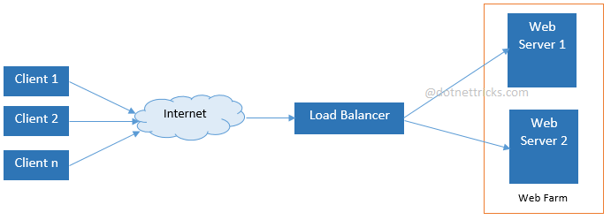
Web Garden and Web Farm in IIS
Web Farm
When a web application is hosted on multiple web servers and access based on the load on servers, it is called Web Farm.
In web farm, a single application is hosted on multiple IIS server and these IIS servers are connected with the VIP (Virtual IP) with load balancer. Load balancer IPs is exposed to external world for accessing your web application. Hence, when a request comes to server from client, it first hits the load balancer, and then based on the traffic on each server; load balancer distributes the request to the corresponding web server.
In web farm, a single application is hosted on multiple IIS server and these IIS servers are connected with the VIP (Virtual IP) with load balancer. Load balancer IPs is exposed to external world for accessing your web application. Hence, when a request comes to server from client, it first hits the load balancer, and then based on the traffic on each server; load balancer distributes the request to the corresponding web server.

Slide 15
Web Garden and Web Farm in IIS
Advantage of Web Farm:
It provides high availability. If any of the web servers goes down then Load balancer redirects the incoming requests to other web servers in the web farm.
It provides high performance response for client requests.
Limitation of Web Farm:
There are some limitations with Web Farm; also. When you use session mode to “In Proc" with your application, it will not work properly as expected; since session will be handled by different web servers. For avoiding this issue; you should use session mode "Out Proc" having "Session State Server" or "SQL-Server Session State".

