Slide 1
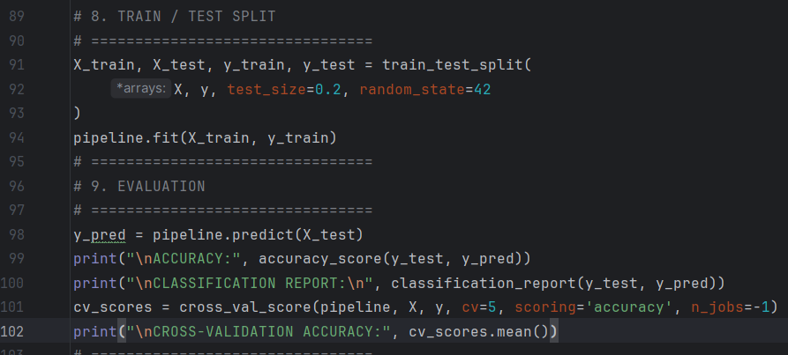
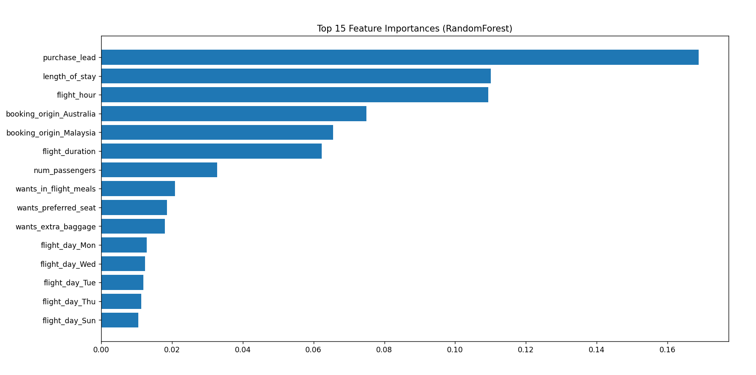
British Airways Booking Prediction Model Summary:
Key insight:
Code sample:
Objective
Random Forest Classifier with tuned parameters
Purchase lead ,Flight duration and booking origin are the strongest predictors of booking completion.
Customers with shorter purchase lead time or booking from certain countries (Malaysia, Australia, Indonesia) have higher likelihood to complete bookings.
Model performs well in identifying potential buyers (Recall 70.5%) but precision is moderate, indicating some false positives.
These insights can guide marketing targeting and dynamic offers to improve conversion.
Our analysis is built upon a robust dataset comprising approximately 50,000 rows, each represent a unique customer interaction or potential booking attempts, most costumers don’t complete the booking
.
Data preparation
Features encoded with hot encoder and prepared for Random Forest model.
dataset balanced using SMOTE, producing 68,036 training samples with equal class distribution (0: 34,018, 1: 34,018).
Model Evaluation:
Accuracy: 72.1%
Class 1 (booking) metrics: Precision = 31.0%, Recall = 70.5%, F1 = 0.431
Confusion Matrix:
[[6158 2346]
[441 1055]]

