Slide 1
Introduction to QAOA
Quantum Finance Meetings

Slide 2
QAOA = Quantum Approximate Optimization Algorithm
  Introduced in arXiv:1411.4028 by Farhi, Goldstone and Gutmann
  It is a variational algorithm
  Hybrid – i.e. partially quantum, partially classical
  Motivated by the Adiabatic Theorem
  Convergence ensured* also by the Adiabatic Theorem
  Very useful to tackle combinatorial optimization problems

Slide 3
Variational Algorithm
  Optimization problem with the solution encoded in the minimum or maximum of some observable
  The strategy is to provide a “good” family of parametric states in the hope that they include the solution space for some values of the parameter

Slide 4

Hybrid Algorithm:
  Partially quantum, partially classical
Classical optimization
Quantum
Processing
Feedback

Slide 5
The idea for parametrization:
  State preparation by a sequence of parameter-dependent unitaries

Slide 6
The idea for parametrization:
  State preparation by a sequence of parameter-dependent unitaries
Optimization with p+1 layers include p layers

Slide 7
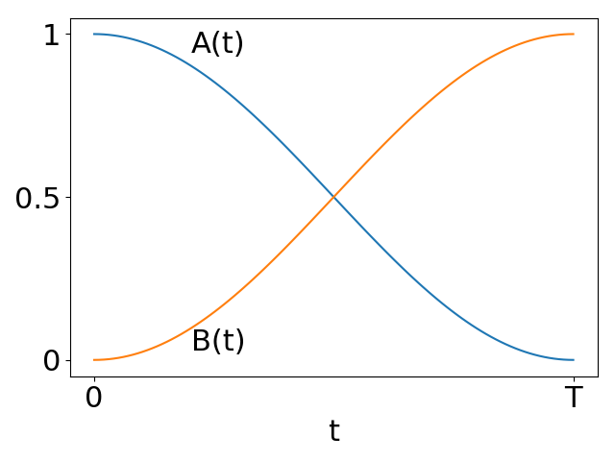
Establishing A_{i}
  Inspiration from Adiabatic Quantum Computing
Adiabatic Theorem:
For a sufficiently slow transition from H_{M} to H_{C}, the system remains at the corresponding eigenstate at all times

Slide 8
Establishing A_{i}
  Inspiration from Adiabatic Quantum Computing
  The idea:
  Encode the solution of the problem in the lowest/highest eigenstate of H_{C}
  Use H_{M} with a known and easy-to-prepare ground state
  Use the adiabatic theorem to go from H_{M} to the solution of the problem

Slide 9
Establishing A_{i} – Connecting to our parametric description
  Trotterization – Approximate commutativity for small evolutions

Slide 10
The QAOA prescription
  Alternation between H_{M} and H_{C}

Slide 11
“Canonical” application – Combinatorial Optimization
  Optimization over n binary variables
  e.g.
  Brute force method: 2n evaluations of C required

Slide 12
“Canonical” application – Combinatorial Optimization
  Optimization over n binary variables
  The idea for quantization: Each variable is mapped to a qubit
  Thus:

Slide 13
“Canonical” application – Combinatorial Optimization
  Specific class – Quadratic unconstrained binary optimization (QUBO)
  As a quantum operator:

Slide 14
“Canonical” application – Combinatorial Optimization
  Specific class – Quadratic unconstrained binary optimization (QUBO)
  As a quantum operator:

Slide 15
Extra slides

Slide 16
The “trick” to implement multiple-qubit rotations
  For two qubits: Convert a ZZ rotation into a single-Z rotation
=

Slide 17
The “trick” to implement multiple-qubit rotations
  For two qubits: Convert a ZZ rotation into a single-Z rotation
=

Slide 18
The “trick” to implement multiple-qubit rotations
  Using the result in a rotation
  Given
  Then

Slide 19
For n qubits: Cascaded application of CNOTs
=
=
=

